Slide 1
Unit 1 Topic 1
I’m going to play basketball.
Section C
WWW.PPT818.COM

Slide 2
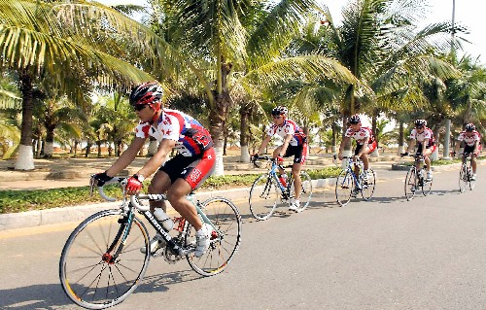
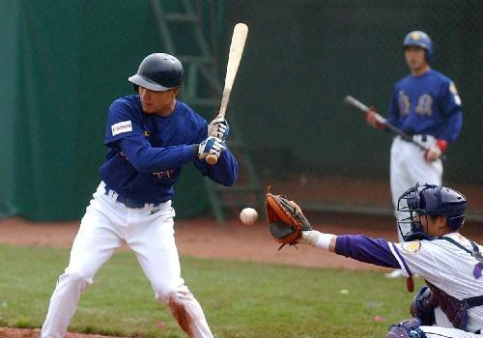
— What sport is it?
— It’s …
(going) cycling
(playing) baseball

Slide 3
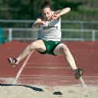
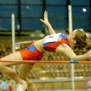
— What sport is it?
— It’s …
the long jump
the high jump

Slide 4
Ask and answer
Do you like doing exercise?
How often do you do exercise?
How long do you spend doing
exercise?
花费（时间金钱等）

Slide 5
1a Read and understand.
Look at the picture in 1b. Guess and tick which sports Ann likes very much. Then read the passage and check your answers.
cycling
jumping
tennis
swimming
basketball
mountainclimbing

Slide 6
Ann likes sports very much. She goes cycling twice a week and often goes mountain climbing on Sunday. She spends half an hour exercising in the gym every day. She learns baseball on Saturdays, and now she plays it well. She is also good at jumping. There is going to be a school sports meet next weekend. She is going to take part in the high jump and the long jump. Her classmates are going to cheer her on. They are sure that she will win.

Slide 7
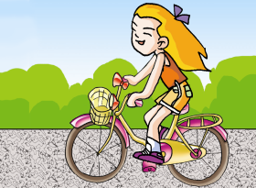
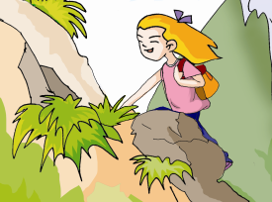
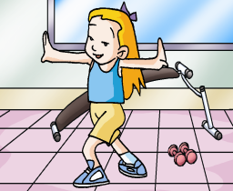
1b Read 1a again and write the key phrases
under each picture.
exercise in the gym every day
go cycling twice a week
go mountain climbing on Sundays

Slide 8
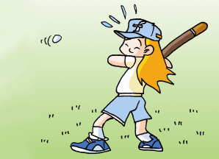
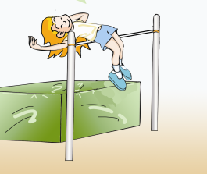
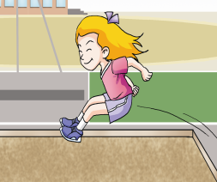
take part in
the high jump
learn baseball on Saturdays
take part in
the long jump

Slide 9
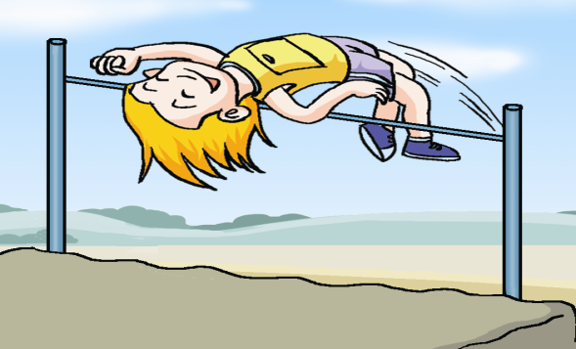
What kind of sport is she doing?
She is cycling.
She is doing the high jump.
She is playing baseball.
She is doing exercise.
She is doing the long jump.
She is climbing the mountain.

Slide 10
1c Retell the passage according
to the form.
Name | Activity | Time
Ann | go cycling | twice a week
 | go mountain climbing | on Sundays
 | exercise in the gym | half an hour every day
 | learn baseball | on Saturdays

Slide 11
Test your memory
Answer the questions as quickly as you can.
How often does she go cycling?
What does she do on Sundays?
How long does she stay in the gym every day?
What is Ann going to do in the school sports meet?
Twice a week.
She often goes mountain climbing.
She stays in the gym for half an hour every day.
She is going to take part in the high jump and the long jump.

Slide 12
Project
1d
Talk about which sports you do at different times in a week.
The following questions may help you.
Which sport do you like best? Why?
When and where do you usually do it?
How often do you do it?
How long do you do it each time?
Is it good for your health?
Wh-questions (what, who, why, when, which, where and how) are useful to get information and ideas from other people.

Slide 13
Example:
I like sports very much. I spend twenty minutes running on the school playground. I often play basketball on Sunday afternoons. I learn football on Saturdays, and now I play it pretty well. There is going to be a school sports meet next week. I am going to take part in the 100-meter race. My classmates are going to cheer me on. They are sure that I will win.

Slide 14
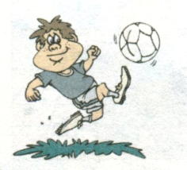
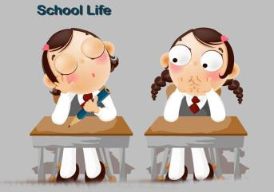
2a&2b Ask and answer
He is going to play soccer. He likes it very much.
What is he going to do this afternoon?

Slide 15
Ask and answer
Because it makes him strong and it’s popular all over the world.
受欢迎的
Why ?

Slide 16
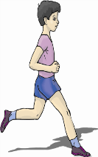
Make a similar dialog
I/run
tomorrow morning
be good for my legs, heart
and lungs
most people like it
be good for 对…… 有益/有好处
A: What are you going to do tomorrow morning?
B: I am going to run. I like it a lot.
A: Why?
B: Because it is good for my legs, heart and lungs and
most people like it.

Slide 17
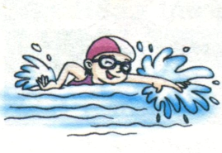
Make a similar dialog
she/swim
the day after tomorrow
help to keep her heart and
lungs healthy
a good way to keep fit
保持健康
A: What is she going to do the day after tomorrow?
B: She is going to swim.
A: Why?
B: Because it helps to keep her heart and lungs healthy
and it’s a good way to keep fit.

Slide 18
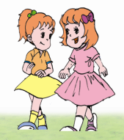
Make a similar dialog
they/walk
after supper
help them to relax
a good way to keep healthy
放松，轻松
保持健康
A: What are they going to do after supper?
B: They are going to walk.
A: Why?
B: Because it helps relax and it’s a good way to keep
healthy.
back

Slide 19
Key phrases
twice a week 一周两次
on Sundays 每逢周日
★ spend + 时间/金钱 + (in) doing sth.
花……做某事
★ spend + 时间/金钱 + on sth.
在……花……
pretty well 相当好
be good at 擅长于

Slide 20
Key points
1.She spends half an hour exercising in the gym every day.
spend …doing sth. 花费时间金钱做某事
spend … on sth. 在某事上花费时间或金钱
e.g. 他每天花半小时玩电脑游戏。
He ____________________________ computer games every day.
这本书花了我爸爸50元。
My father ______________________this book.
spends half an hour playing
spent fifty yuan on

Slide 21
2.She is also good at jumping.
be good at sth./doing sth.擅长于某事/做某事
e.g. Mary擅长于跳舞。
Mary _____________________.
is good at dancing
3.She is going to take part in the high jump.
take part in 参加
e.g. 你要参加学校运动会吗？
Are you ____________________the school sports meet.
going to take part in

Slide 22
Exercises
1.--- _____ do you visit your uncle? --- Once a week.
How long B. How many
C. How often D. How soon
2. What do you usually do _____ weekends?
on B. in C. / D. for
3. Maria _____ every day. She ____ to play football.
exercise; like B. exercises; like
C. exercises; likes D. exercise; likes
4. I like running because it makes me _______.
health B. healthy C. to health D. to healthy

Slide 23
Put the following sentences into English.
1. 全世界都流行足球。
2. 打篮球可以使我们增强体质。
3. 游泳能有助于你的心肺保持健康。
4. 跑步对我们的心肺有益。
5. 散步是保持健康的一种好办法。
6. 下个月将举行一次校运会。

Slide 24
1. 全世界都流行足球。
2. 打篮球可以使我们增强体质。
3. 游泳能有助于你的心肺保持健康。
Football is popular all over the world.
Playing basketball can make us strong.
Swimming can help to keep your heart and lungs healthy.

Slide 25
4. 跑步对我们的心肺有益。
5. 散步是保持健康的一种好办法。
6. 下个月将举行一次校运会。
Running is good for our heart and lungs.
Walking is a good way to keep fit.
There is going to be a school sports meet next month.

Slide 26
Summary
We know:
the advantages of sports
talk about exercise plans.
talk about favorite sports and
reasons.
3. write a passage about exercise
plans, favorite sports and
reasons.
We can:

Slide 27
Homework
Make a survey and write a report.
1.What kind of sports is your good friend going to do this Sunday?
2.Why?

