Slide 1
Unit 3 On the move
外研版高中英语必修二
Section A Starting out & Understanding ideas
WWW.PPT818.COM

Slide 2
Motoball—a New and Dangerous Sport
摩托足球—— 一款风靡欧洲的新运动。比赛场上硝烟四起,勇敢的选手们奋力拼搏,摩托足球可算称为野蛮版的足球。
What do you get when you combine football and motorcycles?The answer is Motoball,a sport generally unknown in America,but fairly popular^{①} in Europe.As you can guess,it’s not a nice game.Right from noise to smoke,the brave players perform^{②} on their motorcycles.Motoball is a terrible version(版本) of soccer.The new sport is largely played in Europe,where many countries even have national teams.Some of the best Motoball players in the world are from Russia.

Slide 3
A Motoball match is played on a regular football field,complete with goal posts.There are two teams of five players each—four riders and a goalie,who is the only one not riding a bike.The players on motorcycles chase^{③} a large ball that is 40cm in diameter and weighs about one kilogramme.As the bikers speed towards the ball,they stop the motorcycle with just one foot and draw the other foot back to kick the ball.The matches are judged by two referees,assisted^{④} by two linesmen.A match is divided^{⑤} up into four 20-minute periods.

Slide 4
The goalies stand in a red area that is marked as a driver-free zone.The rest of the grass,mud or concrete field is pretty much free for the riders to tear after the ball,at speeds as high as 65 miles per hour.There are a few rules set in place that prevent^{⑥} the players from getting hurt.
Today,several Motoball championships are held in Europe,including the European Nations Championship,the Coupe de France,European Champion Clubs’ Cup and more.Needless to say,the leading nation almost every year is Russia,closely followed by France.

Slide 5
词海拾贝
①popular adj. 受欢迎的
②perform vt. 执行;表演
③chase vt. 追赶
④assist vt. 帮助
⑤divide vt. 分成
⑥prevent vt. 阻止

Slide 6
典句欣赏
As the bikers speed towards the ball,they stop the motorcycle with just one foot and draw the other foot back to kick the ball.
译文:随着骑手快速驶向球,他们用一只脚停住摩托车,并将另一只脚往后缩回,以(猛力)踢球。
分析:本句是一个复合句。As the bikers speed towards the ball是从句,they stop the motorcycle...是主句。one...,the other...“一个……,(两者中的)另一个……”。
理解诱思
What do you think of Motoball?
答案:As far as I am concerned,Motoball is very exciting but a little dangerous.

Slide 7
Ⅰ
Ⅱ
Ⅲ
Ⅰ.知识体系图解
surfing
represent
goal
basis
equipment
content
plastic
factor
defend
soldier
conflict
death
assure

Slide 8
Ⅰ
Ⅱ
Ⅲ
考虑到;鉴于
追溯到
尽情地,心满意足地
拿……来说
消除;出毛病
爆发
放下
生死攸关的事情

Slide 9
Ⅰ
Ⅱ
Ⅲ
Ⅱ.释义匹配
1.defend A.a feeling of quiet happiness and satisfaction
2.goal B.to protect your own goal from your opponents
3.content C.something that you hope to achieve in the future
4.represent D.to speak or act officially for another person or group of people
5.assure E.to make something certain to happen or to be achieved
答案:1.B 2.C 3.A 4.D 5.E

Slide 10
Ⅰ
Ⅱ
Ⅲ
Ⅲ.阅读导学
根据pp.26—27课文内容,选择正确答案
1.What do we know about Neil Armstrong?
A.He is a famous football player.
B.He gave football new rules.
C.He invented the football.
D.He is an astronaut.
2.What makes football popular all over the world?
A.It is simple to play. B.It can be played freely.
C.It can have hair inside. D.It can be made of plastic bags.
答案:D
答案:A

Slide 11
Ⅰ
Ⅱ
Ⅲ
3.Why does the author use the game between British and German soldiers in 1914?
A.To show that it is popular all over the world.
B.It is a creative and exciting sport.
C.It can break down walls and bring people together.
D.It can bring peace to people all over the world.
4.What does the word “conflict”(Para.4) most probably mean?
A.Experience. B.Fighting.
C.Cooperation. D.Peace.
答案:C
答案:B

Slide 12
重点词汇
重点句式
随堂练习
1.represent v.代表,表示
【课文原句】Talk about what you think these things represent in a football game.
说说你认为这些东西在足球比赛中代表什么。
【词汇精讲】represent是及物动词,意为“代表,表示”。
You might represent each letter with a number,for example.
例如:你可以用一个数字代表一个字母。
In maths,x represents an unknown number.
在数学上,x代表未知数。

Slide 13
重点词汇
重点句式
随堂练习
【词汇拓展】
The king is represented as a villain in the play.
剧中国王的形象是一个恶棍。
I hereby represent to the company that I am free to enter into this agreement.
在此,我向公司申明:我自愿签订此协议。

Slide 14
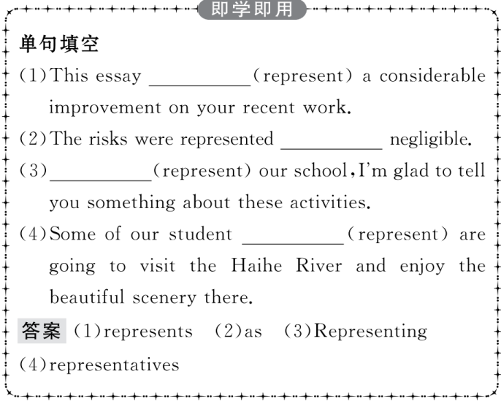
重点词汇
重点句式
随堂练习

Slide 15
重点词汇
重点句式
随堂练习
2.equipment n.装备,设备,用具
【课文原句】You don’t need expensive equipment;even the ball doesn’t have to cost much money.
你不需要昂贵的设备,就连球也不需要花很多钱。
【词汇精讲】equipment意为“装备,设备,用具”,是不可数名词。
We have all the equipment we need now.
我们需要的设备现在都有了。
A fire-engine is a special vehicle carrying equipment for fighting large fires.
消防车是一种装载有消灭大火灾设备的特殊交通工具。
We should try out all the equipment before we do the experiment.
我们应该在做实验之前把所有的设备都试一下。

Slide 16
重点词汇
重点句式
随堂练习
【词汇拓展】
Please equip yourself with a sharp pencil and a rubber for the exam.
请准备一枝削尖的铅笔和一块橡皮参加考试。
A degree in the history of art is very nice but it doesn’t exactly equip you for many jobs.
能获得一个艺术史学位固然不错,但在很多工作中它并不见得会使你有用武之地。

Slide 17
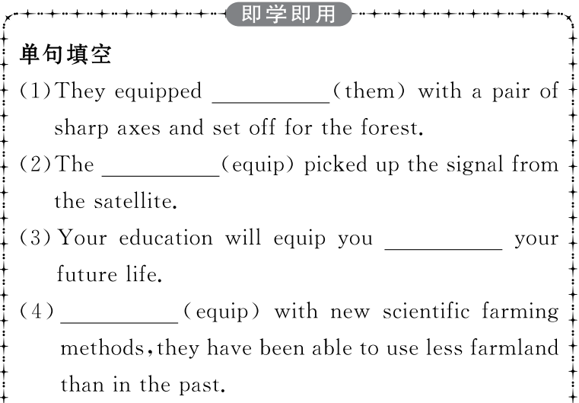
重点词汇
重点句式
随堂练习

Slide 18
重点词汇
重点句式
随堂练习

Slide 19
重点词汇
重点句式
随堂练习
3.content n.满意,满足
【课文原句】All over the world you can see kids playing to their hearts’ content with a ball made of plastic bags;just like Pelé did when he was a boy.
在世界各地,你都可以看到孩子们尽情玩塑料袋做的球,就像贝利小时候一样。
【词汇精讲】content表示“满意,满足”时是不可数名词,表示“内容”时是可数名词。
I was delighted to be able to eat my favourite dishes to my heart’s content.
我很高兴能够痛痛快快地吃我最喜爱的菜。
I read the letter once again,trying to absorb its contents.
我又读了一次信件,试图理解它的内容。

Slide 20
重点词汇
重点句式
随堂练习
【词汇拓展】
Neither the teacher nor the students are content with the result.
这位老师和学生们都对这个结果不满意。
We should not content ourselves with only a little book knowledge.
我们不应该仅仅满足于有一点点书本知识。

Slide 21
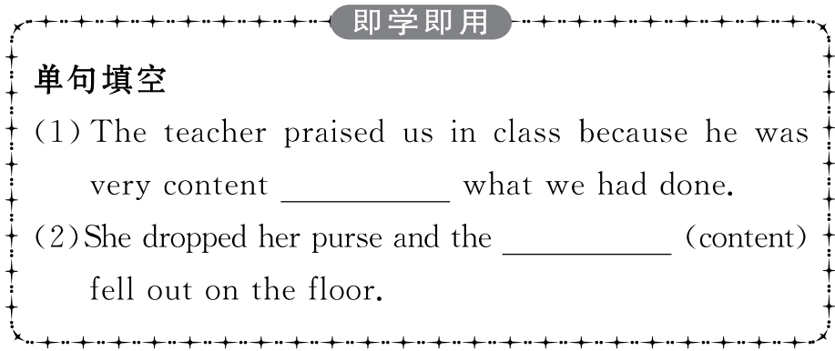
重点词汇
重点句式
随堂练习

Slide 22
重点词汇
重点句式
随堂练习

Slide 23
重点词汇
重点句式
随堂练习
4.defend v.(比赛中)防守,防卫
【课文原句】...how they use their bodies to pass,score and defend can be amazing to see...
……看他们如何利用自己的身体传球、得分和防守令人称奇……

Slide 24
重点词汇
重点句式
随堂练习
【词汇精讲】defend意为“防卫,防守,辩护”,可作及物或不及物动词。
How can we defend our homeland if we don’t have an army?
如果我们没有军队,如何保卫祖国?
The Great Wall was built from the Qin Dynasty and its purpose was to defend their own territories against the invasion of their enemies.
长城自从秦朝时就开始修建,它的目的是保护他们自己的领土不被敌人入侵。

Slide 25
重点词汇
重点句式
随堂练习
【词汇拓展】
What points can be raised in defence of this argument?
有什么论点能提出来为这个说法辩护呢?
Humour is a more effective defence than violence.
幽默是比暴力更有效的防御武器。

Slide 26
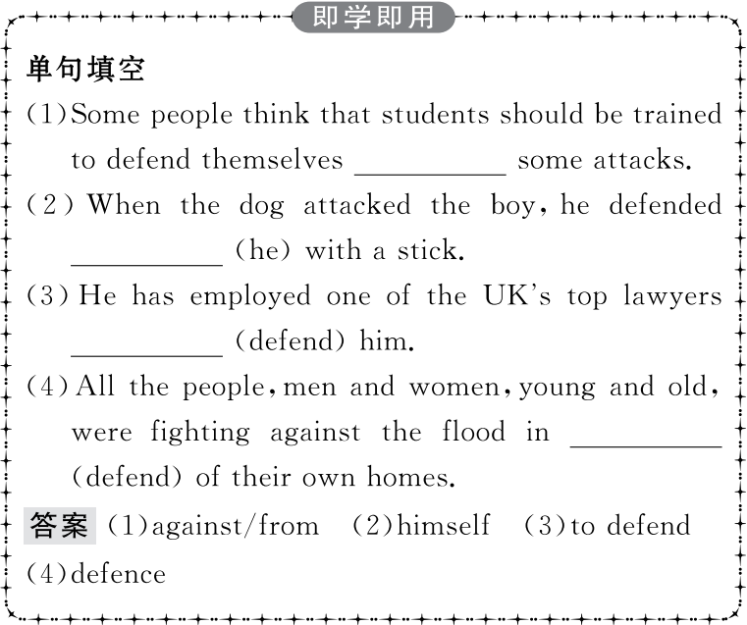
重点词汇
重点句式
随堂练习

Slide 27
重点词汇
重点句式
随堂练习
All over the world you can see kids playing to their hearts’ content with a ball made of plastic bags;just like Pelé did when he was a boy.
在世界各地,你都可以看到孩子们尽情玩塑料袋做的球,就像贝利小时候一样。
【句式剖析】本句中的see kids playing...是“see sb doing”结构,其中的playing是动词-ing形式,在句中作宾语补足语,表示动作正在进行。
When I passed,I saw my friends playing chess.
我路过时,看到我的朋友们在下棋。
We saw them planting trees when we swam in the river.
我们在河里游泳时看到他们在植树。

Slide 28
重点词汇
重点句式
随堂练习
【句式拓展】
They were very glad to see the plan carried out.
看到计划得以执行他们非常高兴。
A neighbour saw the man slip into the room.
一个邻居看到那人进了房间。

Slide 29
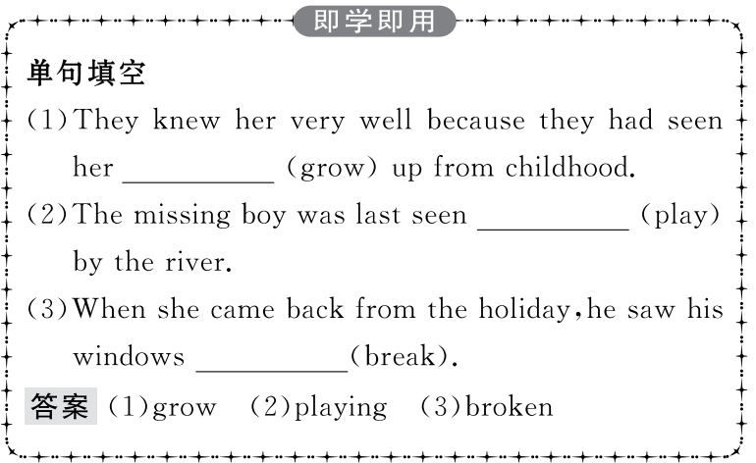
重点词汇
重点句式
随堂练习

Slide 30
重点词汇
重点句式
随堂练习
Ⅰ.单句填空
1.The history of the football (go) back over two thousand years to Ancient China.
答案:goes
2.It was in Great Britain the football was given new rules.
答案:that
3.Football is popular all over the world because it is cheap (play).
答案:to play
4.When I passed the playground,I saw some kids (run) around the track.
答案:running
5.As we can see,our planet is shaped a football.
答案:like

Slide 31
重点词汇
重点句式
随堂练习
Ⅱ.课文语篇填空
The history of the game 1. (date) back to two thousand years ago to Ancient China.At that time,it was known as cuju,2._________ was a game using a ball of animal skins with hair inside.Modern football started in Great Britain,where the game 3. (give) new rules.
One factor for football’s 4. (popular) is that it is simple and cheap to play.All over the world you can see kids 5.____________ (play) to their hearts’ content with a ball made of plastic bags.
Another factor for football’s global popularity is that it is 6._____ (create) and exciting,which is fun enough to attract millions of people.How the professional players use their bodies to pass,score and defend can be amazing 7. (see).
dates
which
was given
popularity
playing
creative
to see

Slide 32
重点词汇
重点句式
随堂练习
best
Football has become one of the 8. (good) ways for people to communicate and everyone understands 9. .It breaks down walls and brings people together on and off the field.
As Bill Shankly said,“Some people believe football is a matter of life and death,...I can assure you it is much,much more important
10. that.” This might sound funny,but one only has to think about the Earth to realise that our planet is shaped like a football.
it
than

Slide 33
重点词汇
重点句式
随堂练习
Ⅲ.概要写作
根据教材pp.26—27的语篇内容写一篇60词左右的内容概要
参考范文
Football,which was invented in Ancient China,is one of the most popular sports in the world.(要点1) One factor for its popularity is that it is simple and cheap to play.(要点2) Another factor is that it is creative and exciting.(要点3) Besides,football has become one of the best ways for people to communicate no matter what language they speak.(要点4)

