Slide 1
Unit 4 Wild animals
Study skills & Task
WWW.PPT818.COM

Slide 2
Study skills
The suffixes -ing, -ness and -ion
Verb/ Adjective | Noun
mean
ill
act
meaning
illness
action

Slide 3
Practice
Change the following words into nouns
discuss
collect
kind
sick
feel
celebrate
begin
dark
meet
invite
discussion
collection
kindness
sickness
feeling
celebration
beginning
darkness
meeting
invitation

Slide 4
Pre-task
A guessing game
Which animal is it?
elephant
1
It is big and strong, it can carry heavy things with its long nose.
dolphin
It is a sea animal and looks like a large fish. It is very clever and often plays some games for us in the zoo.
2
tiger
It’s the king of the animal world. It has black stripes(条纹) on its body.
3

Slide 5
A guessing game
Which animal is it?
wolf
4
It is not big. It looks like a dog. It usually lives with its family. It never kills for fun.
bear
It’s strong , and has thick fur and sharp paws. It can walk upright(直立). Sometimes it’s very dangerous.
5
panda
It only lives in China. Its favourite food is bamboo. It’s fat but it can climb trees easily.
6

Slide 6
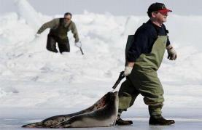
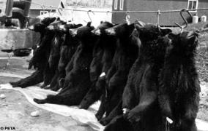
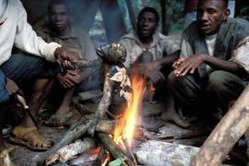
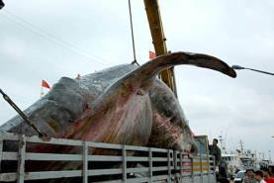
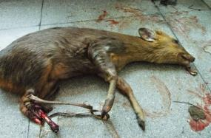
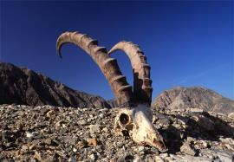
Many of them are in danger!
We should do something!

Slide 7
While-task:
Read Simon’s notes on bears.
What do bears look like?
What do most bears eat?
What are bears good at doing?
What danger are bears facing?
They are big and heavy.
Most bears eat meat and fish.
Bears are good at climbing and swimming.
Hunters catch them for their fur and paws.

Slide 8
Help Simon complete
the report.

Slide 9
A report on giant pandas
How to write a report
Para 1
Look
Para 2
Food
Para 3
Ability
Para 4
Qualities
Para 5
Danger

Slide 10
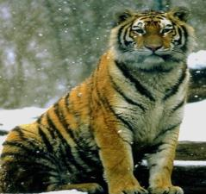
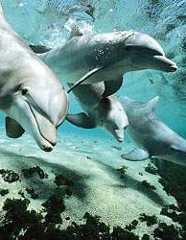
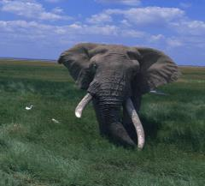
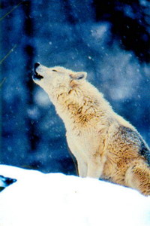
Post-task: Let’s help more animals
You can also choose any animal you like to write.

Slide 11
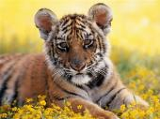
Step 1 Write down notes
Tigers
Appearance
Ability
Character
Food
Danger
Action
A model

Slide 12
Step 2 Give your report
Report: Tigers are in danger!
1
2
3
4
5
A model

Slide 13
Pay attention to:
Step 3 Correct the article in pairs
The writing steps(步骤);
The word spelling(拼读);
The neat handwriting(书写);

Slide 14
Step 4 Show your report
Report: Tigers are in danger!

Slide 15
Learn a song
请让我来帮助你,就像帮助我自己;
Let me help you, be likely to help myself;
请让我去关心你,就像关心我自己;
Let me take care of you, be likely to take care of myself;
这世界会变得更美丽.
The world will be more beautiful!

