Slide 1
Numbers
第二课时
WWW.PPT818.COM

Slide 2
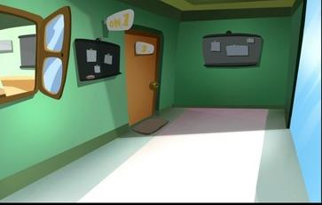
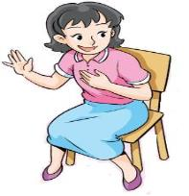
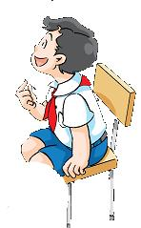
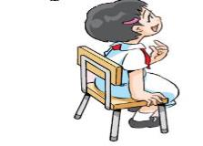
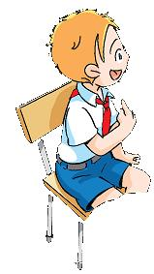
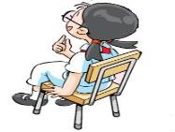
Good morning, boys and girls. I have a good news(消息) for you. Today, I have some challenges（挑战） for you. If you can pass the challenge, you will get a chance（机会） to visit the farm tomorrow.
Notes:
2

Slide 3
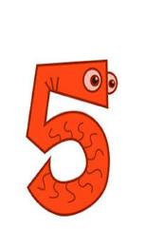
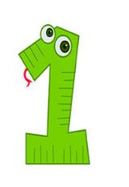
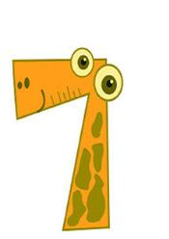
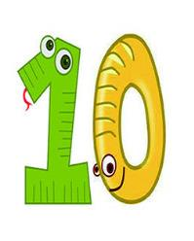
Count and say

Slide 4
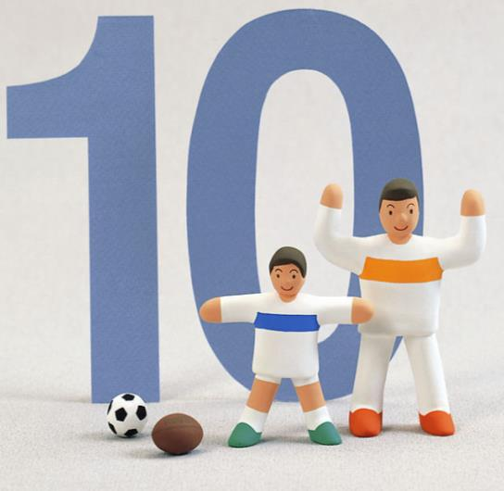
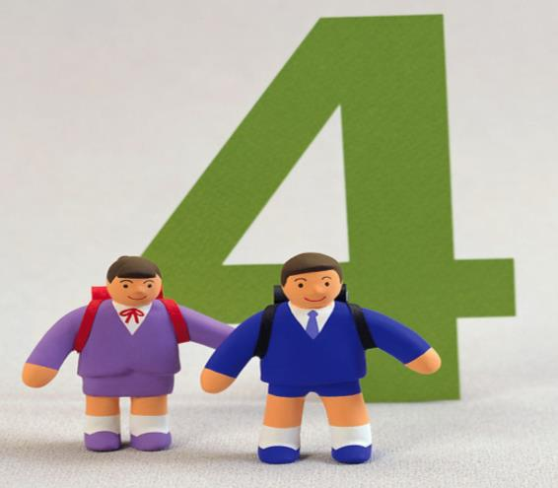
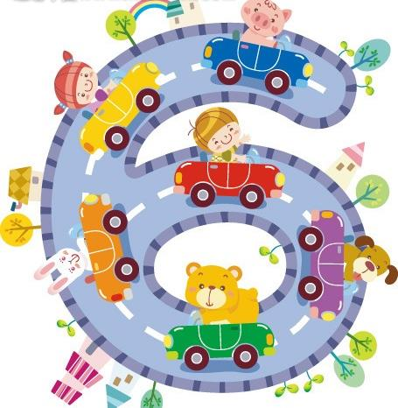
Quick response

Slide 5
In our classroom
A：How many …?
B: Let’s count. One, two, three…

Slide 6
Count and say
A：How many…?
B:Let’s count. One, two, three…

Slide 7
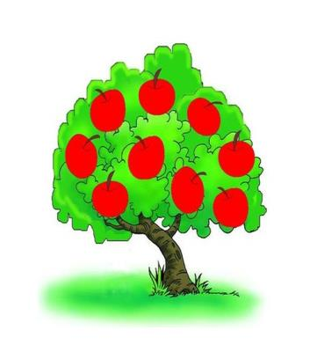
In the fruit garden
A：How many…?
B: Let’s count. One, two, three…
…

Slide 8
Good job. Let’s go to the farm.
Notes:
8

Slide 9
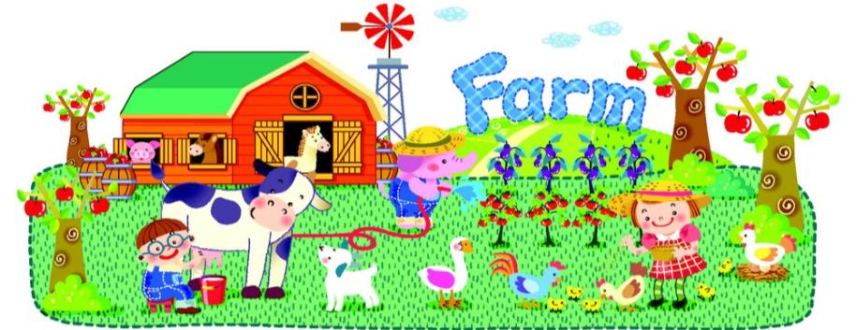
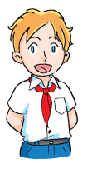
I hear pigs and chicks.
What do you hear?
I hear sheep and dogs.
I hear cows and cats.
Let’s go and see.

Slide 10
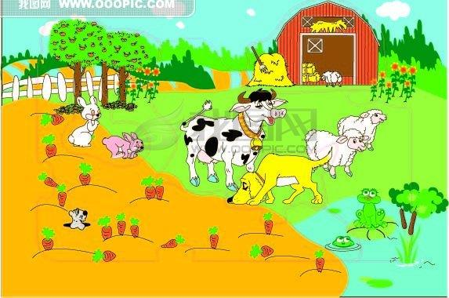
one
seven
two
three
four
five
six
How many sheep?
One,two,three...
There are seven sheep
How many rabbits?
One,two,three...
There are seven rabbits.

Slide 11
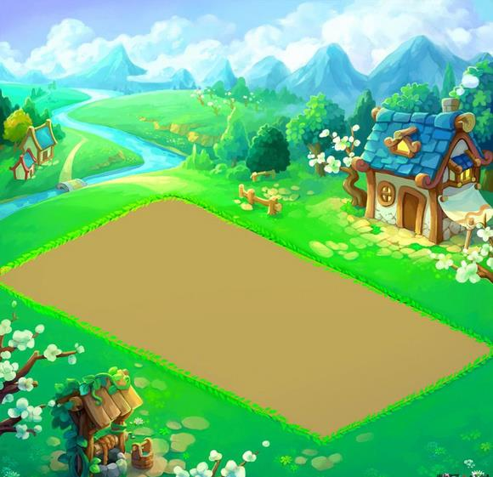
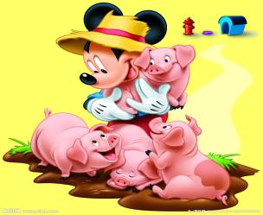
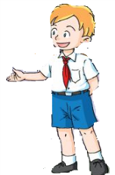
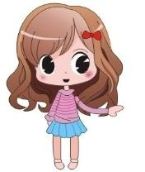
three
two
four
ten
one
six
five
nine
seven
eight
One,two,three…
There are _____ pigs.
How many pigs?
ten

Slide 12
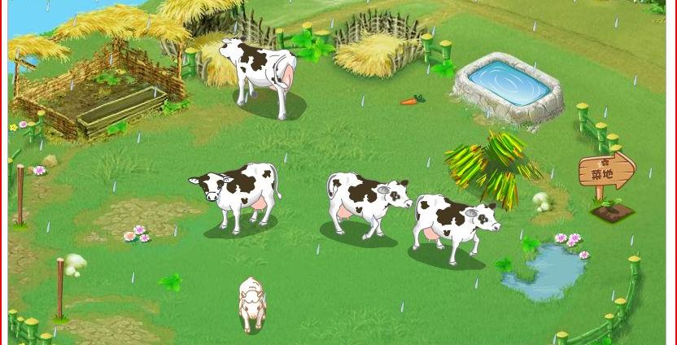
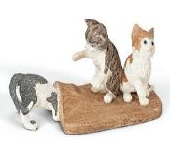
How many cows?
Let’s count. One,two,three…
There are _________ cows.
ten
How many cats?
One,two,three…
...

Slide 13
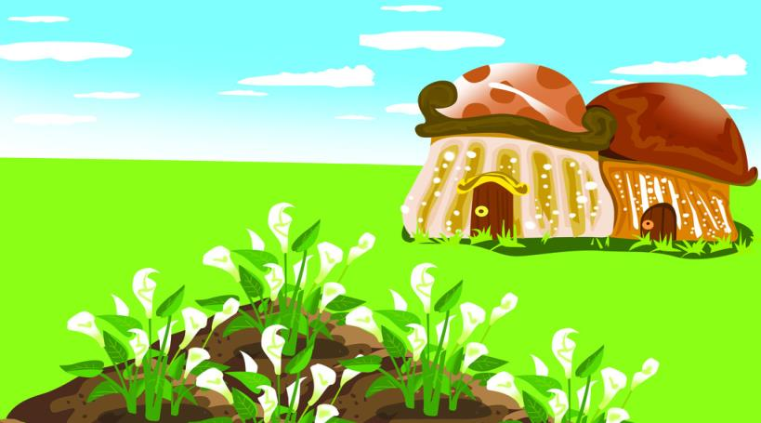
They are chicks.
Oh,look. What are they?
Umm. Let me count.
How many chicks, Kitty?

Slide 14
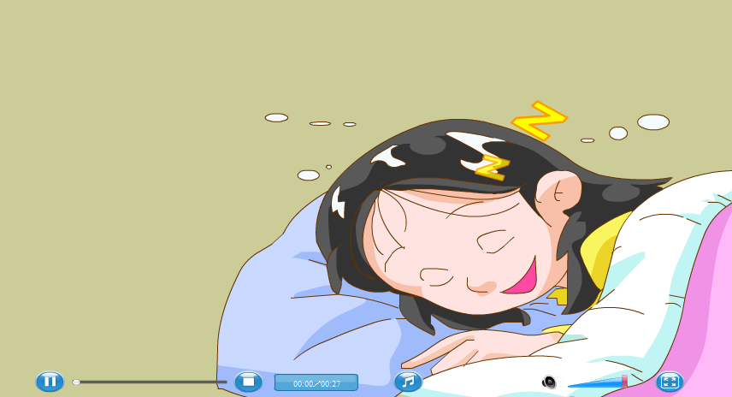
Listen and count
How many chicks?
There are________chicks.

Slide 15
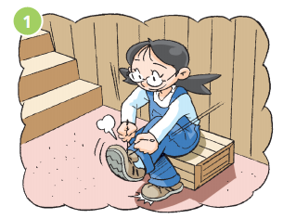
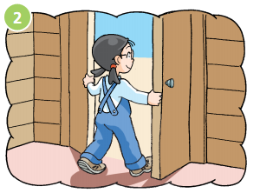
One, two.
Put on my shoes.
Three, four.
Open the door.
Notes:
15

Slide 16
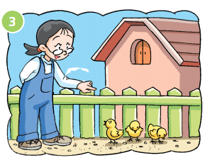
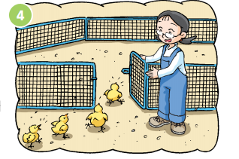
Five, six.
Count the chicks.
Seven, eight.
Open the gate.
Notes:
16

Slide 17
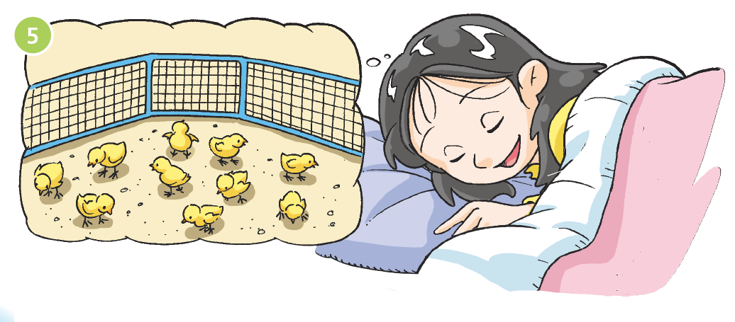
Nine, ten.
Count them again.
How many chicks?
Notes:
17

Slide 18
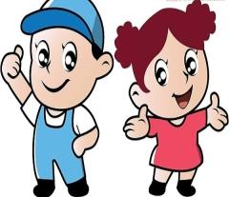
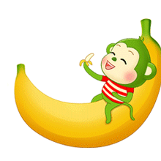
Ask and answer
A:How many boys?
B:There is______boy.
one/a
A:How many girls?
B:There is______boy.
one/a
A:How many _____s?
B:There is______.
A:How many _____?
B:There is______.

Slide 19
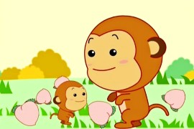
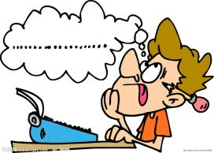
Let’s guess
A：How many …?
B: There are/is…

Slide 20
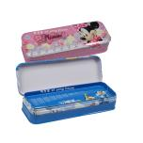
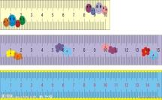
Count and say在小组内数一数，说一说
A：How many ...?
B: One, two, three... There is/are ... How many…?
C: One, two, three…There is/are…How many…?
D: One, two, three…There is/are … How many…?
A: One, two, three…there is/are…

Slide 21
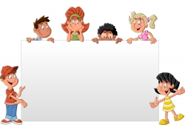
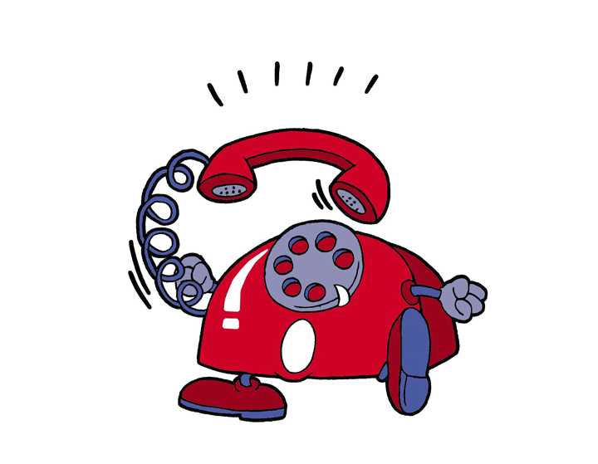
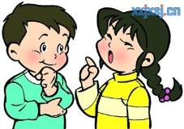
15570481595
Pair-work
A：What’s your dad’s/mum’s number?
B: It’s______________.

Slide 22
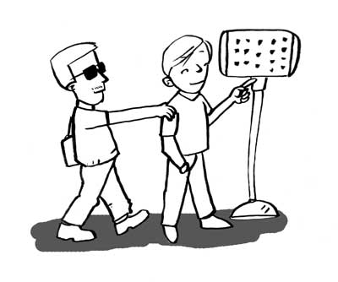
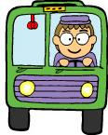
The blind man is waiting for bus No. 595. Let’s help him.
258
117
987
595

Slide 23
Homework
1. Read the text in P52 for 10 minutes.
2. Count your books and tell your parents the number.
3. Count your things in your schoolbag and write it down with the sentence:
There are…
Notes:
23

