Slide 1
Module 4 Home alone
Unit 2 I became so bored with their orders that I wished they would leave me alone.
WWW.PPT818.COM

Slide 2
新课导入
New words
actually
manage
unhappy
turn off
order
be worried about
business
on business
sofa
adv. 事实上
v. 管理；支配
adj. 不高兴的
关掉；关闭(设备)
n. 命令；指示
担心
n. 工作
出差
n. (长)沙发

Slide 3
新课导入
New words
snack
midnight
wake up
hand in
empty
unable
all day long
burn
cup
task
n. 点心；小吃
n. 午夜；子夜
醒；醒来
提交；上交
adj. 空的
adj. 不能做某事的
整天
v. (使)烧焦；(使)烤糊
n. 杯子；一杯饮料
n. 任务；工作

Slide 4
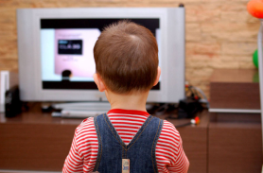
新课导入
Lead-in
What do you do when you are home alone?
思 考

Slide 5
新课讲解
1
Work in pairs. Talk about daily things you do alone
and the things your parents do for you.
思 考
cook dinner
go shopping
tidy up
wash clothes

Slide 6
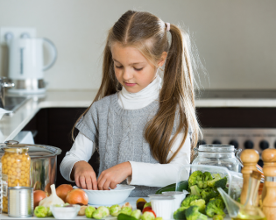
新课讲解
思 考
When my parents are not at home, I can cook dinner by myself.

Slide 7
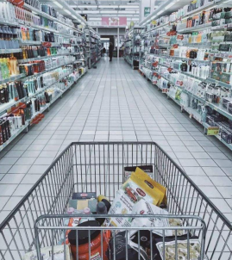
新课讲解
思 考
My parents go
shopping to buy some useful things for me.

Slide 8
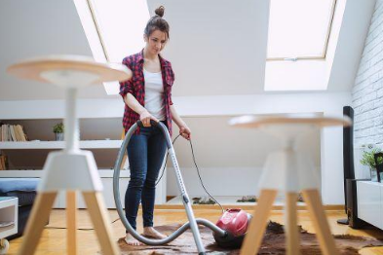
新课讲解
思 考
I tidy up the room every day.

Slide 9
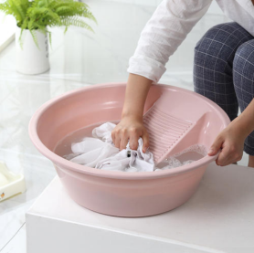
新课讲解
思 考
I can wash clothes by myself.

Slide 10
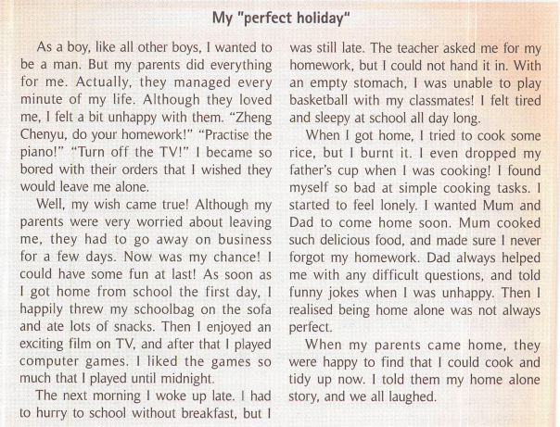
新课讲解
Read the passage and choose the best summary.
2
思 考

Slide 11
新课讲解
a) Zheng Chenyu found his life more
difficult without his parents.
b) Zheng Chenyu depended on is
parents to prepare meals for him.
c) Zheng Chenyu had so much homework that
he did not have time to look after himself.
d) Zheng Chenyu should learn to cook.
✔
思 考

Slide 12
新课讲解
Read paragraph 1 and answer the questions:
1. Did his parents love him?
2. What did his parents do?
3.What did he wish?
思 考
Yes, they did.
They managed every minute of his life.
He wished they would leave him alone.

Slide 13
新课讲解
Read paragraph 3 and find out what kind of
troubles he meet.
1.I woke up late and hurry to school without breakfast but it was still late.
2.I couldn’t hand in homework.
3.I was unable to play basketball with an empty stomach.
4.I felt tired and sleepy at school all day long.
思 考

Slide 14
新课讲解
3
Complete the sentences. See how Zheng Chenyu’s feelings changed.
思 考
a bit unhappy
1 Zheng Chenyu felt ________________ with his parents because they did everything for him and managed every minute of his life.
2 After Zheng Chenyu’s parents went away on business, he felt ___________ because he could _______________.
excited
have some fun

Slide 15
新课讲解
tired and sleepy
3 Zheng Chenyu felt _______________ after the first night.
4 Zheng Chenyu felt _______________ when he found he could not look after himself well.
5 Zheng Chenyu realised being home alone ___________________________.
思 考
lonely
was not always perfect

Slide 16
新课讲解
4
Complete the passage with the correct form of the words in the box.
burn cup empty order simple task
orders
Zheng Chenyu was bored with his parents’ (1) _______. He was happy when his parents went away on business, though he soon found that he could not do (2) _______ things. He forgot his homework. He went to school with a(n) (3) _______ stomach. He (4) _______ his food and broke his father’s (5) ________. Zheng Chenyu had to learn to do (6) ________ like cooking and tidying up. He realised being home alone was not always perfect.
simple
empty
brunt
cup
tasks

Slide 17
新课讲解
Language point
1. As a boy, like all other boys, I want to be a man.
作为男孩，就像其他所有男孩一样，我想做个男子汉。
man在此处意为“男子汉”。
例如：Don’t cry anymore. Be a man!
别再哭了。要像个男子汉！

Slide 18
新课讲解
Language point
2. Actually, they managed every minute of my life.
实际上，他们安排了我生活中的每一分钟。
manage的意思是“安排；管理”，在这里作者用夸张的手法表达了对父母管得太多的不满。
Parents should not manage everything for their children.
父母不应该为孩子安排一切。
I manage my time well.
我把自己的时间安排得很好。

Slide 19
新课讲解
Language point
3. I liked the games so much that I played until midnight.
我太喜欢玩游戏了，以至于一直玩到午夜。
思 考
(1)“so＋形容词或副词＋that引导的结果
状语从句”，意思是“如此……以致于……”。 如：
When the basketball fans saw Jeremy Lin, they got so excited that they cried out.
当球迷们看到林书豪时，他们太激动，喊了起来。

Slide 20
新课讲解
Language point
4. …, but I could not hand it in. ……， 但是我交不了
hand in指把物品“上交”，反义短语是hand out，把物品“分发”出去 。
We can help the teacher hand out the exam papers.
我们可以帮老师分发试卷。
I want you both to hand in your exercise-book today.
我要你们俩今天把练习本交上来。

Slide 21
新课讲解
Language point
5. When I got home, I tried to cook some rice, but I burnt it.当我到家时，我尽量做些饭，但我把饭烧糊了。
burn（burned, burned; burnt, burnt）这里意为“（使）(食物)烧焦；（使）烧糊”。
burn 动词 还表示“（使）燃烧，烧毁，烧伤”
burn 名词 “烧伤”
burning 形容词 “燃烧的，烫手的”
burnt 形容词 “烧坏的”

Slide 22
新课讲解
5
Write a passage about what you can do and what you cannot do when your parents are away.
思 考
·Make lists of what you can do and cannot do when your parents are away.
I can wake up on time .
I cannot make breakfast.
·Now join the sentences with although，but or so...that.
I can wake up on time, although I cannot make breakfast.
·Write a conclusion to the sentences.
I will miss my parents, but I think I can look after myself very well.
·Share your passage with your classmates.

Slide 23
当堂小练
一、单项选择。
A
( ) 1. _____ he is a little child, Jerry knows a lot about the world.
A. Though B. Since
C. If D. Because
( ) 2. He was _____ tired _____ he could not go on walking.
A. too...to B. such…that C. so…that
( ) 3. It was _____ lovely weather_____ we decided to spend
the day on the beach.
A. such a…that B. such…that
C. such…as D. so…that
C
B

Slide 24
当堂小练
二、根据所给汉语意思，用单词或短语完成下列
英文句子。
1.他醒来时发现屋里只有他一个人。
He ______ ______ to find himself alone in the house.
2.我把那块表交给了警察。
I _______ the watch ______ to the police.
3.我试着和他联系，却没联系上。
I tried to contact (联系) him, but _______ _______ _______.
woke up
handed in
was unable to

