Slide 1
Unit2 My Family
陕旅版
三年级下册
第二课时
WWW.PPT818.COM

Slide 2
>>Review
Look and say
M= Mother
S= sister
F= father
B= brother
T:What’s this?
S1:It’s M. Mother.

Slide 3
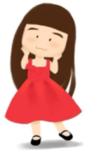
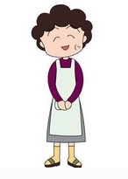
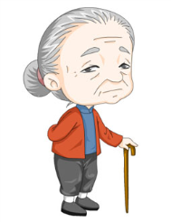
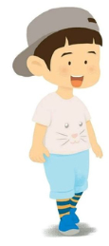
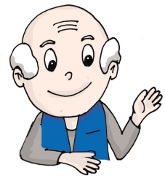
>>Review
I can say
2
3
father
____
____
sister
Mother
4
5
6
___
____
____
grandma
brother
grandpa

Slide 4
>>Warming-up
I can say

Slide 5
>>Presentation
Draw and say
This is …

Slide 6
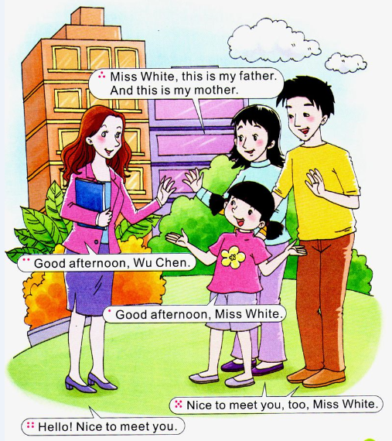
>>Presentation
Let’s talk

Slide 7
>>Presentation
Let’s talk
Read and act
Wu Chen: Good afternoon, Miss White.
Miss White: Good afternoon, Wu Chen.
Wu Chen: Miss White, this is my father.
And this is my mother.
Miss White: Hello! Nice to meet you.
Mum and dad: Nice to meet you, too, Miss White.

Slide 8
>>Practice
Read it by yourselves for one minute .
自读课文一分钟。
一分钟倒计时
60
Learning tip :
50
10
当你自己朗读时，遇到不会读或不明白意思的单词或句子，可以把它圈起来，请教同学或老师！
20
40
30
开始

Slide 9
>>Practice
Super Mary:表演我最棒！
小组合作：
1.4人一小组
2.根据剧本分角色练习
3.适当加上一些动作辅助表演
4.在课文基础上进行创编
Make a new dialogue 创编新对话

Slide 10
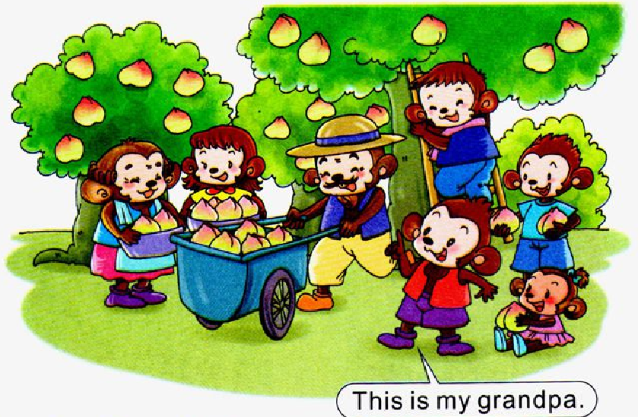
>>Practice
Point and say
This/That/He / She is …

Slide 11
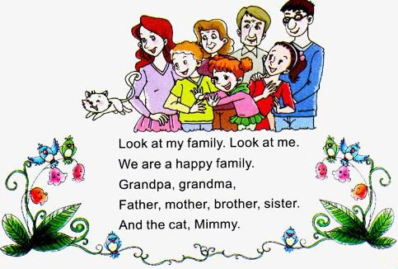
>>Practice
Let’s chant

Slide 12
>>Summary
如何介绍家庭成员：
This is my …
初次见面的打招呼用语：
—Nice to meet you!
—Nice to meet you, too!

Slide 13
>>Homework
1.听课文录音并跟读，按照正确的语音、语调朗读并表演课文对话。 2.学生2人一组，仿照课文创编新对话(至少4句）。
3.预习B Let’s learn more。
close

