Slide 1
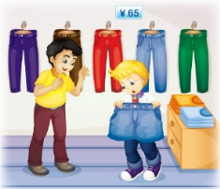
Unit2 Can I help you?
人教精通版五年级下册
WWW.PPT818.COM

Slide 2
>>Review
Let’s chant

Slide 3
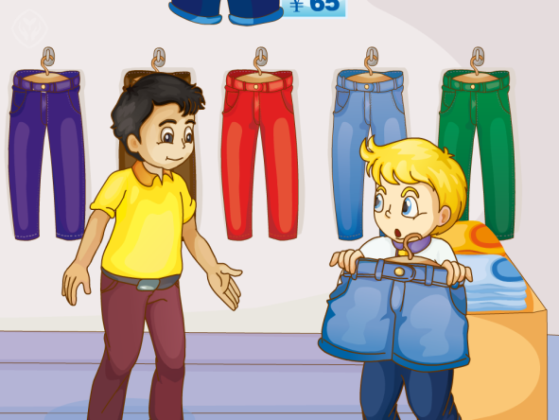
>>Presentation
Look and say
Who are they?
What are they talking about?

Slide 4
>>Presentation
Listen and say
1. What does Peter want to buy?
A pair of short pants.
2. Are they nice for Peter?
No, they are too big for him.

Slide 5
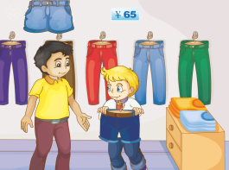
>>Presentation
Listen and say
3. What does Peter say?
Would you show me that pair of short
pants?
4. How much are these short pants?
They’re sixty-five yuan.

Slide 6
>>Presentation
Look and read
I want a pair of short pants, please.
Can I help you?
Can I try them on?
How about this one?
Oh, they are too big for me.
Sure.

Slide 7
>>Presentation
Look and read
Sure. Here you are.
Would you please show me that pair of short pants?
They are good. How much are they?
They’re sixty-five yuan.
Thank you.
I’ll take it.

Slide 8
>>Presentation
Listen and read
Just talk
 | Salesman: Can I help you?
 | Peter: I want a pair of short pants, please.
 | Salesman: How about this one?
 | Peter: Can I try them on?
 | Salesman: Sure.
 | Peter: Oh, they are too big for me.

Slide 9
>>Presentation
Listen and read
 | Peter: Would you please show me that pair of short pants?
 | Salesman: Sure. Here you are.
 | Peter: They are good. How much are they?
 | Salesman: They’re sixty-five yuan.
 | Peter: I’ll take it.
 | Salesman: Thank you.

Slide 10
>>Practice
Tips for actors
（演员考核标准）
Let’s act
Read fluently
流利地朗读
Act fluently
流利地表演
Act it out with emotions
有感情的表演

Slide 11
>>Practice
活动1
击鼓传物
Would you show me …?
How much …?

Slide 12
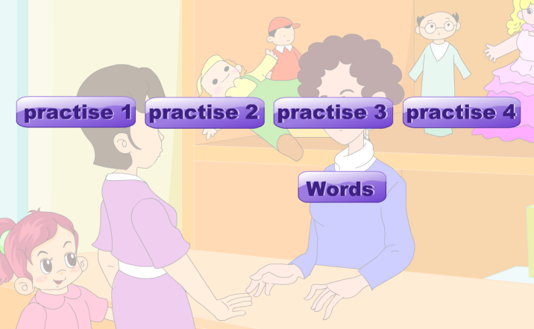
>>Practice
活动2
配音表演

Slide 13
>>Summary
本课学到的重点句型是什么？
—Would you show me that pair of
short pants?
—Sure. Here you are.
—How much are these short pants?
—They’re sixty-five yuan.

Slide 14
>>Homework
1.观看课文动画，按照正确的语音、语调朗读课文对话。 2.根据本课对话以及你在生活中的购物经历，编写一段新的对话，要求不少于6句。
3.预习 Lesson12。

