Slide 1
Lesson 1
This is my desk
WWW.PPT818.COM

Slide 2
New Words

Slide 3
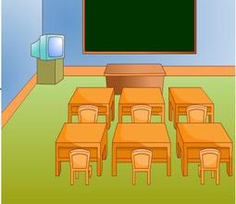
classroom
教室

Slide 4
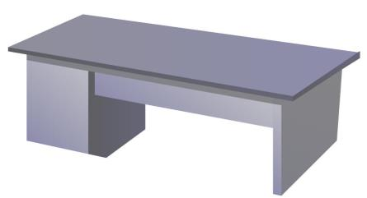
desk
桌子

Slide 5
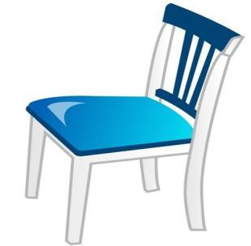
chair
椅子

Slide 6
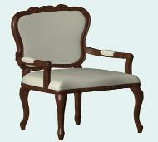
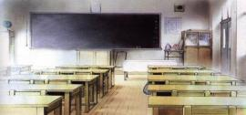
Words
desk
chair
classroom

Slide 7
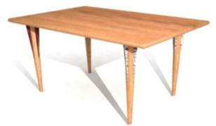
What’s this?
This is my desk.

Slide 8
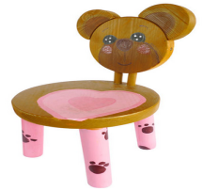
What’s this?
This is my chair.

Slide 9
What’s this?
This is our classroom.

Slide 10
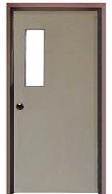
What’s this?
This is a door.

Slide 11
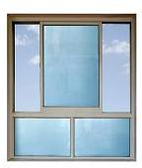
What’s this?
This is a window.

Slide 12
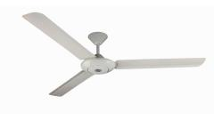
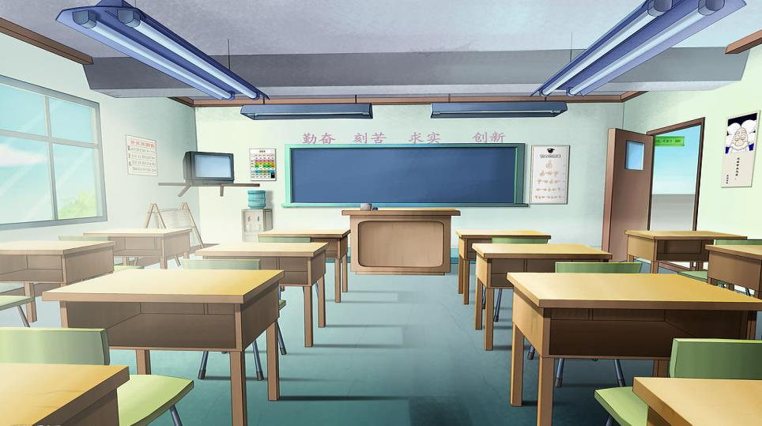
fan
light
window
blackboard
TV
door
chair
desk
What’s in the classroom?

Slide 14
H
h
I
i

Slide 15
j
K
k
J

Slide 16
Homework
Copy the words.
desk chair classroom
This is my…
2. Make a mini dialogue.

Slide 17
Thank you!

