Slide 1
人教精通版四年级下册
Unit1 Welcome to my new home!
WWW.PPT818.COM

Slide 2
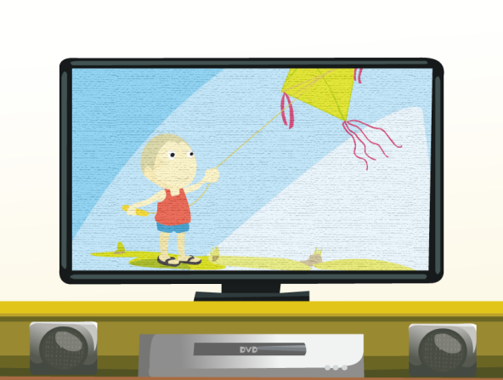
Review
Let’s chant
（单击图片可播放动画）

Slide 3
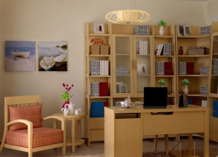
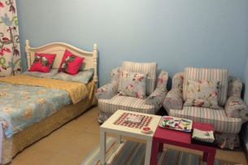
Review
Guessing game
What room is it?

Slide 4
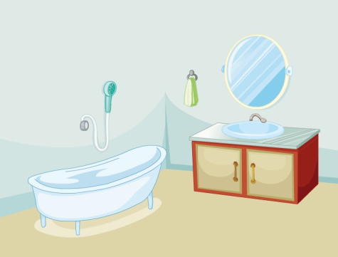
Lead-in
What room is it?
Kate’s bathroom
She often takes a bath in the bathroom.

Slide 5
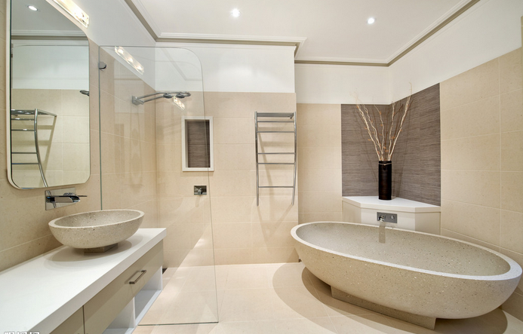
Presentation
bathroom

Slide 6
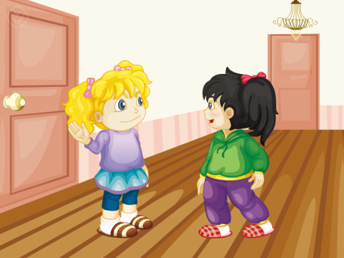
Presentation
Kate shows the bathroom to Li Yan.

Slide 7
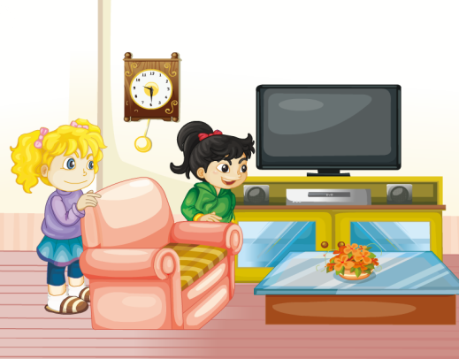
Presentation
After that, Kate shows her the living room.
What’s in the living room?

Slide 8
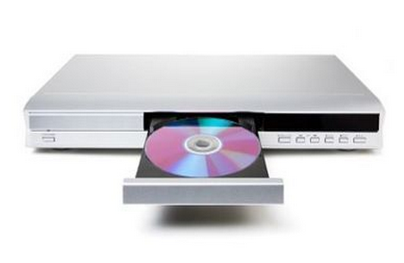
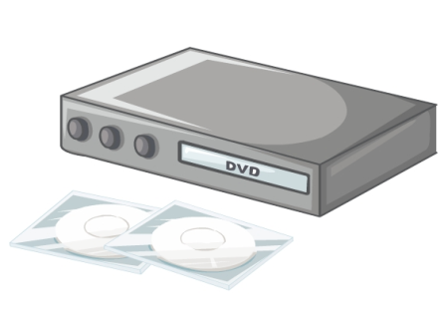
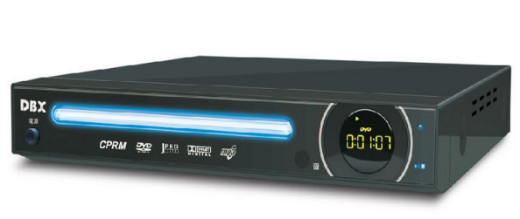
Presentation
DVD player
There is a DVD player in the living room.

Slide 9
Presentation
clock
There is a big clock in the living room.

Slide 10
Presentation
（单击图片可播放动画）

Slide 11
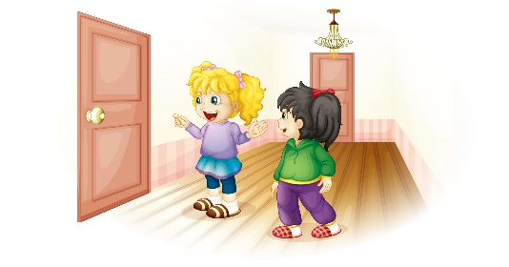
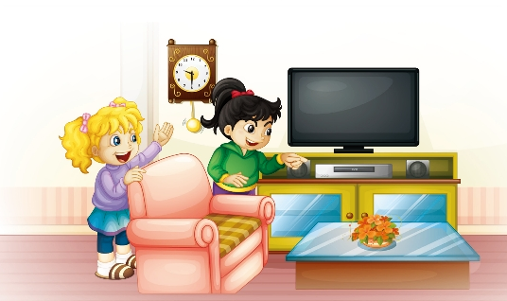
Presentation
Let’s read
There is the living room. That’s the bathroom.
What’s in the living room?
Come and see.
Oh, there’s a new DVD player.
And there’s a big clock.

Slide 12
Practice
录音 | 课文句子
K: This is the living room. That’s the
bathroom.
L: What’s in the living room?
K: Come and see.
L: Oh, there’s a new DVD player.
K: And there’s a big clock.

Slide 13
Presentation
Read and write
（单击图片可播放动画）

Slide 14
Practice
活动1
男女朗读对抗赛

Slide 15
Practice
活动2
Group work
规则：四人一组，先填写这张信息卡，随后依次表达片上信息。例如：My name is Lucy. Look at my living room. There is a TV in my living room. There are ... I often watch TV in the living room.
Name: Lucy
Room: Living room
Things: TV, 2 sofas, table
Things to do: Watch TV
Name: Room:
Things:
Things to do:

Slide 16
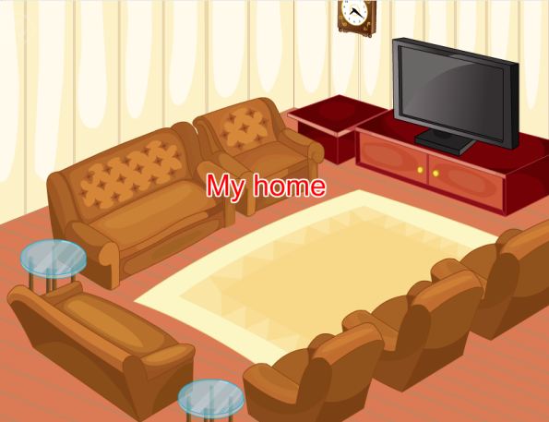
Consolidation
Let’s chant
（单击图片可播放动画）

Slide 17
Summary
1.本节课的重点单词有哪些？
bathroom
DVD player
clock
2.本节课的重点句型有哪些？
What’s in the living room?
There is a DVD player.

Slide 18
Homework
1.学会唱本课Let’s chant 部分的歌曲。
2. 邀请你最好的朋友去家中做客，并用英语介绍自己家中房间及其陈设。
Close

