Slide 1
Lesson 2
You’d better take an umbrella.
WWW.PPT818.COM

Slide 2

What's Li Ming's plan?
I'll go to a summer camp in Britain.
I'll go to English classes and visit some famous places.

Slide 3

Jenny, Danny and Liming在一起讨论LiMing的夏令营。
Where is Danny going to stay for the summer camp?
We 're going to stay in London.

Slide 4

What is Li Ming going to do during his stay in London?
Liming is going to have English classes during the weekdays .
Liming'll visit some famous places during the weekends.

Slide 5
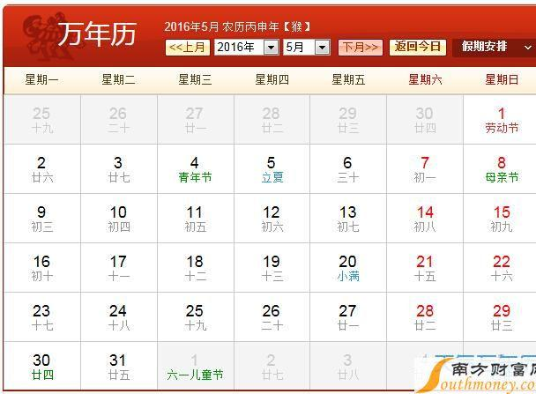
weekday
weekend

Slide 6
What is Li Ming going to do during his stay in London?
Liming is going to have English classes during the weekdays .
Liming'll visit some famous places during the weekends.

Slide 7

Where is Liming going to visit?
the British Museum
Hyde Park
the London Eye

Slide 8
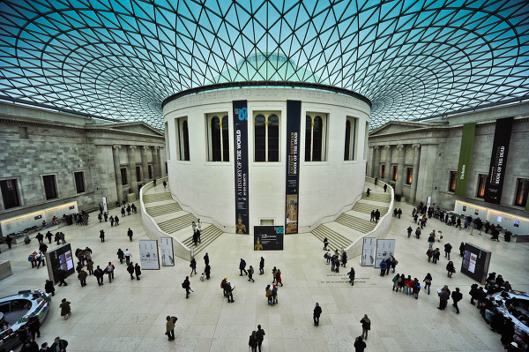
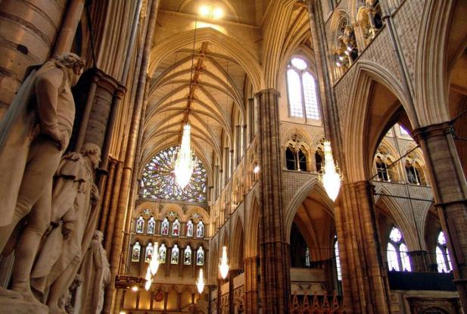
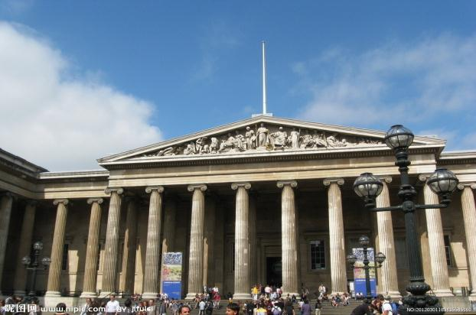
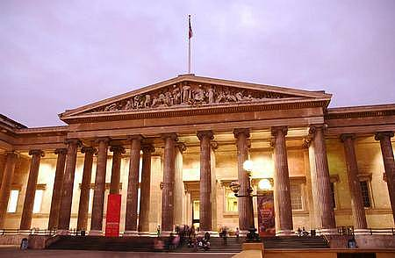
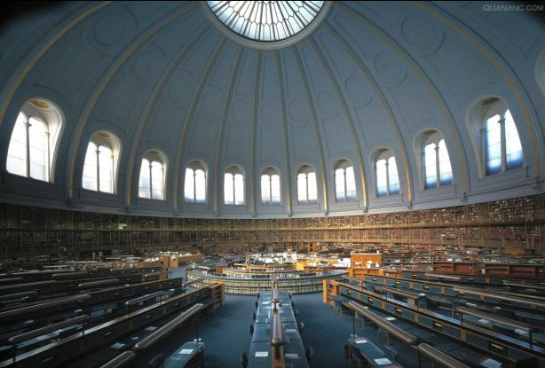
the British Museum
大英博物馆始建于1753年，1759年对外开放。博物馆正门的两旁各有8根又粗又高的罗马式圆柱，每根圆柱上端是一个三角顶，上面刻着一幅巨大的浮雕。整个建筑气魄雄伟，蔚为壮观。现有建筑为19世纪中叶所建，共有100多个陈列室，面积六七万平方米，共藏有展品400多万件。

Slide 9
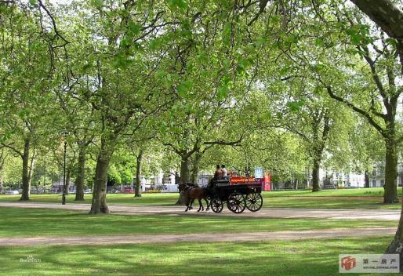
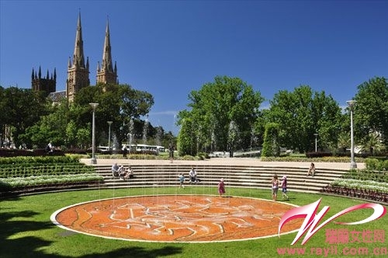
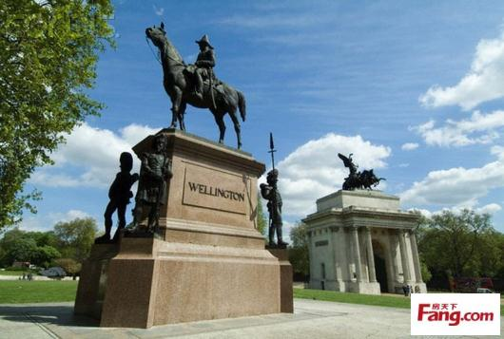
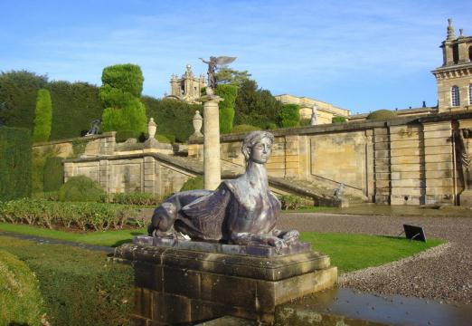
Hyde park
英国海德公园是伦敦最知名的公园之一，海德公园英国最大的皇家公园。位于伦敦市中心的威斯敏斯特教堂。海德公园历史悠久，历史氛围浓厚。

Slide 10
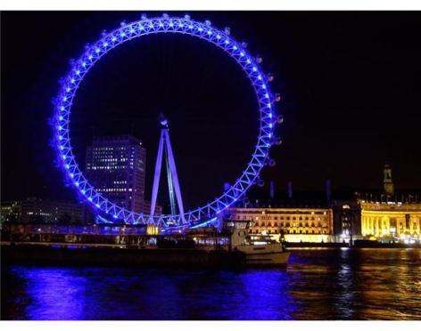
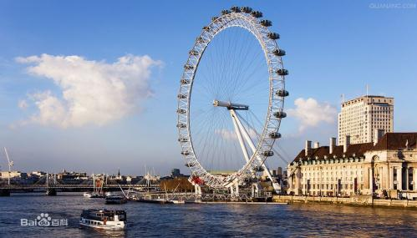
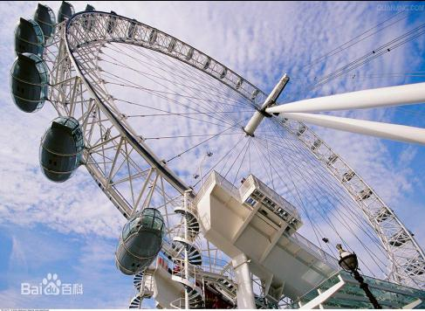
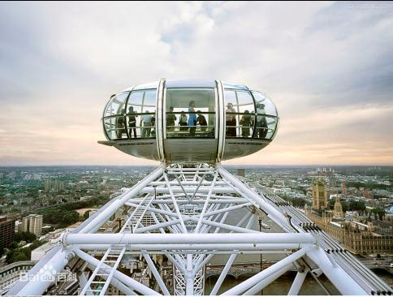
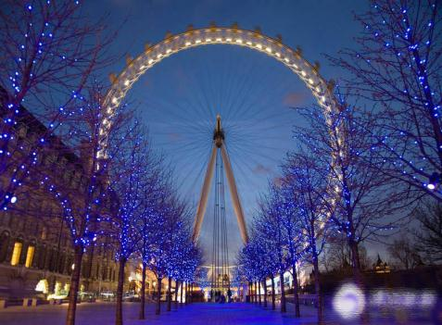
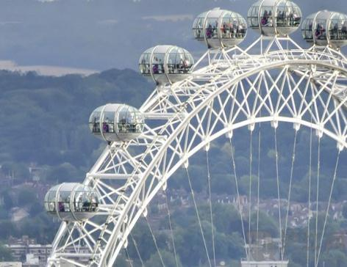
the London Eye
伦敦眼（The London Eye）1[1] ，坐落在英国伦敦泰晤士河畔，总高度135米（443英尺）。伦敦眼共有32个乘坐舱（由序号1排列到33。因为宗教忌讳，没有13号），因舱内外用钢化玻璃打造，所以设有空调系统。每个乘坐舱可载客约25名，回转速度约为每秒0.26米，即一圈需时30分钟。

Slide 11
Are you going to visit the British Museum?
We'll also go to Hyde Park and the London Eye.

Slide 12


Are you ready for the camp?
I think so.
I have my camera,clothes and a map.

Slide 13
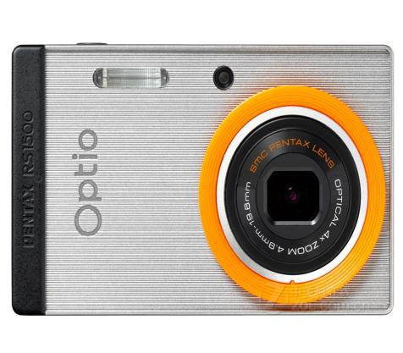
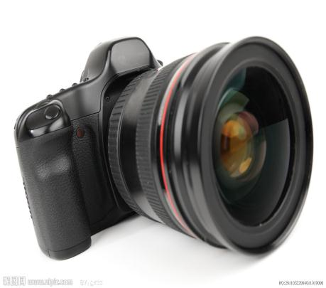
camera

Slide 14

I have my camera,clothes and a map.
You 'd better take an umbrella.

Slide 15
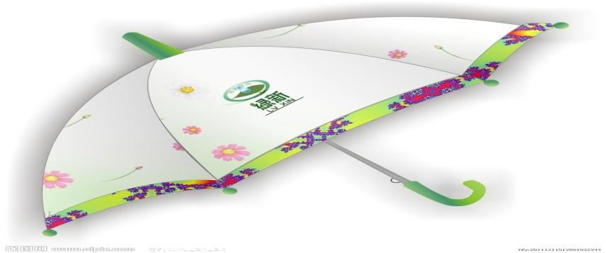
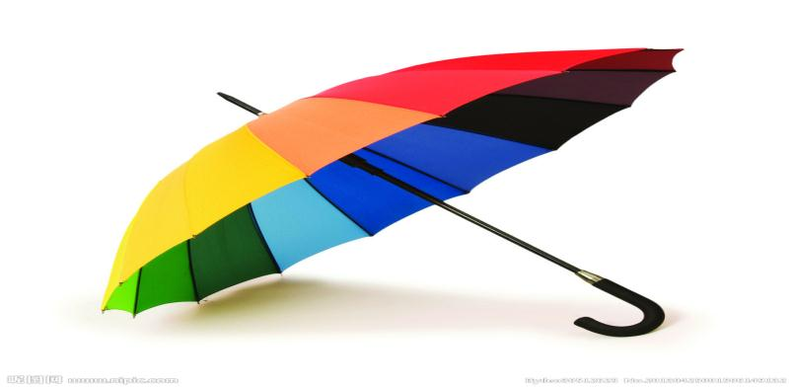
umbrella

Slide 16
I have my camera,clothes and a map.
You 'd better take an umbrella.
It often rains in London.

