Slide 1
Unit 1 Lesson 3
Nice to meet you.
WWW.PPT818.COM

Slide 2
我也很高兴见到你。
Nice to meet you.
回答：Nice to meet you, too.
表示：很高兴见到你。
用于陌生人初次见面，互相介绍问候时。
A: Hi, I’m Lily.
B: Hello, I’m Lucy, nice to meet you.
A: Nice to meet you, too.

Slide 3
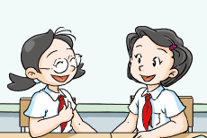
Look and read
Nice to meet you.
Nice to meet you, too.
Glad to see you.
Glad to see you too.

Slide 4
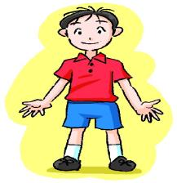
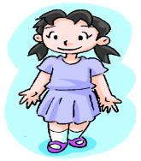
Good morning.
morning
Good morning.

Slide 5
Good afternoon.
afternoon
Good afternoon.

Slide 6
How are you? This is Lily.
She is my sister.
I’m fine. Thank you.

Slide 7
Nice to meet you!
Nice to meet you, too!

Slide 8
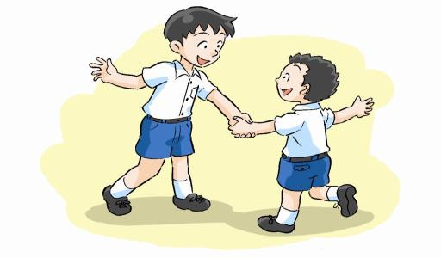
Good afternoon, Li Ming.
Good afternoon,
Liu Wei.
Nice to meet you.
Nice to meet you, too.

Slide 9
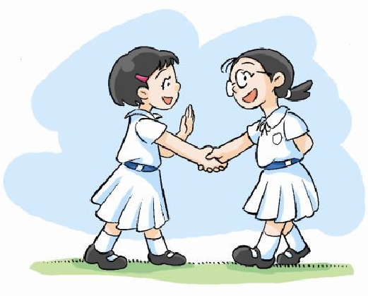
Hi, I’m Song Qian.
Hello, I’m Li Ling.
Nice to meet you, too.
Nice to meet you.

Slide 10
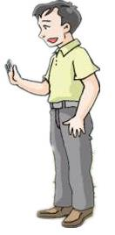
Hi, Alice.
Hello, Mr. Li.
Mr. Li
李先生
Nice to meet you, too.
Nice to meet you.

Slide 11
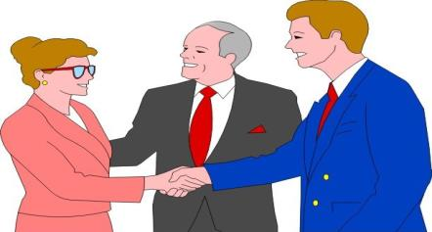
Nice to meet you, Miss Zhang.
Nice to meet you, too.
Miss. Zhang
张小姐

Slide 12
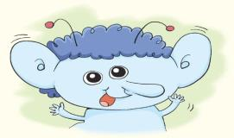
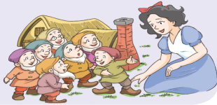
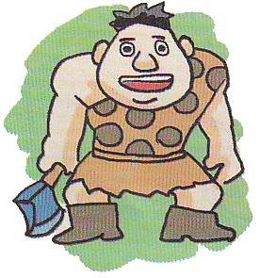
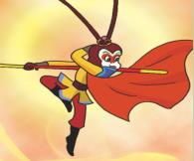
Nice to meet you!
Beebo
Snow White
Practice
the Monkey King
Giant

Slide 13
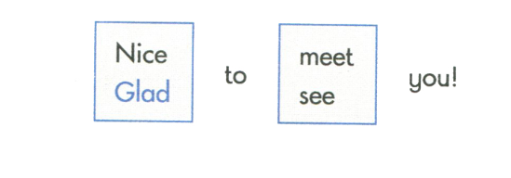
LOOK and learn
Nice to meet you!
Nice to meet you, too!

Slide 14
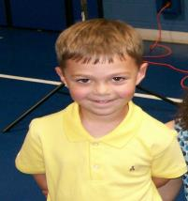
Mini dialogue
S1: Hello, Mr …
S2: Hello, Miss …
S1: Nice to meet you.
S2: Nice to meet you, too.
S1: Goodbye.
S2: Goodbye.

Slide 15
Homework
1. Copy the words and sentences.
Miss Good afternoon.
Nice to meet you. Nice to meet you, too.
2. Make a mini dialogue.

