Slide 1
Unit 9 Where will you go?
WWW.PPT818.COM

Slide 2
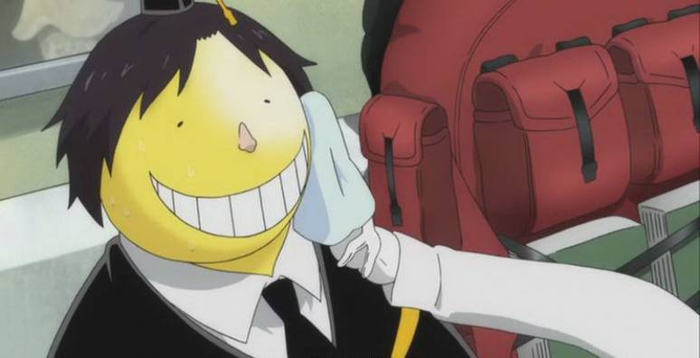
Let’s go travelling!
If I can travel abroad,
在外国
I will go to …

Slide 3
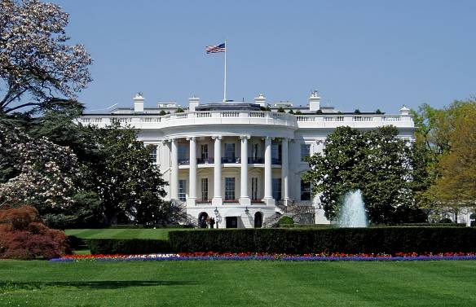
I will choose the USA.
I'll go to Washing.D.C.
I'd like to visit the White House.
Washington D.C. is the capital of America
and it’s famous for the White House.

Slide 4
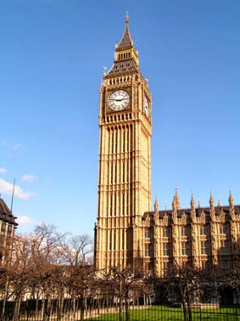
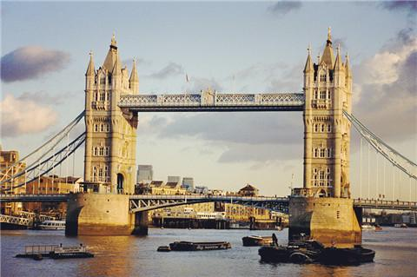
I will choose Britain.
I'll go to London.
I'd like to visit the Big Ben and
Tower Bridge.
London is the capital of the UK and it’s famous
for the Big Ben and the Tower Bridge.

Slide 5
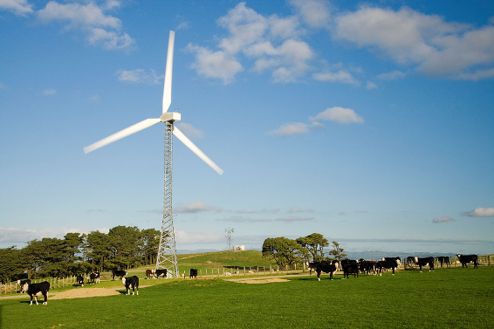
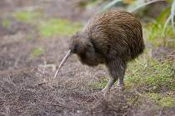
I will choose New Zealand.
I'll go to Wellington.
I'd like to see the kiwi.
Wellington is the capital of New Zealand and
it’s famous for the kiwi birds and natural beauty.

Slide 6
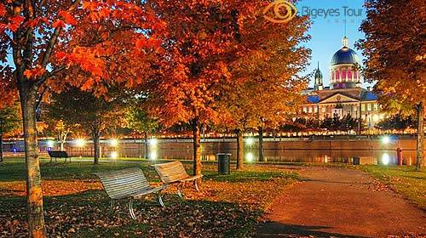
I will choose Canada.
I'll go to Ottawa.
I'd like to see the maple trees.
Ottawa is the capital of Australia and
it’s famous for the maple trees.

Slide 7
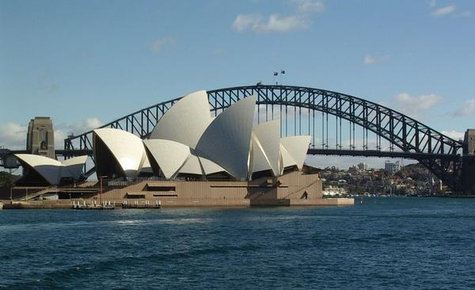
I will choose Australia.
I'll go to Sydney.
I'd like to visit the Sydney Opere
House and Harbour Bridge.
Sydney is the biggest city of Australia and it’s
Famous for the Sydney Opera House and the
Sydney Harbour Bridge.

Slide 8
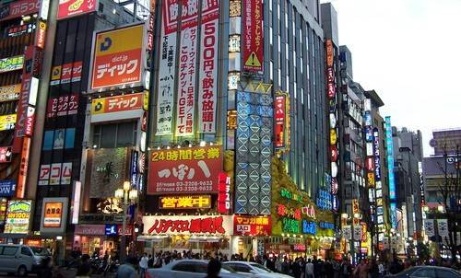
I will choose Japan.
I'll go to Tokyo.
I'd like to go shopping in Tokyo.
Tokyo is the capital of Japan.
Tokyo is a good place to go shopping.

Slide 9
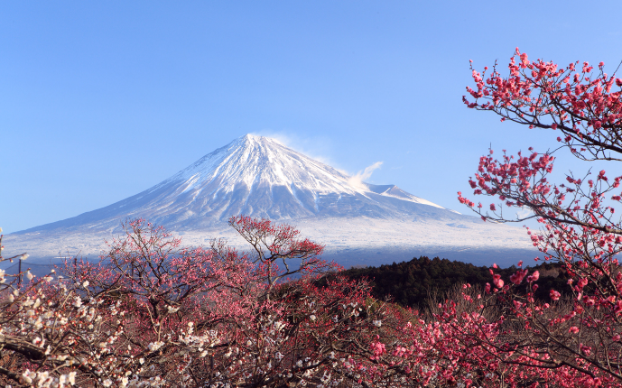
I will choose Japan.
I'd like to visit the Mount Fuji.

Slide 10
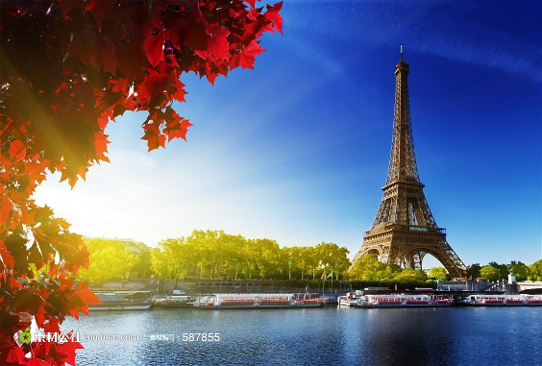
I will choose France.
I will choose France.
I will choose France.
I'll go to Paris.
I'll go to Paris.
I'll go to Paris.
I'd like to visit the Eiffel Tower.
I'd like to visit the Eiffel Tower.
Paris is the capital city of France and it’s
famous for the Eiffel Tower.
Paris is the food capital in the world
And it is a great place to go shopping.

Slide 11
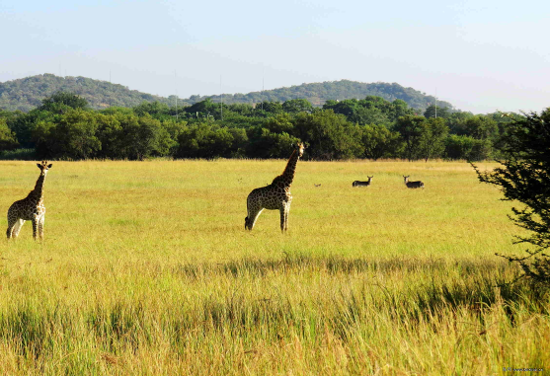
I will choose South Africa.
I'd like nature in south Africa.
South Africa is famous for natural beautiful.

Slide 12
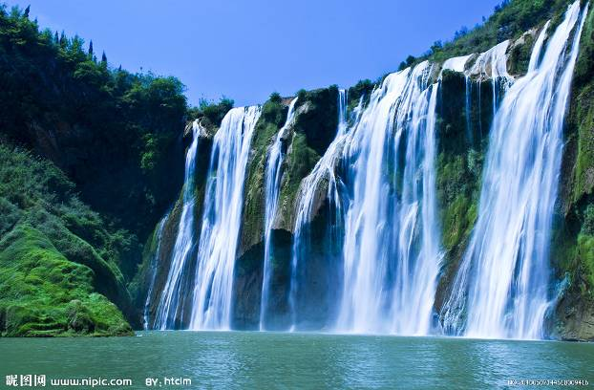
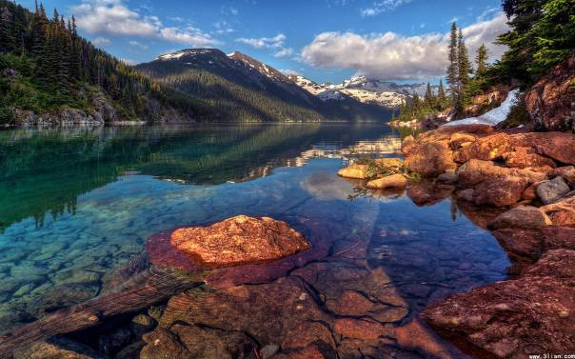
I will choose Canada.
Canada is famous for the beautiful lakes
and waterfall .

Slide 13
If you can travel to any country in the world,
Where will you go?
Why?

Slide 14
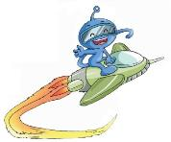
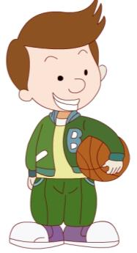
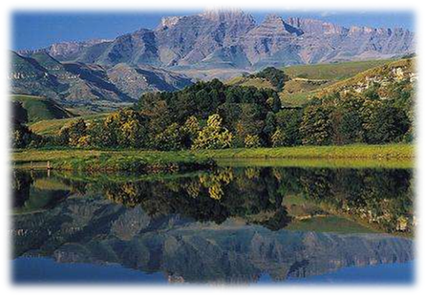
I think I will go to South Africa.
I love nature and in South Africa I can see
many beautiful mountains and forests.
South Africa

Slide 15
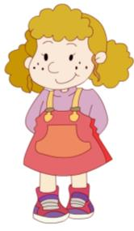
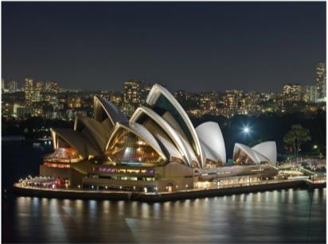
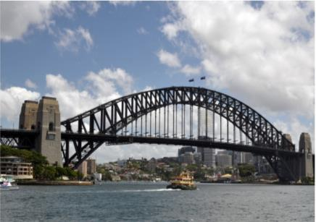
I will choose Australia.
I ‘d like to see the Sydney Opera House and
the Harbour Bridge.
Australia

Slide 16
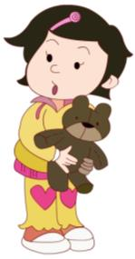
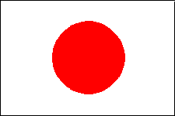
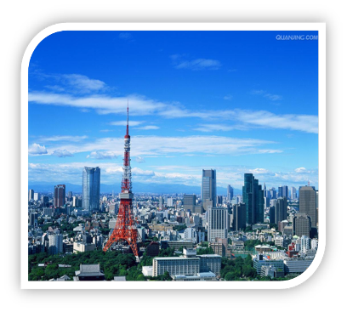
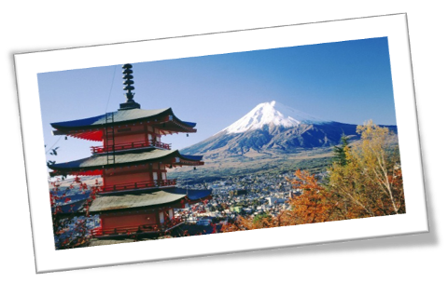
I want to go to Japan. Tokyo is so modern and
it’s a great place to go shopping, too. I’d like
to buy a robot there.
Japan

Slide 17
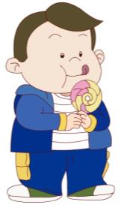
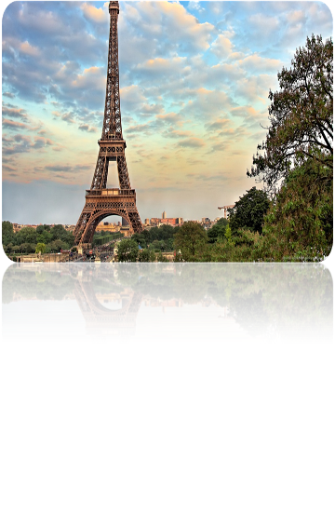
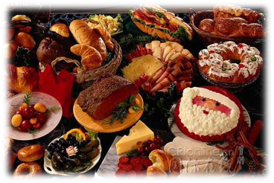
If I can travel abroad I will go to France, of
course. I love food and people say that Paris
is the food capital of the world.（世界美食之都）
France

Slide 18
Fill the blanks
If they can travel abroad, Ben will go to _______. Because he loves _____and he can see many ________and ________ in _________.
Janet will _____ Australia. She wants to see the ____________ and the___________ .
Xiaoling wants to go to ________. Because ________ is a modern city and it’s a great place to ___________. She wants to buy a ______ there.
Jiamin will go to ________. Because he loves food and ________ is the food ______of the world.
South Africa
nature
单击出各单词
mountains
forests
South Africa
choose
Sydney Opera House
Sydney Harbour Bridge
Japan
Tokyo
go shopping
robot
France
Paris
capital
Notes:
18

Slide 19
Make a travel plan
France
If I can travel abroad, I will Choose _______.
I will go to _______. _____ is the _______
of ________. ______ is famous for ____________. Because I 'd like to _________________.______ is _________________________, _____ is a great place to __________. I'd like to ________________
and ___________ in _________.So I plan to travel to there. I will go there with ____________. We will stay there for ___________.
I'm sure I'll have a good time there.
Paris
Paris
capital
单击出各单词
France
Paris
Eiffel Tower
visit Eiffel Tower
Paris
the food capital of the world
Paris
enjoy the delicious food
go shopping
go shopping
Paris
my parents
seven days
Notes:
19

Slide 20
make a travel diary
chose
I travelled abroad last year, I ______ France.
I _____ to Paris. I ____ there by plane with my parents. We _______ there for seven days.
_____ is the _______of ________. ______ is famous for ____________. _______ is _________________________, _____ is a great place to __________. So we __________________
and ___________ in Paris. We _____ a good time there. I ______ I can fly to Paris again.
went
went
stayed
Paris
capital
France
France
Eiffel Tower
Paris
the food capital of the world
Paris
go shopping
enjoyed the delicious food
went shopping
had
hope
Notes:
20

