Slide 1
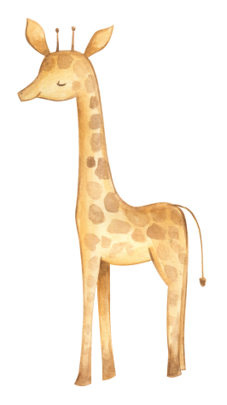
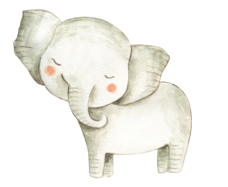
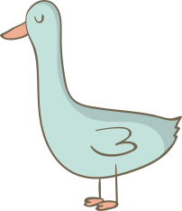
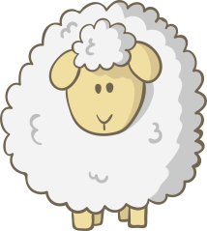
精通六下 Unit 1
I went to Sanya for my holidays.
WWW.PPT818.COM

Slide 2
核心词汇
sun
moon
star
blackboard
subject
word
lesson
yesterday
learn
单词;词
课
星星
黑板
学科
昨天
学习
太阳
月亮

Slide 3
核心词汇
say
use
but
why
by plane
at night
at home
a lot of
乘飞机
说
用
但是
为什么
在家里
很多
晚上

Slide 4
短语
go to the beach
enjoy sunbathing
enjoy the moon and stars
stay at home
have a party
enjoy Spring Festival
listen to English
speak English
过春节
听英语
讲英语
去沙滩
享受日光浴
看月亮和星星
待在家里
聚会

Slide 5
短语
read English
write English
talk in English
play in English
do tasks
have an English party
act in drama
learn from each other
做任务
举办英语聚会
读英语
写英语
用英语交谈
用英语玩游戏
表演戏剧
互相学习

Slide 6
核心句型
1. — What did you do during your holidays?
假期你做了什么?
— I went to Sanya with my parents.
我和我的父母一起去了三亚。
— What ______ you ______ yesterday?
— I ______ to the hospital.

Slide 7
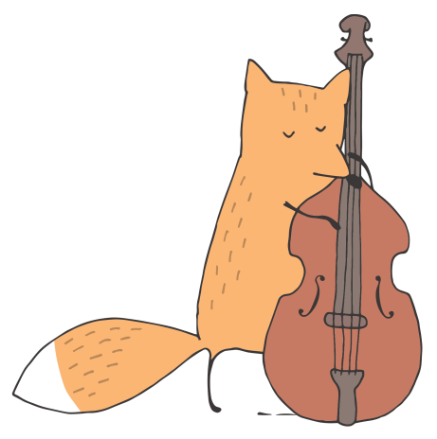
核心句型
2. — How did you get there?
你怎样到的那里?
— We went there by plane.
我们乘飞机去的。
— ______ did you go to school?
— I went to school on foot.

Slide 8
核心句型
3. We have learned a lot of words and sentences.
我们已经学了很多的单词和句子。
我们已经学习了九个新单词。
We______ ______ nine new words.
他已经学会了如何打篮球。
He______ ______ how to play basketball.
莉莉从她的妈妈身上学到了很多。
Lily______ ______ a lot from her mother.

Slide 9
核心句型
4. We are very interested in English.
我们对英语很感兴趣。
be interested in 对……感兴趣
+名词、代词或动词的-ing形式。
My sister is interested in ____________ (draw) pictures.
The twins are interested in____________ (take) pictures.
I am____________ (interest) in science.

Slide 10
核心句型
5.Our English teacher taught us in many ways.
我们的英语老师用很多种方法教我们。
teach是“教”的意思,过去式是taught
My mother often____________me English.
Our PE teacher____________us to play basketball yesterday.
I will____________you to swim.

Slide 11
核心句型
6. We learned from each other.
我们互相学习。
learn from 指从某个地方或向某人学到知识。
I learn a lot____________my teacher.
You should ____________ ____________others.
We____________ ____________our mistakes.

Slide 12
了解句型
1. We enjoyed sunbathing during the day.
2. That sounds wonderful!
3. I also had a big party with Yang Ming, Peter, Li Yan and Lisa.
4. The holiday was interesting!
5. I’d like to tell you about our English learning.
6. — What did we learn in the first year?
— We learned many new words and used them.

Slide 13
Exercise
根据汉语提示完成句子。
1. Our teacher often asks us to look at the__________(黑板)
and listen carefully.
2. Tom saw__________(很多) apple trees in the countryside.
3. The sun is bigger than the__________(月亮).
4. I ate lots of grapes __________(昨天).
5.__________(为什么) are you angry?

Slide 14
Exercise
用所给词的适当形式填空。
1. We learned English by__________(write) English dairies every day.
2. — Did you__________(have) a party last month?
— No, I__________(have) the party last week.
3. We have learned nearly 400__________(word).
4. English and math are my favourite__________(subject).
5. Did you enjoy__________(ride) a horse last weekend?

Slide 15
Exercise
单项选择。
( ) 1. — _____ you_____ English last night? — Yes, I did.
A. Do; learn B. Did; learn C. Did; learned
( )2. I’d like to go to the cinema with you,_____ I am too busy now.
A. so B. but C. and
( )3. She_____ Sanya last month.
A. will visit B. visits C. visited
( )4. — _____ did you learn English? — We learned English by_____ to English songs.
A. How; listen B. How; listening C. Why; listening
( )5. We should wash our clothes by .
A. ourselves B. myself C. yourself

Slide 16
Exercise
连词成句。
1. how, learned, Let, me, you, we, English, tell (.)
2. go, did, How, you, Beijing, to (?)
3. holidays, enjoy, Did, you, your (?)
4. English, by, drama, learned, in, acting, We (.)
5. learned, a, English, lot, words, of, have, We (.)

Slide 17
Exercise
选择合适的句子,补全对话。
John: You look sad. What happened?
Kate: I have trouble(困难)in learning English. I couldn’t remember the English words.1.__________
John: I learned English words by using them.2._________
Kate: Then how about talking? I couldn’t talk with others.
John: 3.__________
Kate: By the way, did you do tasks in English?
John: Yes. 4.__________
Kate: Thank you. I will try my best to learn English.
John: 5.__________I hope you can improve your English.
A. I often used the new words to make sentences.
B. You should practise talking with your classmates.
C. You are welcome.
D. Our teacher often asked us to do tasks with our partners.
E. How did you learn English words?

Slide 18
Exercise
阅读短文,判断正(T)误(F)。
Sarah went to Dalian with her friends during her summer holiday. They went there by plane. On Monday, they went to a beautiful beach. The weather was sunny and hot. So they had great fun playing in the water. In the afternoon, they went shopping. But there were too many people in the shop, so they didn’t enjoy it. On Tuesday, they went to the museum. It was boring. On Wednesday the weather was cool. So they played basketball. They played all morning. It was really fun. On Thursday they went to the zoo and saw many animals. And then they came back home by ship.
( )1. Sarah and her friends went to Dalian by ship.
( )2. On Monday, Sarah had fun going shopping.
( )3. They went to a museum on Tuesday.
( )4. It was very hot on Wednesday.
( )5. They played tennis on a cool morning.

Slide 19
Exercise
以“My Holiday”为题,写一篇小短文,讲述一下你在过去的某一个假期的经历。词数在50—60之间。

