Slide 1
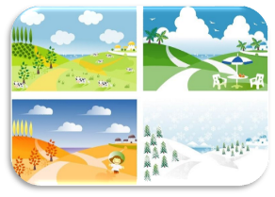
Unit6 There are four seasons in a year.
人教精通版六年级上册
WWW.PPT818.COM

Slide 2
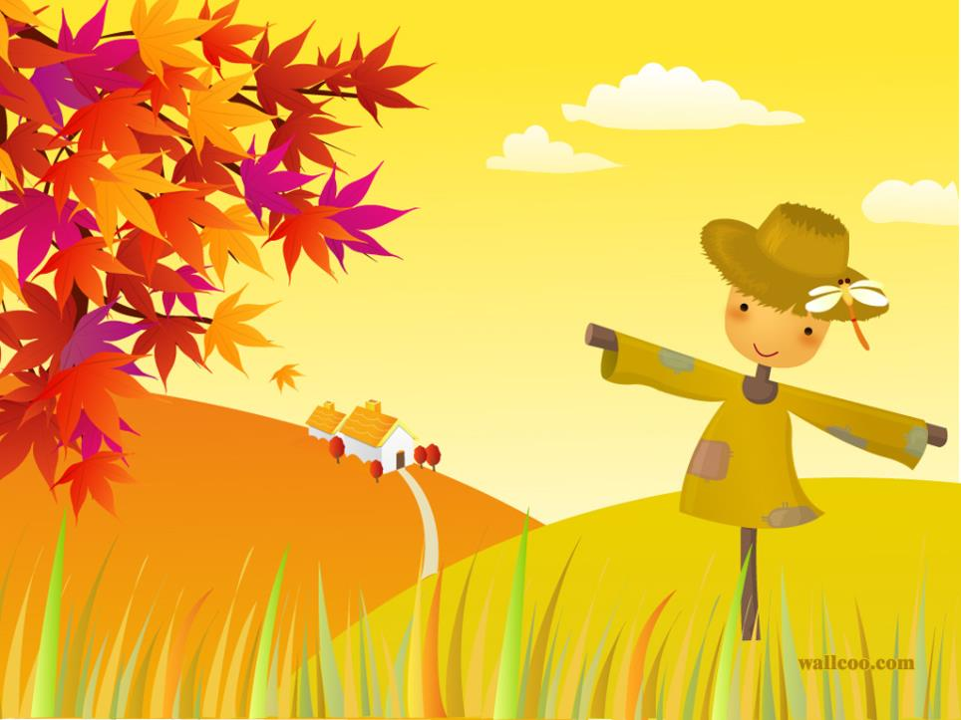
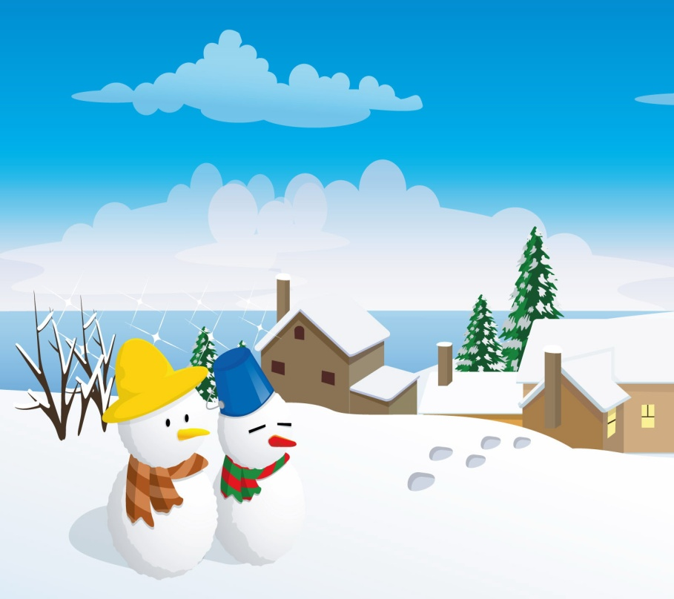
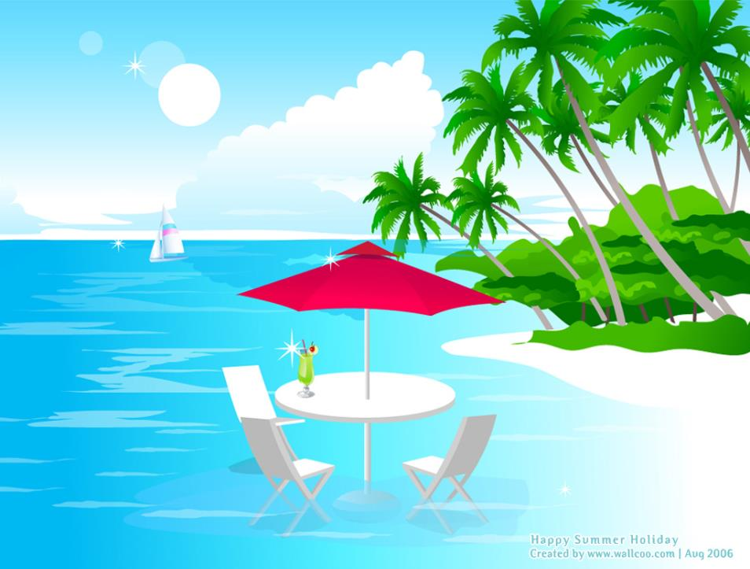
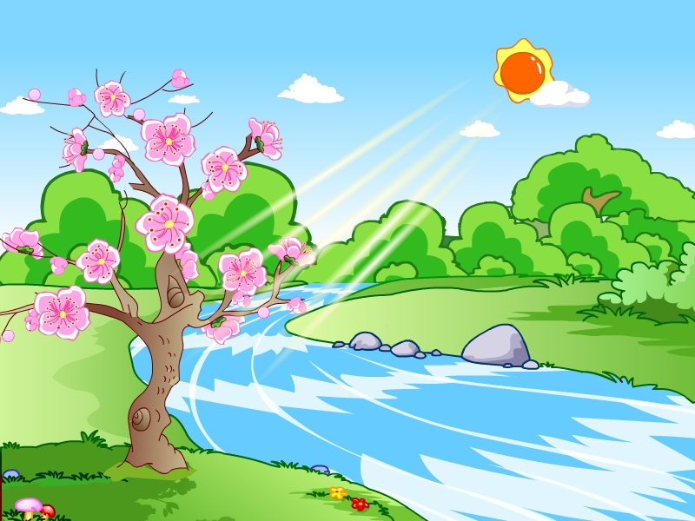

Slide 3
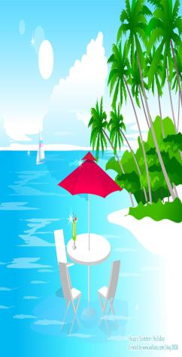
>>Lead-in
There are four in a year.
seasons
Spring is the first season.

Slide 4
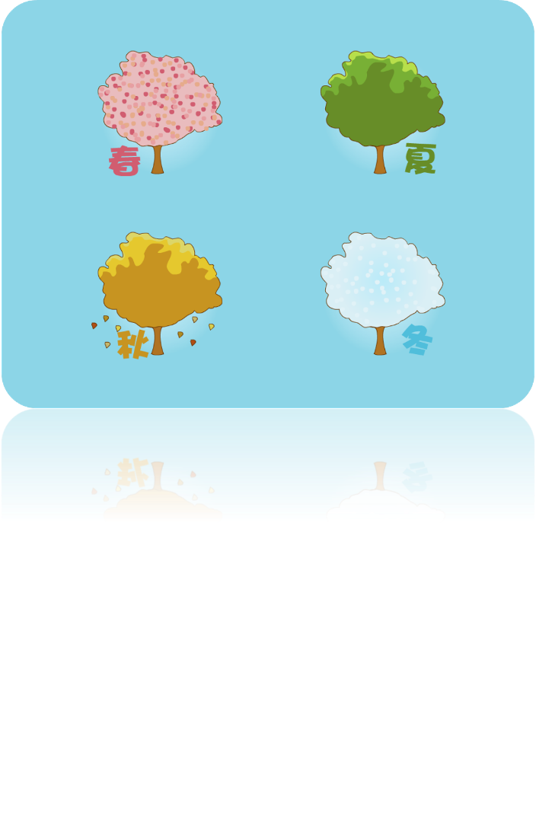
>>Presentation
Just read and talk

Slide 5
>>Presentation
Read and judge
√
A. In China, springtime begins around March.
B. In China, springtime begins around April.
A. It’s very cold in spring, and it gets colder and colder.
B. It’s still a little cold in spring, but it gets warmer and warmer.
A. The days get longer and longer in spring.
B. The days get shorter and shorter in
spring.
√
√

Slide 6
>>Presentation
In China, springtime begins around March.

Slide 7
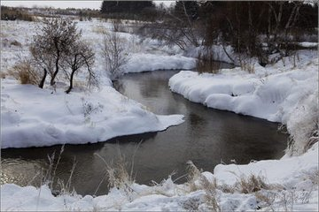
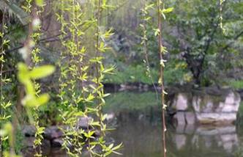
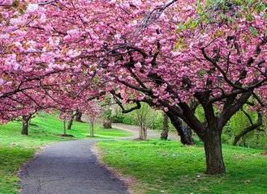
>>Presentation
It is still a little cold, but it gets warmer and warmer.
What’s the weather like in spring?

Slide 8
>>Presentation
Look and say
In spring, the days get ______ _______________, and the nights get _________________.
shorter and shorter
longer and longer

Slide 9
>>Presentation
Can you say?
warm — warmer and warmer
long — longer and longer
cold —
short —
tall —
colder and colder
shorter and shorter
...

Slide 10
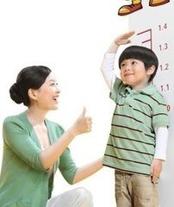
>>Presentation
Look and say
I grow ______________.
taller and taller

Slide 11
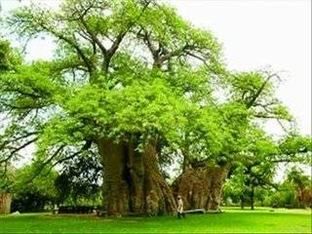
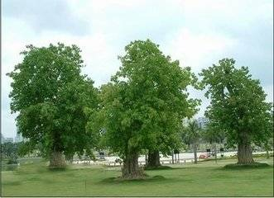
>>Presentation
Look and say
The trees are __________________.
greener and greener

Slide 12
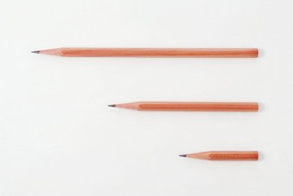
>>Presentation
Look and say
My pencil gets _______________.
shorter and shorter

Slide 13
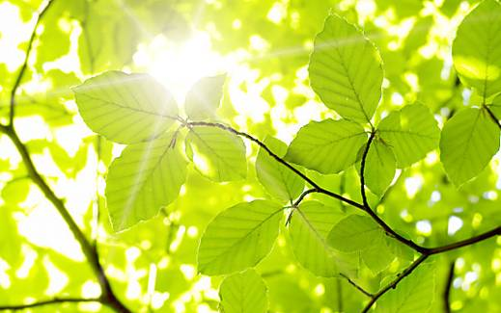
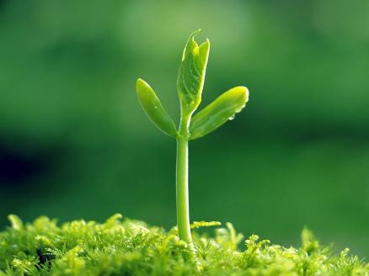
>>Presentation
Look and say
green
Spring is the _____ season.

Slide 14
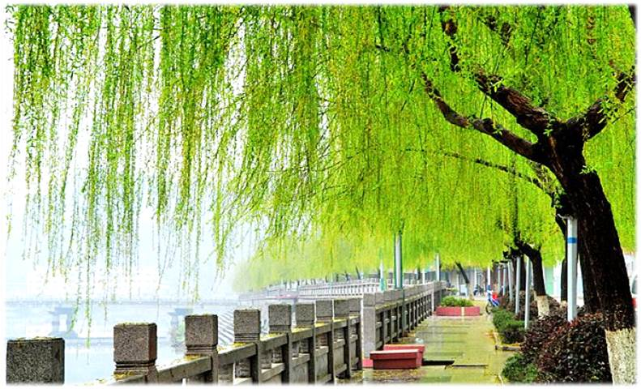
>>Presentation
The trees have new green leaves.

Slide 15
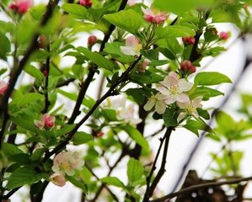
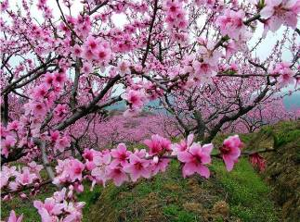
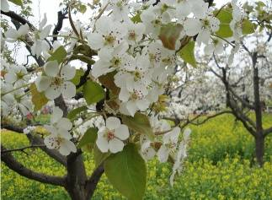
>>Presentation
Look and say
There are a lot of _______ on the trees.
flowers
apple trees
peach trees
pear trees

Slide 16
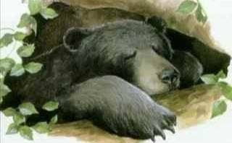
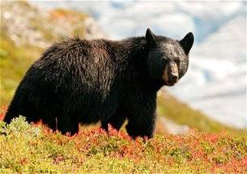
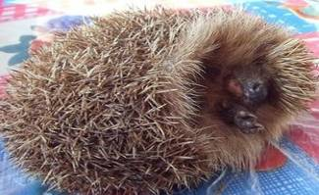
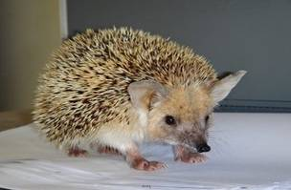
>>Presentation
Look and say
Some animals wake up from their long sleep.

Slide 17
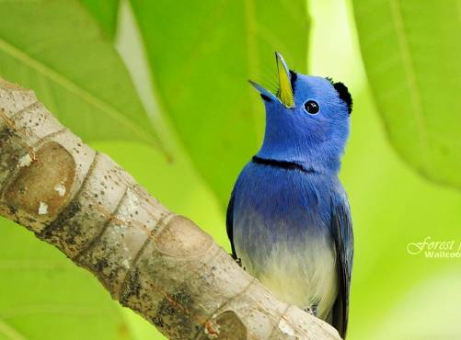
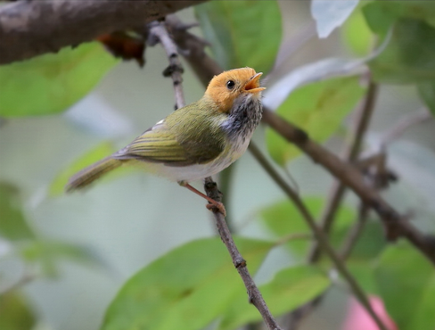
>>Presentation
Look and say
Birds
_____ sing to welcome the spring.

Slide 18
>>Practice
Read and write
What is spring like? Spring is the green ______. The trees have new _______ leaves.There are a lot of _______ on apple trees, pear trees and peach trees. Some _______ wake up from their long sleep. _____ sing to welcome the spring.
season
green
flowers
animals
Birds

Slide 19
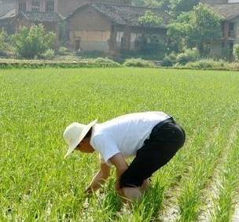
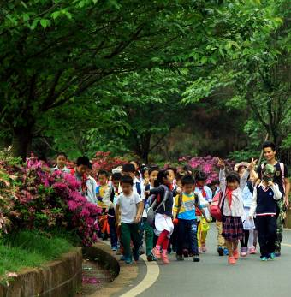
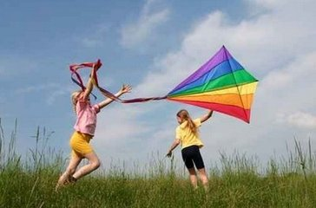
>>Presentation
Look and say
What do people do in spring?
go on spring outings
farm the land
fly kites

Slide 20
>>Practice
Can you say?
fly kites
种地
go on spring outings
放风筝
farm the land
去春游

Slide 21
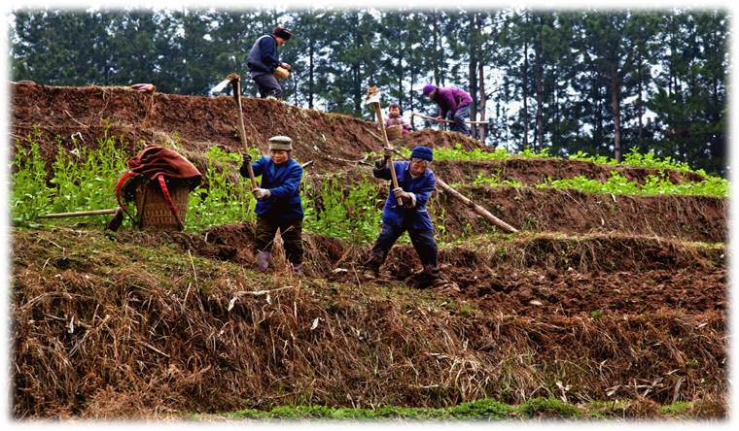
>>Practice
Look and say
Farmers are busy. They ____________.
farm the land

Slide 22
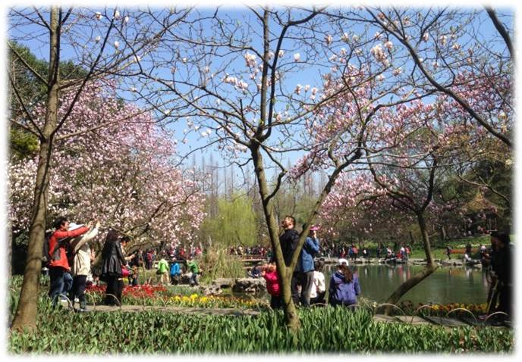
>>Practice
Look and say
go on spring outings
People __________________.

Slide 23
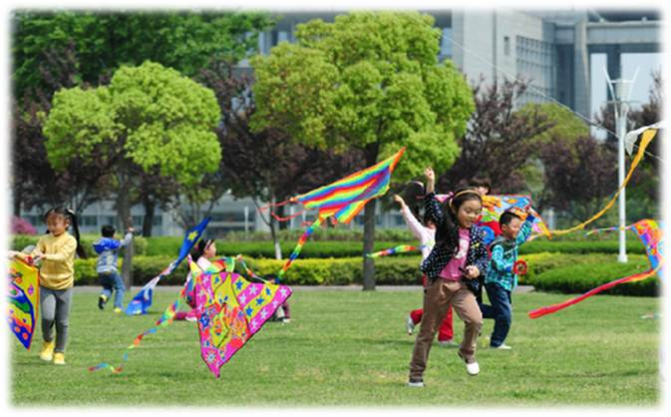
>>Practice
Look and say
fly kites
Children ________.
Everyone enjoys the spring.

Slide 24
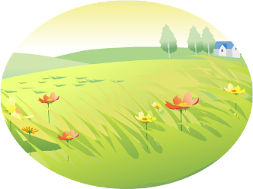
>>Practice
Just read and talk
Listen and imitate
There are four seasons in a year. Spring is the first season. In China, springtime begins around March. It is still a little cold, but it gets warmer and warmer, and the days get longer and longer.

Slide 25
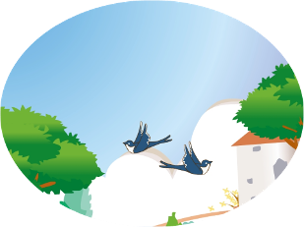
>>Practice
Just read and talk
Listen and imitate
What is spring like? Spring is the green season. The trees have new green leaves. There are a lot of flowers on apple trees, pear trees and peach trees. Some animals wake up from their long sleep. Birds sing to welcome the spring.

Slide 26
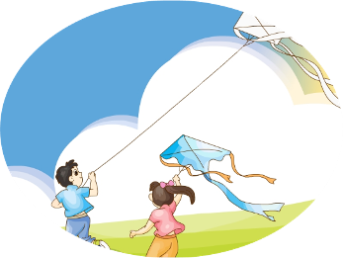
>>Practice
Just read and talk
Listen and imitate
What do people do in spring? Farmers are busy. They farm the land. People go on outings. Children fly kites. Everyone enjoys the spring.

Slide 27
>>Practice
Let’s read
Read together.
(齐读)
Read in pictures.
（分图读）
Read in groups.
(分组读）

Slide 28
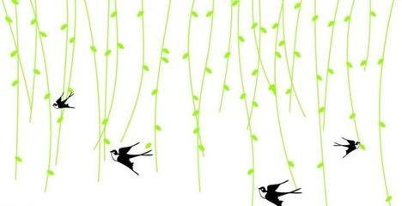
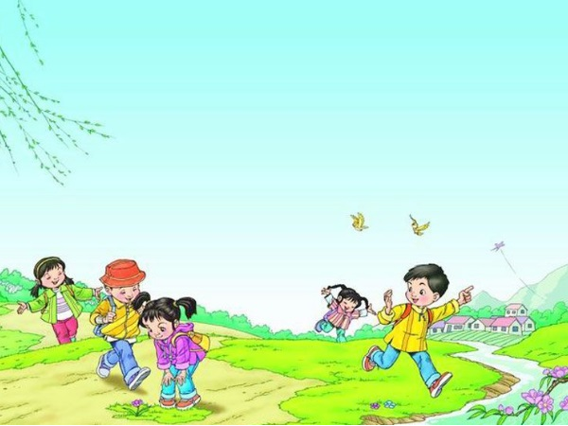

Slide 29
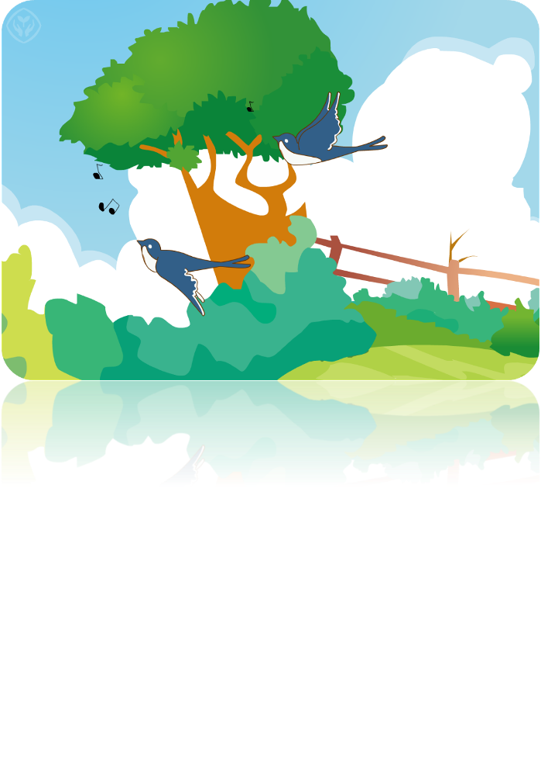
>>Practice
Let’s sing

Slide 30
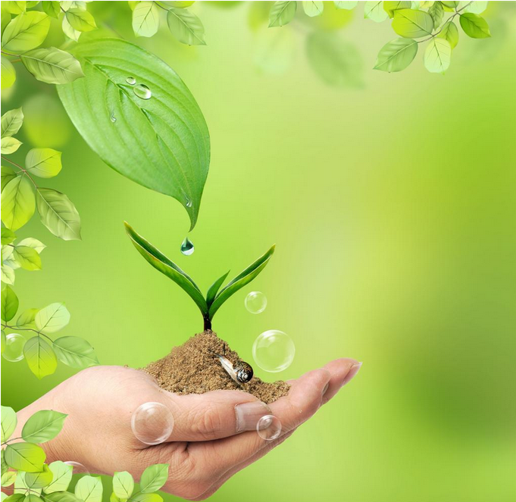
A year’s plan starts with spring.
一年之计在于春。

Slide 31
>>Homework
1.跟读课文动画或录音，按照正确的语音、语调朗读课文。 2.把本课所学到的英文歌曲唱给家人听，另外再学唱一首关于春天的歌曲。
3.预习 Lesson 33。

