Slide 1
Unit 5 Topic 3
Now it is a symbol of England.
Section B
WWW.PPT818.COM

Slide 2
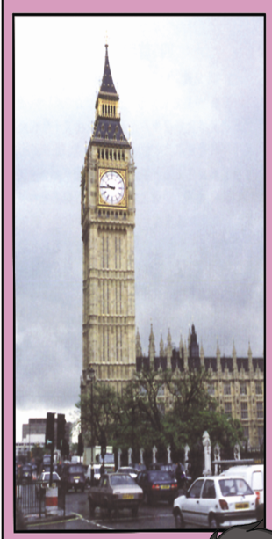
Big Ben/a clock tower/ the queen of England built so that the people
would have the same time
Big Ben is a clock tower which/that the queen of England built so that the people would have the
same time.

Slide 3
the Opera House/look like a huge sailing boat/is the pride of Australians
The Opera House which/that looks like a huge sailing boat is the pride of Australians.

Slide 4
the Statue of Liberty/
a gift from France to the USA /designed by Gustave Eiffel
The Statue of Liberty which/that is a gift from France to the USA was designed by Gustave Eiffel.

Slide 5
Gustave Eiffel/designed the Eiffel Tower/a great leader in the arts
Gustave Eiffel who/that designed the Eiffel Tower
was a great leader in the arts.

Slide 6
Make sentences by following the example.
3
not only, I , have,
Tom, but also, a car
Tom’s mine
Not only Tom but also I have a car.

Slide 7
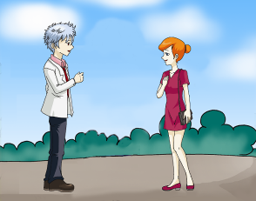
Make sentences by following the example.
3
I’m a teacher.
I’m a nurse.
neither, he , she, nor,
be, an engineer
neither…nor…
既不……也不……
Neither he nor she is an engineer.

Slide 8
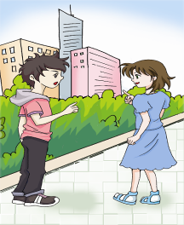
Make sentences by following the example.
3
Probably you’re wrong.
probably, you, either,
I, or, wrong, be
Probably you’re wrong.
Probably either you or I am wrong.

Slide 9
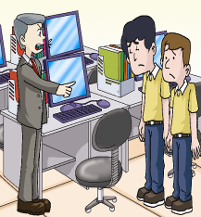
Make sentences by following the example.
3
You two are fired!
both, and, he, Jack,
fire, be
Both he and Jack are fired.

Slide 10
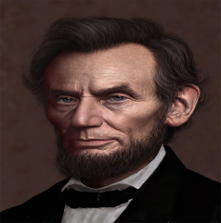
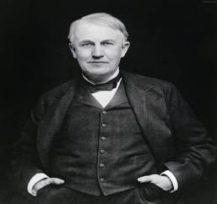
Abraham Lincoln was one of the greatest presidents of the USA.
n.镭
Marie Curie not only discovered radium but also won the Nobel Prize twice in her lifetime.
n.奖，奖励
n.一生，终生
Thomas Edison invented more than 2 000 new things, including the light bulb, the telegraph and photographic film.
adj.摄影的
n.电报

Slide 11
1b Listen to 1a and complete the table.
Name | People they admire most | Reason
Kangkang | Abraham Lincoln | ______ and no much education, never gave up, became one of the famous ___________ of the USA
Susanna | Marie Curie | ___________ radium, _____ the Nobel Prize for two times
______ | Thomas Edison | exploring ______, many great_________
poor
presidents
discovered
won
Li Ming
spirit
inventions

Slide 12
1a Look, listen and say.
动画P19-1a

Slide 13
Notes:
give up 放弃
learn …from… 向……学习
Not only did she discover radium but also she won the Nobel Prize twice in her lifetime.
当not only 位于句首时，主语和谓语要倒装.

Slide 14
1c Work in groups of three to retell the information based on 1b.
You can begin like this:
Kangkang admires Abraham Lincoln most because…
Name | People they admire most | Reason
Kangkang | Abraham Lincoln | poor and no much education, never gave up, became one of the famous presidents of the USA
Susanna | Marie Curie | discovered radium, won the Nobel Prize for two times
Li Ming | Thomas Edison | exploring spirit， many great inventions

Slide 15
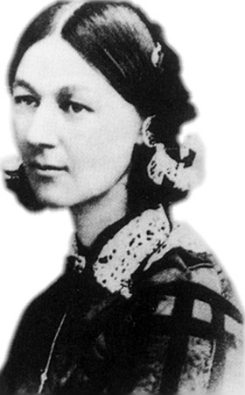
Who's she?
What do you know about her?

Slide 16
2 A. Listen to the passage about Florence Nightingale and complete the following information.
Florence Nightingale
was born in _____________ on ________.
decided to be a nurse when she was_____.
went to field hospitals to nurse the soldiers ___________.
was known as ______________.
opened the world’s first __________ after the war.
died at the age of______, in ____.
Her birthday became the International Nurse Day in _____.
a rich British family
May 12, 1820
24
during the war
“the lady with the lamp”
nursing school
ninety
1910
1974

Slide 17
B. Listen again and mark T (True) or F (False).
1. She thought helping people was both a duty and a pleasure. ( )
2. She decided to be a nurse when her parents agreed. ( )
3. She spent her money buying medicine, food, clothes, and beds for the wounded. ( )
4. She always carried a lamp in her hand when she cared for the patients at night.( )
5. She stopped serving the patients as a nurse after the war. ( )
T
F
T
T
F

Slide 18
Florence Nightingale
was born in a rich British family on May 12, 1820.
decided to be a nurse when she was 24.
went to field hospitals to nurse the soldiers during the war.
was known as “the lady with the lamp”.
opened the world’s first nursing school after the war.
died at the age of ninety, in 1910.
Her birthday became the International Nurse Day in 1974.

Slide 19
Sum up
Words:
prize n. 奖，奖励
neither pron. 两者都不
nor conj. 也不
Phrases:
give up 放弃
learn…from… 向……学习
Sentences:
Not only did she discover radium but also she
won the Nobel Prize twice in her lifetime.

Slide 20
Sum up
Grammar:
neither… nor… 两者都不；既不……也不……
not only…but also… 不但……而且……
either… or… 或……或……；
不是……就是……
以上词组连接主语时，谓语动词都要与邻近的主语单复数保持一致。

Slide 21
Homework
Read and practice the conversation.
Write down the key words of the conversation and then introduce one famous person you’ve learnt today.
Search for more information about Lincoln.

