Slide 1
Unit1 We have new friends.
人教精通版五年级上册
Lesson 4
WWW.PPT818.COM

Slide 2
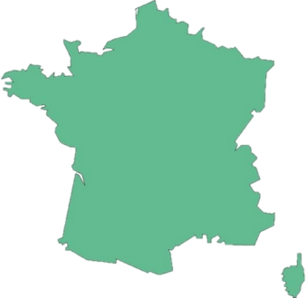
>>Review
Look and say
France
is from
Pat comes from France.

Slide 3
>>Review
Look and say
Germany
is from
Perry comes from Germany.

Slide 4
>>Review
Look and say
Name
Country
Hobby
My name is…
I’m…
I come from…
I’m from…
I like…
Zhou Pei
Pat
Perry

Slide 5
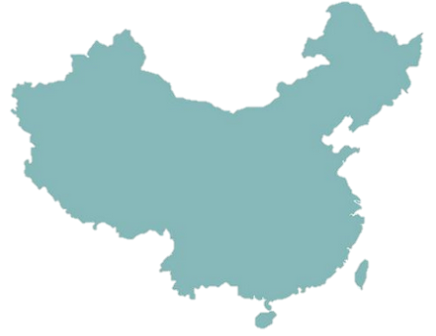
>>Presentation
Look and say
Where are you from?
I’m from China.

Slide 6
>>Presentation
Just practise
Where do you come from?
I come from France.

Slide 7
>>Presentation
Just practise
Where do you come from?
I come from Germany.

Slide 8
>>Practice
Just write
where
are
哪里
是
you
from
你，你们
从
—Where are you from?
你来自哪里？
—I’m from China.
我在来自中国。

Slide 9
>>Practice
Let’s find
I come from
I come from
I want a friend
from
I come from
I want a friend
from
I come from
I come from
I want a friend
from

Slide 10
>>Practice
Group work
句子接龙
Where do you come from?
I come from…
Where do you cone from?
I come from…
How about you?
I come from…

Slide 11
>>Practice
Let’s chant

Slide 12
>>Summary
如何询问和回答某人来自哪个国家？
1. —Where do you come from?
—I come from …
2. —Where are you from?
—I’m from …

Slide 13
>>Homework
1.观看课文动画，按照正确的语音、语调朗读课文对话。 2.在世界地图上找出中国，美国，澳大利亚，英国，加拿大，法国，德国，俄罗斯，新西兰，并用英文标注出这些国家。
3.预习 Lesson 5。

