Slide 1
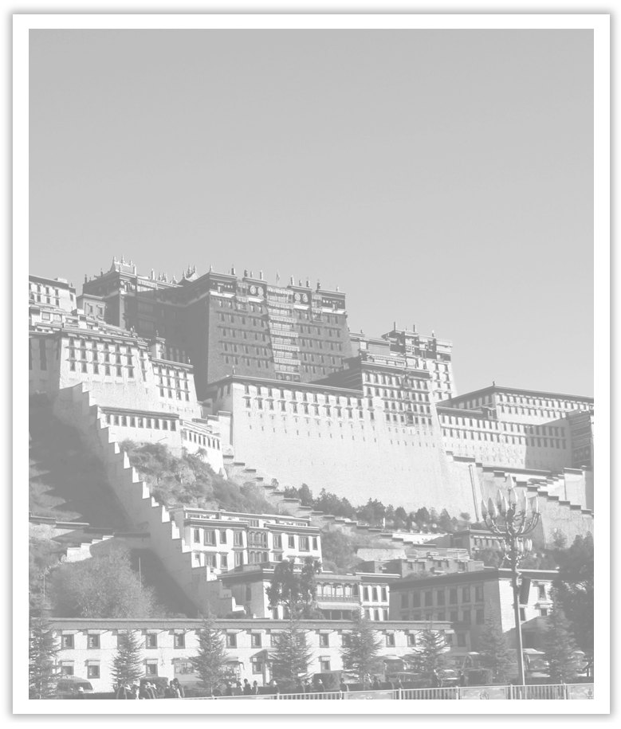
Unit 1 Cultural Heritage
Section Ⅷ Assessing Your Progress
WWW.PPT818.COM

Slide 2
Ⅰ.单词拼写
1.China is becoming a leading player in the world market of ____________ (有创造力的) goods and service.
2.Anyhow, we badly need a ____________(平衡) between study and relaxation.
3.Besides, more interest groups should be ____________ (建立) for students.
4.This morning, our class ____________ (组织) an activity of cleaning the beach and protecting the oceans.
5.She ____________(企图) to get up, but could not move one leg.
creative
balance
established
conducted
attempted

Slide 3
6.The app is really easy to use, and all songs can be ____________ (下载) to your phone for playing when offline.
7.Net Library is a library that lends out ____________ (数码的) books.
8.The ____________(传统) and customs held on this festival differ from place to place, but there are some similarity in them.
9.She has ____________(认出) the person who attacked the old woman.
10.President Xi Jinping likes to ____________(引用)great lines or phrases from Chinese and foreign classics.
downloaded
digital
traditions
identified
quote

Slide 4
Ⅱ.单句语法填空
1.More and more young people are thinking ____________ (creative) to make their dreams come true.
2.There is a strong probability that Mr.Brown will ____________ (promote) next week.
3.The chairperson received about three hundred ____________ (apply) to join the Bird Watching Club.
4.He’s got himself into a dangerous situation where he is likely ____________ (lose) control.
5.The UN said that sand is not ____________ (limit) and that we might be running out of it.
creatively
be promoted
applications
to lose
limitless

Slide 5
6.The school is just ____________ walking distance of my house.So I am never late for school.
7.It is being discussed whether it is worthwhile to ____________ (preserve) temples like this at such high costs.
8.The news that our team won the champion soon found its way ____________ the country.
9.No sooner had she apologized than he ____________ (forgive) her.
10.It is not enough to have great ____________(quality)，and we should also have the management of them.
within
preserve
throughout
forgave
qualities

Slide 6
Ⅲ.选词填空
take part in, give way to, turn to, lead to, keep balance, make a proposal, prevent...from..., donate...to...
1.It’s hard to ________________ on just one foot.
2.He ________________ that the problem be discussed at the meeting.
3.To the west, the limestone ________________ a variety of rocks.
4.Farmers have ________________ keeping deer because it can make a lot of money.
5.Modern science has given clear evidence that smoking can ________________ many diseases.
keep balance
made a proposal
gives way to
turned to
lead to

Slide 7
6.We ________________ a voluntary activity organized by our school last Sunday.
7.We ________ some money and clothing ________ the children whose parents were killed in the earthquake.
8.The disease ________ the blood ________ circulating freely, which will cause deaths quickly.
took part in
donated
to
prevents
from

Slide 8
Ⅳ.根据提示用定语从句补全下列句子
1.The man _________________________________(昨天参观我们学校的) is from London.
2.He talked about a hero _____________________________ (没有一个人听说过的).
3.Nearby were two boats _________________________________________________(他们来这个岛屿时乘坐的).
4.My grandfather never forgets the day ______________________________________(他被接纳入党的).
5.The story ______________________________ (这个著名作家讲的) was very long.
who visited our school yesterday
of whom no one had ever heard
by which they had come to the island
when he was admitted into the Party
which was told by the famous writer

