Slide 1
Unit 8
A green world
Grammar
WWW.PPT818.COM

Slide 2

Objectives
To learn to form the passive voice in the simple future tense
To learn to use the passive voice in the simple future tense

Slide 3
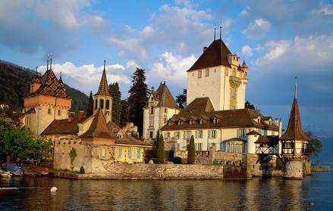
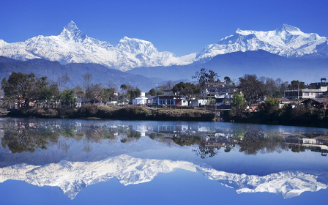
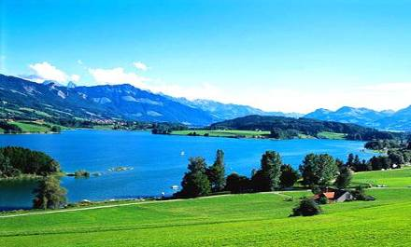
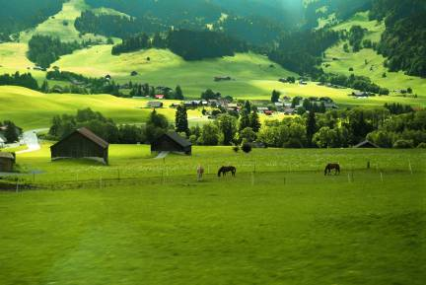
Switzerland is a beautiful country with high mountains and clean blue lakes.

Slide 4
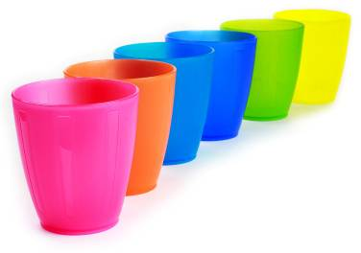
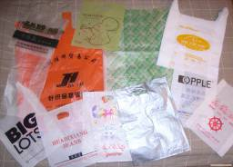
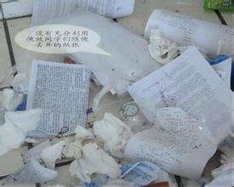
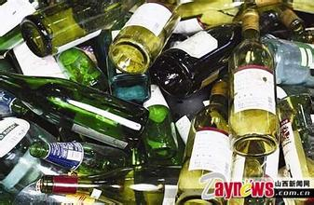
In Switzerland what do people do with the things like
plastic,paper and glass?

Slide 5
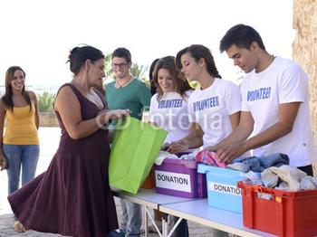
How do they deal with the old clothes in Switzerland?

Slide 6
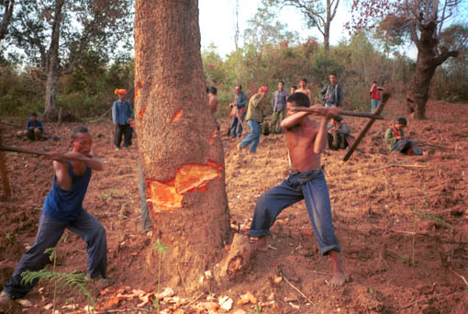
In Switzerland ,if you cut down trees, what will happen?

Slide 7
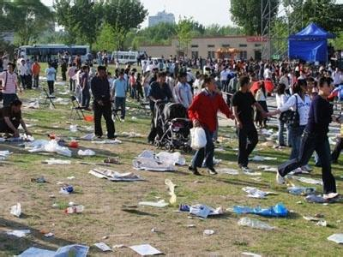
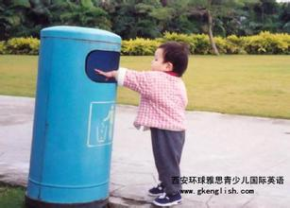
If you drop in the public place, what will be the result?

Slide 8
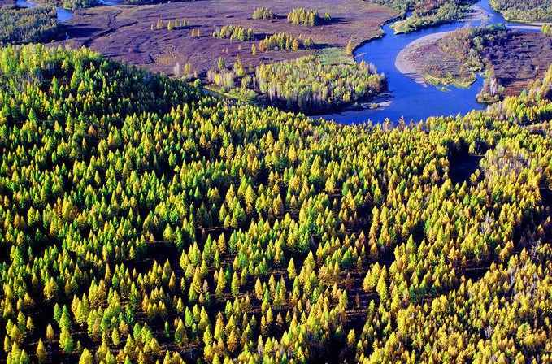
What do they think of rich resources in our country?

Slide 9
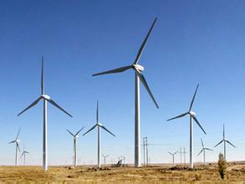
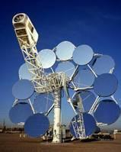
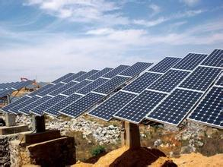
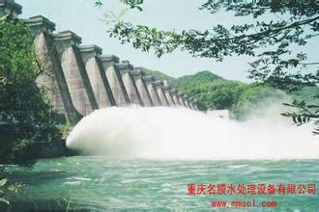
What kind of energy do the Swiss use?

Slide 10
1.In Switzerland, things like plastic, paper and glass are separated into different groups and then recycled.
2.Some of the old clothes are sold in charity shops,some are given to the poor,and others
are sent to factories for recycling.
3.If we cut down trees,we will be punished.
4.If we drop litter in the public place,we will be fined.
5.The energy of the sun,wind and water will be used widely in the future

Slide 11
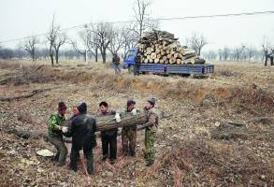
被动语态的一般将来时
You will be punished if you cut down a tree.

Slide 12
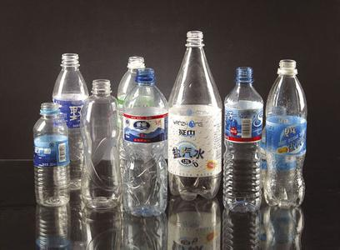
These bottles will be recycled to make new things.

Slide 13

We use the passive voice in the simple future tense when the action has not taken place yet.

Slide 14
被动语态的一般将来时用来描述将要发生的动作。如:
He will be taken/is going to be taken to hospital in a few minutes.
他几分钟之内就会被送到医院。
The food will be eaten /is going to be eaten by the dog soon.
这些食物马上就会被狗吃掉。

Slide 15
被动语态的一般将来时的构成
主语 | will be/ be going to be | 过去分词
I | will be /am going to be | supported.
You /We /They | will be /are going to be
He /She/It | will be /is going to be
注意: 主语是第一人称时, 被动语态的一般将来时也可以用“shall be + 动词的过去分词”来表达。

Slide 16
时态 | 肯定形式 | 否定形式 | 疑问形式
一般将来时
S+will be
+done
S+will not
be+done
Will+ S
+done?
S+am/is/are going to be done
S+am/is/are
not going to
be done
Am /Is/Are
+S+going to
be done?

Slide 17



The students are talking about Environment Week. Help them make sentences using passive voice
activities / in Environment Week / a lot of / organize / are going to
A lot of activities are going to be organized in Environment Week.

Slide 18


design / posters / will / by Sandy
Posters will be designed by Sandy.

Slide 19


to all the people / send / leaflets / in the town / will
Leaflets will be sent to all the people in the town.

Slide 20


are going to / hold /some of the activities / in the town square
Some of the activities are going to be held in the town square.

Slide 21
Lisa is telling her cousin Harry about a show that will be held in this Environment Week on the phone. Help Lisa answer Harry’s questions using the passive voice.
Lisa: Hi, Harry. There’s going to be an environment show here.
Harry: Really? When is the show going to be held?

Slide 22
The show is going to be held this Friday evening.
Lisa: (1) ____________________________
________________ (this Friday
evening)
Harry: Will the show be held at your
school?(where)
Lisa: No, (2)_________________________
__________. (at the town hall)
Harry: Who will be invited to the show?
The show will be held at the
town hall

Slide 23
Lisa: _______________________________
_______________________ (some famous people in our town)
Harry: What will be displayed at the
show?
Lisa: (4)_____________________________
_____________________________
_____________ (videos about the
past and present of Sunshine Town)
Some famous people in our town will be invited to the show.
Videos about the past and present of Sunshine Town will be displayed at the show.

Slide 24
Harry: What will be discussed at the show?
Lisa: (5) ____________________________
____________________________
_________ (ways about how to
protect the environment)
Ways about how to protect the environment will be discussed at the show.

Slide 25
Make a dialogue
A class meeting ----How to review our lessons more efficiently
When---next Monday
Where---in Class 7,Grade 8
Who---physics/Chinese/math teacher…
What activities--- ?

Slide 26
对比三种时态的被动结构：
时态 | 主动语态 | 被动语态
一般 现在时
一般 过去时
一般 将来时
do/does
is/am/are+done
did
was/were+done
will/
be going to do
will be done
be going to be done

Slide 27
下面让我们来看一下被动语态的疑问和否定形式该如何表达呢？
时态 | 肯定形式 | 否定形式 | 疑问形式
一般 现在时
S+
am/is/are
+done
S+am/is/are
+not+done
Am/Is/Are
+S+done?

Slide 28
时态 | 肯定形式 | 否定形式 | 疑问形式
一般 过去时
一般将来时
S+
was/were
+done
S+
was/were
+not+done
Was /Were
+S+done?
S+will be
+done
S+will not
be+done
Will+ S
+be+done?
S+am/is/are going to be done
S+am/is/are
not going to
be done
Am /Is/Are
+S+going to
be done?

Slide 29


实战中考
1. A Disneyland Park ___ in Shanghai Pudong New Area in the near future. (上海市)
A. builds B. has built
C. will build D. will be built
2. A new factory is being built in Neijiang. I hope it _____ at the end of this year.
(四川省内江市)
A. will be finished B. finishes
C. will finish D.is going to finish

Slide 30
3. —It’s said that an airport _____ in Yangzhou.
—It’s true. That’s what we are getting excited about these days.
(江苏省扬州市)
A. builds B. will build
C. is building D. will be built
4. Tomorrow there’s a programme about
our school on TV. Then it _________ by
millions of people. (辽宁沈阳)
A. will see B. saw
C. will be seen D. was seen

Slide 31
Pollution
II. Kitty is writing an article about pollution. Help her complete the article using the passive voice.
Pollution is one of the biggest problem in the world today. In many places, rubbish (1)___________ (throw) into lakes and rivers, so many of them (2)____________ (pollute).
is thrown
are polluted

Slide 32
In some cities, the air (3)________ (fill) with pollution. This makes people ill, and more people (4)_____________ (hurt) in the future if it is not cleaned up.
As well as people, animals (5)___________ (harm) by pollution. Land and water pollution kills many animals every year. If we do not act to improve the environment,
is filled
will be hurt
are harmed

Slide 33
more living things (6)____________ (kill) by pollution.
However, there is some good news. A show (7)___________ (hold) at the town hall this Friday evening. All of us will have a chance to think about the world around us. On that day, we (8)_____________ (show) how to protect the environment.
If we work together, we can make the world a better place.
will be killed
will be held
will be shown

Slide 34
III Translation
1.More young people will be invited to
join this year’s evening party.
2.This magazine will be returned to the
library in a week.
3.Two libraries will be built in our
hometown.
4.Where will the fridge be bought by them?
5.When will these plants be protected?

Slide 35



巩固练习
Complete the passage with the correct form of the words.

Slide 36
is held
The World cup _________(hold) every 4 years.In 1950 the FIFA _______(hold)in Brazil.It ___________(hold )there this year.It __________(hold) on June 13th.It ______________(last)about a month.
was held
will be held
will be held
lasts/will last

Slide 37
The World Cup __________(consider)the most popular sporting events in the world.The team must ________(take) part in elimilation games within their own continents before it ________(qualify) to become one of the 32 nations in the final.
is considered
take
is qualified

Slide 38
Brazil is the most successful world cup team.It ________(win) the tournamt 5 times.World cup trophy _______(weigh)4.97kilos.It _________(make) of pure gold.
It’s a pity that Chinese football team __________(take) part in it only once.We hope they ________(see) in the World Cup in the future.
has won
weighs
is made
has taken
will be seen

Slide 39
Millions of people around the world (1) _________ (watch) the last Olympic Games. And the next Olympic Games (2)____________ (see) by millions more. Some stars of the last Olympics (3) ______________ (train) at special schools. Special programme was set up help them.
watched
will be seen
were trained

Slide 40
There, students’ performance (4) _____________ (record) and (5) ___________ (compare) with the world's beat sports stars. The coaches (6) _______ (use) the information to chaining programmes, The same programmes (7) ______ also _______ (help) to make the stars of the future.
was recorded
compared
used
will
help

Slide 41

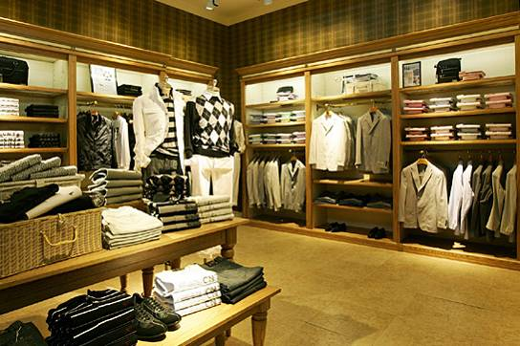
display vt. & vi. 展示; 陈列

Slide 42
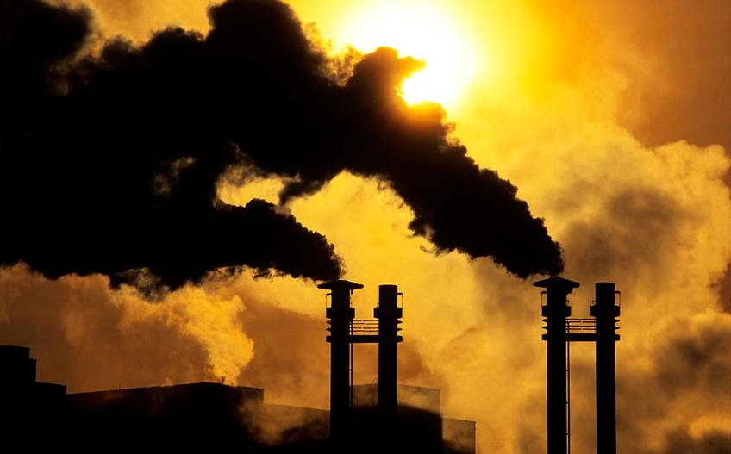
pollute vt. 污染

Slide 43
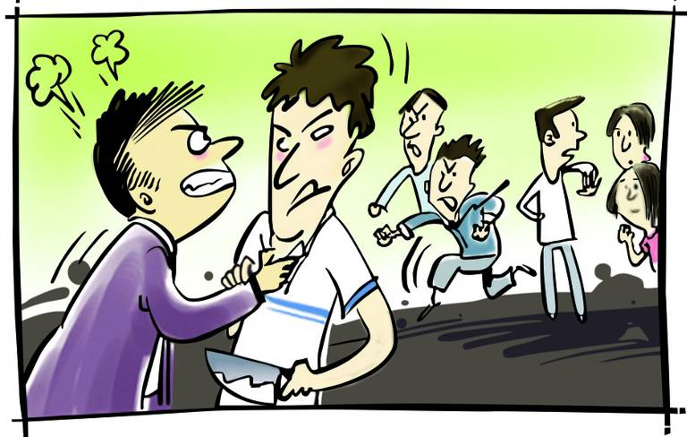
harm vt. 伤害; 损害

Slide 44
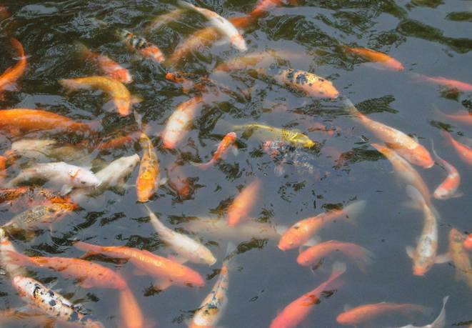
living adj. 活着的, 活的

Slide 45

I. 根据句意及括号内所给动词的提示填空。
1. A cat __________ (keep) in my grandmother’s house.
2. The concert __________ (hold) last
Friday evening.
3. Jane was made _________ (work) ten
hours a day.
is kept
was held
to work

Slide 46
4. A new hospital _________________ ______ (build) in our city next year.
5. More than 50 trees ________________ (plant) next month.
6._____all the money________________
(spend) on the new house by the couple next year?
will / is going to be
built
Will be planted
Will
be going to be spent

Slide 47
1. Review the contents of this lesson.
2. Finish the exercises in the workbook.
3. Preview the next lesson.

