Slide 1
Unit 1 Friends
Reading 1
WWW.PPT818.COM

Slide 2
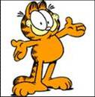
Qualities of my friend
She’d like to share everything with her friends.
generous
I can tell her anything
and she keeps my secrets.
a true friend

Slide 3
She can always help me with my problems. I can go to her when I am in trouble.
helpful
She is willing/ready to help me any time
PPT模板：www.1ppt.com/moban/ PPT素材：www.1ppt.com/sucai/
PPT背景：www.1ppt.com/beijing/ PPT图表：www.1ppt.com/tubiao/
PPT下载：www.1ppt.com/xiazai/ PPT教程： www.1ppt.com/powerpoint/
资料下载：www.1ppt.com/ziliao/ 范文下载：www.1ppt.com/fanwen/
试卷下载：www.1ppt.com/shiti/ 教案下载：www.1ppt.com/jiaoan/
PPT论坛：www.1ppt.cn PPT课件：www.1ppt.com/kejian/
语文课件：www.1ppt.com/kejian/yuwen/ 数学课件：www.1ppt.com/kejian/shuxue/
英语课件：www.1ppt.com/kejian/yingyu/ 美术课件：www.1ppt.com/kejian/meishu/
科学课件：www.1ppt.com/kejian/kexue/ 物理课件：www.1ppt.com/kejian/wuli/
化学课件：www.1ppt.com/kejian/huaxue/ 生物课件：www.1ppt.com/kejian/shengwu/
地理课件：www.1ppt.com/kejian/dili/ 历史课件：www.1ppt.com/kejian/lishi/
She is good at telling jokes.
She often makes us laugh.
funny
She has a good sense of humour.
humourous

Slide 4
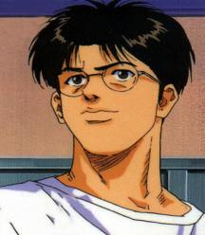
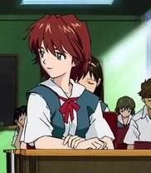
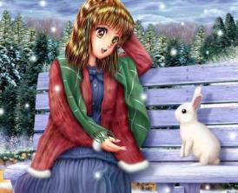
Appearance of friends:
Wear small round glasses
short hair
straight hair
P9 B1

Slide 5
Name：
Looks: 1.________
has 2. _________ hair
Personality:3._________ and helpful
slim
short
generous
Name：
Looks: the 4._________in his class
wears small round 5.________
Personality:has a good sense of 6._______
tallest boy
glasses
humour
Name：
Looks: has big 7._______ eyes
has long8.________hair
Personality:9.___________ can keep a 10.______
bright
straight
a true friend
secret

Slide 6
Betty ‘T’ or ‘F’
F
Betty is very fat.
Betty is willing to help others any time.
She likes to share things with her friends.
4. She only gives seats to old men in need
on the bus.
5. She wants to be a dancer when she grows up.
T
T
F
F

Slide 7
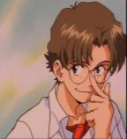
Max Answer some questions:
How tall is Max?
Does Max wear glasses? How does he look ?
3. When we are with Max, How do we feel? Why?
4. Do his legs fit well under the school desks?
What happens to him when he walks past the desk?
Almost 1.75 metres tall.
Yes. He looks smart.
We never feel bored. He tells funny jokes.
No. He often knocks our books and pens onto the floor.

Slide 8
May Fill in the blanks
May is shorter than me. She has _________ hair. Everyone thinks she is very ______.
May is a ____ friend. When something
_______ me, I can always go to her. I can tell her ________ because she can ____ a ______.
She ____ often and never ______________
about anyone.
straight
pretty
true
worries
anything
keep
secret
smiles
says a bad word
P9 B2

Slide 9
Part B2 True or false:
Betty is generous to old people only.
Betty wants to be a singer in the future.
Max looks smart in his small round glasses.
Max is not good at telling jokes.
May is sweet and pretty.
May likes to say bad things about her friends.
everyone
F
T
T
very
F
T
never says
F

Slide 10
Part B4
1.worries
2.keep a secret
3.tell funny jokes
4.feel bored
5.share
6.ready to help

Slide 11
Who would you choose as your best friend， …?---I’ll choose Betty.
Why?---Because she is generous and helpful.
What does he/she look like?
----She is slim and she has short hair.

