Slide 1
Unit 8 It must belong to Carla.
Section A Period 2 3a-4c
WWW.PPT818.COM
Notes:
1
1

Slide 2
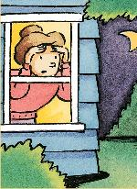
Look at the picture and answer the two questions.
1. What can you see in the picture?
2. What can we know about the woman?
There is a woman looking out of the window.
She is a little worried.
She might …

Slide 3
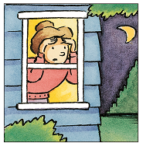
Reading
Read the article and decide which might be the best title.
3a
A. A Small and Quiet Town
B. Strange Happenings in My Town
C. Animals in Our Neighborhood

Slide 4
We live in a small town and almost everyone knows each other. It used to be very quiet. Nothing much ever happened around here. However, these days, something unusual is happening in our town. Victor, a teacher at my school, is really nervous. When he was interviewed by the town newspaper, he said, “Every night we hear strange noises outside our window.

Slide 5
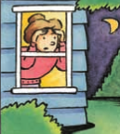
My wife thinks that it could be an animal, but my friends and I think it must be teenagers having fun. My parents called the policemen, but they couldn’t find anything strange. They think it might be the wind. I don’t think so!”

Slide 6
Victor’s next-door neighbor Helen is worried, too. “At first, I thought that it might be a dog, but I couldn’t see a dog or anything else, either. So I guess it can’t be a dog. But then, what could it be?” One woman in the area saw something running away, but it was dark so she is not sure. “I think it was too big to be a dog,” she said. “Maybe it was a bear or a wolf.”

Slide 7
Everyone in our town is feeling uneasy, and everyone has his or her own ideas. There must be something visiting the homes in our neighborhood, but what is it? We have no idea. Most people hope that this animal or person will simply go away, but I do not think that is going to happen. The noise-maker is having too much fun creating fear in the neighborhood.

Slide 8
3b
Read the article again and find words to match the meanings.
teenagers, neighbor, neighborhood, noise-maker, wolf, uneasy
nervous or worried _________
young people _________
person in the next house __________
area where people live ____________
animal like a very large dog _______
person who makes noise __________
uneasy
teenagers
neighbor
neighborhood
wolf
noise-maker

Slide 9
3c
Read the article carefully and write what people think about the strange noises.
Who gave opinions? | What are the opinions?
Victor’s wife | She thinks that it could be an animal.
Victor and his friends
They think it must be teenagers having fun.

Slide 10
The policemen
Helen
One woman in the area
The writer himself
They think it might be the wind.
She guesses it can’t be a dog.
She thought that maybe it was a bear or a wolf.
He thinks the noise-maker is having too much fun creating fear in the neighborhood.

Slide 11
Language points
1. It used to be very quiet.
used to do sth. 曾经，过去常常做
某事（现在不做了）
be used to do sth. (=be used for doing sth.) 被用来做某事
be used to doing sth. 习惯于做某事

Slide 12
1.我曾经在这个学校学习。
I ____ ____study in this school.
2. 我们的父母习惯了居住在山村。
Our parents ___ ___ ____living in the village.
3. 这个箱子是被用来储存玩具的。
This box ___ ____ _____storing toys.
= This box ____ ____ _____store toys.
used to
are used to
is used for
is used to

Slide 13
2. However, these days, something
unusual is happening in our town.
构成：不定代词+形容词
（定语后置）
eg: 一些重要的事情 something important
一些有趣的事 something interesting
happen为不及物动词，意为“发生；碰巧”，指事情的发生带有一定的偶然性或不能预料。

Slide 14
3. One woman in the area saw something running away...
see sb. doing sth. 看见某人正在做某事
（强调动作正在发生）
see sb. do sth. 看见某人做某事
（强调发生的整个过程）
类似短语：
一听 listen to, hear
二看 watch, notice, see

Slide 15
4. The noise-maker is having too much
fun creating fear in the neighborhood.
have fun doing sth. 做某事愉快
=have a good time doing sth.
=enjoy oneself doing sth.
eg：我享受放风筝的乐趣。
I have fun flying kites.

Slide 16
Grammar Focus
Fill in the blanks.
1. 这是谁的排球?
______ ________ is this?
这一定是卡拉的。她热爱排球运动。
It _____ be _______. She loves volleyball.
Whose volleyball
must Carla’s

Slide 17
2. 这是谁的发带？
______ ____ ____ is this?
它可能是梅的发带。或者可能属于琳达。她们两人都是长头发。
It _____ be Mei’s hair band. Or it _____ belong to Linda. They ____ have long hair.
Whose hair band
could
might
both

Slide 18
3. 那晚你看见了什么？
_____ did you see that night?
我不确定，但肯定不可能是狗。它更大。我想也许是一头熊或一匹狼。
I’m ___ ____, but it _____ ___ a dog.
It was bigger. I think it _____ ___ a bear or a wolf.
What
not sure
can’t be
might be

Slide 19
可能性: must> can/could > may/ might
否定
否定
may not / might not
can not ( can’t)
could not(couldn’t)

Slide 20
情态动词表推测：
1）肯定句： must 一定
could / may / might 可能
2）否定句： can’t / couldn’t 不可能
may not / might not
可能不……
3）疑问句： Can/ Could …?
可能……吗？

Slide 21
4a
Choose the best way to complete each sentence using the words in brackets.
1. A: Where’s Jean?
B: I’m not sure. She ________ (is/ might be/ must be) in the laboratory.
might be
n. 实验室
2. A: Everyone is going to the pool after school.
B: Really? It _______ (must be / can’t be /could be ) hot ________.
must be
outdoors
adv. 在户外，在野外

Slide 22
3. A: That’s the phone.
B: Hmm. I wonder who it _______ (must
be / could be / should be).
could be
4. A: I wonder if these are Jim’s glasses.
B: They _______ (can’t be / might be /
could be) his. He doesn’t wear glasses.
can’t be
5. A: I hear water running in the bathroom.
B: It ________________ (could be / must be / can’t be) Carla. She was __________ taking a shower.
could be/ must be
thinking of

Slide 23
4b
Complete these responses.
n. 外套
1. A: Many people are wearing coats.
B: The weather must be _____________
____________.
2. A: Sally has been coughing a lot.
B: She might be ____________________.
getting colder/ cold outside
having a sore throat/ ill

Slide 24
3. A: This restaurant is always very
crowded.
B: The food ________________.
4. A: Whenever I try to read this book,
I feel sleepy.
B: It can’t _________________.
must be delicious
adj. 困的
be very interesting

Slide 25
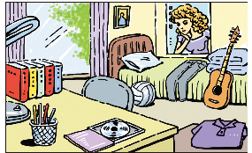
4c
Look at this picture of a room. How much can you tell about the person who lives here? Is it a boy or a girl? What are his/her hobbies? Discuss your ideas with a partner.

Slide 26
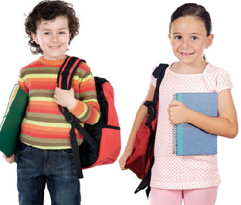
It could be a girl’s room
because it’s very tidy.
I guess so. But it might be a boy’s room because the clothes look like boys’ clothes.

Slide 27
Choose the correct answer.
1. — Excuse me. Is this the right way to the Summer Palace?
— Sorry, I am not sure. It _____ be.
A. might B. will
C. must D. can
___

Slide 28
2. — Isn’t that Ann’s husband over there?
— No, it _____ be him. I’m sure he doesn’t wear glasses.
A. can’t B. must not
C. won’t D. may not

Slide 29
3. You ____ be tired . You’ve only been working for an hour.
A. must not B. won’t
C. can’t D. may not

Slide 30
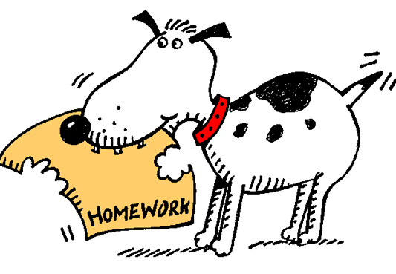
Homework
1. Recite the text on Page 59.
2.Finish the exercise in the workbook.

