Slide 1
Unit2
Great people
WWW.PPT818.COM

Slide 2
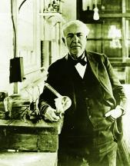
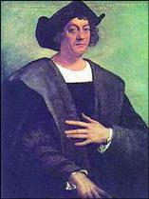
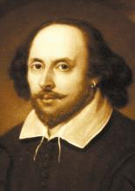
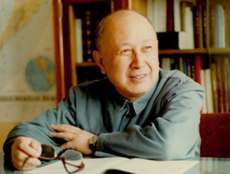
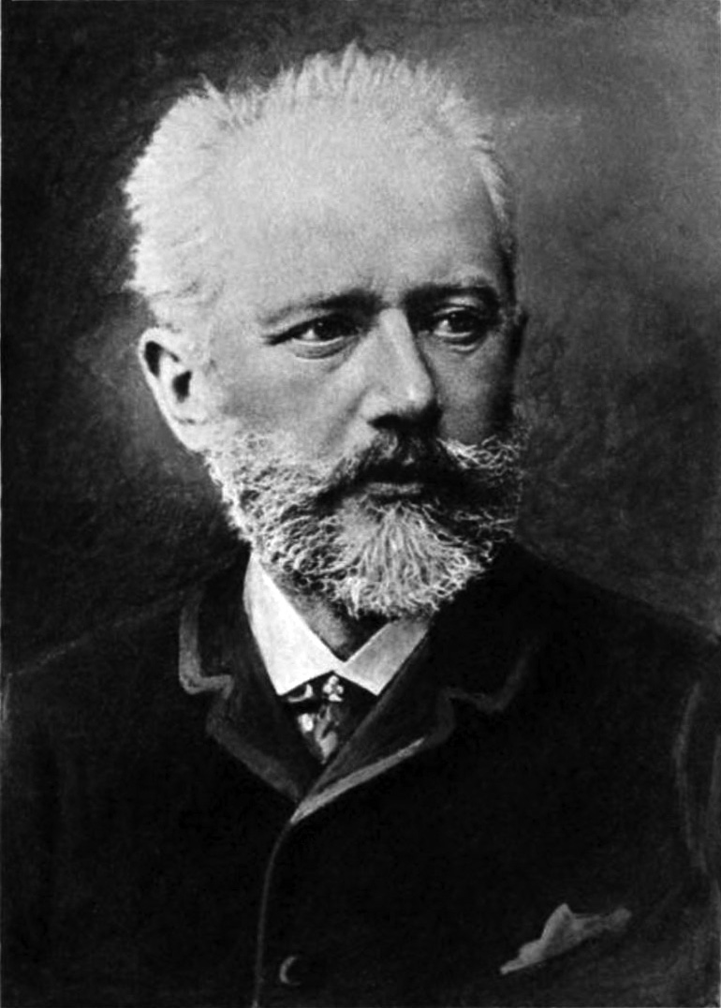
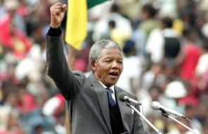
inventor
explorer
writer
president
scientist
composer

Slide 3
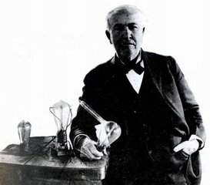
Thomos Edison
托马斯.爱迪生
American
an inventor
发明 v.
一个发明家
发明 n.
发明了一千多种发明
invented over 1,000 inventions

Slide 4
New words
inventor n.
发明者
invent v.
发明
invention n.
发明物；创意

Slide 5
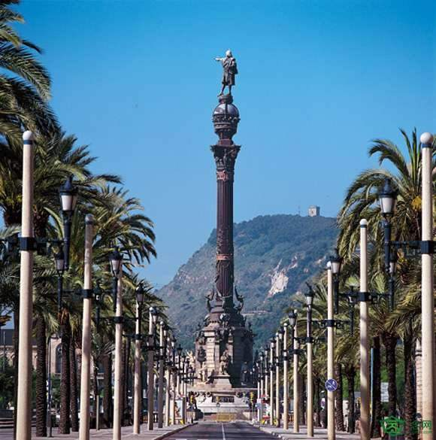

Slide 6
New words
explorer n.
探险者；考察者
Italian n.
意大利人
European n.
欧洲人

Slide 7
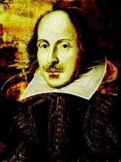
a writer
一个作家
English
英国文学的一个伟大作家
a great writer of English literature
William Shakespeare
威廉. 莎士比亚

Slide 8
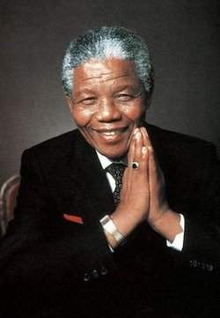
Who is he ?

Slide 9
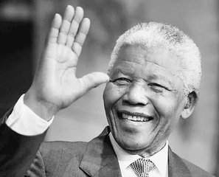
a president
一个总统
South African
Nelson Mandela
一生为争取非洲黑人权利的斗士
尼尔森. 曼德拉
a fighter for the rights of black Africans all his life
斗士

Slide 11
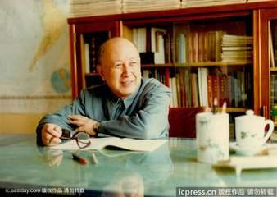
a scientist
一个科学家
Chinese
Qian Xuesen
钱学森
中国航空技术项目的先驱
the pioneer of China’s space technology programme

Slide 12
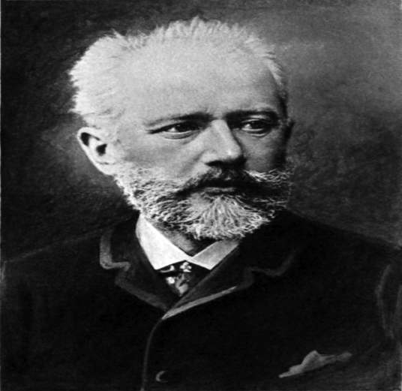
Peter Tchaikovsky
彼得.柴可夫斯基
a composer
一位作曲家
Russian
一位古典音乐的作曲家
a composer of classical music

Slide 13
Finish Part A and B. Then answer together.
Name | Job (A) | What he did (B)
Columbus
Shakespeare
Qian Xuesen
Edison
Mandela
Tchaikovsky
explorer
Italian, one of the first Europeans to discover America
English , a great writer of English literature
writer
scientist
Chinese, the pioneer of China’s space technology programme
American, created over 1,000 inventions
inventor
president
South African, a fighter for the rights of black Africans all his life
composer
Russian, a composer of classical music

Slide 14
Comic Strip

Slide 15
Listen and answer
1.Who does Eddie think is the greatest person in the world?
2.Does Hobo know who Paul Yum is?
3. Who is Paul Yum?
Paul Yum. [pɔ:l ‘jʌm]
No, he doesn’t.
He invented Eddie’s favourite food.

Slide 16
Read and Learn
invent 发明
an inventor 发明者
invention 发明物
an explorer 探险者
Italian 意大利人
European 欧洲人
literature 文学
South African 南非人
fighter 斗士
pioneer 先锋
Russian 俄罗斯人
composer 作曲家
classical 古典的

Slide 17
文中短语
1.创造了1000多项发明
create over 1000 inventions
2.第一批发现美洲的欧洲人之一
one of the first Europeans to discover America
3.英国文学的一个伟大作家
a great writer of English literature

Slide 18
4.一生为争取非洲黑人权利的斗士
a fighter for the rights of black Africans all his life
5.中国航空技术项目的先驱
the pioneer of China’s space technology programme
6.一位古典音乐的作曲家
a composer of classical music

Slide 19
文中短语
7.有史以来最伟大的人
the greatest person in history
8.我从未听说过他
I have never heard of him.
9.许多人改变了我们生活的方式
Many people have changed the way we live.

Slide 20
Complete the sentences
explorer
Columbus is the first _________ (探险家) in Europe to discover America.
Mandela is a _____(斗士) for the rights of black Africans.
Many young students don’t like ______ (古典的) music.
Chinese people ___________ (发明) paper.
He was the ________ (先锋) of China’s space technology programme.
.
fighter
classical
invented
pioneer

Slide 21
Homework
Remember the new words and stories .
Learn from the great people.

