Slide 1
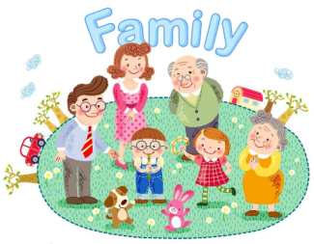
Unit2 My Family
陕旅版
三年级下册
第一课时
WWW.PPT818.COM

Slide 2
>>Review
One—Ten
Activity 1
One
three
…
two
four

Slide 3
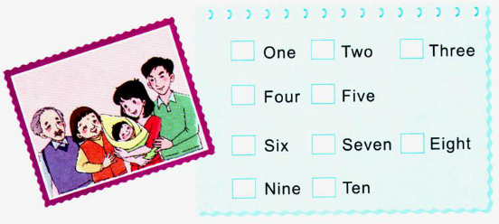
>>Lead-in
Think and tick
How many people are there in your family?

Slide 4
>>Presentation
Let’s learn
Look at this family.

Slide 5
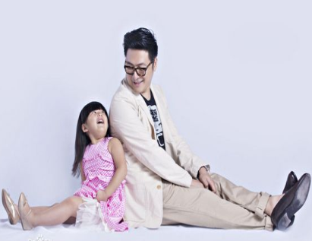
>>Presentation
Look and say
Who’s that man?
He’s my father.

Slide 6
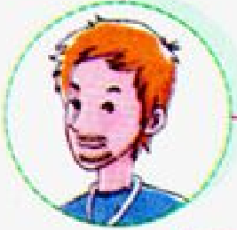
>>Presentation
Let’s learn
father(dad)

Slide 7
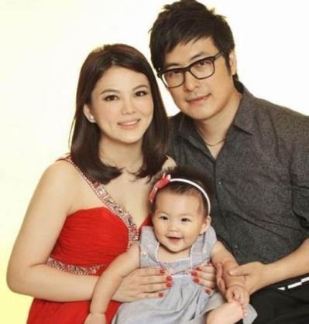
>>Presentation
Look and say
Who’s that woman?
She’s my mother.

Slide 8
>>Presentation
Let’s learn
mother(mom)

Slide 9
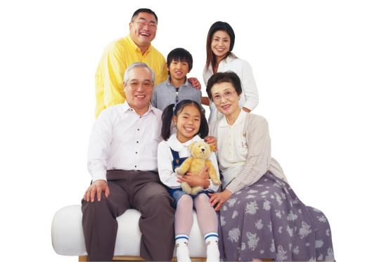
>>Presentation
Let’s say
This is my farther (dad).
This is my mother (mum).

Slide 10
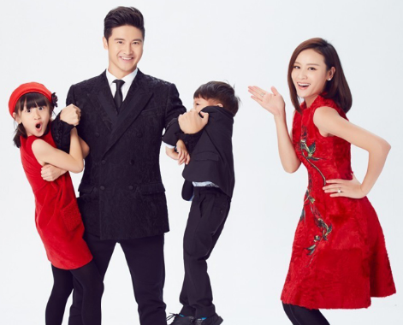
>>Presentation
Let’s learn
sister
brother
father(dad)
mother(mum)

Slide 11
>>Practice
Game 1
Which is missing?
father
mother
brother
sister

Slide 12
>>Presentation
Let’s learn
mother(mom)
father(dad)
grandma
grandpa

Slide 13
>>Presentation
Let’s learn
mother(mom)
father(dad)
grandma
grandpa

Slide 14
>>Presentation
Let’s learn
Mother’s father
grandpa
Father’s father
grandpa
Mother’s mother
grandma
Father’s mother
grandma

Slide 15
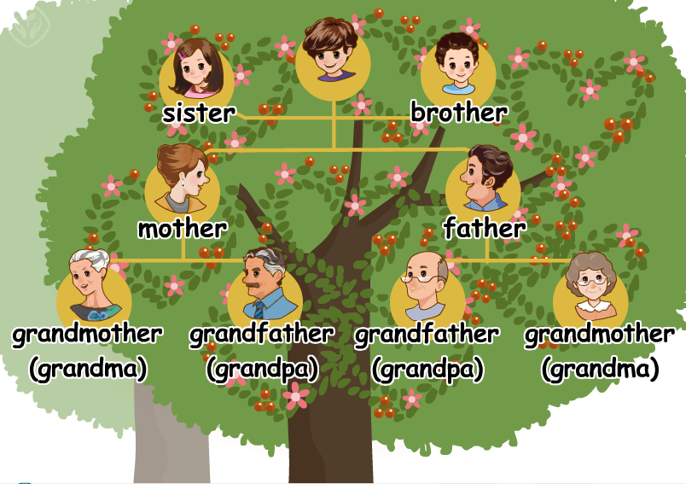
>>Presentation
Let’s learn
family tree

Slide 16
>>Presentation
Let’s learn
Look at this family. This is …
father(dad)
brother
grandpa
mother(mom)
sister
grandma

Slide 17
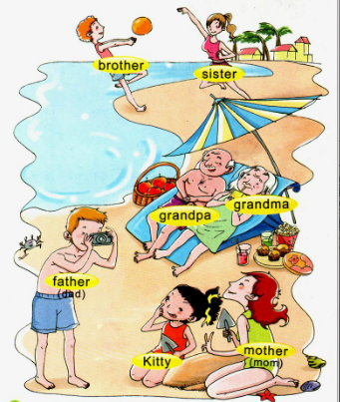
>>Presentation
Let’s learn
family
bother
sister
grandma
grandpa
father
(dad)
mother
(mom)
Kitty

Slide 18
>>Practice
Game 2
Magic fingers
brother father mother family
sister grandpa grandma

Slide 19
>>Practice
活动
大转盘
sister
father
(dad)
grandpa
brother
grandma

Slide 20
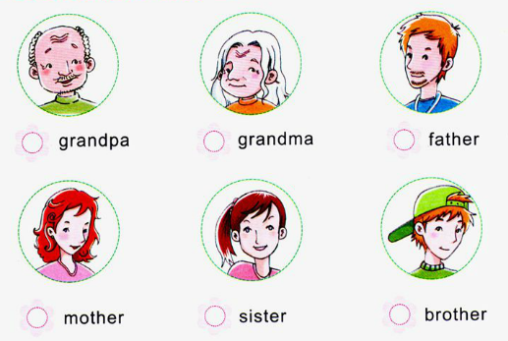
>>Practice
Listen and tick
√
√
√
√

Slide 21
>>Practice
Game 3
句子接龙
This is my father.
Hi, This is ...

Slide 22
>>Summary
与家庭成员相关的单词：
grandpa grandma father(dad)
mother(mom) brother sister

Slide 23
>>Homework
1.听课文录音并跟读，按照正确的语音、语调朗读并表演课文对话。 2.正确书写本课所学单词5遍，并让家长听写1遍。
3.预习A Let’s talk。
close

