Slide 1
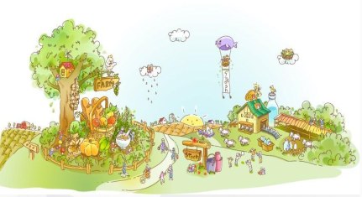
Unit4 He lives in a Village
陕旅版
五年级下册
第一课时
WWW.PPT818.COM

Slide 2
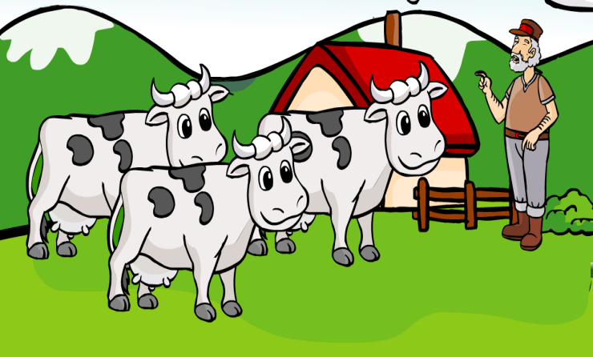
>>Warm-up
Sing a song

Slide 3
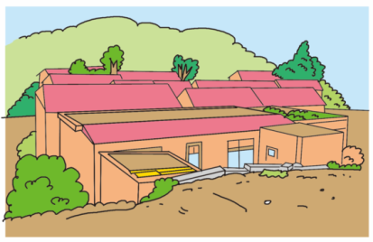
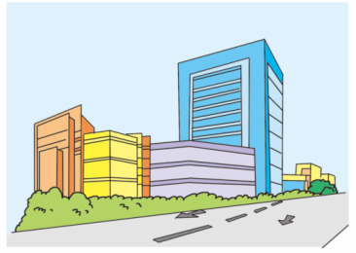
>>Lead-in
Look and tick
Where is your home?

Slide 4
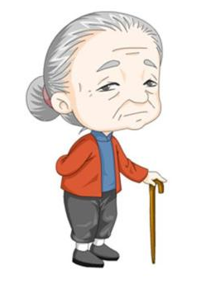
>>Lead-in
Look and say
These are my grandma and grandma.
Where is their home? Can you guess?

Slide 5
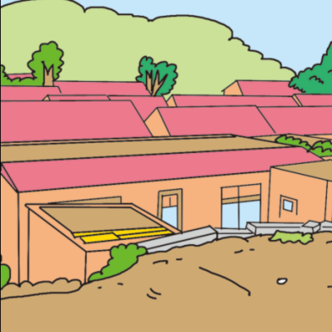
>>Presentation
Let’s learn
Look! My grandpa and grandma live in a village.
Look at the trees, the grass and the houses.
This is a village.

Slide 6
>>Presentation
Let’s learn
In the village, there is a tree.
Can you guess what is in the tree?
Can you guess what is under the tree?

Slide 7
>>I can say
The bird is in the tree.
The ____ is ____ the tree.
in
on

Slide 8
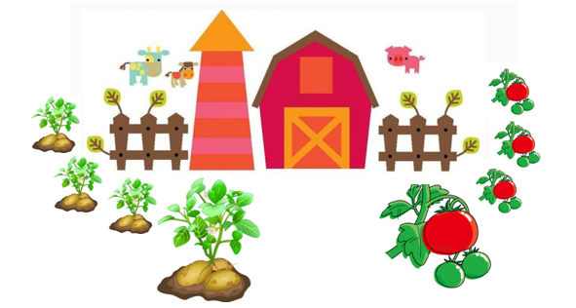
>>Presentation
Let’s learn
There is a farm in the village.
On the farm, there are many potatoes and tomatoes.
potatoes
tomatoes

Slide 9
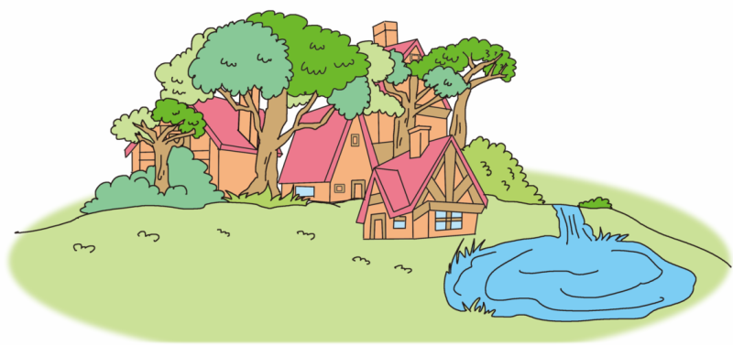
>>Presentation
Let’s learn
Near the village, there are two places.
There is a lot of water and many fishes in them.
Can you guess what they are?

Slide 10
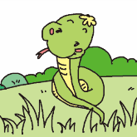
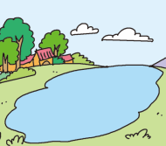
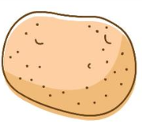
>>Practice
Magic fingers

Slide 11
>>Practice
Play a game
bird
snake
potato
tomato
What’s missing?
village
lake
river

Slide 12
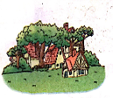
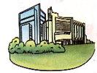
>>Practice
Listen and circle
1
2
3
4

Slide 13
>>Summary
本课所学的重点单词：
village
snake
tomato
bird
potato
river
lake

Slide 14
>>Homework
1.听课文录音并跟读，按照正确的语音、语调朗读并表演课文对话。 2.同伴之间互相提问本节课所学的新单词，并默写一遍。
3. 预习 Unit4 A Let’s talk。
close

