Slide 1
Unit 5 Topic 1
I usually come to school by subway.
Section B
WWW.PPT818.COM

Slide 2
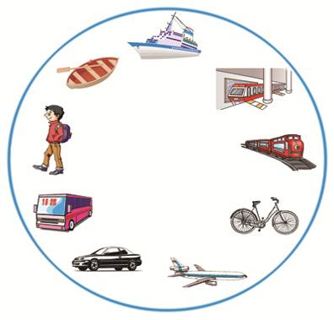
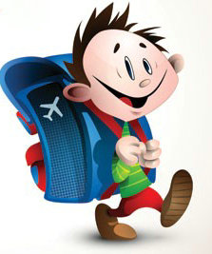
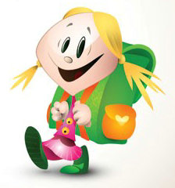
Ask and answer.
How do you usually
come to school ?
By bike.

Slide 3
Fill in the blanks with always, often, seldom.
never ______
seldom
sometimes ______
often
usually _______
always
0%
100%

Slide 4
Use always, usually, often, sometimes, seldom, never and the means of transportation to make sentences.
A: I often come to school on foot.
B: I never come to school by bus.
C: My father always goes to work by subway.
D: He seldom goes to work by train.
E: Sometimes I come to school by bike.
…

Slide 5
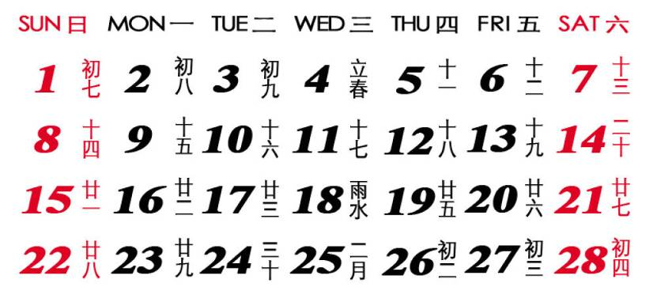
weekdays

Slide 6
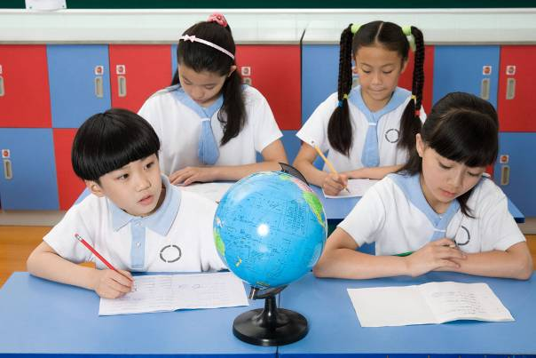
do one’s homework

Slide 7
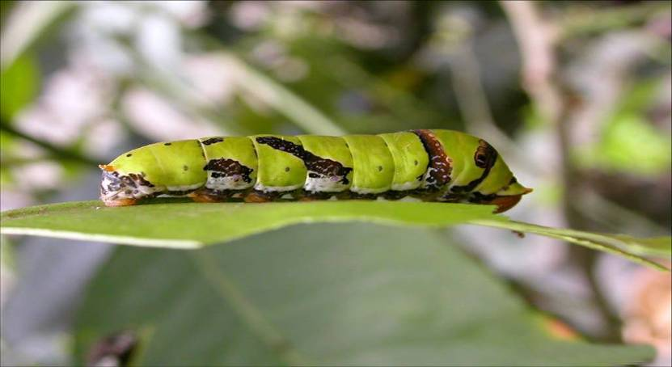
worm

Slide 8
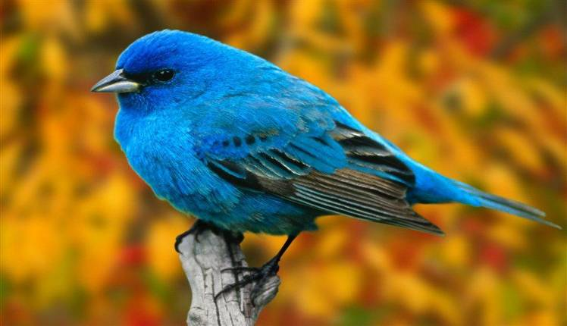
bird

Slide 9
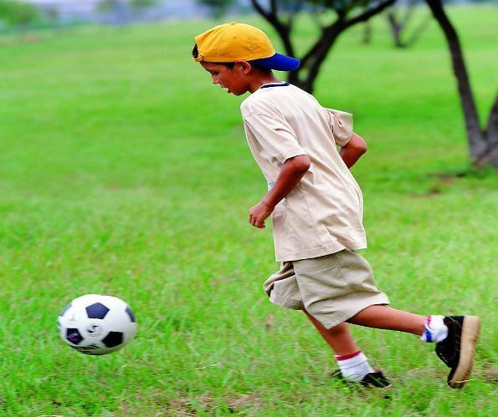
play soccer/football

Slide 10
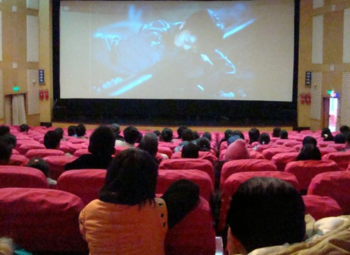
see a movie

Slide 11
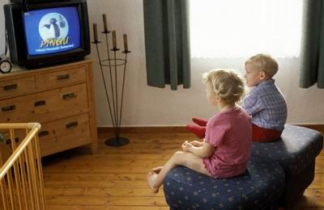
watch TV

Slide 12
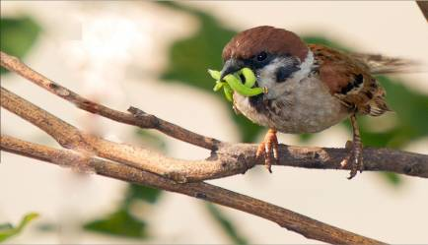
What time do you usually get up?
A: I usually get up at half past six.
B: I usually get up at six.
C: …
We should go to bed early and get up early.
As the saying goes,
“____________________________ .”
The early bird catches the worm

Slide 13
Listen to 1a and complete the sentences with usually, always, often, sometimes, seldom, or never.
1. Michael ________ walks to school but __________ goes by bike.
2. Helen ________ goes to school on foot. She _________ takes the underground.
3. Sally ________ takes the underground. She ________ goes to school by bus.
usually
sometimes
seldom
often
never
always

Slide 14
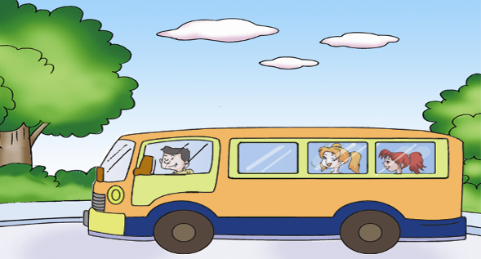
Fill in the blanks after the example.
4
They always go to the zoo by bus.
They always _____ _____ _____to the zoo.
take a bus

Slide 15
go…by subway — take the subway
go…by bike — ride a bike
go…on foot — walk
go…by bus — take a bus
go…by car — take a car
go…by plane — fly
E.g. He usually flies to Beijing.
= He usually _____ to Beijing ___ _____.
goes
by plane

Slide 16
Ask and answer questions about the pictures in 2a with your partner.
Example：
A: How does Li Xiang often come to school?
B: He often comes to school by bike./ He often rides a bike to school.

Slide 17
Listen and check (√) the correct answers.
Activity Frequency | walk to school | take a bus to school | do her homework in the evening
always
usually
often
sometimes
seldom
never
√
√
√

Slide 18
Activity Frequency | watch TV in the afternoon | play soccer on Sundays | see a movie
always
usually
often
sometimes
seldom
never
√
√
√

Slide 19
Chant and then match the first four sentences with the pictures.

Slide 20
1. Go on learning adverbs of frequency.
_______________________________________
2. Learn the means of transportation in different expressions.
always, usually, often, sometimes, seldom, never
go…by subway — take the subway
go…by bike — _____ a bike
go…on foot — ______
__…by bus — take a bus
go…by car — _____ a car
go…_______ — fly
ride
walk
go
take
by plane

Slide 21
Homework
Please write a short passage according to Section B, 3.
E.g. Nancy is my good friend.
She often walks to school.
She sometimes takes a bus to school.
She always does her homework …

