Slide 1
Unit3 Birthday
Have some cake, please.
WWW.PPT818.COM

Slide 2
New words
song 歌曲
Let’s sing a song.

Slide 3
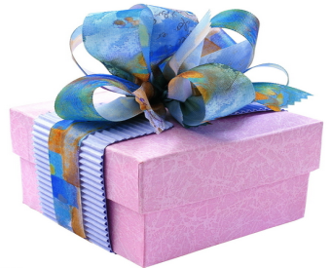
New words
present 礼物
Here is a present for you.

Slide 4
We should be polite
我们应该懂礼貌
Happy birthday!
Here is a present for you.
Thank you.

Slide 5
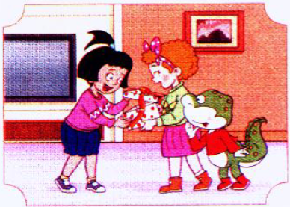
New words
open
打开
open the present

Slide 6
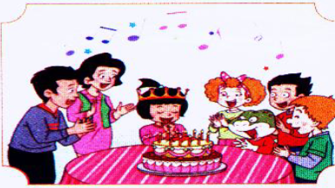
New words
wish
愿望
make a wish

Slide 7
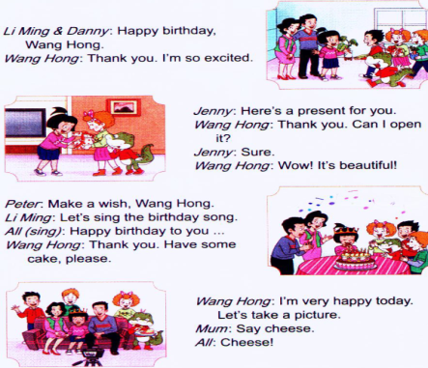
1.Listen and say
听录音，回答问题

Slide 8
Questions
Whose birthday is it?
2. What do they do?
It’s Wang Hong’s.
They have a birthday party.

Slide 9
open the present
Wang Hong
make a wish
sing the birthday song
They
have some cake
take a picture

Slide 10
2.Listen and repeat

Slide 11
3.Read in your group
Read the text in different ways(齐读、分角色读、领读……）

Slide 12
Sharp eyes
Play a game:
open
present
wish
song
say cheese

Slide 13
What’s missing?
Play a game:
open the present
take a picture
make a wish
say cheese
sing the birthday song
happy birthday

Slide 14
哺育之恩何以报
Wherever you spend your birthday, please don’t forget one person. Who is she? It’s your mother. WITHOUT HER WITHOUT YOU.
Parents raised us, we must learn to be grateful.

Slide 15
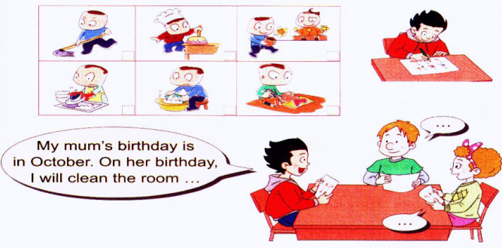
Let’s do
在妈妈生日那天，你能为妈妈做什么事情呢？

Slide 16
Homework
1.听录音，模仿跟读。
2.调查你的朋友在妈妈过生日时为妈妈做了什么事情。

