Slide 1
Around my home
WWW.PPT818.COM

Slide 2
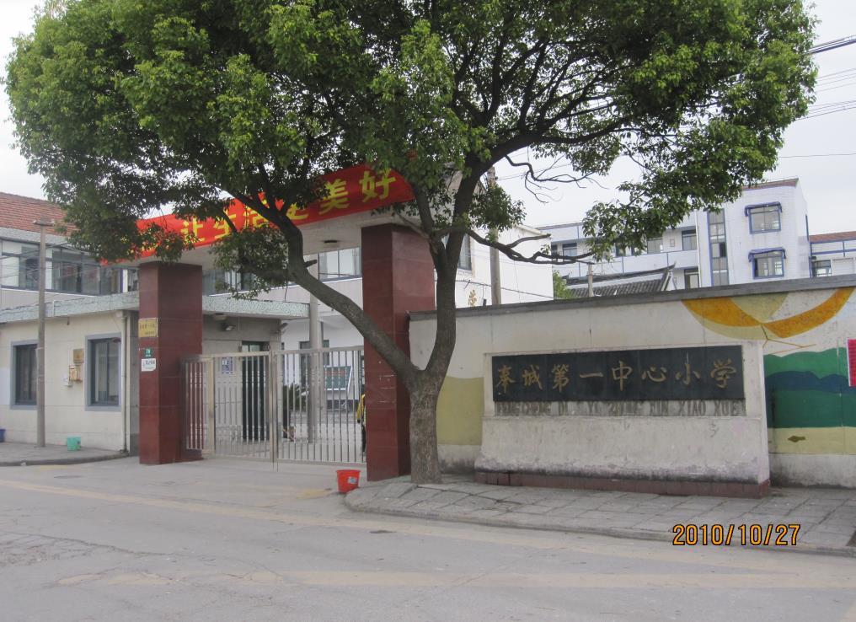

Slide 3
Let's read!
Our school is old but beautiful.
We can sing and dance in the hall.
We can read books in the library.
We can have P.E lessons in the gym.
We can run and play in the playground.
We can see computers in the computer lab.
We can study in the classroom.
We can have lunch in the canteen.
Our teachers are busy in the teachers’ office.
Wel-welcome to our school !

Slide 4
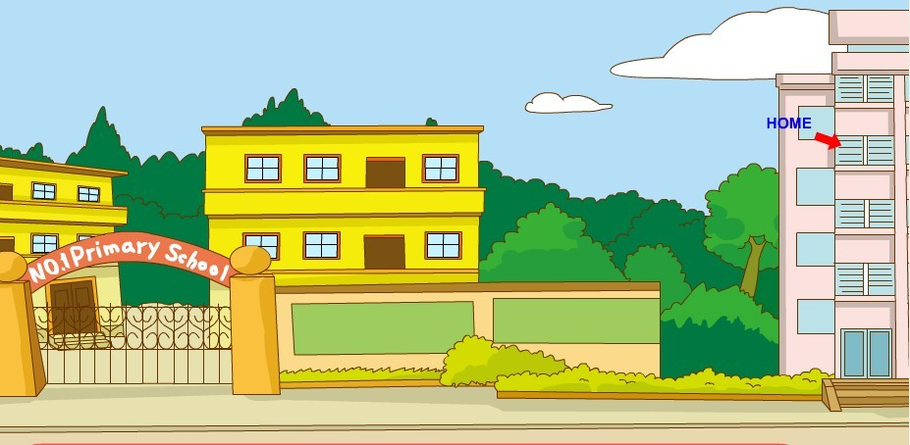
next to
Green Street

Slide 5
Where is your home?
It’s on Green Street.
Where is your home?
It’s on Green Street.
Where is your home?
It’s next to the school.
Where is the school? In front of the trees.
Where are the trees?
Behind the school.
Behind the school.
On Green Street.

Slide 6
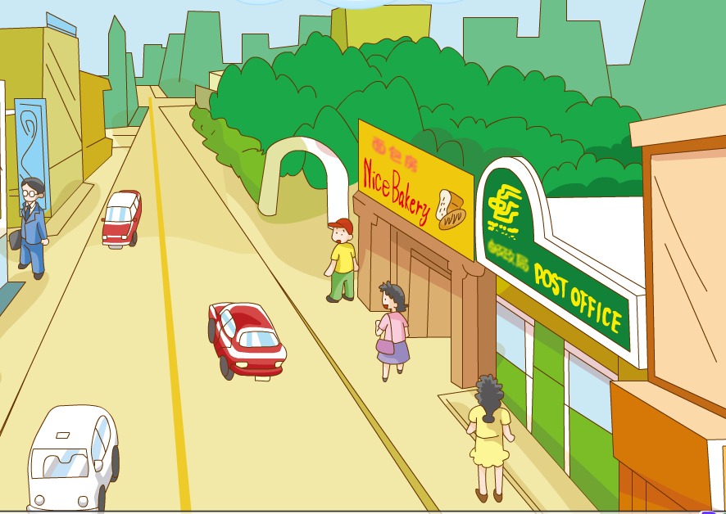

Slide 7
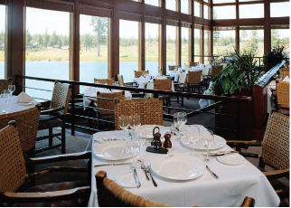
restaurant
-- have a big meal
I can eat/drink ___________ in the restaurant.

Slide 8
Read and match:
fire station
You can post a letter.
restaurant
You can see fire engines.
post office
You can buy all kinds of goods.
supermarket
You can have a big meal.
Try to say:
There is _____ on Flower Street.
I can _____________ in the _____________.

Slide 9
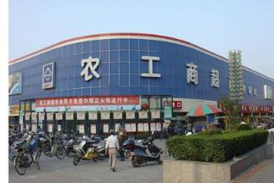
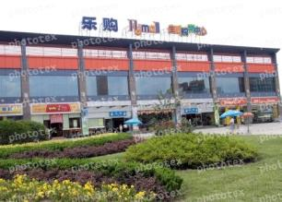
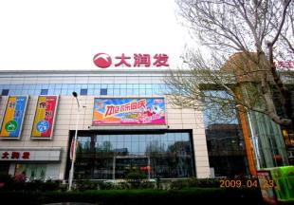
Do you know these places?

Slide 10
Read the passage:
Welcome to Flower Street . There is a post office on this street. Next to the post office, there is a cake shop. We can buy cakes there.They are nice.Where is my home ? It’s between a restaurant and a supermarket. Is there a fire station?No,but there is a park behind the reataurant.There are many shops on Flower Street too. There is a book shop, a toy shop and two fruit shops.It is a busy(热闹的)street.

Slide 11
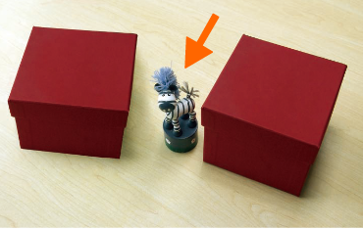
between
between two boxes
between the ____ and the _____

Slide 12
Let's have a try!
My home
Welcome to _______ Street . There is a ______on this street. Next to ________, there is _______. We can _______ there.They are ______. Where is my home ? It’s between _____ and _______. Is there a _______ ?No,but there is _____ behind ______.There are many shops on Flower Street too. There is ______, ______ and _______.It is a busy street.

Slide 13
Assignment:
1.Copy the new words and sentence then recite.
2.Write down the passage.

