Slide 1
Unit 6 Unit 3
I get up at seven
WWW.PPT818.COM

Slide 2
12
11
1
10
2
9
3
8
4
7
5
6
It’s a clock

Slide 3
Clock 钟

Slide 4
What time is it, please?
（请问，现在几点了？）
It’s three o’clock.
4 o’clock
6 o’clock
9 o’clock
12 o’clock
11
12
1
10
2
9
3
8
4
7
5
6
o’clock 点钟

Slide 5
12
11
1
10
2
It’s …… o’clock.
9
3
It’s one o’clock.
8
4
7
5
6

Slide 6
12
11
1
10
2
9
3
8
4
7
5
6
It’s six o’clock.

Slide 7
12
11
1
10
2
9
3
8
4
7
5
6
It’s eight o’clock.

Slide 8
12
11
1
10
2
9
3
8
4
7
5
6
It’s nine o’clock.

Slide 9
12
11
1
10
2
9
3
8
4
7
5
6
It’s eleven o’clock.

Slide 10
12
11
1
10
2
9
3
8
4
7
5
6
It’s twelve o’clock.

Slide 11
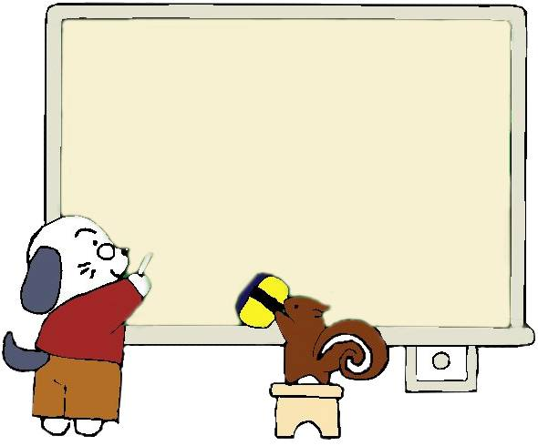
时间表达方法：
“at + 时间+o’clock” 表示“在 几点”
如： at seven o’clcok 在七点
at eight o’clock 在八点

Slide 12
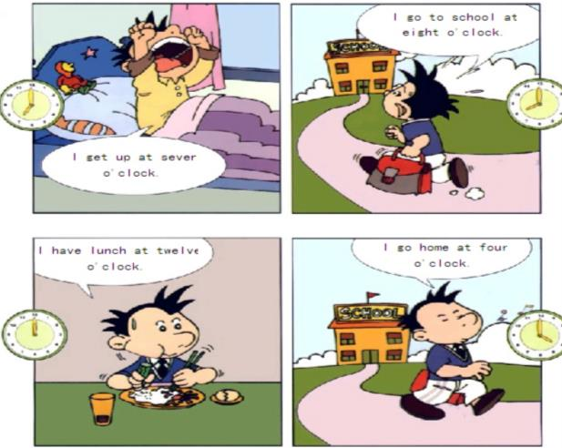
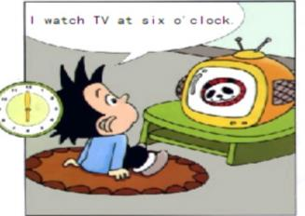
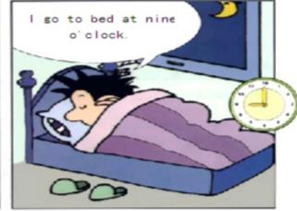
1
2
5
3
4
6

Slide 13
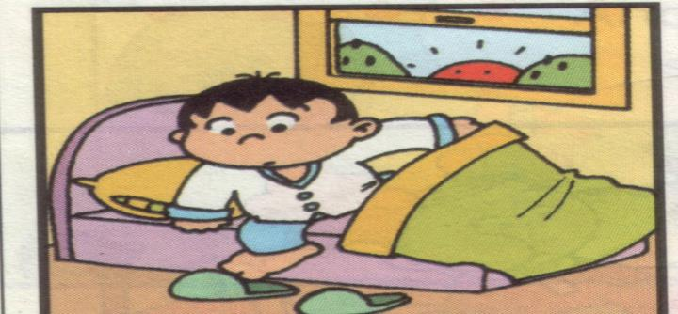
起床 get up

Slide 14
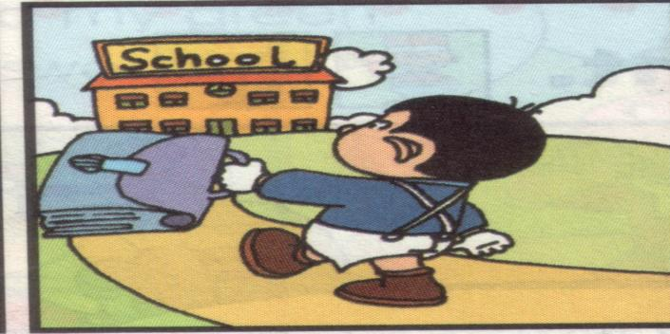
上学 go to school

Slide 15
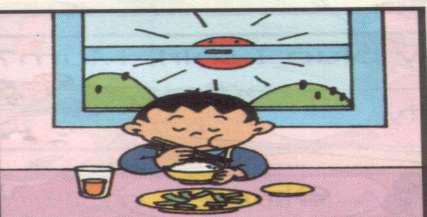
吃午饭 have lunch

Slide 16
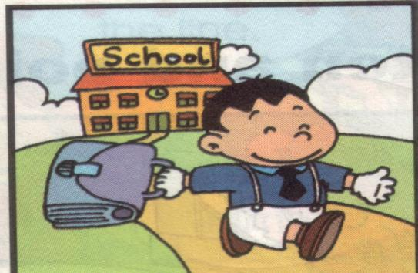
回家 go home

Slide 17
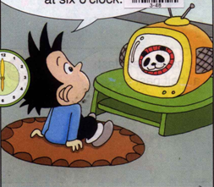
看电视 watch TV

Slide 18
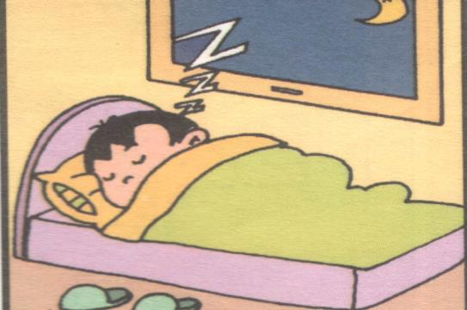
上床睡觉 go to bed

Slide 19
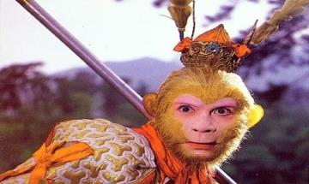
火眼金睛
get up
go toschool
have lunch
go home
go to bed
watch TV

Slide 20
get up 起床
go to school 上学
have lunch 吃午饭
go home 回家
watch TV 看电视
go to bed 上床睡觉

Slide 21
Watch and Choose
Li ming’s Day
get up | go to school | go home | go to bed
Seven
o’clock
B. nine
o’clock
C. four
thirty
D. eight
o’clock

Slide 22
Watch and Choose
Li ming’s Day
get up | go to school | go home | go to bed
seven
o’clock
B. nine o’clock
C. four
thirty
D. eight o’clock

Slide 23
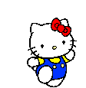
巩固练习

Slide 24
请补全下面的句子，相信你一定很棒！
I （ ）at （ ）o’clock. (起床，6点）
I （ ）at （ ）o’clock. （去上学，8点）
I （ ）at （ ）o’clock. （吃午饭，12点）
I （ ）at （ ）o’clock. （回家，5点）
I （ ）at （ ）o’clock. （看电视，6点）
I （ ）at （ ）o’clock. （上床睡觉，9点）
get up
six
go to school
eight
have lunch
twelve
go home
five
watch TV
six
go to bed
nine
根据提示描述美羊羊一天的活动。

Slide 25
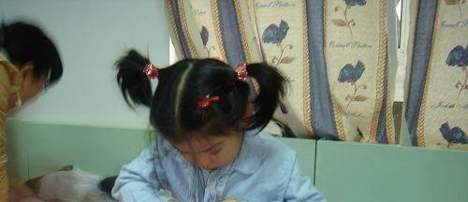
7：00

Slide 26
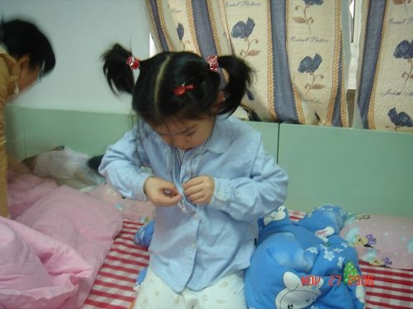
I get up at seven o’clock.

Slide 28
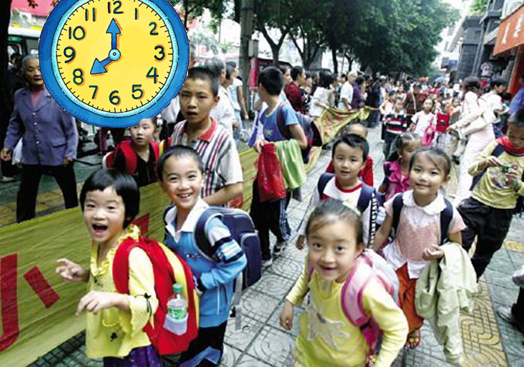
I go to school at eight o’clock.

Slide 30
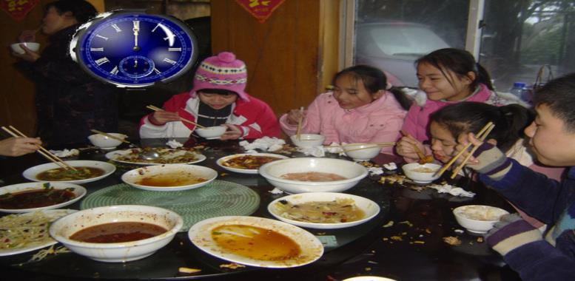
I have lunch at twelve o’clock.

Slide 32
I go home at four o’clock.

Slide 34
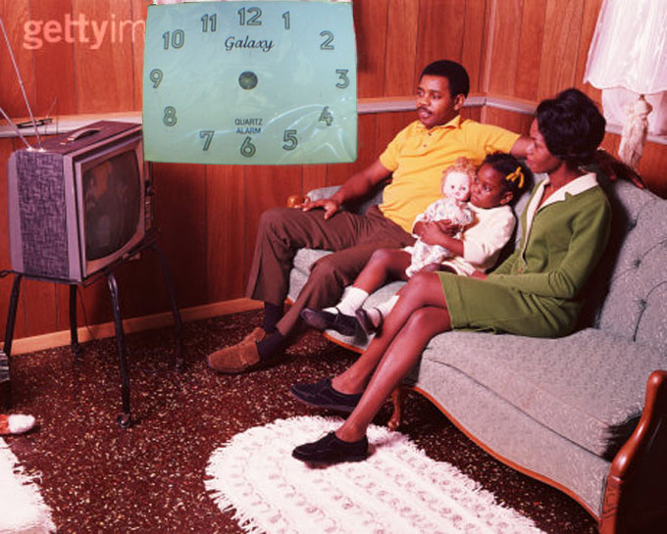
I watch TV at six o’clock.

Slide 35
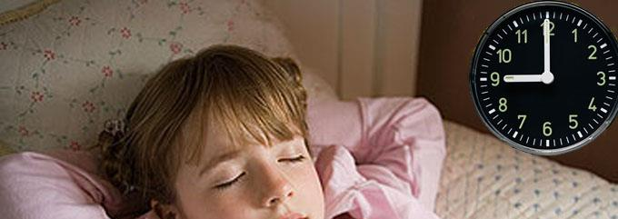

Slide 36
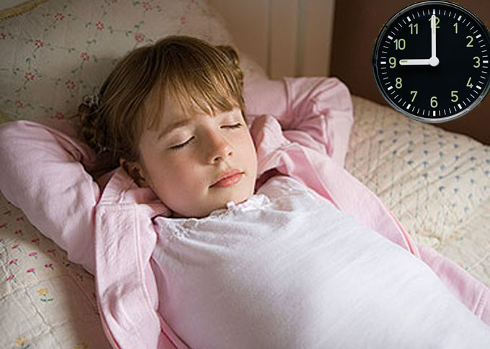
I go to bed at nine o’clock

Slide 37
I …at … o’clock.
I get up at seven o’clock.
I go to school at eight o’clock.
I have lunch at eleven o’clock.
I go home at four o’clock.
I watch TV at six o’clock.
I go to bed at nine o’clock.

Slide 38
get up
go to school
have lunch
go home
watch TV
go to bed
I … at … o’clock.
“at + 时间+o’clock” 表示
“在 几点”
如： at seven o’clcok
在七点
at eight o’clock
在八点
句型
一天的
日常活动
时间表达法

Slide 39
Thank you, bye-bye!

