Slide 1
Unit6 I like hamburgers.
人教精通版三年级上册
WWW.PPT818.COM

Slide 2
Review
Let’s sing

Slide 3
Review
Play a game
Game
Quick response

Slide 4
Lead-in
Look and guess
I have some food. Guess, What’s in it?

Slide 5
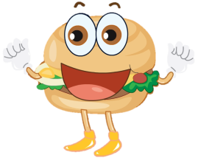
Presentation
Just learn
hamburger

Slide 6
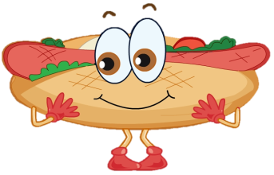
Presentation
Just learn
hot dog

Slide 7
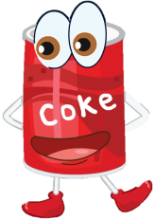
Presentation
Just learn
Coke

Slide 8
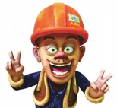
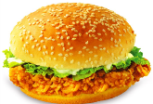
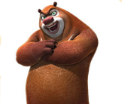
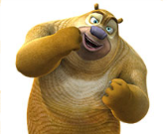
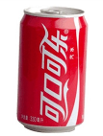
Presentation
Look and say
I like .
I like .
I like .

Slide 9
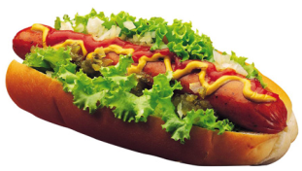
Presentation
Look and say
I like hot dog. How about you?

Slide 10
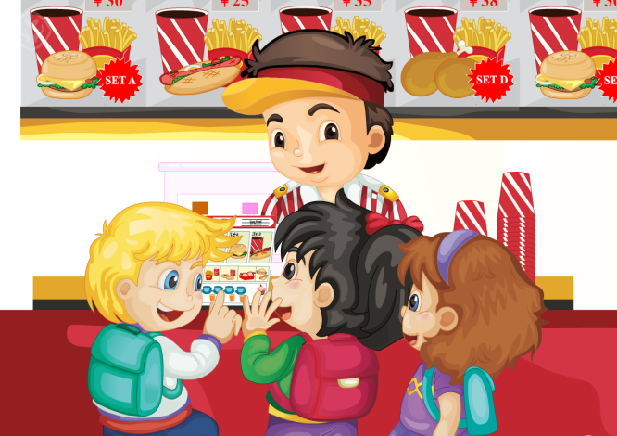
Presentation
Look and say
What do they like?

Slide 11
Presentation
Read and judge
True or False?
1. Peter likes hamburger.
2. Li Yan likes hot dogs.
3. Lisa likes hamburger.

Slide 12
Presentation
Listen and imitate
I like hot dogs. How about you?
I like hamburgers.
Me too.

Slide 13
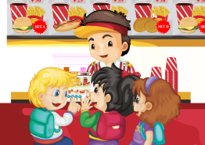
Practice
Let’s read
1
2
3
Read together.
(齐读)
Read in roles.
（分角色读）
Read in groups.
(分组读）

Slide 14
Show time
三人一组试着练习对话并表演，其他同学评价。
 | 模仿录音中的语音语调，有感情地朗读。
 | 可以脱离课本，适当改动其中部分，语音地道。
 | 适当添加内容，意思完整，有创新，表演生动。
Good
Great
Excellent

Slide 15
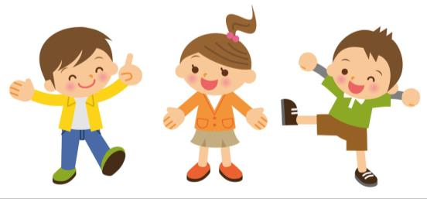
Practice
活动
句子接龙
I like hamburgers. How about you?
I like hot dogs. How about you?
I like ...

Slide 16
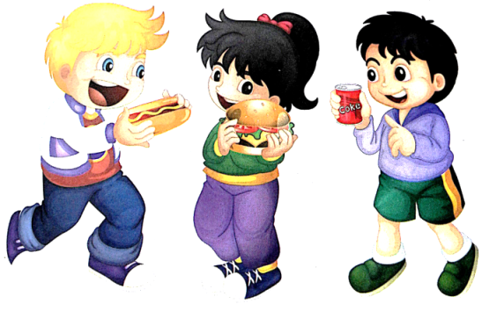
Practice
Let’s chant
I like hot dogs. Yummy, yummy, yummy!
I like hamburgers. Yummy, yummy, yummy!
I like Coke. Yummy, yummy, yummy!

Slide 17
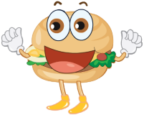
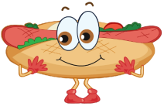
Summary
本课学习的食物及饮料类的单词有:
hamburger
hot dog
Coke

Slide 18
Homework
1.观看或跟读Just talk部分的课文动画或录音，并注意语音、语调。
2.学唱本课Let’s chant部分的英文歌曲，并唱给你的父母听。
3.预习Lesson32。
Close

