Slide 1
We should obey the rules.
WWW.PPT818.COM

Slide 2
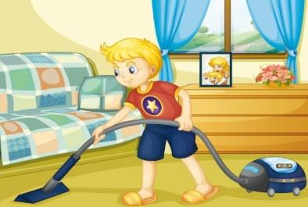
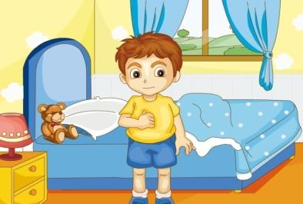
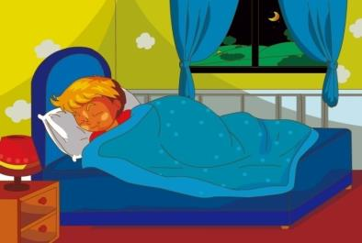
Review
do housework
get up
go to bed

Slide 3
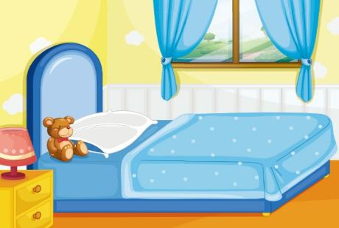
Just practice
You should…/You shouldn’t…

Slide 4
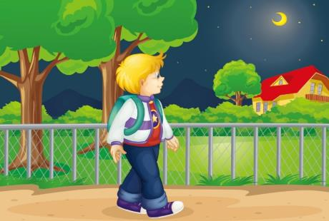
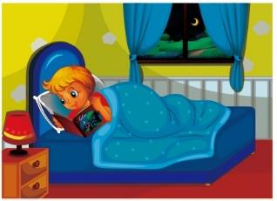
Just practice
You should…/You shouldn’t…

Slide 5
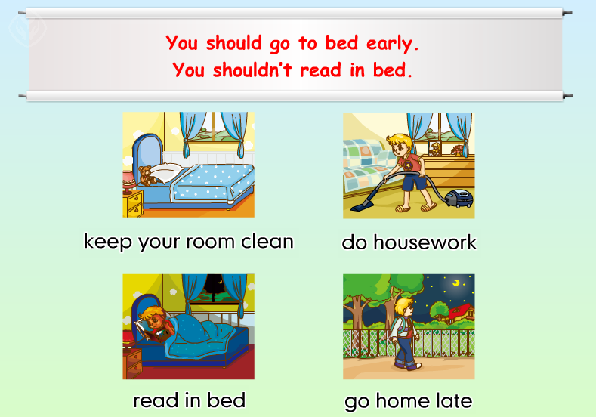
Just practice

Slide 6
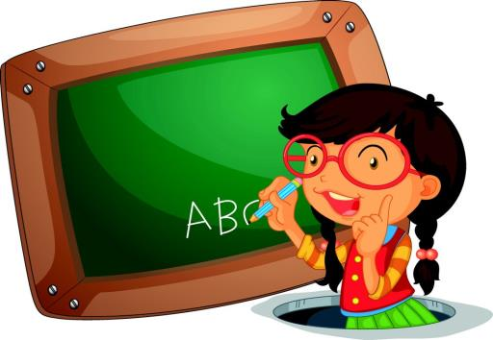
Just write
Can you write them?
go home
do housework
get up
go to bed

Slide 7
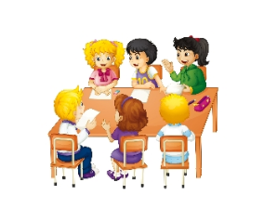
Let’s talk
We shouldn’t go home late.
We should keep our classroom clean.
We should…
We shouldn’t…

Slide 8
Let’s talk
We should:
1. ____________________
2. ____________________
3. ____________________
We shouldn’t:
1. ____________________
2. ____________________
3. ____________________

Slide 9
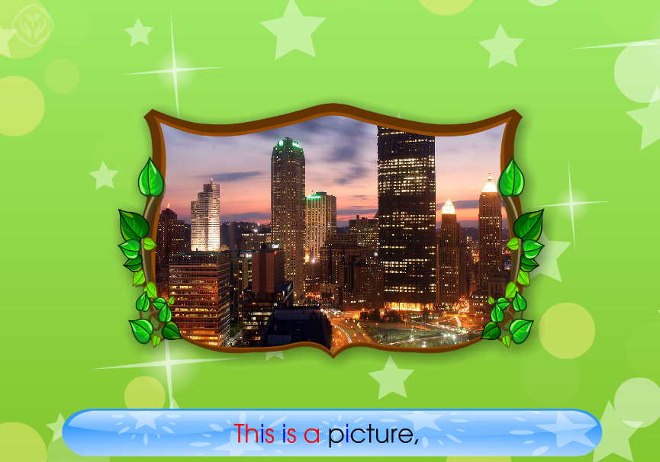
Let’s chant

Slide 10
四会短语：
go home
do housework
get up
go to bed
如何表达应该和不应该做某事？
You should…
You shouldn’t…

Slide 11
Thank you.

