Slide 1
Unit 3 Health
What’s wrong with you?
WWW.PPT818.COM

Slide 2
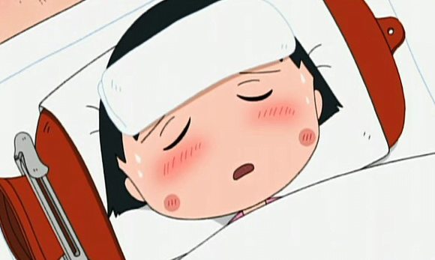
sad

Slide 3
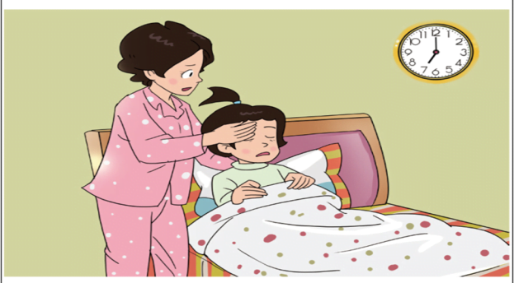
What’s wrong with Wang Hong?
（怎么啦？）

Slide 4
1.读课文划出Wanghong的病症
2.试着读出这些病症的句子。
3.尝试完整地读出课文。

Slide 5
I don’t ____ well, mum. I feel cold.
feel
fever
Oh, you have a _____.

Slide 6
fever
I have a _____.
fever
I have a _____.
Let’s go and see the doctor.

Slide 7
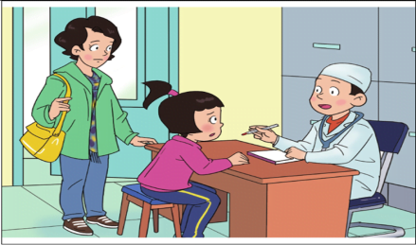
Read and find
Doctor 是怎么询问王红病情的？
What’s wrong with you?
Do you have a headache?
I cough and feel cold.
Yes, I have a very bad headache.

Slide 8
Read in roles.
What’s wrong with you?
I cough and feel cold.
Do you have a headache?
Yes. I have a very bad headache.
Let me have a look.

Slide 9
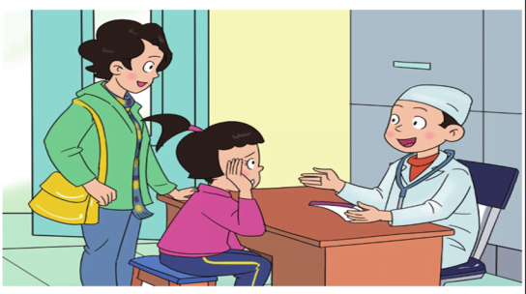
Read and find
Doctor 诊断的结果是什么？
You have a bad cold.

Slide 10
Read and find
At last, what did the doctor say?
Don’t worry. Take some medicine. You’ll be all right.

Slide 11
medicine

Slide 13
cough
have a fever
have a headache
feel cold
A: What’s wrong with you?
B: I __________.
A: Go and see the doctor, please.
B: OK.

Slide 16
Do you _____?
Yes, I do/ No, I don’t.

Slide 17
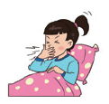
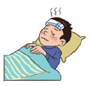
Let’s talk.
What’s wrong with you?
I cough.
Go and see the doctor, please.
OK.

Slide 18
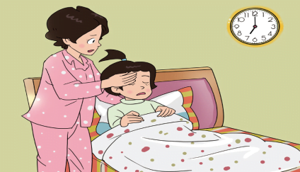
What’s wrong with you, Wang Hong?
I cough and feel cold.
I have a very bad headache.
I have a bad cold.

Slide 19
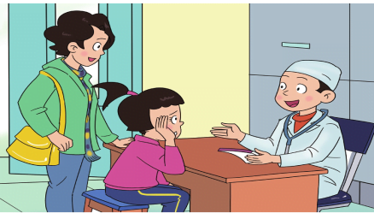
Don’t worry.
Take some medicine.
You’ll be all right.
Drink some water.
Sleep a lot.

Slide 20
Homework:
读熟签字。
L1新单词3，重点句型1，汉。
预习L2。

Slide 21
Thank You

