Slide 1
Unit 4 Topic 3 China is the third nation that sent a person into space.
Section B
WWW.PPT818.COM

Slide 2
Review
He is an American astronaut who was the first man to set foot on the moon.
关系代词
定语从句
先行词
人
Which
物
Who
人
物
that
人物
Shenzhou Ⅹ is a spaceship that/which was launched with three astronauts in 2013.

Slide 3
Review
关系词 | 先行词 | 在从句中成分
________ | 人 | 主语，宾语
which | _______ | 主语，宾语
that | 物 ，人 | ___________
Who
物
主语，宾语

Slide 4
Review
( ) 1.The number of people ____ lost their lives in
Indonesian earthquake reached as many as 6200.
A. which B. who C. Whom
( ) 2.---Have you been to the new Sports Center
_____ is just opened in town?
---No, not yet.
A. where B. who C. that
( ) 3.This is a new museum ______ was built
last year.
A. when B. who C. which
( ) 4.Do you know the girl _____ is singing on
the stage?
A. who B. what C. which
B
C
PPT模板：www.1ppt.com/moban/ PPT素材：www.1ppt.com/sucai/
PPT背景：www.1ppt.com/beijing/ PPT图表：www.1ppt.com/tubiao/
PPT下载：www.1ppt.com/xiazai/ PPT教程： www.1ppt.com/powerpoint/
资料下载：www.1ppt.com/ziliao/ 范文下载：www.1ppt.com/fanwen/
试卷下载：www.1ppt.com/shiti/ 教案下载：www.1ppt.com/jiaoan/
PPT论坛：www.1ppt.cn PPT课件：www.1ppt.com/kejian/
语文课件：www.1ppt.com/kejian/yuwen/ 数学课件：www.1ppt.com/kejian/shuxue/
英语课件：www.1ppt.com/kejian/yingyu/ 美术课件：www.1ppt.com/kejian/meishu/
科学课件：www.1ppt.com/kejian/kexue/ 物理课件：www.1ppt.com/kejian/wuli/
化学课件：www.1ppt.com/kejian/huaxue/ 生物课件：www.1ppt.com/kejian/shengwu/
地理课件：www.1ppt.com/kejian/dili/ 历史课件：www.1ppt.com/kejian/lishi/
C
A

Slide 5
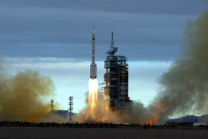
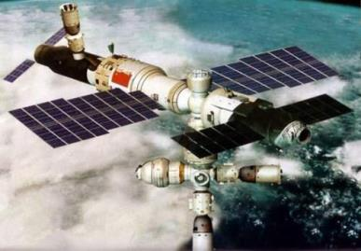
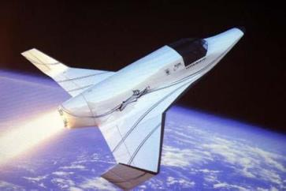
What do you know about the spaceships?

Slide 6
What do you know about the spaceships?
1.Spaceships mainly use electronic
controls.
2.Astronauts use computers to control
the speed and direction of their
spaceships, even the temperature.
…
adj. 电子的

Slide 7
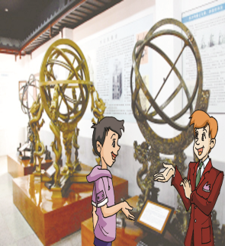
1a What did Kangkang want to know ?
He wants to know something about recent spaceship developments.
development n. 发展
with the development of …
随着……的发展
develop v.发展
developing adj.发展中的
developed adj. 发达的

Slide 8
1b What can computers do to spaceships? Tick the possibilities and then listen to 1a to check your answers.
( ) 1. make food for astronauts
( ) 2. change the speed of spaceships
( ) 3. control the direction of spaceships
( ) 4. control the temperature of
spaceships
√
√
√
Make predictions based on what you know.

Slide 9
1a Look, listen and say.
动画1a

Slide 10
1c Read 1a and fill in the blanks.
Kangkang wanted to know something about recent spaceship developments. Mr. Brown told him that spaceships used to be _________by astronauts and now mainly use ________ controls. Then he explained to Kangkang that the speed and ________ of spaceships as well as the temperature are controlled by computers. Kangkang then realized he knew little about computer technology. Mr. Brown _________ him to learn to use computers well and make computers _______ us better in the future. Kangkang made up his mind to work hard to _________ computer technology.
controlled
electronic
direction
advised
serve
master

Slide 11
Key words
K: amazing, development
B: electronic, control, astronauts
K: work
B: computers, speed, direction,
temperature
K: so little, technology
B: master, advise , make …do…
K: introduction, impossible
Act it out !

Slide 12
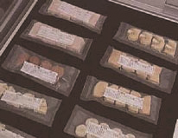
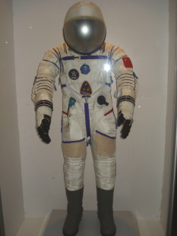
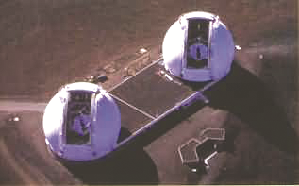
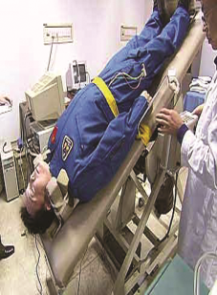
2 A. Listen to four short passages and number the pictures. The words below the pictures may help you.
food ( ) spacesuit ( ) telescope ( ) machine ( )
2
1
3
4

Slide 13
2 B. Listen again and fill in the blanks.
1. A spacesuit is like a very small
_______.
2. Astronauts add ________ to ________
to make it bigger.
3. On earth, we can look at the
_______________ through telescopes.
4. ________ are training on a special
machine. It _______ them through the
air.
spaceship
water
dried food
stars and planets
Astronauts
lifts

Slide 14
3 Read the following sentences and complete them with that, which, who.
1. Do you know Neil Armstrong _________was the first man to set foot on the moon?
2. This is the spaceship ________ the astronauts use on space.
3. In all big cities, there are things _________ tourists shouldn’t miss!
4. He is a man ________ means what he says.
that/who
that/which
that/which
who/that

Slide 15
4 Listen and read the attributive clauses, paying attention to the pause, weak form and intonation.
1. China is the third nation /that sent a person into space.
2. Yang Liwei is our national hero /who traveled around the earth in Shenzhou V for 21 hours in 2003.
3. Spaceships /which use electronic controls /used to be controlled by astronauts.
4. Chang’e I is a spaceship /which was launched as China’s first lunar probe.
5. More and more people have personal computers /that are used to play games and watch movies.

Slide 16
Exercises
1.The movie ____ we saw last night was fantastic.
A. that B. what C. whose D. who
2. Liu Yang is the first woman astronaut _____ has ever traveled in space.
A. whom B. which C. who D. whose
3. People are talking about the old houses ______ Jackie Chan bought in Anhui twenty years ago.
A. which B. where C. who D. when
4. Most students like the teachers _____ understand them well.
A. which B. who C. where D. when
5. It’s interesting that there are many people _____ speak French in Canada.
A. which B. where C. who D. whom

Slide 17
Exercises
Fill in the blanks with who, which, that.
1. The train ___________ has just left is for Shenzhen.
2. I still remember the year ___________ we spent together.
3. Jack is no longer the person_________ I met five years ago.
4. Who is the worker _________ was late for work today?
5. Some people __________ are successful language learners often fail in other fields.
which/that
that/which
who/that
that/who
who/that

Slide 18
Summary
We learn:1. Some words: electronic, spacesuit
2. Some phrases: master computer
technology, advise sb. to do sth.,
make sb./sth. do, made up one’s mind
3. Some sentences:
(1) Spaceships are so amazing.
(2) I think that if I work hard then nothing is
impossible.
We can: 1. Learn more about the astronauts’ life.
2. Read the attributive clauses with correct
pause, weak form and intonation.

Slide 19
Assignment
Read 1a.
Memorize the useful expressions and key sentences which we learned today.
Finish Section B in your workbook.
Preview Section C.

