Slide 1
Unit 7 Shopping Grammar
WWW.PPT818.COM

Slide 2
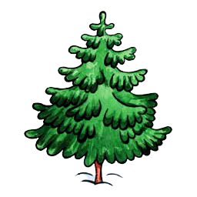
Look and say
We can see some presents in the tree.
We can’t see any presents in the tree.

Slide 3
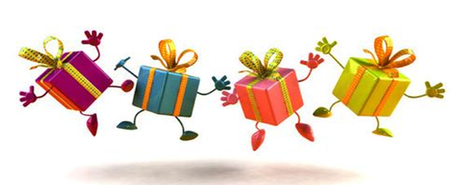
Read and think
- I want to buy some Christmas presents.
I need some money.
Do you have any money?
- No, I don’t have any money.

Slide 4
Read and think
Would you like some Christmas
presents?
- Can I borrow some money from you?

Slide 5
Think and complete
We use some and any before
countable and uncountable nouns.
We use _______ in a positive sentence.
We use ______ in a negative sentence
and a question.
We can also use _______ in a question
when we are making an offer or a
request. We use it when we expect
the answer to be “yes”.
some
any
some

Slide 6
Shopping for a party
M: We need many things for the party, Daniel.
D: Yes. We have a big cake and _______ bread.
Do we need _______ fruit?
M: Sure. We need _______ bananas and oranges.
D: What about drinks?
M: We need _______ juice and cola.
D: OK. Do we need to buy _______ paper cups?
M: Yes. We also need _______ paper cups.
D: All right. Let’s go.
some
any
some
some
any
some

Slide 7
A New Year’s Day party
food
drinks
snacks
activities

Slide 8
A New Year’s Day party
A: Hi, …! Our class will have a New Year
party. What should we get ready for it?
B: Oh, really? That’s great! I think we must
buy some drinks, like milk and cola.
A: That’s a good idea. Do we need any …?
B: ….
★★★ 语音语调准确，朗读流利，至少使用5次 some或any
★★★★ 语音语调优美，注意感情和肢体语言，不看书
★★★★★ 语音语调优美，注意感情和肢体语言，增加自己
的语言，对话长且有趣

Slide 9
Look and say
There are some presents in the tree.
Are there any presents in the tree?
No, there aren’t any presents in the tree.
There is a bell in the tree.

Slide 10
Look and say
Is there any good news?
Yes, there is.
Our class is going to have a New Year’s Day party.

Slide 11
Look and say
就近原则：
在 there be 结构中，be动词的形式由最靠近它的名词决定
What ______ in the tree?
There _______ a bell and some presents in it.
There _______ some presents and a bell in it.
is
is
are

Slide 12
Look and say
____________ presents are there in the tree?
There are four presents in it.
____________ bells are there in the tree?
There is only one bell in the tree.
How many
How many

Slide 13
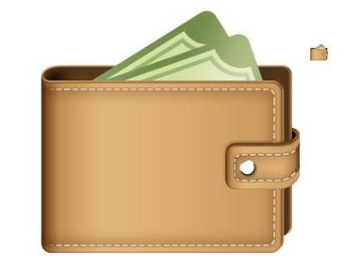
Look and say
____________ money is there in the wallet?
We don’t know.
How much

Slide 14
Shops around my school
My schools is very beautiful, and _________ some shops around it. _________ a bookshop near my school. __________ a lot of good books in it. _________ also some pens, rubbers and exercise books. Sometimes we go there after school. __________ hair clips, music boxes and some other nice things too. We can buy presents for our friends in the shop. Not far away from my school, ________ also a supermarket. It is not very big, but ___________ enough snacks in it.
there are
There is
There are
There are
There are
there is
there are

Slide 15
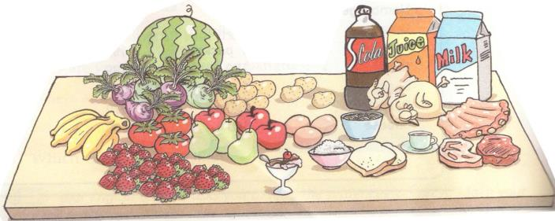
Think and say
A: Is there … on the table?
B: Yes, there is. / No, there isn’t.
A: Are there … on the table?
B: Yes, there are. / No, there aren’t.

Slide 16
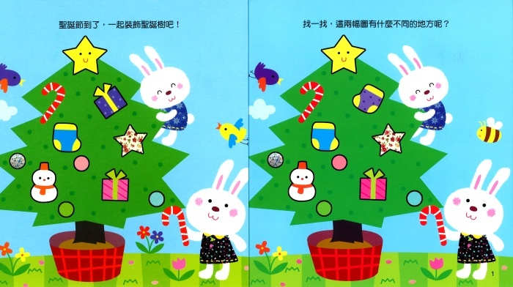
Think and say
There is/are … in Picture 1, but there isn’t/aren’t ... in Picture 2. There is/are ….

Slide 17
Think and say
How many “there be” sentences can you say in a minute?
Group 1: in our classroom
Group 2: in your bedroom
Group 3: in a food shop
Group 4: in a supermarket

Slide 18
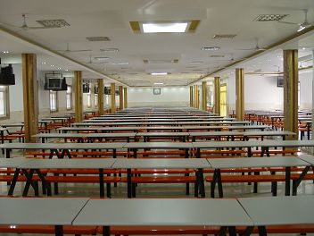
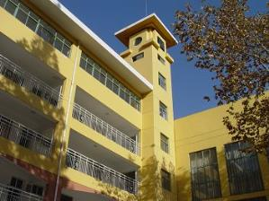
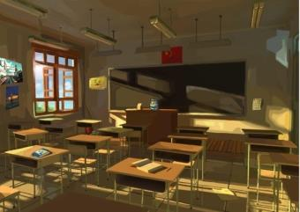
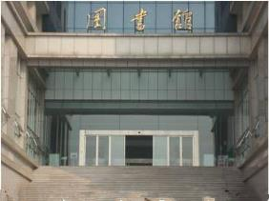
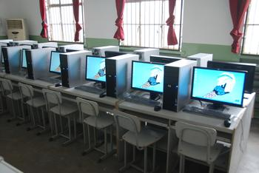
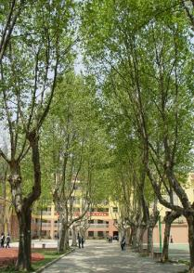
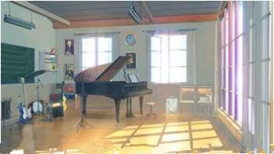
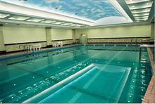
Think and write
Can you write a short passage to introduce your school?
Try to use some/any and there is/there are.
Notes:
18

Slide 19
Homework
Review the uses of “some”,
“any” and “there be”.
2. Share the passage with
your classmates.
3. Preview Integrated skills.

