Slide 1
Module 6 A trip to the zoo
Unit 2 The tiger lives in Asia.
WWW.PPT818.COM

Slide 2
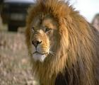
Guessing game
I am orange and black, and I am the king in the forest.
I am the tiger’s cousin, and I like eating small animals.
tiger
lion

Slide 3
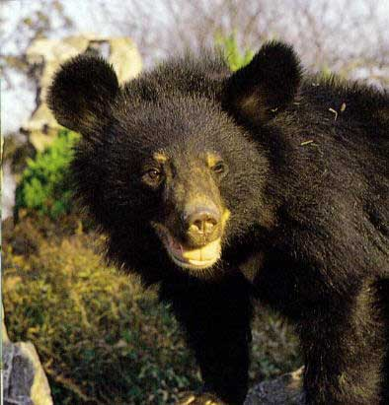
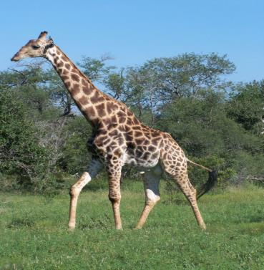
I am brown or black and I lived in the forest.
I am tall and I have a long neck.
bear
giraffe

Slide 4
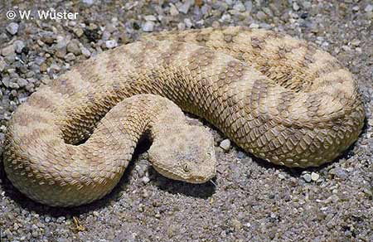
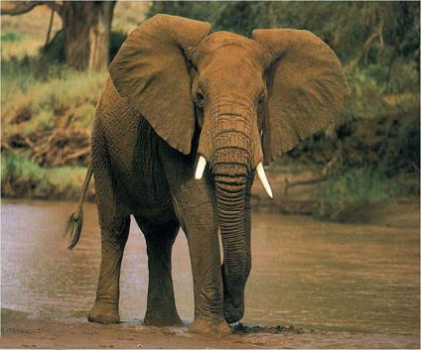
I am long and thin.
I can’t jump.
I am very big and have a very long nose.
snake
elephant

Slide 5
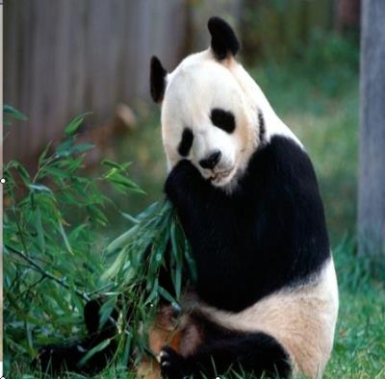
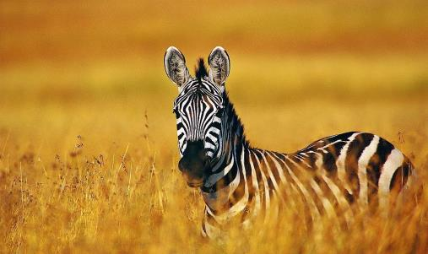
panda
panda
I’m also black and white. I have four legs.
I’m black and white,
fat and cute.
I love bamboo.
zebra

Slide 6
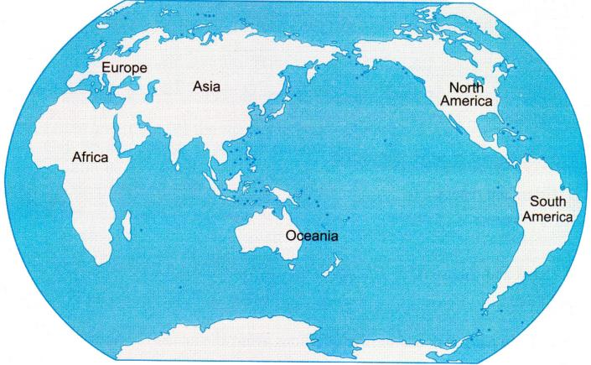
Where do tigers live?
tigers bears elephants giraffes lions monkeys pandas zebras
There are tigers in Asia.

Slide 7
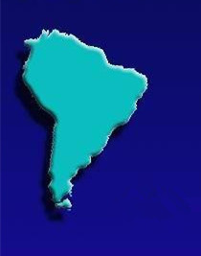
Fast Q & A: What’s the continent? What animals live in it?

Slide 8
Fast Q & A: What’s the continent? What animals live in it?

Slide 9
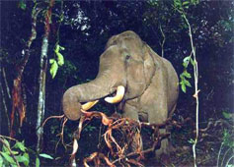
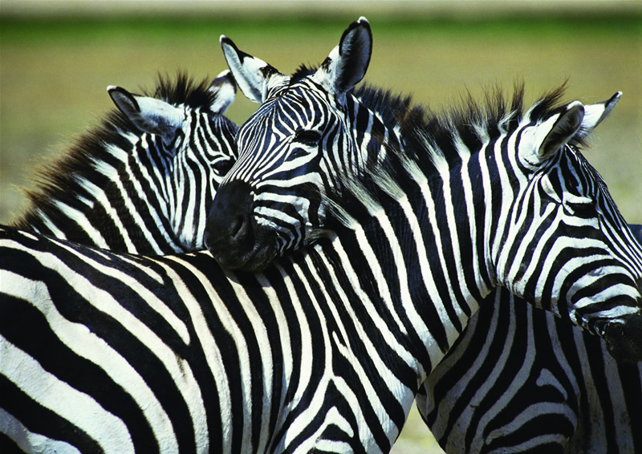
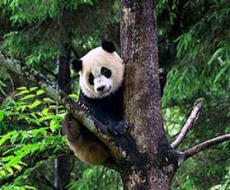
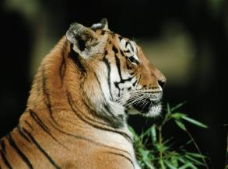
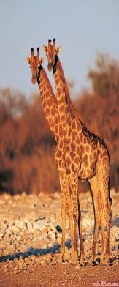
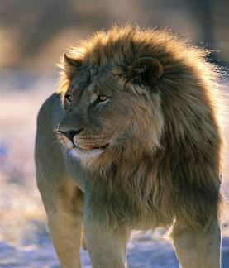
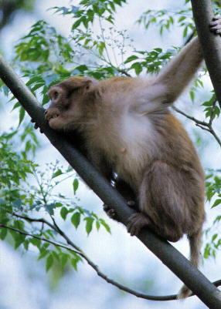
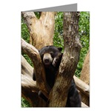
Fast Q & A: What is it? Where does it live ?

Slide 10
3. Read the passage and complete the table.
Animal | Home | Food
Elephants
Pandas
plants, leaves, bamboo and a little fruit
Africa Asia
bamboo plants and leaves
China

Slide 11
Animal | Home | Food
Zebras
Tigers
Monkeys
plants, leaves and grass
Africa
many kinds of animals
Asia
Africa, Asia and America
meat, leaves, fruit and eggs

Slide 12
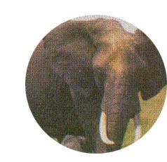
The elephant lives in_____ and in____. It eats_______ and a little _____, but it doesn’t eat _____.
It likes ______.
Africa
Asia
plants
fruit
meat
elephant
water

Slide 13
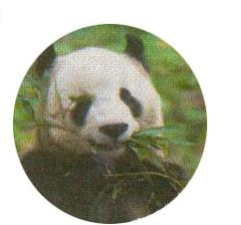
There are only about _____ pandas in ____ and about 200 of them live in ____. The panda eats about________ of _______ a day, as well as plants and_______.
1800
China
zoos
panda
30 kilos
bamboo
leaves

Slide 14
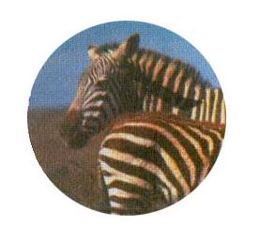
The zebra is an ______ animal. Like the panda, it’s _____. It eats plants and leaves, as well as _____, but the zebra _______ eat bamboo.
African
black and white
grass
doesn’t
zebra

Slide 15
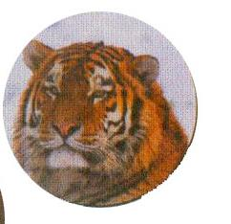
Asia
The tiger lives in ____. It usually lives______. It likes _____ and is good at ________. It’s _______ and catches many kinds of ______ for food.
alone
water
swimming
strong
animals
tiger

Slide 16
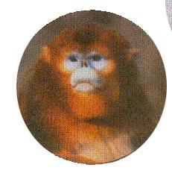
Monkeys live in ______, ____ and ______. There are about ____ kinds of monkeys. Monkeys eat ____, ______ , _____and even ____!
Africa
Asia
America
200
monkey
meat
leaves
fruit
eggs

Slide 17
4. Complete the sentences with the correct form of the words and expression from the box.
African a little grass kilo only world
1. The elephant eats __________ fruit.
2. The pandas eats about 30 ______ of
bamboo a day.
a little
kilos

Slide 18
3. The zebra eats plants, leaves and
_______ but not bamboo.
4. There are ______ about 1,800
pandas in China.
5. Monkeys live in many countries all
over the ______ but not in Europe.
6. You can find elephants in Africa and
Asia, but zebras are only
_______ animals.
grass
only
world
African

Slide 19
After reading
Pair work: Ask questions
about the animals in the text.
根据文中介绍的动物及其相关信息，向大家提一个问题

Slide 20
Where does it live?
What does it often eat?
Does it come from Europe?
Does it eat meat?
Does it like water?

Slide 21
Homework: Introducing an animal
小组合作，与组员交流一下，思考如何向大家介绍一种动物。写成一段话，比比看哪个小组写的句子多。

Slide 22
Exercises
A. 根据首字母提示填空：
1. China is a country in A___.
2. They are Europeans. They come from
E_____.
3. The dog is my favourite a______.
4. In autumn, we can see the yellow
l_____ of the trees.
5. The old man lives a_____. I usually
talk with him.
sia
urope
nimal
eaves
lone

Slide 23
B. 完成句子：
1. 狮子是美洲的吗？
Is the lion ____________________?
2. 他们不来自亚洲。
They don’t ____________________.
3. 这是只非洲大象吗？
Is this _________________________?
American
come from Asia
an African elephant

Slide 24
4. 你愿意住在美洲吗？
Would you like _________________?
5. 熊猫一天吃30公斤竹子，也吃植物和
叶子。
The panda eats about 30
______________ a day, ___________
plants and leaves.
to live in America
kilos of bamboo
as well as

