Slide 1
Seeing the doctor
WWW.PPT818.COM

Slide 2
ill

Slide 3
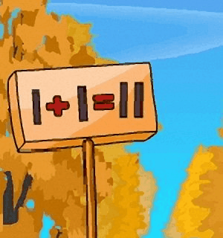
wrong

Slide 4
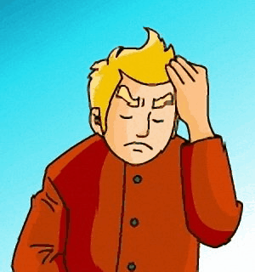
headache

Slide 5
fever

Slide 6
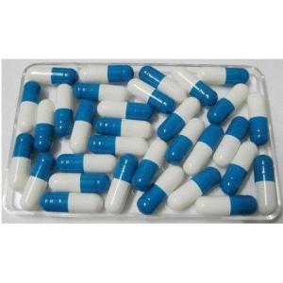
medicine

Slide 7
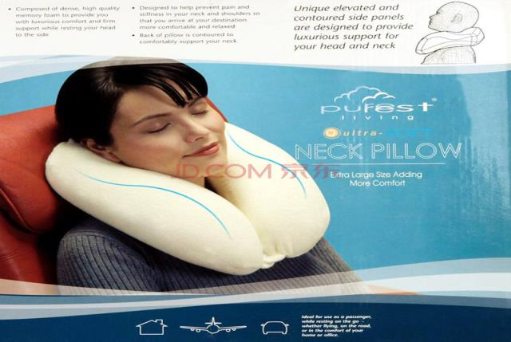
rest

Slide 8
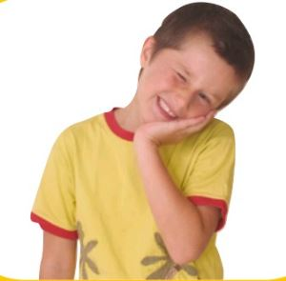
toothache

Slide 9
practice

Slide 10
ill
wrong
headache
fever

Slide 11
should
medicine
rest
toothache

Slide 12
wrong
fever
rest
medicine

Slide 13
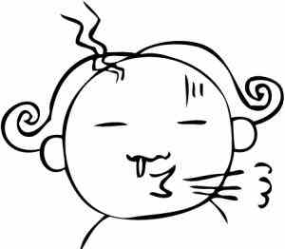
have a cold

Slide 14
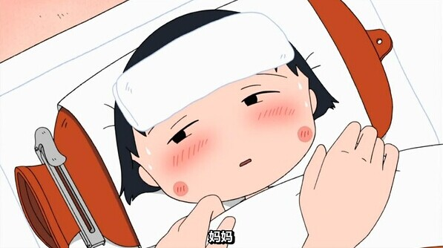
have a fever

Slide 15
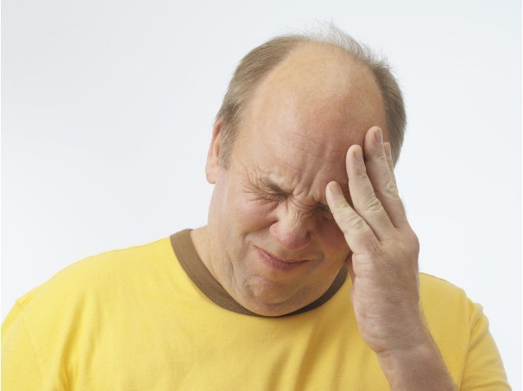
have a headache

Slide 16
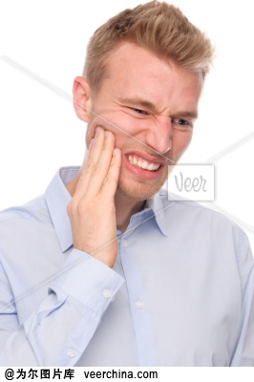
have a toothache

Slide 17
have a rest

Slide 18
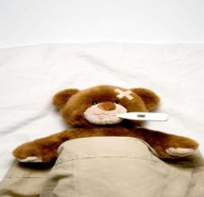
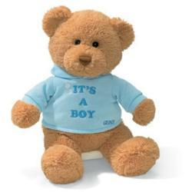
get well

Slide 19
连连看

Slide 20
have a cold
康复
have a fever
休息一下
have a headache
牙疼
have a toothache
感冒
发烧
have a rest
头疼
get well

Slide 21
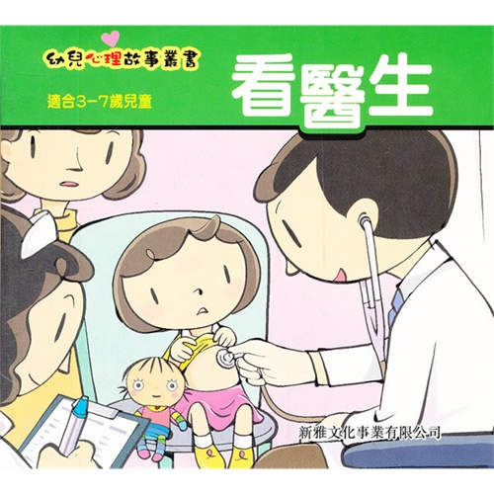
Kitty is not feeling well. She is ill,
Her mum takes her to the hospital.

Slide 22
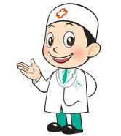
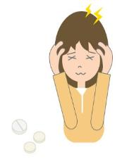
What’s wrong with you?
Doctor :
Kitty :
I have a headache .

Slide 23
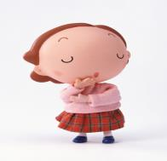
Mrs Li :
She has a fever too.
Let me have a look . Open your mouth and say “ Ah…”.
Doctor :

Slide 24
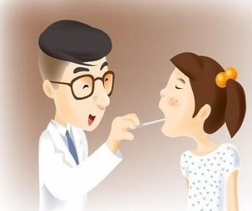
Kitty :
Ah…
Doctor :
You have a cold .
You should take some medicine.
You should also drink a lot of water.
You shouldn’t go to bed late.
Have a good rest and you’ll get well soon.

Slide 25
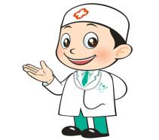
Thank you ,doctor.
Kitty :
Doctor :
You’re welcome.

Slide 26
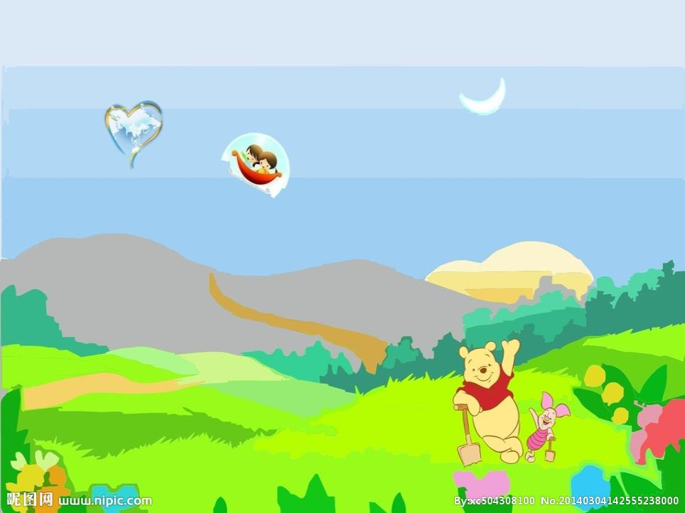
Ask and answer

Slide 27
I have a …
What should I do ?
A :
You should …
You shouldn’t…
B :

Slide 28
Cold
. Go to see the doctor.
. Wear warm clothes.
. Drink a lot of water.
. Have a good rest.

Slide 29
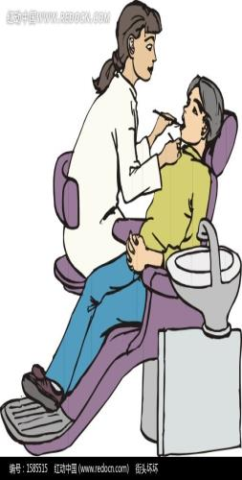
Toothache
. Go to see the dentist.
. Brush your teeth every morning
and evening .
. Don’t eat before bedtime.
. Don’t eat too much candy.

Slide 30
Listen and say
Doctor, Doctor, I have a fever.
You should drink a lot of water.

Slide 31
Listen and say
Doctor, Doctor, I have a toothache.
You shouldn’t eat so many cakes .

Slide 32
Listen and say
Doctor, Doctor, I have a cold.
You should wear warm clothes .

Slide 33
Listen and say
Doctor, Doctor, I have a cough.
You should take some medicine.

Slide 34
toothache

Slide 35
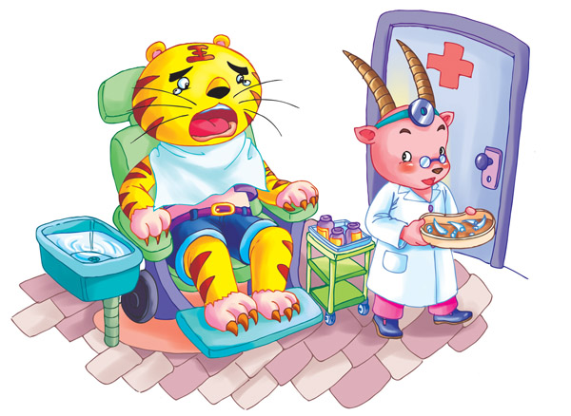
toothless

Slide 36
present

Slide 37
world

Slide 38
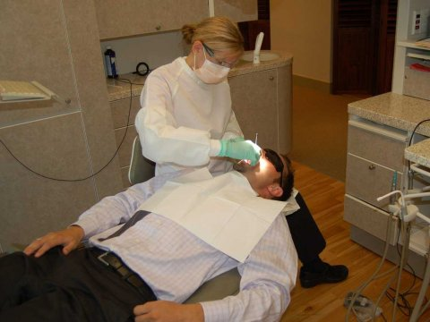
dentist

Slide 39
have a toothache

Slide 40
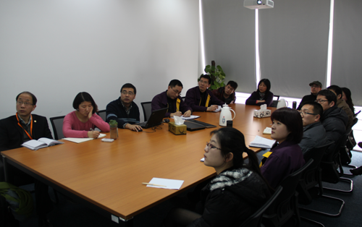
have a meeting

Slide 41
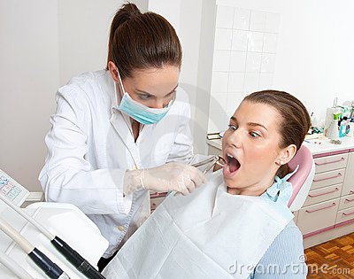
pull…out

Slide 42
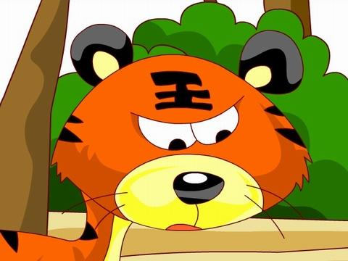
Read a story
A toothless tiger

Slide 43
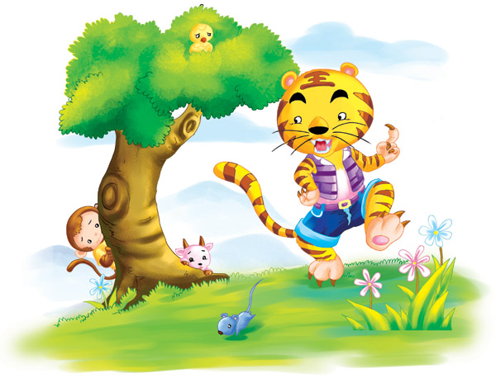
I’m the king of the forest .
Help ! help!
All the animals are afraid of tiger .

Slide 44
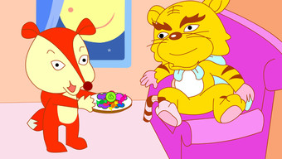
My king , I have a present for you . It’s the best food in the world .
Really ?
Try it . You’ll love it .

Slide 45
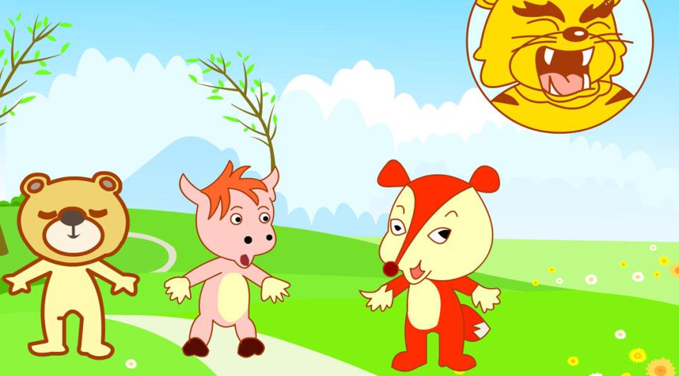
What shall we do ?
I have an idea .
The animals have a meeting . A clever fox has a good idea .

Slide 46
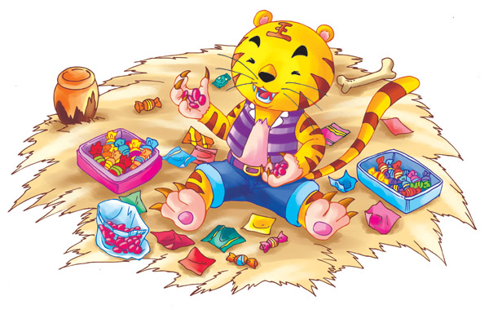
The fox gives the tiger a lot of candy.
The tiger likes the candy very much .

Slide 47
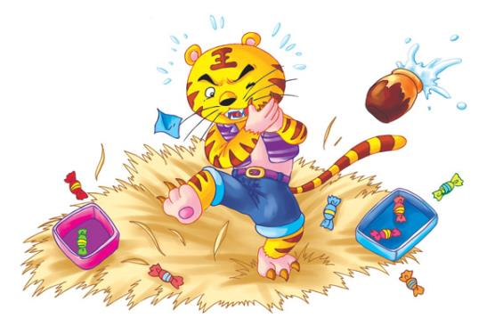
The tiger eats candy every day . Soon he has a toothache .

Slide 48
The animals come to help.
They pull all the tiger’s teeth out.

Slide 49
He becomes a toothless tiger!

Slide 50
Answer the questions.
1, Who are the animals afraid of ?
2, What does the fox give the tiger ?
The animals are afraid of the tiger.
The fox gives the tiger a lot of candy .

Slide 51
3, What gives the tiger a toothache ?
4, How do the animals help the tiger ?
The candy gives the tiger a toothache.
The animals pull all the tiger’s teeth out .

Slide 52
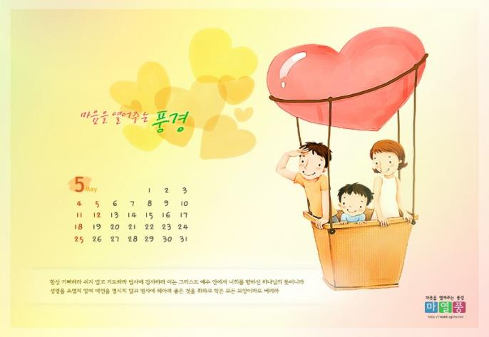
May
[meɪ]

Slide 53
wait
[weɪt]

Slide 54
ay
ai
[eɪ]

Slide 55
Practice
birthday
today
play
day
wait
May

