Slide 1
Unit 4
A good read
WWW.PPT818.COM

Slide 2
Warming up
Do you like reading?
What type of book do you like?

Slide 3
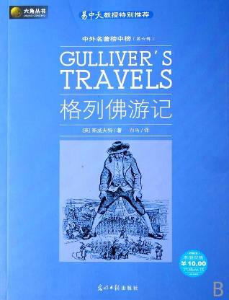
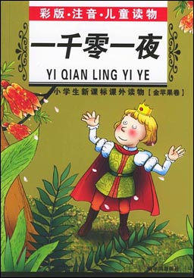
Presentation
read n. 读物

Slide 4
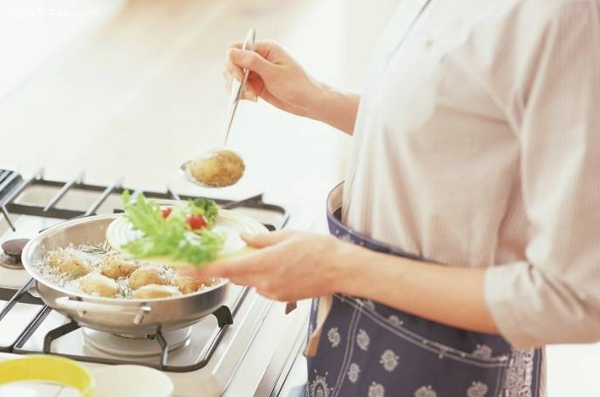
cooking n. 烹饪, 烹调

Slide 5
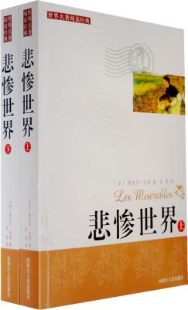
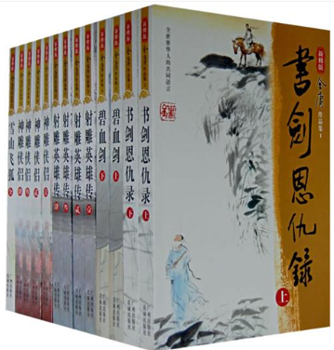
novel n. 小说

Slide 6
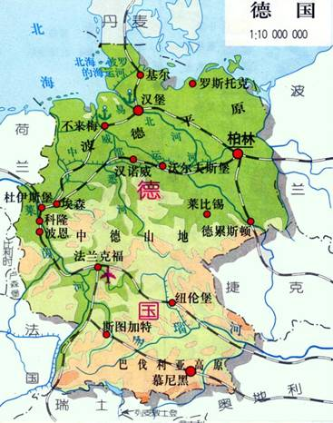

Germany n. 德国

Slide 7

knowledge n. 知识

Slide 8
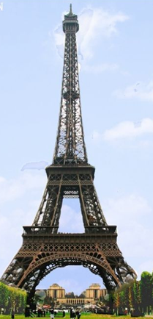
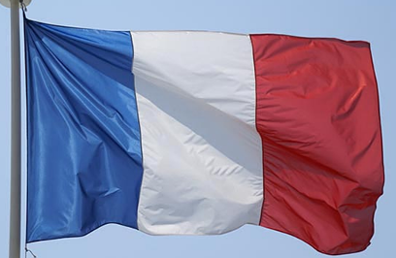
French adj. 法国(人)的

Slide 9
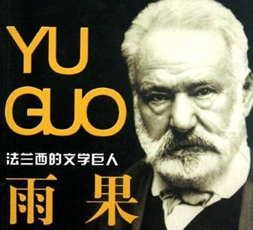
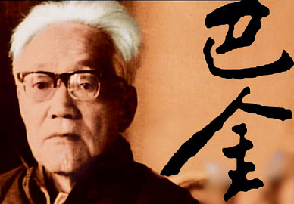
writer n. 作者, 作家

Slide 10
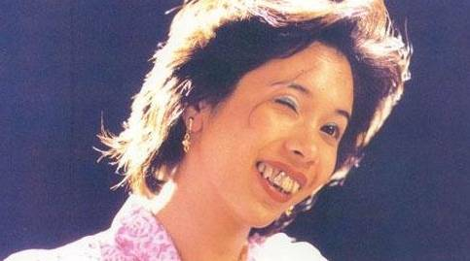
ugly adj. 丑陋的

Slide 11
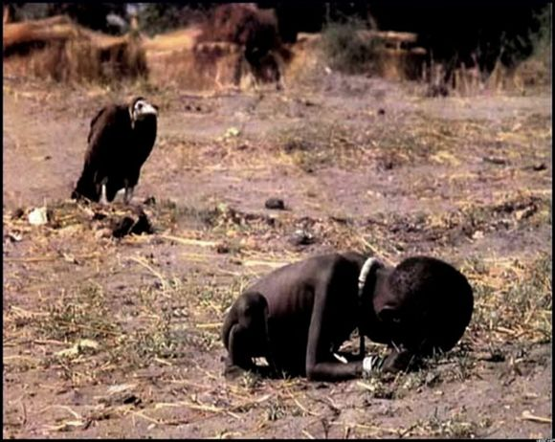
touch vt./ vi. 感动，触动

Slide 12
read n. 读物
cooking n. 烹饪, 烹调
novel n. 小说
Germany n. 德国
knowledge n. 知识
French adj. 法国(人)的
writer n. 作者, 作家
ugly adj. 丑陋的
touch vt./ vi. 感动，触动

Slide 13
Has Hobo decided what to do with the books?
2. What does Hobo want to use the books to do?
Not yet.
He wants to use them to reach the box on the fridge.

Slide 14
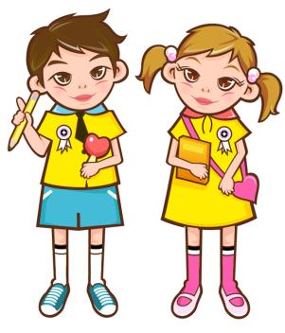
Read aloud the conversation and act it out in pairs.

Slide 15

Welcome to the unit
What type of book do you like?
A Mr Wu is showing the Class 1, Grade 8 students some books. Write the type of book under each picture. Then put a tick ( ) in the box if you have read this type of book before.

Slide 16

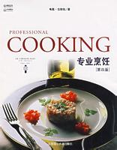
cooking

Slide 17
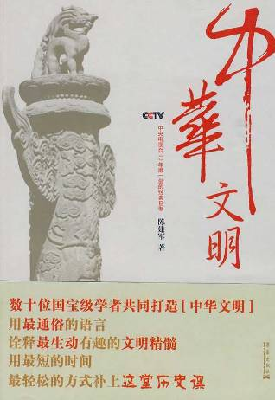
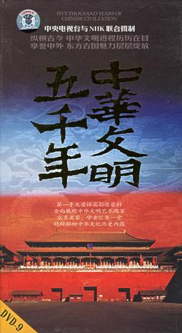
culture

Slide 18
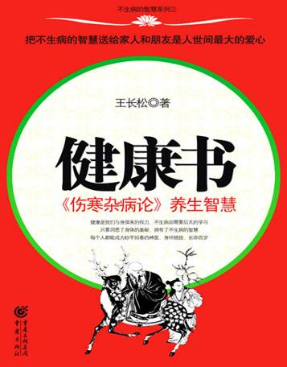

health

Slide 19
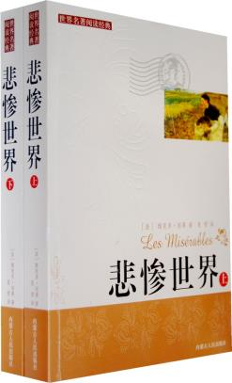
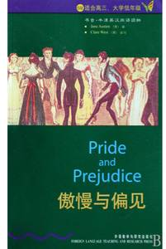
novel

Slide 20

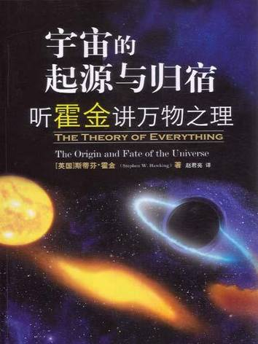
science

Slide 21


travel

Slide 22
B Sandy and Daniel are talking about what they like to read. Read the conversation and answer the following questions.

Slide 23
1. What is Daniel reading?
2. Why does he like reading history books?
He is reading a book about Germany in World War II.
Because they improve his knowledge of the past .

Slide 24
3. Does Sandy like reading history books?
4. What does Sandy like to read in her spare time?
No, she doesn’t. She thinks they’re boring.
She likes reading novels and plays.

Slide 25
Free talk
Work in pairs and talk about the type of book you like.
A: What do you like to read in your spare time?
B: I like reading ….
A: Why do you like reading ….
B: Because …

Slide 26
Notes
Have you decided what to do with these books, Hobo?
霍波, 你已经决定了怎样处理这些书吗？
句中“疑问词what + 动词不定式”结构作宾 语，该结构中的疑问词还可用when、how、which等。
e.g. I did not know how to get away.
我不知道如何逃走。

Slide 27
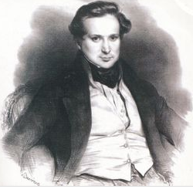
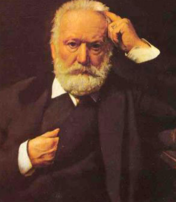
2. I like reading novels and plays. The Hunchback of Notre Dame by the French writer Victor Hugo is great.
我喜欢阅读小说和戏剧, 法国作家维克多·雨果的《巴黎圣母院》很棒。

Slide 28
维克多·雨果，法国浪漫主义作家，人道主义的代表人物，19世纪前期积极浪漫主义文学运动的代表作家，法国文学史上卓越的资产阶级民主作家，被人们称为“法兰西的莎士比亚”，人道主义代表人物。一生写过多部诗歌、小说、剧本、各种散文和文艺评论及政论文章，在法国及世界有着广泛的影响力。
雨果的创作历程超过60年，其作品包括26卷诗歌、20卷小说、12卷剧本、21卷哲理论著，合计79卷之多。其代表作有《巴黎圣母院》和《悲惨世界》。

Slide 29

《巴黎圣母院》是法国作家雨果(1802-1885)创作的浪漫主义小说，叙述的是一位从小生活在巴黎圣母院钟楼的敲钟人卡西莫多(Quasimodo)的故事。
卡西莫多天生身形与长相都异于常人，只能独自在钟楼上过着与世隔绝的生活，直到一场嘉年华会上遇到了吉普赛女郎艾斯美拉达(Esmeralda), 他的世界才开始发生变化。

Slide 30
3. The story of the ugly man Quasimodo really touched me.
丑陋人卡西莫多的故事感动了我。
touch vt. 感动, 触动
e.g. His sad story touched our hearts.
他的悲惨的故事深深打动了我们
的心。

Slide 31

I. 请根据首字母写出单词的正确形式。
1. I am reading a book about c ______. It teaches me how to cook nice food.
2. Lu Xun is a famous w_____ in China. He wrote many n_______.
3. Have you d_______ what to do next.
4. We u____ pens to write.
5. In short, h_____ is more important than wealth.
ooking
riter
ovels
ecided
se
ealth

Slide 32
II. 翻译短语。
1. 怎样处理这些书
2. 给我一本小说
3. 用某物来做某事
4. 冰箱上的盒子
how to deal with the book /what to do with the book
give a novel to me/give me a novel
use sth. to do sth.
the box on the fridge

Slide 33
5. 一本关于德国二战的书
6. 对…...感兴趣
7. 提高某人的知识
8. 法国作家
A book about Germany in World War II
be interested in …
improve one’s knowledge
French writer

Slide 34
1. Read the text book and learn the new words and phrases by heart.
2. Finish the exercises in the workbook.

