Slide 1
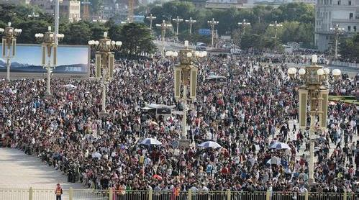
Module 9 Population
Unit 2
Arnwick was a city with 200,000 people.
WWW.PPT818.COM

Slide 2
Teaching objectives
1. To learn the vocabulary in unit 2.
2. To listen and understand the
text on page 74.
3. To try our best to let more people
know the problems of our growing
population.

Slide 3
Words and expressions
/flæt/
/'rʌbɪʃ /
/'kwaɪət /
/'ləukl /
flat
rubbish
quiet
local
close down
套房；公寓 n.
垃圾；废弃物 n.
寂静的; 安静的 adj.
当地的; 本地的 adj.
(永久）关闭，关停

Slide 4
/'pju:pl /
/pə'lu:ʃn /
/'pʌblɪk /
/'sɜ:vɪs /
/ 'sɔlv /
pupil
pollution
public
service
solve
学生; (尤指)小学生n.
污染 n.
公共的；公众的 adj.
公共服务；服务 n.
解决问题 v.

Slide 5
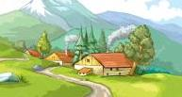
2
Listen, read and learn
Could it be your town?
Jo is fifteen and lives in Parkville. When Jo’s grandparents first came to Parkville, it was a quiet village. They had a small house,
close to fields and hills.

Slide 6
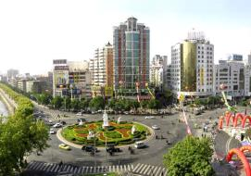
Parkville was near Arnwick, a city with
200,000 people. People from Parkville moved
to Arnwick to find jobs, and they needed places to live. However, it was expensive to
live in the city centre, so the government built flats outside the centre.

Slide 7
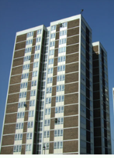
Soon, Parkville became part of Arnwick, and Arnwick became a city with over a million people. Jo’s family lives in one of those flats.
It is very crowded, and rubbish
is also a problem.

Slide 8
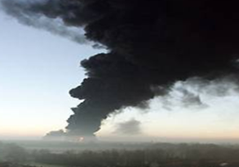
The small local school in Parkville closed down five years ago, so Jo now has to go to a
school in Arnwick with 2000 pupils. It takes an hour to get there by bus. There is a lot of
traffic and pollution.

Slide 9
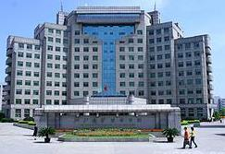
It is clear that Arnwick needs more schools, buses and hospitals. It needs fresh air, clean water, and better public services. It also needs more police to protect its people. But to do all
these things, it needs
more money.

Slide 10
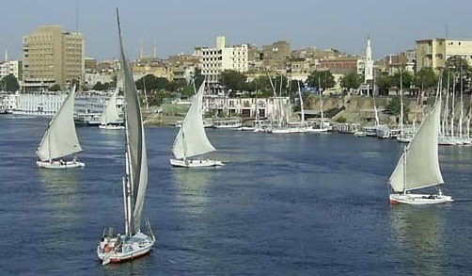
However, can money help solve all these problems? Do we need more big cities like this? In fact, this is just a story. But it describes what is happening all over the
world. Could it be your town some day?

Slide 11
短语背诵
be close to
from...to...
need places to live
live in the city centre
part of...
离......很近
从......到
需要地方居住
住在城市中心
…...的一部分
一个有着二十万万人口的城市
a city with 200,000 people

Slide 12
close down
better service
solve all the problems
in fact
all over the world
关闭
更好地公共服务
解决所有的问题
事实上
全世界
到那乘公交要花费一个小时。
It takes an hour to get there by bus.

Slide 13
课文
巩固
根据短文填空
I used to live in Parkville. It was a _____ village near Arnwick. Then people from Parkwille ______ to Arnwick to _____ jobs,
and the government built _______ for them.
Soon Parkville became ______ __ Arnwick.
Five years ago, the ____ school in Park-ville _____ _____. It _____ me longer time to go
to school.
quiet
moved
find
flats
part
of
local
closed down
took

Slide 14
课文
巩固
It also caused a lot of _____ and _______. How I wish I could go to a school near
my neighborhood !
Arnwick needs more schools, buses and ________. It needs fresh air, clean water, and better ____________. It needs more ______ to protect people. It needs _____
______to do all these things.
traffic
pollution
hospitals
public service
police
more
money

Slide 15
课文
巩固
Parkvile was a _____village when Jo’s ___________ first came there.
Arnwick is a city with _______ people
and they are from Parkvile to Arnwick
to find ____ and places to live in.
quiet
grandparents
200,000
jobs

Slide 16
课文
巩固
3. The Arnwick government built ________ outside the centre because living in the
city centre was ________.
4. Except the population, ________ is also a
problem in Arnwick. It needs more _____
to protect its people.
flats
expensive
rubbish
police

Slide 17
Language points
flats “公寓，套房”
house “房子”
It’s clear that … “很清楚……”
很明显，我们要在即将到来的
期末考试前努力学习。
It’s clear that we need to work hard
before the coming final exam.

Slide 18
local adj. 当地的
close down “（永久性地）停工，关闭”。
去年那家公司关闭。
The company closed down last year.
The government closed down all the coal mines in this area in the 1980s.
当地政府在20世纪80年代关闭了这个地区的所有煤矿。

Slide 19
pollution n. 污染
pollute v. 污染
噪音污染是城市中更为严重的问题。
Noise pollution is more serious in the city.
水污染
water pollution
大气污染
air pollution

Slide 20
It takes sb. some time to do sth.
某人花多长时间做某事。
It takes an hour to get there by bus.
乘巴士去那儿需一个小时。
It took me an hour to do my homework.
我用了一个小时做作业。

Slide 21
flat local pollution
rubbish service thousand
Many towns and cities have the same problems as Arnwick. People need places
to live, so the (1) ______ government has
to build more (2) _________. People need
better bus and train (3) __________.
local
flats
services

Slide 22
flat local pollution
rubbish service thousand
They also produce more (4) ________, so the government has to make more efforts to protect the city against (5) __________. As we say, a hun- dred people make a (6)
________ problems!
rubbish
pollution
thousand

Slide 23
汉译英
他觉得他像家庭中的一员了。 (one of …)
2. 她花了两个小时做作业。(It takes…to do)
3. 中国丝绸驰名天下。 (all over the world)
He feels like one of the family now.
It took her two hours to do her homework.
The Chinese silk is famous all over the world.

Slide 24
1. Please make _____ for the old woman.
A. house B. flat C. room D. rooms
2. The factory _____ last year and the villagers
were very happy to have a better life.
A. closed off B. closed away C. closed down
3. Air ______ is a serious problem in big cities.
A. pollution B. pollute C. rubbish
4. The government needs to make ______ to
protect the forest.
A. laws B. stories C. ways
C
C
A
A

Slide 25
5. Our school is ______ the Building.
A. near from B. far to
C. close to D. far away
6. It takes me a long time ________
the TV play. A. watch B. watches
C. watching D. to watch
15. Life in the city can’t be _______ than that in the country.
A. enjoyed B. more enjoyable
C. much enjoyable D. enjoyable
C
D
B

Slide 26
Write a composition about how to solve the problems in your home town.
With the development of our home town, it is becoming stronger and stronger. But there are still some problems in our home town.

Slide 27
Homework
1. Recite the text on page 74.
2. Do something to protect our hometown.
3. Complete the exercise in the workbook.

Slide 28
Protect the environment! Because we have only one earth, this is our common home!
保护环境吧！因为我们只有一个地球，这是我们共同的家园！

Slide 29
Goodbye

