Slide 1
Module 8 Accidents
Unit 2 I was trying to pick it up when it bit me again.
WWW.PPT818.COM

Slide 2
目录导航
01
课 前 预 习
02
课 堂 导 学
03
课 文 理 解
04
巩 固 提 升

Slide 3
课 前 预 习
一、必背单词 (请在课文中找出下列单词)
名词
1. 痛；疼痛 ___________
2. 冰箱 ____________
3. 药；药物 ____________
pain
fridge
medicine

Slide 4
动词
1. 咬；叮 ___________
2. 出现；显露 ____________
3. 爬；攀爬 ___________
4. 扔；掷 ____________
bite
appear
climb
throw
兼词
更糟的；更坏的adj. 更糟；更严重adv. ____________
worse

Slide 5
二、常用短语(请在课文中画出下列短语)
1. 早几天前a few days earlier
2. 捡起它pick it up
3. 把……扔向厨房的另一边throw…across the kitchen
4. 躺在桌子上lie on the table
5. 匆忙/赶紧去医院hurry to hospital
6. 变得更糟糕get worse

Slide 6
7. 处于巨大的痛苦中in great pain
8. 把某物送往某地send sth. to…
9. 一……就……as soon as
10. 第二天the next day
11. 取出/拿出某物take out sth.
12. 正如你所知as you know
13. 从箱子里爬出来climb out of a box

Slide 7
三、经典句型(请在课文中画出下列句型)
1. 我正试图捡起它，这时它又咬了我一口。 | I was trying to pick it up when it bit me again.
2. 当亨利正试图找到这条蛇时，他的手开始剧烈地疼痛起来。 | When Henry was trying to find the snake, his hand began to hurt badly.

Slide 8
3. 医生给他做检查时，疼痛加剧。 | As the doctors were checking him, the pain got worse.
4. 他们一得知是哪种蛇咬伤了亨利，就给他对症下药。 | As soon as they learnt what kind of snake bit him, they gave Henry the right medicine.
5. 但是你知道，蛇可不会笑！ | But as you know, the snake won’t smile！

Slide 9
课 堂 导 学
1. I was trying to pick it up when it bit me again.
当我正试图捡它，这时它又咬了我一口。
(1)pick up“捡起；拾起；接(某人)”，后接名词作宾语时，该名词通常放在短语之后，但也可放在短语中间；接人称代词宾格作宾语时，只能用pick it/them up。

Slide 10
如：
①他捡起了刀叉。
He _______________ his knife and fork.
②地上有一些书。
请把它们捡起来。
There are some books on the ground. Please _______________.
picked up
pick them up

Slide 11
(2)bite sth. /sb. “叮、咬某物/某人”，若后接具体身体部位常用“bite sb. on /in+身体部位”。(类似用法的动词有hit, catch等)。如：
①这只小狗把我的手咬了。
The little dog _______________ the hand.
②刚才他爸爸打了他的脸。
His father _______________ the face just now.
bit me on
hit him in

Slide 12
2. As he was lying there in great pain， …
当他躺在那儿处于巨大的痛苦中时……
in great pain “剧痛”。 pain 既可表示肉体上的“疼痛”，也可表示精神上的“痛”；泛指疼痛时是不可数名词；特指身体某个部位疼痛时是可数名词，常用于 “have a pain /pains in /on+身体部位”。

Slide 13
如：
(1)玛丽的爷爷奶奶离开了她，她非常难过。
Mary’s grandparents left her, so she was _______________.
(2)我哥哥昨晚背痛。
My brother _______________ his back last night.
in great pain
had a pain in

Slide 14
3. As soon as they learnt what kind of snake bit him, they gave Henry the right medicine. 他们一得知是哪种蛇咬伤了亨利，就给他对症下药。
as soon as连词，意为“一……就……”，连接时间状语从句；如果主句用一般将来时，从句要用一般现在时(主将从现)

Slide 15
【学以致用】
（ ）(1)I ____ you the message as soon as I get it.
A. will send B. sent C. send D. sends
（ ）(2)They will come to see you ____ they finish the work tomorrow.
A. after B. before C. as soon as D. until
A
C

Slide 16
课 文 理 解
一、阅读Act. 3课文，完成下列题目。
（ ）1. Where did the snake bite?
A. Henry’s mobile phone.
B. Henry’s hand.
C. Henry’s head.
D. Henry’s foot.
B

Slide 17
（ ）2. Where did the snake come from?
A. Asia. B. Africa. C. America. D. China.
（ ）3. When did Henry pick up his mobile phone?
A. When his hand began to hurt badly.
B. When he hurried to hospital.
C. When the snake lay on the table.
D. When he found the snake in the kitchen.
A
C

Slide 18
（ ）4. Which of the following is NOT true according to Paras. 5 & 6?
A. As the doctors were checking Henry， the pain got worse.
B. At first，the doctors could help Henry.
C. When the doctors knew the kind of snake， they could give Henry the right medicine.
D. Henry left hospital the next day.
B

Slide 19
（ ）5. Which paragraph is the main idea of the passage?
A. The first paragraph.
B. The fourth paragraph.
C. The second paragraph.
D. The last paragraph.
D

Slide 20
二、根据Act. 3课文，完成下列短文填空。
One day， Henry was working in a restaurant. Suddenly， a snake 1. __________. It 2. __________ his hand. He wanted to
3. __________ it up but it bit him again. He 4. __________ the snake across the kitchen. The snake lay on a table. He took a
5. __________ of the snake. The snake 6. __________ behind the fridge.
appeared
bit
pick
threw
photo
hid

Slide 21
Henry’s hand began to hurt 7. __________ when he was trying to find the snake. He 8. __________ to hospital. The doctors checked him， but they could not help him. Then he suddenly remembered the photo. The doctors 9. _______ the photo to a zoo and learnt what kind of snake it was. The doctors gave Henry the right 10. __________， and he left hospital the next day. So if a snake bites you， take a photo with your mobile phone.
badly
hurried
sent
medicine

Slide 22
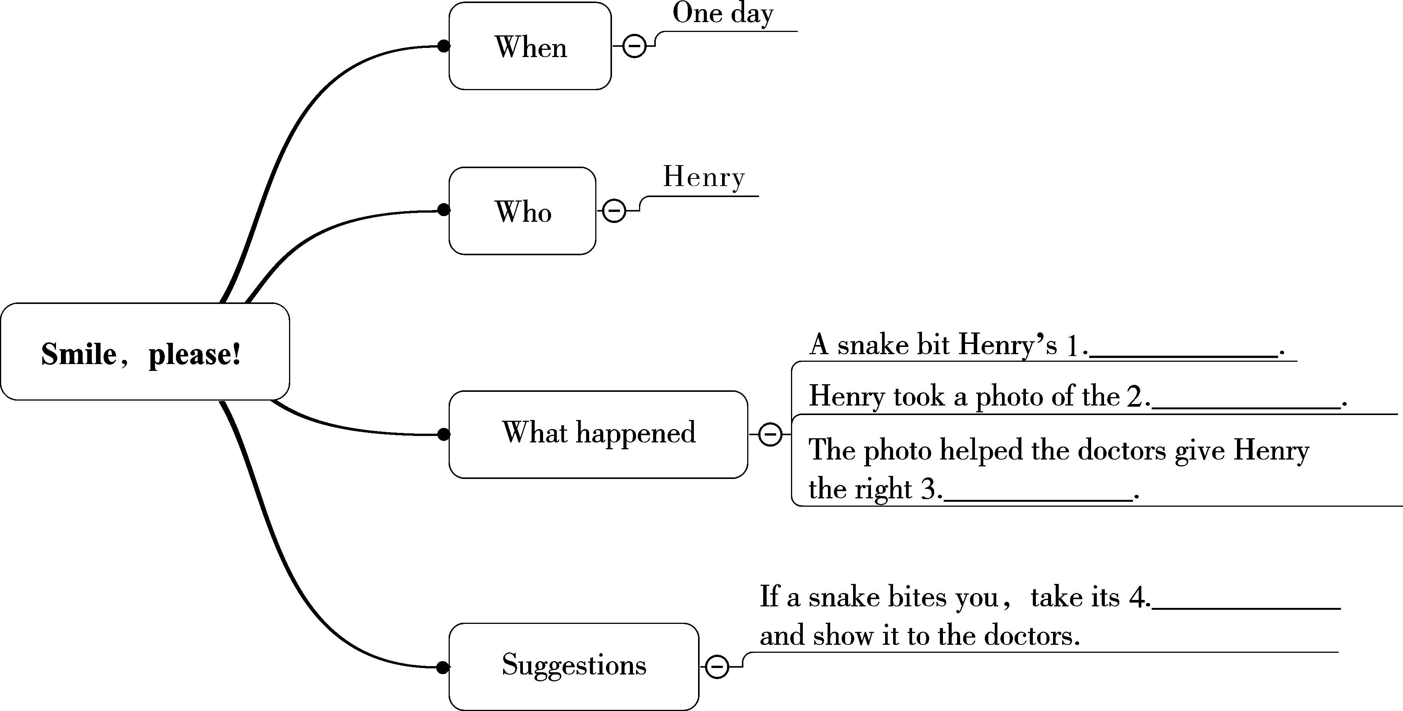
三、根据课文内容，完成下列思维导图，然后口头复述课文。
hand
snake
medicine
photo

Slide 23
巩 固 提 升
一、根据句意或汉语提示填写单词。
1. A dog __________ (咬)Mr Brown’s hand this morning and it hurts badly now.
2. Do you want to __________ (爬)the hill with me tomorrow?
3. I __________ (躲)behind the door just now，so you couldn’t find me.
bit
climb
hid

Slide 24
4. Don’t ________ (扔)the books everywhere. You should put them away.
5. In summer I think _______ are the most useful for us to keep food and drinks cool.
6. Because of the heavy traffic, the pollution is getting ________ than before.
7. If you are ill for long, you had better take some Chinese _____.
throw
fridges
worse
medicine

Slide 25
二、单项填空。
（ ）1. —Do you ____ your son after school every day?
—No. He comes back home on the school bus.
A. look up B. get up C. pick up D. put up
（ ）2. ____ time goes by，my grandpa’s memory seems to get ____.
A. If； worst B. If； worse C. As； worst D. As； worse
C
D

Slide 26
（ ）3. While she ____ TV last night，she ____ a sound outside the room.
A. was watching；was hearing
B. watched；was hearing
C. watched；heard
D. was watching；heard
D

Slide 27
（ ）4. —Can a plane fly ____ the Atlantic Ocean?
—Yes，but it needs to go ____ the clouds for hours.
A. across；through
B. through；across
C. across；across
D. through；through
A

Slide 28
（ ）5. Mr Green was talking on the phone ____ I arrived at his office this morning.
A. while B. when C. after D. where
（ ）6. In the accident the man hurt badly and he was in great ____, so he was sent to hospital at once.
A. danger B. peace C. time D. pain
B
D

Slide 29
（ ）7. —What’s your plan for the summer holiday?
—I’ll go to Beijing ____ the school term ends.
A. though B. so that C. as soon as D. because
（ ）8. While all the staff(全体工作人员) ____ a meeting，a customer came in.
A. is having B. were having
C. had D. are having
C
B

Slide 30
（ ）9. Unluckily， the dog bit her ____ the left hand yesterday when she fed it.
A. of B. on C. with D. to
（ ）10. Alice wanted to ____ some photos with her new camera.
A. take B. pass C. touch D. book
B
A

Slide 31
三、根据句意和汉语提示完成句子，词数不限。
1. 地上有张纸，请捡起来。
There is a piece of paper on the floor. Please _______________.
2. 刚才一条蛇从箱子里爬了出来。
A snake _______________ the box just now.
pick it up
climbed out of

Slide 32
3. 当他很痛苦地躺在那里的时候，他想到了他的妈妈。
_________________ he was _________ there __________，he thought of his mother.
4. 正如你所知，杰克是一个善良的男孩。
_______________， Jack is a kind boy.
When/As /While
lying
in pain
As you know

Slide 33
5. 由于更多的工厂和更繁忙的交通，现在空气污染正变得越来越严重。
Now the air pollution __________________________because of more factories and busier traffic.
is getting worse and worse

Slide 34
四、阅读理解。(难度：★★★★☆)
An argument(争论)between a passenger and a driver led to the bus crash that killed at least 13 people in Chongqing on October 28，2018.
A 48-year-old woman passenger had missed her stop and got into an argument with the bus driver, a 42-year-old man，Mr. Ran，at around 10:08 am.

Slide 35
Things got worse between them and Liu struck Ran when they were crossing No. 2 Yangtze Bridge in Wanzhou District. The driver fought back. With the incident turning more and more fierce, Ran lost control of the bus, causing it to run into the wrong lane(车道), knocked into an oncoming(迎面而来的) car before breaking through the road fencing and flying off the bridge, the investigation found.

Slide 36
A video from the bus shows Liu was standing next to Ran and arguing with him. She is then seen hitting Ran twice with her cellphone while Ran catches her arm and hits her on the neck.
The investigation team said the fight greatly endangered public safety and guilty of committing a crime. There were 15 people, including Ran,

Slide 37
on the bus when the incident happened. Thirteen bodies have been taken out from the river so far. The wreck(残骸) of the bus was pulled out of the water by a floating crane(吊车) at 11:30 pm on Wednesday.

Slide 38
（ ）1. Why did the authority say the accident killed at least 13 people?
A. Because the driver and the woman who missed her stop jumped out.
B. Because two people were receiving treatment in the hospital.
C. Because two people were found swimming out of the river.
D. Because there are still two bodies not being found.
D

Slide 39
（ ）2. What caused the fight?
A. The driver made fun of the woman.
B. The woman lost her money on the bus.
C. The woman missed her stop.
D. The driver stopped suddenly and hurt the woman.
C

Slide 40
（ ）3. What does the underlined word “struck” mean in Chinese?
A. 击打 B. 触碰 C. 责备 D. 谋杀
A

Slide 41
（ ）4. What can you learn from this passage?
A. Fights will never endanger public safety.
B. We should be patient when we meet problems.
C. Bus drivers should stop for passengers who missed the stop.
D. Other passengers should protect the driver.
B

Slide 42
（ ）5. In which part of newspaper can you see this passage?
A. Life.
B. Sports.
C. Science.
D. Education.
A

