Slide 1
Unit 10
Can I help you ?
WWW.PPT818.COM

Slide 2
Unit 10 Can I help you?
教学目标：
能在听说读写的活动中理解和运用购物用语“How much is / are…?It’s / They are…yuan.”
能用英语模拟购物情景。

Slide 3
1、How much is Snow White’s dress?
2、What colour is the dress?
3、Is the dress cheap?
4、Is Snow White pretty?

Slide 4
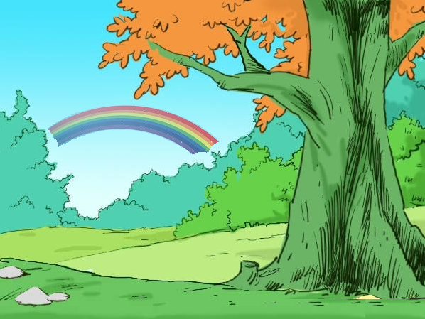
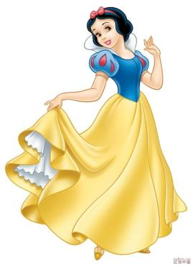
Hello, I’m Snow White. I’m pretty.
Hello, I’m zip. I’m lovely.

Slide 5
Guess!
Your dress is pretty. How much is it?

Slide 6
No. It’s 20 yuan.
90 yuan?
Oh!it’s too cheap.
返回

Slide 7
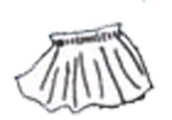
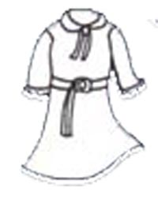
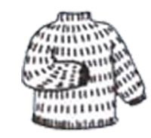
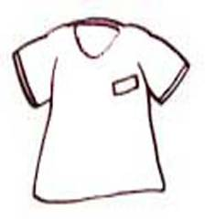
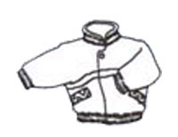
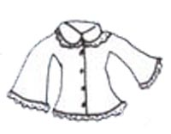
shirt
dress
sweater
skirt
jacket
T-shirt

Slide 8
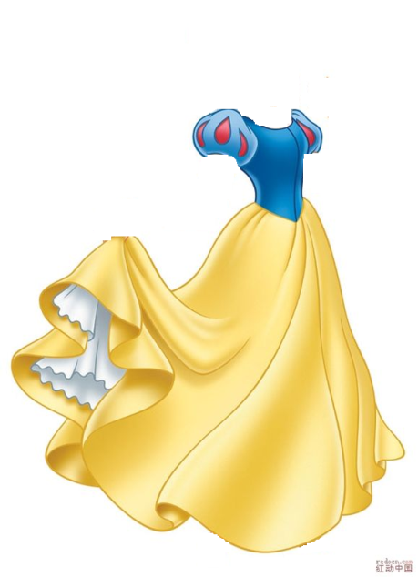
pretty

Slide 9
1、How much is Snow White’s dress?
2、What colour is the dress?
3、Is the dress cheap?
4、Is Snow White pretty?

Slide 10
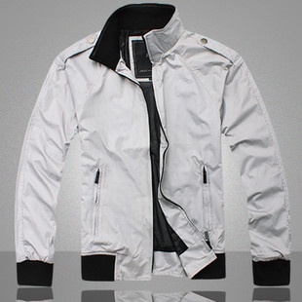
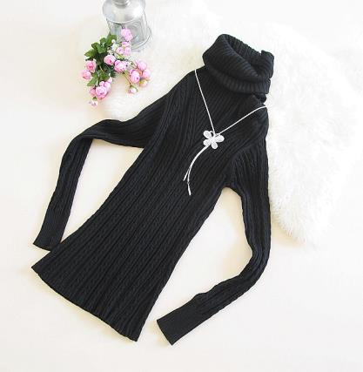
a jacket
a sweater

Slide 11
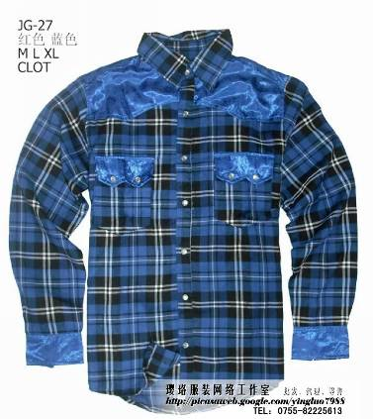
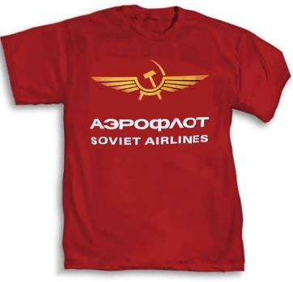
a shirt
a T- shirt

Slide 12
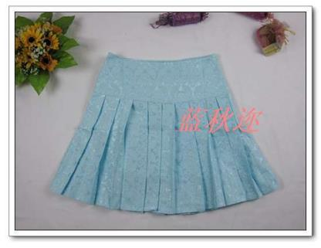
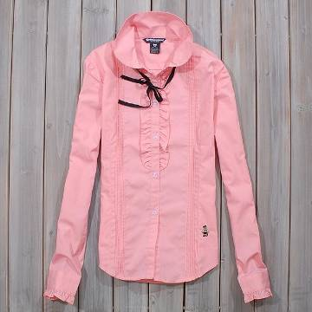
a skirt
a blouse

Slide 13
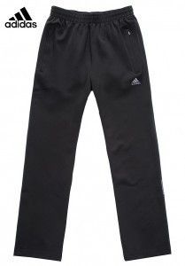
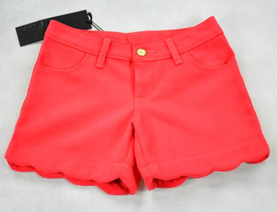
shorts
trousers

Slide 14
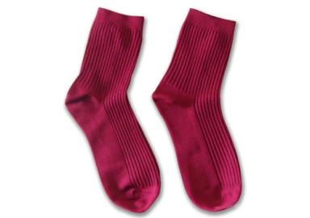
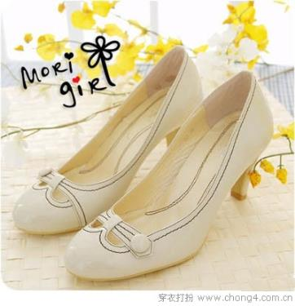
socks
shoes

Slide 15
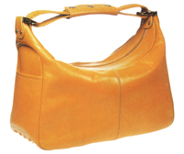
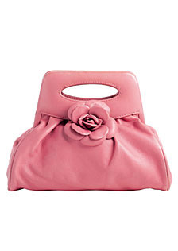
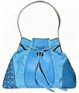
bags

Slide 16
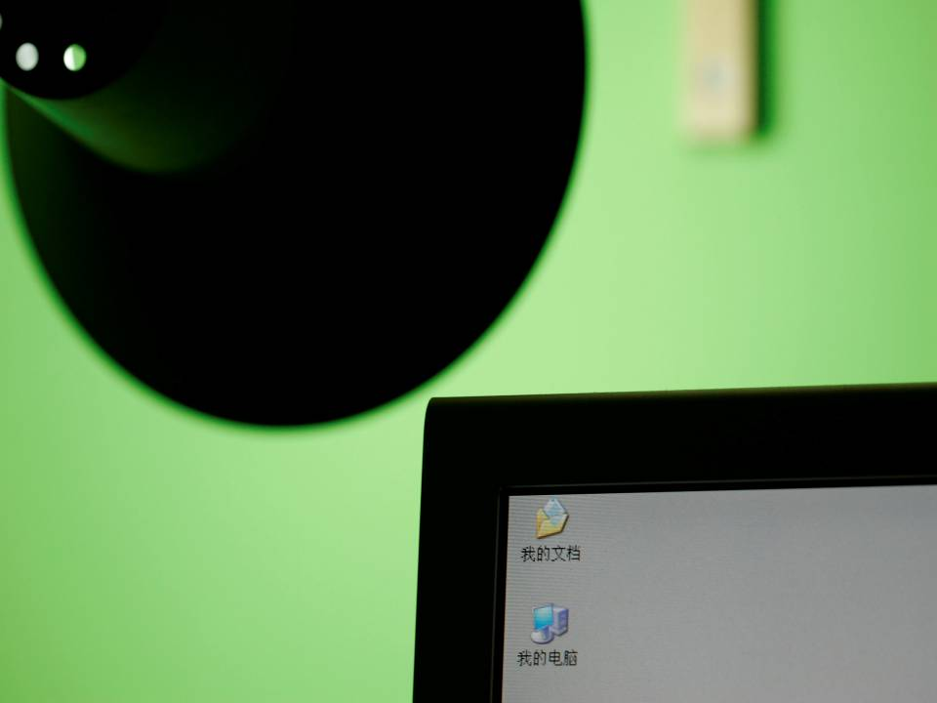
hat
shorts
shirt
jacket
shoes
dress
sweater
blouse
socks
clothes
T- shirt
trousers
skirt
Can you remmember ?
How to spell it ?

Slide 17
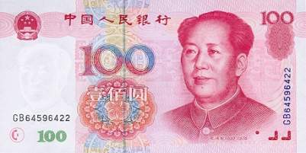
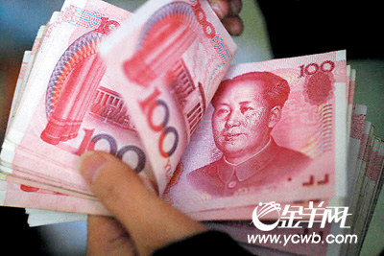
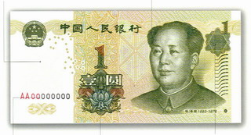
100 yuan
￥
RMB人民币
1 yuan

Slide 18
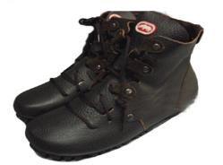
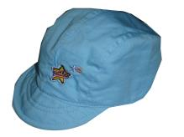
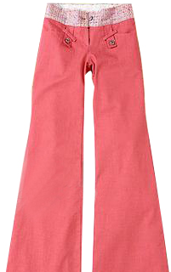
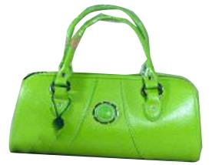
Ask and answer:
￥14
￥ 199
A:How much is this/that + 名词（单）？B:It’s … yuan .
A: How much are these/those + 名词（复） ?
B: They’re … yuan.
￥118
￥238

Slide 19
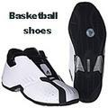
￥ 38
-How much is this bag?
-It’s ￥ 38. (it’s = it is; ￥ = yuan)
￥38
that
￥ 129
-How much are these shoes?
-They are ￥ 129. (they’re = they are)
￥ 129
those

Slide 20
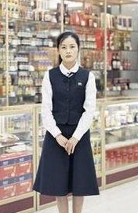
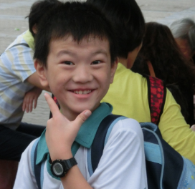
Can I help you?
Yes,please.
I want
to buy some
Shoes.

Slide 21
We have these
black shoes and those brown
ones.
How much are the black shoes?

Slide 22
They’re
150 yuan.
I’ll take them.

Slide 23
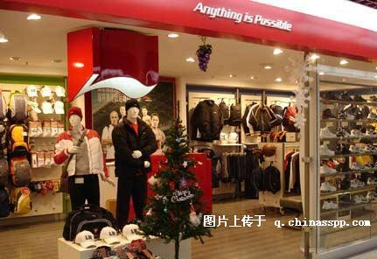
Let's go shopping.

Slide 24
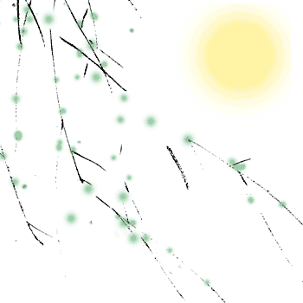
总结一下
学会购物询问价格用 how much句型
1.How much is this/that + 名词（单）？
It’s … yuan .
2.How much are these/those + 名词（复） ?
They’re … yuan.

Slide 25
Homework
1.听读录音Unit10课文
2.模仿Unit10课文写一段购物小对话

