Slide 1
Unit11
I want to be a painter
WWW.PPT818.COM

Slide 2
第一层次：Warm-up
1. Greetings
2. Sing a song

Slide 3
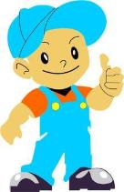
Let’s sing!
I want to be a
I want to be a
I want to be a when I grow up.
I want to be a
I want to be a
I want to be a when I grow up.

Slide 4
第二层次：Presentation and Practice
1.引入
2.创设情景“Mickey愿望记”。
3.游戏巩固本课重难点

Slide 5
引入
1.How many teachers are there in our school?
2.Do you want to be a teacher when you grow up?
3.What do you want to be when you grow up?
I want to be a painter.

Slide 6
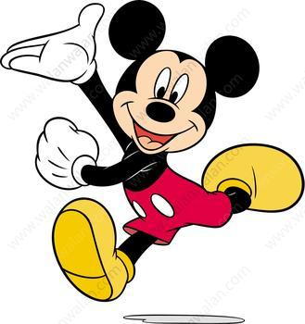
Mickey
愿望记

Slide 7
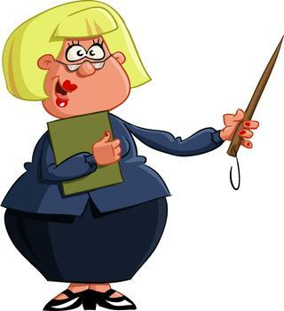
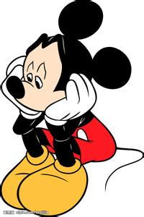
Aki
What do you want to be
when you grow up?

Slide 8
Which one ?
a cook,
a nurse,
A painter,
a builder,
a doctor,
a policeman,
a reporter,
a teacher ?

Slide 9
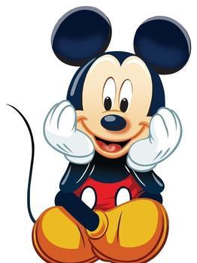
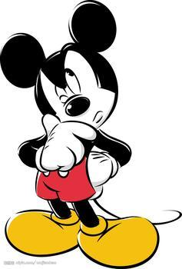
I want to be the person
people need most.
Who is the person people need most?

Slide 10
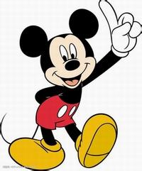
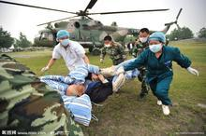
I want to be a doctor.
I want to help sick people.

Slide 11
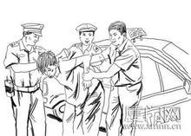
I want to be a policeman.
I like to help people.

Slide 12
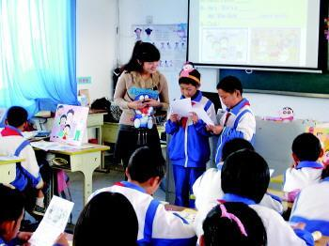
I want to be a English teacher.
I am good at English.
I want to be the engineer of the human soul.

Slide 13
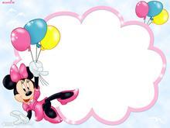
Play a game

Slide 14
doctor
help sick people

Slide 15
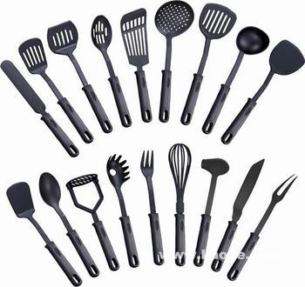
cook
cook nice food for people

Slide 16
第三层次：Dialogue Learning
观看课文动画
Let's Repeat
Let's Answer
小组合作学习课文

Slide 17
Let's learn

Slide 18
Let's Repeat
Tell the teacher what do you hear.
Words,phrases and sentences are all OK.

Slide 19
Let's Answer
1. What does Ben want to be when he grows up?
2. Is Janet good at English?
3.Does Mike love art very much?

Slide 20
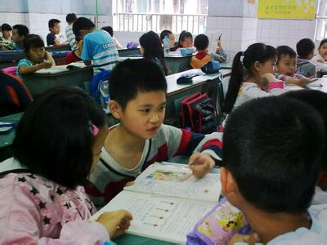
小组合作学习课文

Slide 21
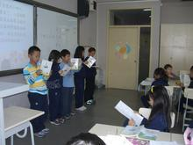

Slide 22
第四层次：Consolidation and Development
Make a survey——Writing

Slide 23
Make A Survey
Name | Occupation | Reason
Janet | English teacher | She is good at English.
What are you going to do when you grow up?
Why?

Slide 24
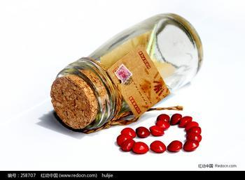
Writing
My name is ____. I am ___ years old. I want to be _______.I like to ________.
Ailsa
10
help sick people
a nurse

Slide 25
第五层次：Sum-up
Try to help students to make a summary about what we have learnt today.

Slide 26
Homework
1.copy the new words and try to recite the passage.
2.Make a survey about your families.
3.Chosen: design a dream card and stick it on your desk as a motto.

Slide 27
Thank you very much!

