Slide 1
What does he look like?
Section B 第2课时
WWW.PPT818.COM

Slide 2
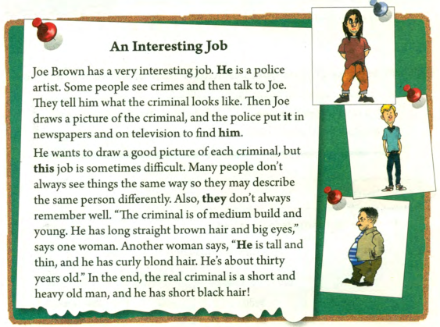

Slide 3
Joe Brown has a very interesting job. He is a police artist. Some people see crimes and then talk to Joe. They tell him what the criminal looks like. Then Joe draws a picture of the criminal, and the police put it in newspapers and on television to find him.
1. 一些人看见犯罪活动，然后告诉乔。
talk to sb.“和…交谈”表示告诉某人什么事 Mom is talking to me.
talk with相互沟通 talk about sth. 谈论
2. draw a picture of...“画…的画像”Tom can draw pictures of dogs well.

Slide 4
1. each为形容词，意为“每个，各自”修饰可数名词单数。
2. same形容词，意为“相同的，同一的”其前往往加the 。
They always ask the same question.
the same(...) as... 和…一样…
My bag is the same color as yours.
He wants to draw a good picture of each criminal,
but this job is sometimes difficult .Many people
don’t always see things the same way so they may
describe the same person differently. Also, they
don’t always remember well. “the criminal is of
medium build and young. He has long straight,
black hair and big eyes,” says one woman. Another woman says, “he is tall and thin, and he has curly blond hair. He’s about thirty years old.” A man says,“ He is of medium height. he has a long nose and small eyes. He wears a brown jacket." In the end, the real criminal is a short and heavy old man, and he has short black hair。

Slide 5
形容词的顺序：
限定词+数量词(序数词在前, 基数词在后)+性状形容词+大小、长短、高低等形体+名词
形容词修饰头发时的顺序：
大小长短→形状→颜色。
She has short curly blonde hair.
He wants to draw a good picture of each criminal,
but this job is sometimes difficult .Many people
Don’t always see things the same way so they may
describe the same person differently. Also, they
don’t always remember well. “the criminal is of
medium build and young. He has long straight,
black hair and big eyes,” says one woman. Another woman says, “he is tall and thin, and he has curly blond hair. He’s about thirty years old.” A man says,“ He is of medium height. he has a long nose and small eyes. He wears a brown jacket.” In the end, the real criminal is a short and heavy old man, and he has short black hair。

Slide 6
根据汉语提示补全句子
1. Joe draws ____ ______ ___ _____ ________ （罪犯的图像）
and the police put it____ _____________and ____ __________
（报纸和电视上）to find him.
2. Many people don’t always see things ____ ______ ______ .（同样的方式）
3. He has _____ ________ ______ ______ and big eyes. （黑色的长直发）
a picture of the criminal
in newspapers on television
the same way
long straight black hair

Slide 7
单项选择
1. Mrs. Green has _______ hair.
A. black long beautiful B. beautiful black long
C. beautiful long black D. a beautiful long black
2. Mr. Black will _______ us an interesting story this evening.
tell B. say C. speak D. talk
3. They have _______ habits.
A. same B. the same C. same as D. the same as
C
A
B

Slide 8
一
词和短语
二
形容词的顺序
each，same，talk等

