Slide 1
Unit 4 Road safety
WWW.PPT818.COM

Slide 2
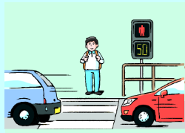
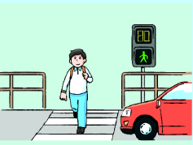
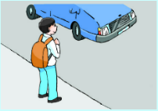
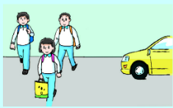
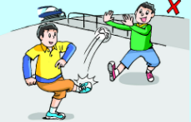
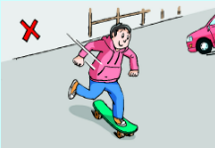
Learning aims（学习目标）:
I can understand the story with the help of pictures.
I know how to cross the road safely.
I can tell others about road safety.

Slide 3
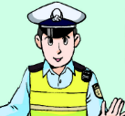
red man
green man
a zebra crossing
traffic lights
a pavement

Slide 4
1
Match the pictures and sentences
What you mustn’t do
on the road
2
How to cross the road
with a zebra crossing
How to cross the road
without a zebra crossing
3

Slide 5
There are many busy roads in the city. How can you cross them safely?
Look! Here’s the green man.
You can cross the road now.
Can you see the red man?
You mustn’t cross the road now.
a zebra crossing
First, you must look for _______________.
Then, you must look at the_______________
and wait for the____________.
traffic lights
green man
Part 1

Slide 6
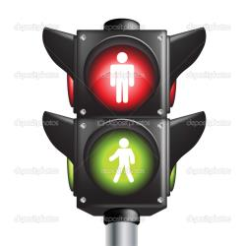
Let’s try to chant!
Do you remember?
How to cross the roads safely
First look for ______________
Then look at ______________
Traffic lights mean different
__________ stop
__________ go
You must wait
On the road!
a zebra crossing
the traffic lights
Red man
Green man
Part 1

Slide 7
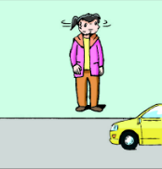
How to cross the road safely when there is no zebra crossing?
Part 2
pavement

Slide 8
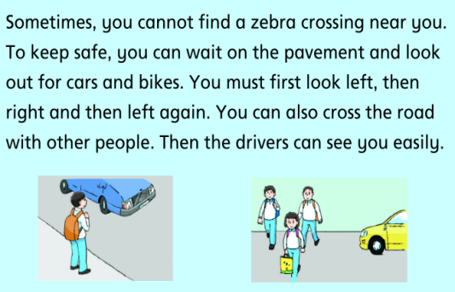
Read Part 2 and judge.
Circle some key words.
T/F
1. You can wait on the motorway and look out for cars and bikes.
2. You must first look right, then left, and then right again.
3. It’s safer to cross the road with other peole.
Part 2

Slide 9
Judge.
True of false?
1. You can wait on the motorway and look out for cars and bikes.
2. You must first look right, then left, and then right again.
3. It’s safer to cross the road with other peole.
pavement
F
F
left
right
left
T
B
Part 2
pavement

Slide 10
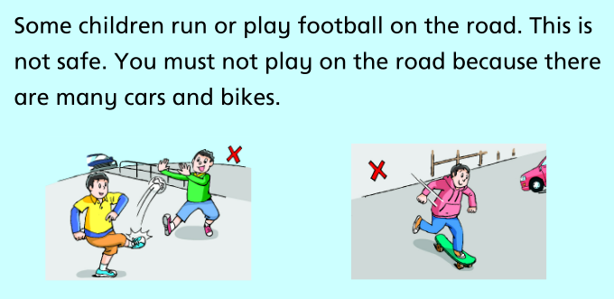
Part 3

Slide 11
Let’s teach Grandma. Act it out.
S1 : Grandma, you mustn’t cross the road like that!
: Why not?
S1: Oh, Grandma. It’s too dangerous. You must first look for …. Then look at … and wait for the …
: But there is no zebra crossing!
S1: When there is no zebra crossing, you must wait on … and look out for ...
: Look out? How?
S1: You must first look … then … and then…
: Like this?
S1: Very good, Grandma! You can also cross… with …, because …
: I think I’ve got it. Thank you .

Slide 12
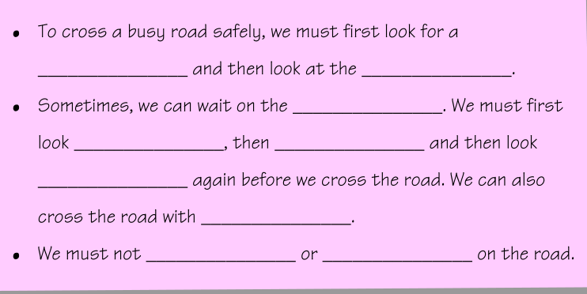
Complete the notes.
Can you finish it by your own?
zebra crossing
traffic lights
pavement
left
right
left
other people
run
play

Slide 13
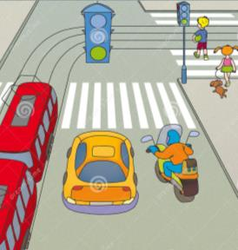
Let’s learn road safety.
To cross the road safely
Look for a zebra crossing
And look at traffic lights.
Let‘s sing it out!
Sometimes no zebra crossing,
Then wait on the pavement
We must look carefully,
Left, right and left again.
Cross the road with more friends,
Drivers can see you easily.
You must not run or play,
On the road it isn’t safe.

Slide 14
Topics:
Road safety for pedestrians/walking people.
Road safety for car drivers.
Road safety for bus passengers（乘客）.
Road safety for bikers.

Slide 15
Group work
Choose one topic to make a PSA（公益广告）.
Road safety for pedestrians/walking people.
Road safety for car drivers.
Road safety for bus passengers（乘客）.
Road safety for bikers.

Slide 16
Tip1: You must use ‘You must/mustn’t…’
Tip2: Make a slogan（口号）. And try to make it funny.
Tip3: You may add some super stars into your PSA.
S1: Road safety for …. Action!
…
…
…
S2: Ladies and gentlemen, …(your slogan)….
All: Let‘s follow the rules and stay safe on the road!
Group work

Slide 17
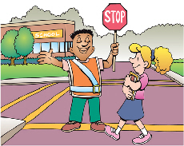
Homework
Read the story again by yourself. Try to retell it in your own words
List out what you must do and must not do. Make it into a poster.

