Slide 1
Are you happy?
WWW.PPT818.COM

Slide 2
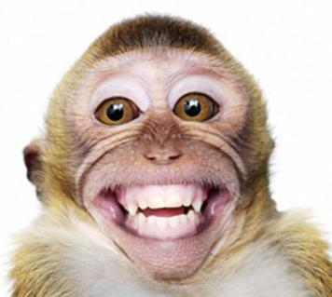
h
a
pp
y

Slide 3
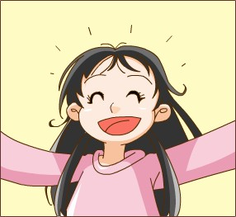
I am happy!

Slide 4
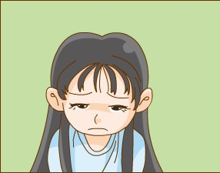
I am not happy!
I am sad.

Slide 5
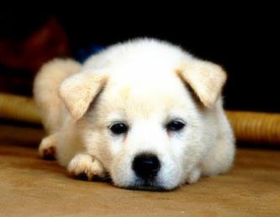
s
a
d

Slide 6
Can you read?
Happy, happy, happy!
I am happy!
I play on the tree!
I swim in the sea!
Sad, sad, sad.
I am sad.
I cry on the bed.
I talk to my dad.

Slide 7
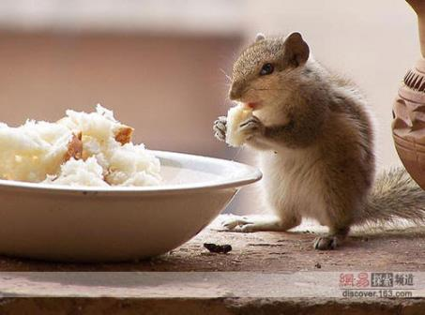
h
un
g
ry

Slide 8
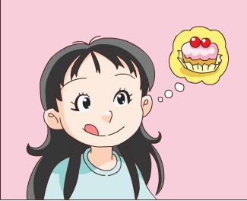
I am hungry!

Slide 9
f
u
ll

Slide 10
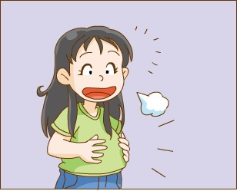
I am full!

Slide 11
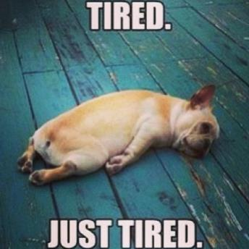
t
ire
d

Slide 12
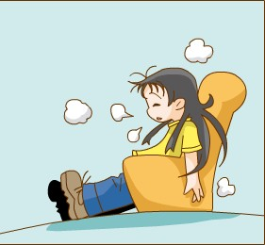
I am tired!

Slide 13
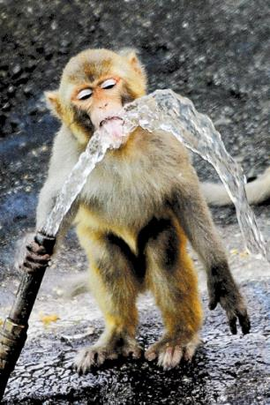
th
ir
s
ty

Slide 14
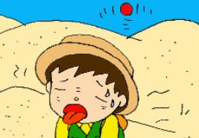
I am thirsty!

Slide 15
Opposite words (反义词)
sad
I’m happy, but Danny is __________.
I feel _________, so I eat a cake. I’m full now.
This tree is tall, but that one is ________.
This is my old friend, Amy.
She is my ________deskmate.
hungry
short
new
Can you say?

