Slide 1
Unit 1
Where did you go on vacation?
Section A (第1课时)
WWW.PPT818.COM

Slide 2

学习目标
Key words & phrases:
anyone, anywhere, wonderful, few, most, quite a few,
go on vacation
Key sentences:
1. — Where did you go on vacation?
— I went to the mountains. / …
2. Did you…? Yes, I did. / No, I didn’t.
Talk about past events.

Slide 3
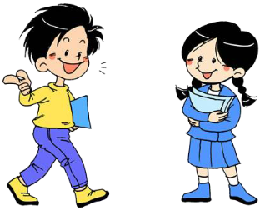
Free Talk
A: Where did you go on vacation?
B: I went to …

Slide 4
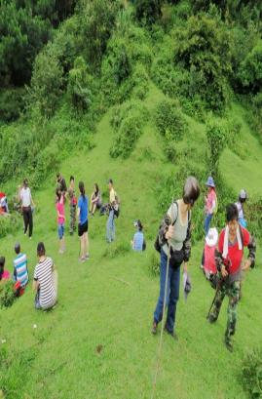
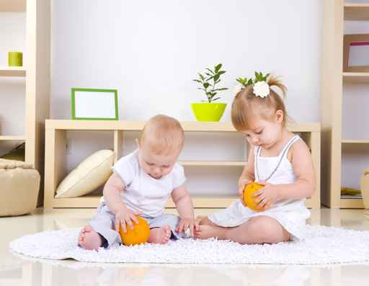
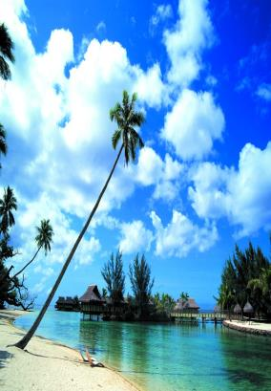
Where did you go on vacation?
went to the
mountains
stayed at home
went to the beach

Slide 5
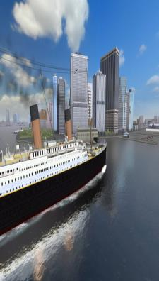
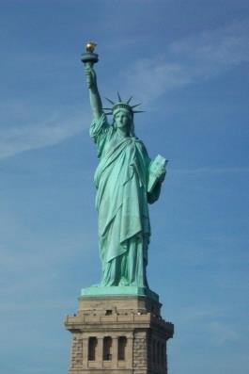
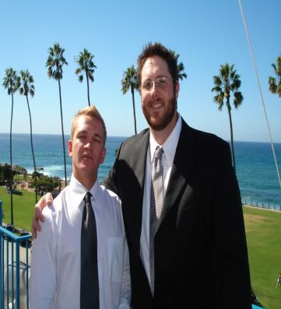
Where did you go on vacation?
went to New York City
visited my uncle

Slide 6
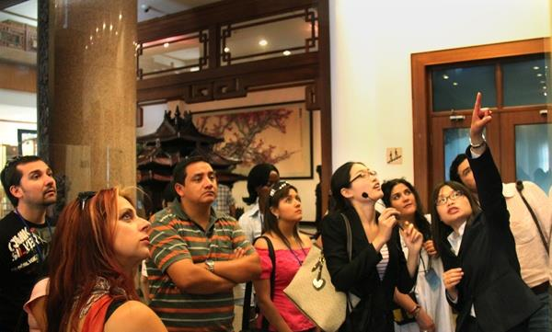
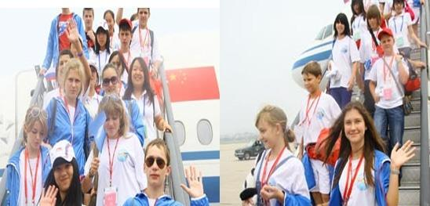
Where did you go on vacation?
visited museums
went to summer camp

Slide 7
1a
Match the activities with the pictures [a-g].
Where did you go
on vacation?
I went to the
mountains.
1

Slide 8

1. stayed at home _____
2. went to New York City ______
3. visited my uncle ____
4. went to summer camp _____
5. went to the mountains _____
6. went to the beach ______
7. visited museums ______
f
b
g
d
c
a
e

Slide 9

将下列词变为过去式
clean stay
play watch
visit practice
study do
have am / is
go
cleaned
stayed
watched
played
visited
practiced
studied
did
was
had
went

Slide 10

Listen and number the people in the picture [1-5].
1b
Where did you go
on vacation?
I went to the
mountains.
2
1
5
3
4
1. Tina 2. Xiang Hua 3. Sally
4. Bob 5. Tom

Slide 11

Pairwork
1c
A: What did Tina go on vacation?
B: She went to the mountains.

Slide 12
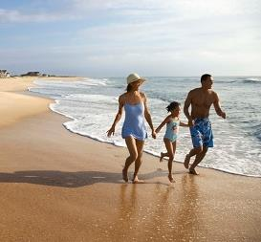
A: Where did … go on vacation?
B: ...
went to the beach

Slide 13
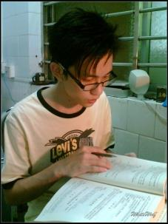
A: Where did … go on vacation?
B: ...
stayed at home

Slide 14
Listen. Where did the people go on vacation? Complete the chart.
2a
People | Places
Grace
Kevin
Julie
New York City (Central Park)
the beach
stayed at home

Slide 15
Listen again. Check (✔) Yes, I did or No, I didn’t for each question.
2b
 | Did you … | Yes, I did. | No, I didn’t.
Grace | go with anyone? | ✔
 | go to Central Park?
 | buy anything special?
✔
✔

Slide 16
Kevin | play volleyball?
 | swim?
 | meet anyone interesting?
Julie | do anything interesting?
 | study for tests?
 | go out with anyone?
✔
✔
✔
✔
✔
✔

Slide 17
Group work
Talk about your vacation plans with your friends and fill in the chart.
Name | Vacation plans | Who? | When?

Slide 18
I decided to go to … David went there last summer vacation. The weather there was … The food … I think it was … So I want to go there next vacation.

Slide 19
Role-play conversations between Grace, Kevin and Julie.
2c
A: Grace, where did you go on
vacation?
B: I went to New York City.
A: Oh, really? Did you go with
anyone?
B: Yes, I went with my mother.

Slide 20
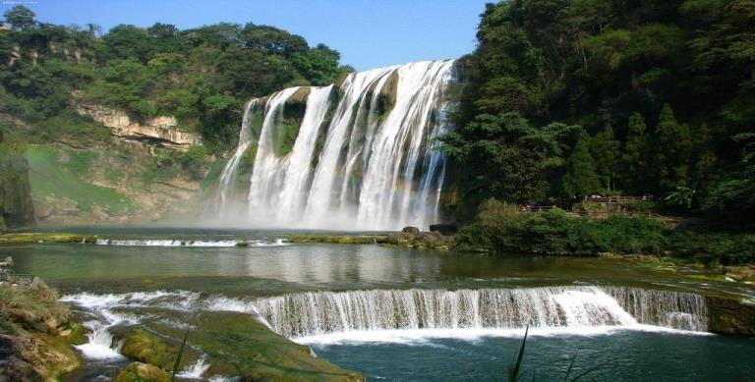
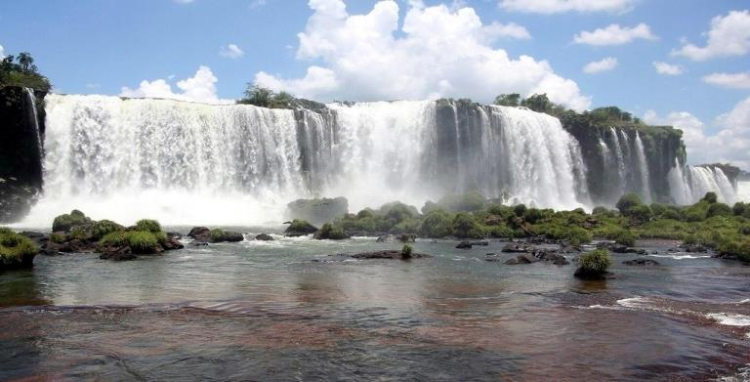
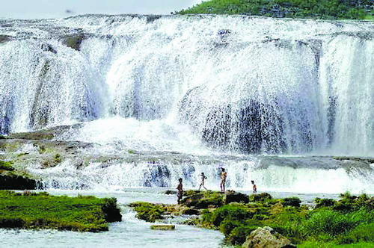
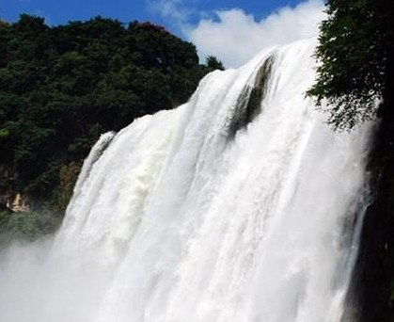
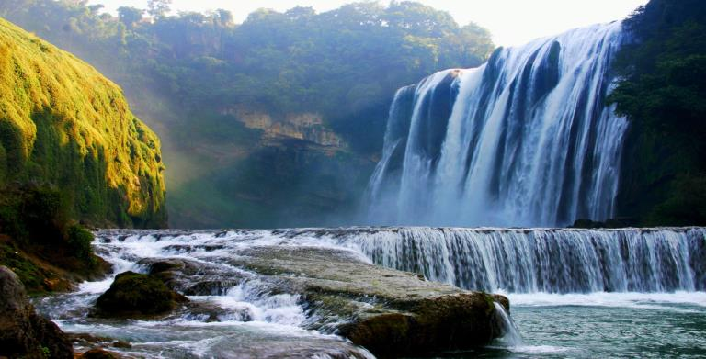
Did you see Huangguoshu Waterfall?
黄果树瀑布

Slide 21
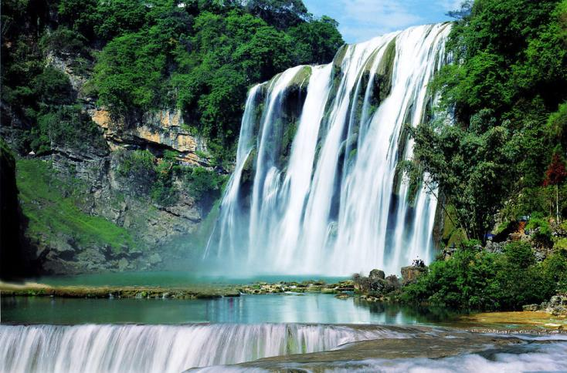
2d
Role-play the conversation.

Slide 22
Useful Expressions
Long time no see.
Did you go anywhere interesting?
… took quite a few photos
most of the time
好久不见。
你去了什么有趣的地方吗？
拍许多照片
大部分时间

Slide 23
Role-play
A: Hi, … Long time no see.
B: Hi, … Yes, I was … last month.
A: Oh, did you go … ?
B: Yes, I went to …

Slide 24

Summary
—Where did you/they/he/she go on
vacation？
— I/They/He/She went to the
mountains/New York City/summer
camp/the beach.
— Did you...？
— Yes，I did./No，I didn't.

Slide 25

Homework
1. Listen, then read the three
conversations aloud.
2. Make a survey about what three of
your friends did during the summer
vacation.

