Slide 1
Module 3 Making Plans
are
going to do
Unit1 What ____ you __________ at weekend ?
WWW.PPT818.COM

Slide 2
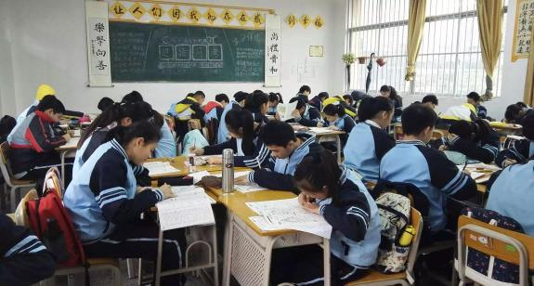
Let's learn the vacabulary.
A:What are they going to do at the weekend?
B:They're going to ___________ at the weekend.
go over lessons
复习功课

Slide 3
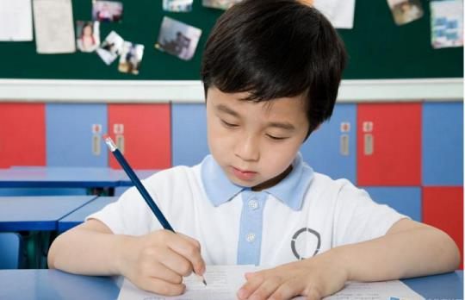
A:What is he going to do this evening?
B:He is going to __________ this evening.
do one’s homework
做家庭作业

Slide 4
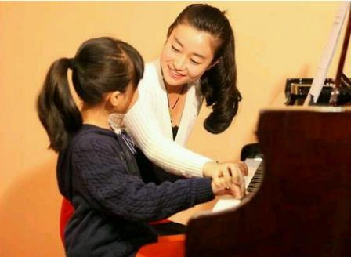
have a piano lesson
上钢琴课
A:What is Lily going to do this Sunday morning?
B:Lily is going to _______ this Sunday morning.

Slide 5
A:What is your mother going to do at the weekend?
B:My mother is going to ______________at the weekend.
check one’s email
查收某人的电子邮件

Slide 6
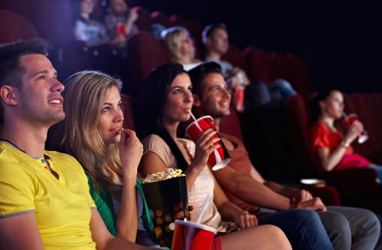
see a movie
看电影
A:What are they going to do at the weekend?
B:They are going to ____________ at the weekend.

Slide 7
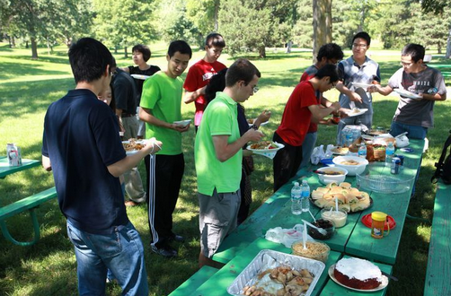
A:What are they going to do at the weekend?
B:They are going to ____________.
have a picnic
野炊

Slide 8
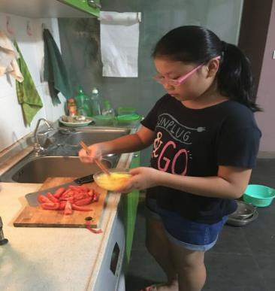
A:What is she going to do at the weekend?
B:She is going to_________ at the weekend.
help with the housework
帮忙做家务

Slide 9
P14
Match the words and expression from Box A with the word and expressions from Box B.
A
check go over have see help have
B
my email
a movie
a picnic
with the house-work
a piano lesson
lessons

Slide 10
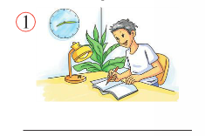
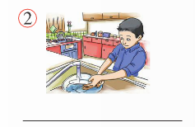
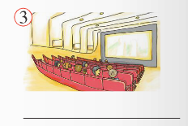
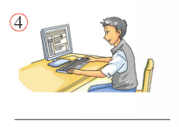
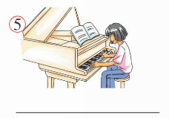
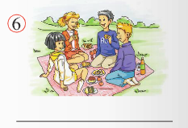
Match the expressions with the pictures.
____________
____________
____________
go over lessons
help with the housework
see a movie
____________
check my email
____________
____________
have a piano lesson
have a picnic

Slide 11
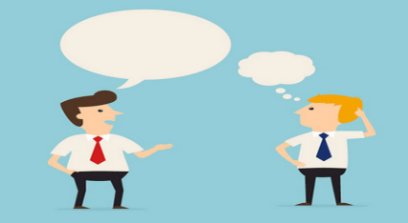
What are you going to do this weekend?
I’m going to__________.

Slide 12
Listen and read
What about Betty’s, Daming’s and Tony’s plans for the weekend ?

Slide 13
Listen and complete the tasks.
Task 1
Answer the following questions.
1. Is Daming going to help with the housework?
Yes, he is.
2. Who is going to have a piano lesson?
Lingling.
3. Is Betty going to stay at home alone at weekend?
No, she isn’t.

Slide 14
Check(√) the plans about Betty and Daming.
Task 2
Time Plans for the weekend |  | Betty | Daming
Saturday morning | check the email
 | do one’s homework
 | help with the housework
√
√
√
Saturday afternoon | see a movie
 | have a piano lesson
Sunday afternoon | have a picnic
√
√
√
√
A:Is /Are...going to ________on Saturday morning?
B：Yes,___________./No,____________.

Slide 15
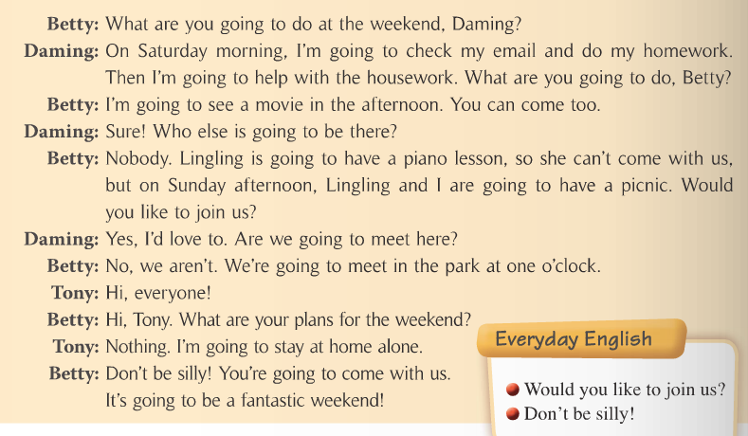
Underline the sentences with be going to do sth.
“be (am, is, are) + going to + 动词原形”表示
计划/打算做某事

Slide 16
Role
1. Role play the conversation in groups.
2. Role play the conversation in front of the class.
play

Slide 17
P15
Complete the conversation with the correct
form of the words from the box.
Task 4
alone else fantastic nothing silly
Betty: What are your plans for next weekend, Lingling?
Lingling: (1)________. I don’t have any plans.
Betty: Are you going to spend it (2) ______ at home?
Lingling: Well, … what are you going to do?
Betty: Tony and I are going to have a picnic in the park.
We’re going to have a (3)________ time. Are you going
to come?
Lingling: I’m not sure.
Betty: Don’t be (4)______! What (5)_____are you going to do?
Nothing
alone
fantastic
silly
else

Slide 18
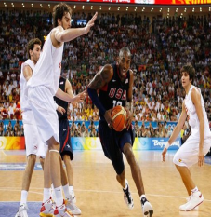
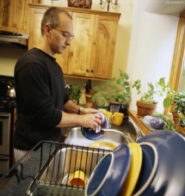
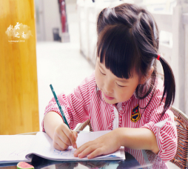
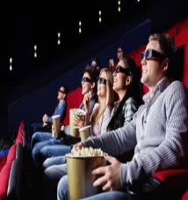
Pair work
help with the
housework
see a movie
play basketball
go over lessons
A:What (is /are) (he/she/you/they) going to do this weekend?
B:I (He/She/They/We) am (is/are) going to …

Slide 19
Ask and answer questions about your plans at the weekend and
complete the diary .
A: What are you going to do on Saturday morning?
B: I’m going to check my email and do my homework.
 |  | You | Your partner
Saturday | morning | check email do homework
 | afternoon
 | evening
Sunday | morning
 | afternoon
 | evening

Slide 20
Report your plans
I’m going to ____________ this Saturday morning . And my friend XX is going to ___________ this Saturday morning.
......

Slide 21
Summary
Important patterns
1. check one’s email
2. go over lessons
3. have a piano lesson
4. see a movie
5. have a picnic
6. do one’s homework
7. help with the housework
8. What are you going to do …?
9. I’m going to do …
10. --Are you going to do …?
--Yes, we are. / No, we aren’t.

Slide 22
Homework
Make up a dialogue: talk about your plans.

Slide 23
Thank you !

