Slide 1
人教精通版三年级上册
Unit2 This is my pencil.
WWW.PPT818.COM

Slide 2
Review
Let’s sing and play

Slide 3
Review
Play a game
I say you do
Show me your bag.
Show me your book.

Slide 4
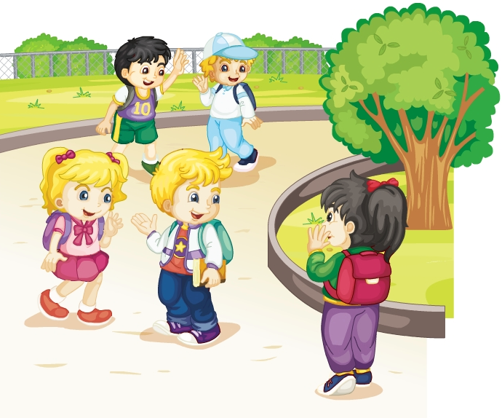
Review
Role-play
Glad to meet you.
Hi, Li Yan. This is Kate.
Glad to meet you, too.

Slide 5
Lead-in
Look and say
Hello, boys and girls. I’m Guang Touqiang. Glad to meet you!

Slide 6
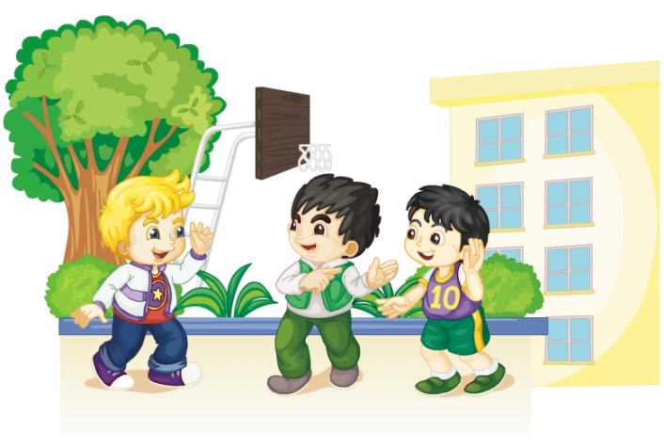
Presentation
Just talk
猜一猜他们都说了什么？

Slide 7
Presentation
Listen and imitate
Hello, Peter! This is Gao Wei.
Nice to meet you.
Nice to meet you, too.

Slide 8
Show time
三人一组，练习对话并表演，其他同学评价。
 | 模仿录音中的语音语调，有感情地朗读。
 | 可以脱离课本，适当改动其中部分，语音地道。
 | 适当添加内容，意思完整，有创新，表演生动。
Good
Great
Excellent

Slide 9
Presentation
Just learn
pen
This is a pen.

Slide 10
Presentation
Just learn
pencil
This is a pencil.

Slide 11
Practice
Game 1
大小声
pencil pen
book bag

Slide 12
Practice
Game 2
魔法手指
pencil pen
book bag

Slide 13
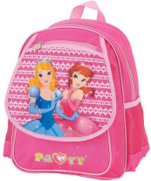
Practice
Look and match
pen
book
pencil
bag

Slide 14
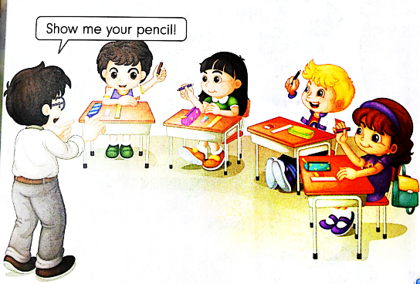
Practice
Let’s do

Slide 15
Summary
本课学到的学习用品类单词有:
pen
pencil

Slide 16
Summary
如何介绍别人并相互问候？
—Hello, Peter! This is Gao Wei.
—Nice to meet you.
—Nice to meet you, too.

Slide 17
Homework
1. 跟读Just talk部分的课文录音，注意语音、语调。
2.运用本课所学知识，用英文给父母介绍一下你的同学或朋友。
3. 预习Lesson 9。
Close

