Slide 1
Unit 11
Sad movies make me cry
Section B 第2课时
WWW.PPT818.COM
Notes:
1

Slide 2
remain unhappy
a happy person with power and money
give sth. to sb.
even though
依然不开心
一个有权有钱的快乐人
把某物给某人
虽然，即使

Slide 3
Free Talk
1. Have you ever joined any competition team?
2. Do you know how to win the competition in a group?

Slide 4
2a Have you ever made a mistake?
How did it make you feel? Talk to
your partner about what happened.

Slide 5
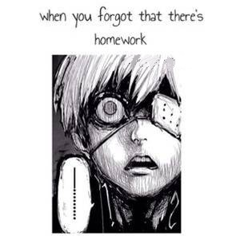
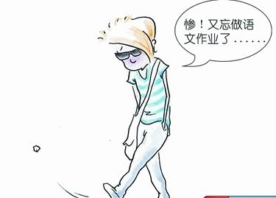
A: Why do you look so …?
B: I …
forget to do my homework

Slide 6
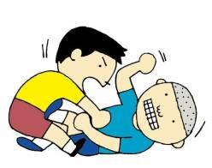
A: Why do you look so …?
B: I …
fight with others

Slide 7
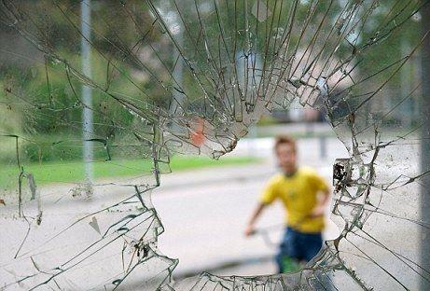
A: Why do you look so …?
B: I …
break the window

Slide 8
思维导图
The background of the story: Peter missed a goal.
Para. 1
The Winning Team
Para. 2-6
A talk between Peter and his father.
Peter’s communication with his teammates. (Peter understood the meaning of “a team”)
Para. 7-11

Slide 9
2b Read the story and number the events in the correct order.
____ Peter got home and went into his room.
____ Peter talked to his teammates.
____ Peter missed a goal.
____ Peter’s father gave him advice.
____ Peter realized that he was worried for
no reasons.
2
4
1
3
5

Slide 10
2c Read the story again and answer
the questions.
1. Why did Peter feel angry and worried?
He was angry with himself for missing an important goal and letting his team down. He was worried that his coach may kick him off the team.

Slide 11
2. What advice did Peter’s father offer him?
Peter’s father advised him not to be too hard on himself but to learn how to communicate with his teammates and learn from his mistake.

Slide 12
3. Do you agree with Peter’s father? Why or why not?
Suggested answers:
Yes, it is no point crying over spilled milk. It is more meaningful to learn from one’s mistakes and do better in the future.

Slide 13
4. What happened after Peter told his teammates that he was sorry?
His teammates asked him not to worry about what had happened as it wasn’t just one person’s fault. They agreed that they should work together to think about how they could do better in the future.

Slide 14
5. Why did Peter think that he was on a winning team even though they lost the last game?
He was on a team with good team spirit that would help them achieve success in the future.

Slide 15
Answer more questions according to the story.
1. What happened to Peter?
He missed scoring a goal and his team lost the game.
2. How did Peter behave when getting home?
After replying to his father, he went to the room without another word.

Slide 16
3. What did Peter’s father say to Peter?
He said that winning or losing is only half the game, the other half is learning how to communicate with your teammates and learning from your mistakes.

Slide 17
4. How did Peter response to his mistake after listening to his father’s words?
He said sorry to his teammates and told them to continue to pull together to win the next game with courage.

Slide 18
2d Find idioms or phrases from the
story to replace the underlined parts.
1. didn’t get the ball into the basket
2. disappointed
3. asked to leave
4. put so much pressure on yourself
5. work hard together
missed scoring that goal
let … down
kicked off
be too hard to yourself
pull together

Slide 19
Retelling
Read the story again and fill in the blanks with the proper words.

Slide 20
Peter had a soccer match today, but they ____ the game because Peter ______ scoring the goal. Peter thought he had let his whole team _____ and was worried that his coach might ____ him off the team. Peter’s father told him that soccer was _____ team _____. He was not the only reason his team lost. If he had a good team, they should _______ each other. ______, winning or losing was only half the game. The _____ half was learning how to ____________ with his teammates and ________ from the mistakes.
lost
missed
down
kick
about
effort
support
Besides
other
communicate
learning

Slide 21
The next day, Peter went to soccer practice with _______ rather than ____ in his heart. His teammates all nodded in _________ that they would continue to ____ together to win the next match. It made him feel _____ to know that he was on a _______ team.
courage
fear
agreement
pull
lucky
winning

Slide 22
Role-play
Make conversations with your partner and then act out this story between Peter and his father in class.

Slide 23
For example:
Father: What’s wrong, Peter?
You look sad.
Peter: I missed scoring a goal.
I made my team lose the game.
…

Slide 24
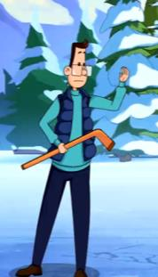
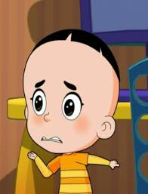
What’s wrong, Peter? You look sad.
I missed scoring a goal. I made my team lose the game.
Don’t be hard on yourself. I’m sure you’re not the only reason your team lost the game.

Slide 25
What do you mean?
Soccer is about team effort. Having a good team means supporting each other. Winning or losing may be important, but so is learning how to communicate with your teammates and learning from your mistakes.
Thanks for your advice, Dad. I think I know what I should do now.

Slide 26
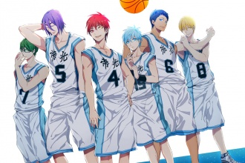
Free Talk
If your football / basketball … team lost a game, what would you do after it?

Slide 27
Free Talk
What will make you feel happy?
What will make you feel sad?
What’s your unforgettable experience of happy things? Share it with your partner.

Slide 28
3a Think of some experiences that
made you feel very happy or sad.
Tell your partner about them. Use
the following ideas to help you.
winning / losing a competition
getting good / bad grades on an exam
performing something well / badly in front of a big group of people
getting into a fight with your best friend
Your first trip outside your hometown

Slide 29
Writing
3b Write a story similar to the one in
2a by using the notes in 3a.
What happened?
When did it happen?
Where did it happen?
How did it make you feel? Why?
What did you learn from it?

Slide 30
An experience that made me very happy was winning the nation-wide English speech competition last year.
At first, I didn’t know what to write for my speech, but after talking to my teacher and reading some books, I had some ideas and started writing. Then I practiced my speech many times.

Slide 31
On the day of the competition, I saw many people there. This made me feel very nervous. I started to worry that I would forget my speech. Then I remembered what my teacher told me – close my eyes and take deep breaths. I did that and it made me feel much better. When my turn came, I gave my speech with confidence.

Slide 32
I waited anxiously for the results, and when I heard that I was the first prize winner, I jumped up and down in joy.
This experience taught me that being well prepared is very important. It helps to read a lot, and also to ask people around you for advice. Most importantly, have confidence in yourself!

Slide 33
Language points
1. He felt like there was a heavy weight on his shoulders as he walked home alone.
(1) weight n. 重量，分量
He was surprised at the weight of the players.
他对那些运动员的体重感到吃惊。
These columns bear the weight of the roof.
这些柱子支撑着屋顶的重量。

Slide 34
知识拓展
lose weight 减肥；体重减轻；瘦身
put on weight 增重
average weight 平均重量；标准重量
net weight 净重
light weight 轻量；空载排水量；车辆自重
heavy weight [体]重量级；平均体重以上的
人；[口]重要人物
weight loss 失重；重量减轻

Slide 35
结果，她体重增加了很多。
As a result, she has ______ a lot of _______.
put on
weight

Slide 36
(2) shoulder n. 肩，肩膀
He had broad shoulders and powerful arms.
他肩膀宽大，双臂有力。
She patted Hans on the shoulder.
她拍了拍汉斯的肩膀。

Slide 37
shoulder vt. 肩负，承担
He has had to shoulder the responsibility of his father’s mistakes.
他得为他父亲的过错承担责任。

Slide 38
知识拓展
be up to one’s shoulders
非常繁忙，深深地陷入（某工作之中）
have (sth.) on one’s shoulders
承担，担负（某事）
shoulder by shoulder
肩并肩地；齐心协力地
take… on / upon one’s (own) shoulders
担当/承担……
turn a cold shoulder upon (to) someone
冷落某人，不理睬某人

Slide 39
完成句子：
他们肩并肩地坐着欢快地交谈。
They sat ______ ______ ______ and talked happily.
答案：
shoulder by shoulder

Slide 40
2. How could he have missed scoring that goal?
goal n. 球门，射门，目标
They were still arguing about the first goal.
他们仍在为第一个进球争论不休。
The goal is to raise as much money as possible.
目的是筹集到尽可能多的资金。

Slide 41
词义辨析
aim, purpose, goal
aim: 常指短期目标，往往比较具体，也比较实际。
purpose: 目的；意图，比较确定，多指采取坚决的行动去达到目的。
goal: 指经过仔细考虑而选中的比较大的目标，常需要努力或克服困难才能达到的目的。

Slide 42
3. He had let his whole team down.
let sb. down 使……失望
Don’t worry. I’ll never let you down.
别担心，我决不会让你失望的。
We hope you will not let us down; you
should achieve something when still young.
希望你能在年轻的时候有所成就，不要让我们失望。

Slide 43
I work very hard because I don’t want to ________.
A. let my parents down
B. let down them
C. let my parents to be disappointed
D. let my parents go
【解析】let 后的不定式不能带to， 排除C；let down是一个动副性短语，宾语是代词时放中间，故排除B；而 D是“让父母走”，不符合句意。所以正确答案为A。
A

Slide 44
4. He was really worried that his coach might kick him off the team.
kick v. 踢，踹
The little girl was crying and kicking.
那个小女孩一边哭 一边乱踢着。
The man kicked the door open in his rage.
盛怒之下那人踢开了门。

Slide 45
知识拓展
kick sb. off 开除某人
kick oneself 严厉自责
corner kick 角球
free kick （足球）任意球
penalty kick 罚点球，罚球
spot kick 点球；罚点球
kick out 解雇；开除；把球踢出界
kick back [口]回踢；反弹
kick up 踢起；引起；激起
kick the habit 戒除嗜好；戒掉习惯
kick at 向……踢去

Slide 46
5. But whatever it was, don’t be too hard on yourself.
be hard on sb. 对某人苛刻，对某人要求严格
Don’t be so hard on him.
别对他太苛刻了。
I don’t want to be hard on your daughter.
我不想对你女儿太严厉。

Slide 47
6. The next day, Peter went to soccer practice with courage rather than fear in his heart.
(1) courage n. 勇敢，勇气
On the contrary, it fills me with strength and courage.
正好相反，它让我充满了力量和勇气。
Thinking back, I don’t know how I had the courage at that time.
现在回想起来，我都搞不清楚我当时哪来的那种胆量。

Slide 48
知识拓展
inspire courage 提振士气 ；激发勇气
keep up one’s courage 不泄气，不气馁
lose courage 丧失勇气，灰心
take courage 鼓起勇气
iron courage 钢铁般的勇气
lion courage 狮子般的勇敢

Slide 49
(2) rather than 表示客观事实，意为“是……而不是……；与其……不如……”。
连接的并列成分可以是名词、代词、形容词、介词（短语）、动名词、分句、不定式、动词等。
You rather than I are going to go camping.
是你而不是我要去野营。
注意
rather than 连接两个名词或代词作主语时，谓语动词应与rather than 前面的名词或代词在人称和数上保持一致。

Slide 50
The sweater she bought was beautiful rather than cheap.
与其说她买的这件羊毛衫便宜不如说它漂亮。
She enjoys singing rather than dancing.
她喜欢唱歌，而不喜欢跳舞。
We should help him rather than he should help us.
是我们应该帮助他而不是他应该帮助我们。

Slide 51
注 意
rather than 后接不定式时，不定式可以带to，也可以不带to。但rather than位于句首时，则只能接不带to 的不定式。如：
I decided to write rather than (to) telephone.
我决定写信而不打电话。
Rather than allow the vegetables to go bad, he sold them at half price.
他惟恐蔬菜烂掉，把它们以半价卖掉了。

Slide 52
He ran rather than walked.
他是跑来的，而不是走来的。
注意：
这里rather than 后用了walked，而没有用walk，表示客观事实，而不是主观愿望。如果换成walk，则作“宁愿……而不愿……”解。

Slide 53
7. But I think if we continue to pull together…
pull v. 拉，拖
Sam and John are pulling the rope.
山姆和约翰在拔河。
She went into the garden to pull a few onions for dinner.
她去园子里拔了几个洋葱准备做饭。

Slide 54
拓展：
pull together 齐心协力，通力合作
If we pull together, we shall succeed.
我们同心协力，我们就会成功。
We must pull together to finish the task.
我们必须齐心协力完成任务。

Slide 55
词语辨析
pull: 最普通用词，可指朝各个方向拉，侧重一时或突然拉动的动作。
drag: 指沿斜坡而上或水平方向缓慢地拖或拉十分沉重的人或物。作借喻时可指把人硬拉扯过来。

Slide 56
知识拓展
pull round 掉头；康复；转向；复原
pull into 进入；到达；拉成；驶入
pull strings 运用关系；找关系；幕后操纵； 走后门
pull apart 撕开；找错误批评；扯断；拉开

Slide 57
8. To his surprise and relief, his teammates all nodded in agreement.
(1) nod v. 点头
She nodded to agree with me.
她点头同意了我的意见。
She nodded when she passed me in the street.
她在街上走过我身旁时向我点了点头。

Slide 58
I asked her if she was ready to go, and she _______. (nod)
He __________ (点头) to me in greeting when I entered the room.
nodded
nodded

Slide 59
(2) agreement n. 同意
The president was in full agreement with the proposal.
总统完全赞同该提议。
The two sides failed to reach agreement.
双方未能取得一致意见.

Slide 60
知识拓展
by agreement 约好
in agreement with 同意；与……一致
general agreement 总协定
reach / come to an agreement 达成协议；取得一致意见，达成共识
trade agreement （国际）贸易协定；雇用合同；劳资协议
written agreement 书面协定；成文契约

Slide 61
根据汉语提示完成单词。
1. Katie only has one meal a day in order to lose _______(重量).
2. While I was leaving home, my father came back with a heavy bag on his ________(肩头).
3. The boy walked around the teacher’s office for a long time and went in at last with _______ (勇气).
4. The teacher told the students not to ____(踢) the door when it was closed.
5. Lily works hard at school because she doesn’t want to ___ her parents _____ (使失望).
weight
shoulder
courage
kick
let
down

