Slide 1
Unit 4 After­School Activities
What Is Your Club Type?
WWW.PPT818.COM

Slide 2

Learning Targets
★ Key words:
type, following, which, circle, add, score, relax, free, mind, active, quietly, must, without, bored, example
★ Key phrases :
be right for sb., listen to music, in one’s free time, love to do sth., on the way, be bored with,
join a club

Slide 3

★ Key sentences:
1. What club is right for you？
2. Then add up your score and find out your club type!
3. I like to listen to music and relax.
4. I usually draw and paint in my free time.
5. I like to read books and exercise my mind.
6. I can't sit quietly.
7. I must do something active inside.

Slide 4

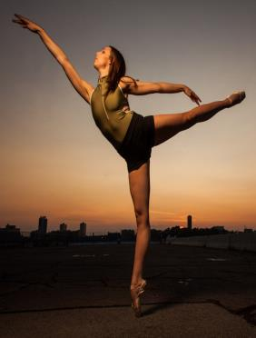


★ Key sentences:
8. I can't go anywhere without them.
9. I will be bored without a book.
PPT模板：www.1ppt.com/moban/ PPT素材：www.1ppt.com/sucai/
PPT背景：www.1ppt.com/beijing/ PPT图表：www.1ppt.com/tubiao/
PPT下载：www.1ppt.com/xiazai/ PPT教程： www.1ppt.com/powerpoint/
资料下载：www.1ppt.com/ziliao/ 范文下载：www.1ppt.com/fanwen/
试卷下载：www.1ppt.com/shiti/ 教案下载：www.1ppt.com/jiaoan/
PPT论坛：www.1ppt.cn PPT课件：www.1ppt.com/kejian/
语文课件：www.1ppt.com/kejian/yuwen/ 数学课件：www.1ppt.com/kejian/shuxue/
英语课件：www.1ppt.com/kejian/yingyu/ 美术课件：www.1ppt.com/kejian/meishu/
科学课件：www.1ppt.com/kejian/kexue/ 物理课件：www.1ppt.com/kejian/wuli/
化学课件：www.1ppt.com/kejian/huaxue/ 生物课件：www.1ppt.com/kejian/shengwu/
地理课件：www.1ppt.com/kejian/dili/ 历史课件：www.1ppt.com/kejian/lishi/

Slide 5
objectives
学会利用问卷了解自己的喜好并找到适合自己的兴趣俱乐部。
掌握本课的重点词汇，短语和句型。
课前准备：
★ 用一分钟时间对单词进行复习，使学
生在新课学习中没有单词障碍。
★ 通过朗读，使学生熟练掌握单词的正
确发音。
★ 所呈现单词均出自课本单词表中的黑
体重点词汇。

Slide 6
Lead in
Think about it!
What do you like to do for fun?
What club do you want to join in?
What is your club type?
Let's see what clubs we have in our school!
There are dance club, singing club, reading club and so on.

Slide 7
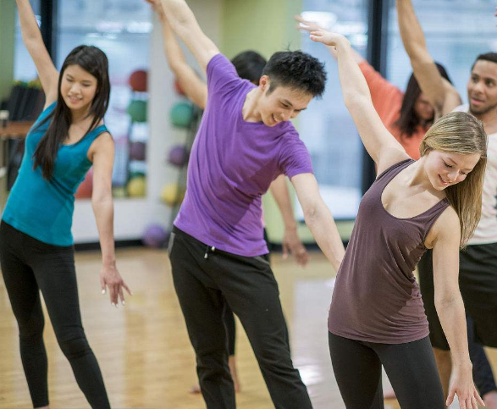
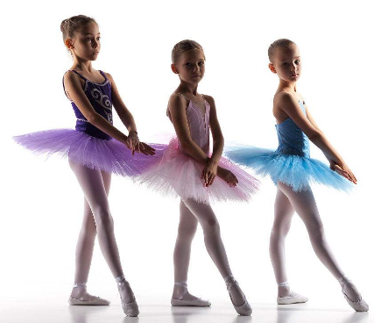
Dance Club
There are so many students in this club!

Slide 8
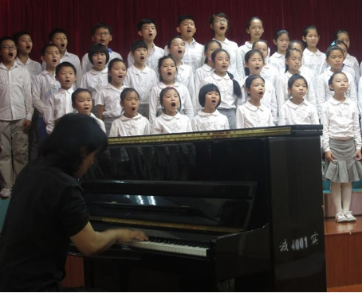
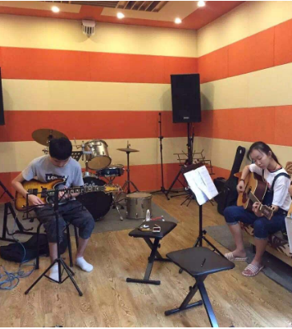
Singing Club
The students in this club love music and songs!

Slide 9
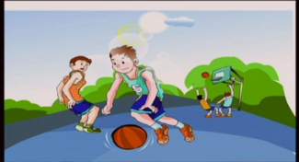
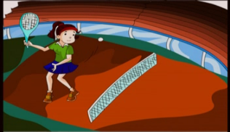
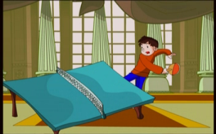
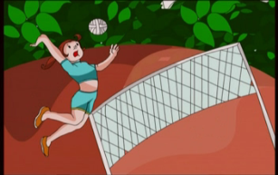
What is your club type?
I want to join the basketball club.
basketball club
tennis club
ping-pong club
volleyball club

Slide 10




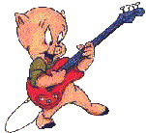

welcome to the clubs!
I want to join the … Because I like...
Chess Club
English Club
Swimming Club
Music Club
Art Club
Guitar club

Slide 11
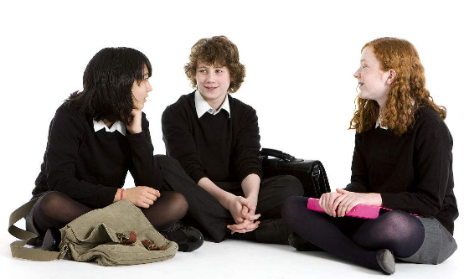
Discussion
What's your favourite sport? Describe it by using the words below.
What?
Where?
How often?
How good?
Who…with?

Slide 12
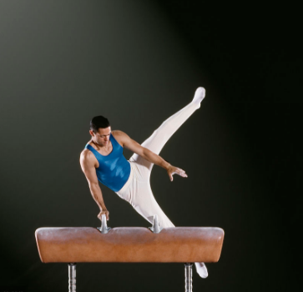
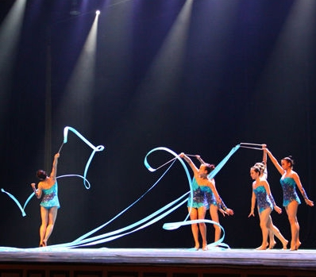
My favourite sport is gymnastics.
Those players are energetic and active!
Watching the show makes me feel excited!

Slide 13
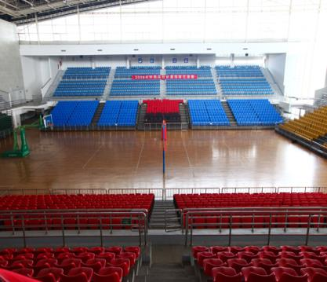
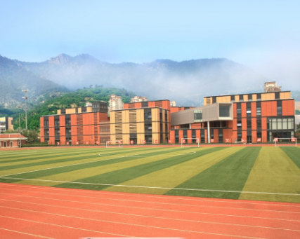
Where can you play your favourite sport?
In the gym of our school
On the playground of our school

Slide 14
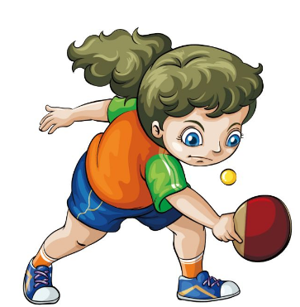
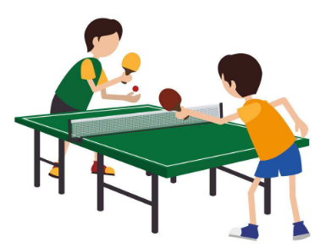
My favourite sport is ping-pong.
Playing ping-pong helps me stay healthy .
I love the player Zhang Jike very much!

Slide 15
Words and expressions
type
following
which
circle
add
score
relax
n. 类型；种类
adj. 接着的；下述的
adj.&pron. 哪(那)一个
v. 圈出 n. 圆
v.加；增加；添加
n. 得分
v. 放松；休息

Slide 16
free
mind
active
quietly
must
without
bored
example
adj. 空闲的；自由的
n. 头脑；思想
adj. 积极的；活跃的
adv. 安静地；平静地
v.aux. 必须；应当
prep. 没有；不用
adj. 无聊的；无趣的
n. 例如；范例

Slide 17
be right for sb. listen to music
in one’s free time
love to do sth.
on the way
be bored with
join a club
适合某人
听音乐
某人空闲的时候
爱、喜欢做某事
在路上
厌倦……
参加俱乐部

Slide 18


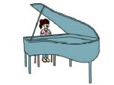
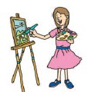

Presentation
What club is right for you?
Read the following questions.
Which answer describes you best? Circle it.
Then add up your score and find out your club type!

Slide 19
1. Do you get enough exercise?
a. Always! I love playing sports.
b. Not really. I like to listen to music
and relax.
c. Not really. I usually draw and
paint in my free time.
d. Never. I like to read books and
exercise my mind.

Slide 20
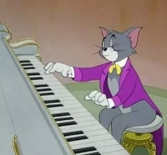
2. What is your favourite school subject?
a. P.E. I like to be active.
b. Music. I like to play an instrument.
c. Art. I love to draw and paint.
d. English and Chinese. I enjoy
reading and writing.

Slide 21
3. What do you do on a cold and snowy
day?
a. I can’t sit quietly. I must do
something active inside.
b. I stay in my room and listen to music
or play an instrument.
c. I paint or draw a picture.
d. I read a book or write a story.

Slide 22
4. You are going on a trip. But you can
only take one thing with you. What do
you take?
a. Running shoes. I can’t go anywhere
without them.
b. A music player. I can’t live without
music.
c. Some paper and a pencil. I can draw
a picture on the way.
d. A good book. I will be bored without
a book.

Slide 23
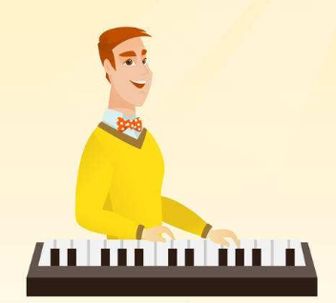
Not look at your answers!
3 or more “a” →Sports
3 or more “b” →Music
3 or more “c” →Art
3 or more “d” →Reading
Or maybe you are in the middle!
For example: 2 “a”+ 2 “b” → Sports and Music

Slide 24
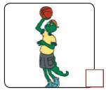
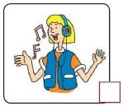

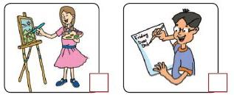
1
Listen to the statements and number
the pictures.
1
2
3
4

Slide 25
Read the lesson and find out your club type. Then write about it.
2
My club type is __________.
I like _____________________________
__________________________________
__________________________________
__________________________________
__________________________________
__________________________________

Slide 26
One possible version
My club type is sports.
I like to play different kinds of sports, like basketball，football, swimming and so on.
But my favourite sport is ping-pong. After class or school, I often play ping-pong with my friends. Ping-pong can make me healthy and make me active. It can also exercise my mind, I think. I make new friends by playing ping-pong, too. We talk about everything when playing.

Slide 27
3
Work in groups. What’s your club type? Interview your classmates and fill in the form.
Example:
Name: Jack
What is your club type? Music
What do you like to do? I like o play the guitar.
Are you in a club now? Yes No
If “No”, do you want to join a club? Yes.
What club do you want to join? I want to join a music club.
If “Yes”, what club are you in? _______

Slide 28
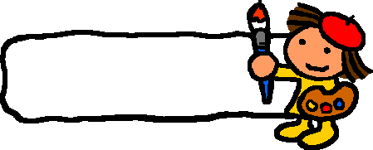

Advertisement
4
Choose a club type and make an advertisement for it.
Example:
Do you like to draw or paint? Join the Art Club!
Drawing and painting is fun for everyone.
Join us after school and have a great time!

Slide 29
Language points
1. What club is right for you？
(1) be right for 对……合适，适合…… 其后常接表示人、组织、团体的代词宾格或名词。例：This plan is right for your vacation. 这项计划适合你的假期。
【拓展】right adj. 正确的; 合适的; 右方的; 好的，正常的。例：Maybe you are right. But I have my own opinion. 或许你是正确的。但是我有自己的意见。

Slide 30
2. Which answer describes you best？
which pron. 哪个; 哪一个; 哪一些
Which is better exercise ─ swimming or tennis?
游泳和网球，哪种运动比较好？
Which of the pens is yours?
哪支笔是你的？
Which of the women is his mother?
哪位女士是他的母亲？
Which way is the wind blowing?
风朝哪个方向刮？

Slide 31
辨析 which 与 what
what 和 which都是疑问代词,可以指事物,它们既可以单独作主语或宾语,也可以作定语修饰名词, 区别:
which | 意为“哪一个”，既可作形容词，也可作代词，用于引导特殊疑问句，表示从给定的范围中去选择事物。
what | 意为“什么，哪个”，它用来引导特殊疑问句，表示的是在不确定的范围内选择事物。

Slide 32
3. Then add up your score and find out your club
type！
(1) add up意为“把……加起来”。它是“动词＋副词”构成的动副型短语，当宾语是代词时，要放在add与up之间；当宾语是名词时，放在两者之间或者up之后均可。例：Can you help me add up these numbers？你能帮我把这些数字加起来吗？
【拓展】 ① add up to意为“总计达……”；
② add...to...意为“把……加到……里面去”。

Slide 33
3. Then add up your score and find out your club type！
(2) score是可数名词，意为“得分，比分”。
询问“比分是多少”的句型为：What is the score？回答时用：It is＋基数词＋to＋基数词．
例：—What's the score of the match now？现在比赛的比分是多少了？—It's 12 to 8. 比分是12 ：8。
(3) type是名词，意为“种类，类型”，相当于kind。常用短语：a type of一种……；different types of不同种类的……

Slide 34
4. I like to listen to music and relax.
relax v. 放松。 其形容词为：relaxing (令人放松的)和relaxed (感到放松的)。
例：It's time to relax yourself. 是时候放松一下你自己了。
【辨析】relaxed 指某人感到轻松、放松、不受拘束的，只能用来修饰人。relaxing指某事某物令人感觉轻松，只能用来修饰物或事。

Slide 35
5. I usually draw and paint in my free time.
in one's free time 在某人的空闲时间里。one's 要跟随主语人称的变化而变化，常使用名词所有格或者形容词性物主代词。其中，free是形容词，意为“空闲的，有空的”，其反义词为：busy忙碌的。常用短语：be free to do sth. 有空做某事。
例：What do you usually do in your free time？你在空闲时间通常做什么？
【拓展】free adj. 免费的;自由的;空闲的

Slide 36
6. I like to read books and exercise my mind.
mind 在此句中作名词，意为“头脑，思想”。
常用短语：make up one's mind to do sth.＝decide to do sth.下定决心做某事；change one's mind 改变主意；keep... in mind 记住……
例：The girl made up her mind to find a new job. 这个女孩下定决心找一份新工作。
You should keep your father's words in mind.你应该记住你父亲说的话。

Slide 37
【拓展】mind 作动词，意为“介意，当心，注意”。常用短语：mind (one's) doing sth. 介意 (某人)做某事。
例：Would you mind my sitting here？你介意我坐在这里吗？
—Would you mind (my) smoking here? 你介意我在这儿抽烟吗？— I'm afraid you can't smoke in public. 恐怕你不能在公共场合吸烟。
—I'm sorry that I broke your cup. 对不起，我把你的杯子打碎了。— Never mind. 没什么。

Slide 38
7. I like to be active.
active adj. 积极的，活跃的。其动词为 act (行动)，反义词为 inactive(不活跃的)，名词为 activity (活动)。例：That boy is very active in class. 那个男孩在课堂上非常活跃。
The club provides all kinds of activities, such as tennis, swimming and so on.
这家俱乐部提供各种各样的活动，诸如网球、游泳等。

Slide 39
Exercise
一、单项选择。
B
1. —It's too cold today. Would you mind ________
the window?
—Certainly not. Go ahead.(贵州安顺中考)
A．to close B．closing
C．close D．closed
2. Could you give me a hand？I can't complete the task on time________ your help. (广东中考)
A．without B．under C．with D．for
A

Slide 40
3. —________ kind of tea would you like?
—I love black tea.
A．Which B．What C．Whose D．That；
4. My deskmate is really ________. She likes to
attend different activities after school. (2017·安徽)
A．active B．quiet
C．lazy D．honest
5. Seeing a bird resting by the window (停在窗户旁)
，the boy moved _______to have a look at it.
A．politely B．quietly C．easily D．safely
A
A
B

Slide 41
二、用疑问词完成英语句子，每空一词。
1. —______ is your favourite subject?
—English, of course.
2. —______ did you go to Tokyo?
—By ship.
3. —______ are you going to spend your holiday?
—In Qingdao.
4. —______ blouse do you like better, the red one
or the purple one?
—The purple one.
What
How
Where
Which

Slide 42
三、根据汉语意思完成句子,一空一词。
1. 这幅画不适合这所房子。
The painting isn’t _______ ________ the house.
2. 看下列图片，然后回答问题。
Look at _______ _______ ________, then answer
the questions.
3. 你可以向别人求助，例如你的父母。
You can ask others for help, ________ ________,
your parents.
right for
the following pictures
for
example

Slide 43
4. 首先，给面粉里加些水。
First, _______ some water ________ the flour.
5. 我爷爷闲暇时喜欢钓鱼。
My grandpa likes to go fishing ________ _______
_______ ________.
6. 如果在牛奶里加点蜂蜜，品尝起来会非常美味。
If you________ some honey to the milk，it will
________ very delicious.
7. 没有钱，我哪儿也去不了。
I can't go ________ ________ money.
add to
in his
free time
add
taste
anywhere
without

Slide 44
四、根据中文提示完成句子。
1. The students want to watch a movie to ________ (放松) after the exam.
2. Little Tom is drawing a __________ (圆 ) on the
paper.
3. What __________ (类型) of books do you like?
4. Steven takes an __________ (积极的) part in
school life.
5. All students __________ (必须) wear school
uniforms on weekdays.
relax
circle
type
active
must

Slide 45
score
6. The _________ is 28 to 22 now. I think our class
will win.
7. If you feel _________ at home, you can take a walk
in the park.
8. _________ apples do you want, the red ones or the
green ones?
9. Suddenly (突然) he came up with a good plan in
his _________.
bored
Which
mind

Slide 46

Summary
Learnt some new words and
expression, for example, which, circle, add, score, relax, free, mind, active, quietly, without...
2. Learnt some useful prepositions
such as on, in , and so on.
3. We’ve done some listening and reading
exercises.

Slide 47



Homework
1. Choose a club type and make an
advertisement for it.
2. Write a short passage about your
favourite club.
3. Preview Lesson 22.

