Slide 1
Unit 3 Welcome to Sunshine Town Integrated skills
WWW.PPT818.COM

Slide 2
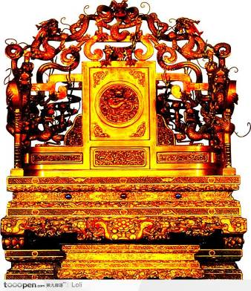
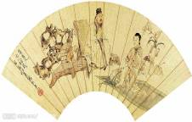
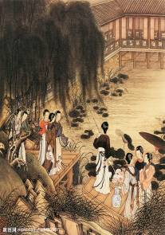
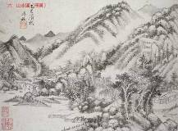
golden throne
金色的 御座
龙椅
Chinese paintings

Slide 3
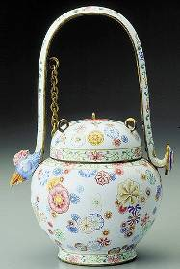
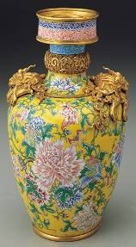
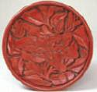
works of art艺术品

Slide 4
The shows at the Palace Museum
Come to the Palace Museum! There are many things to see here. Don’t miss them.
Taihe Palace — the golden throne
Baohe Palace —works of art
Huangji Palace —Chinese Paintings…and many more
You learn all about China’s history at the museum!

Slide 5
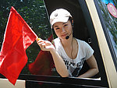
Time | Place | Things to see
10:00 a.m.
Taihe Palace
the golden throne
10:30 a.m.
Zhonghe Palace
works of art
11:00 a.m.
Baohe Palace
works of art
1:00 p.m.
Huangji Palace
Chinese paintings
2:30 p.m.
Fengxian Palace
clocks and watches

Slide 6
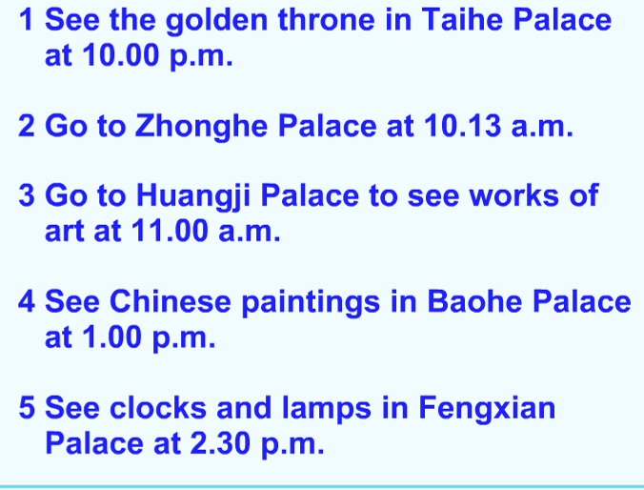
a.m.
10:30a.m.
Baohe
Huangji
watches

Slide 7
Dear Mum,
I am happy in Beijing today because I visited the____________.
It has lots of palaces and interesting things_______(see) there.
Taihe Palace is the highest palace. It is about 27 metres high. The
______ throne is in this palace. It is wonderful. There are nice
______ of art in Zhonghe Palace and Baohe Palace. In Huangji
Palace, I saw some Chinese ________. There are some clocks and
________ in Fengxian Palace.
I learn a lot about the history of China at the museum. If you visit
Beijing next time, don’t miss it.
Best wishes!
Neil
Palace Museum
to see
golden
works
paintings
watches

Slide 8
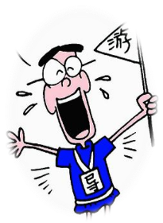
Be the exchange students’ guide(导游).
the Palace Museum
Taihe Palace(the golden throne)
Guide:
The Palace Museum is a wonderful place to visit. Every day lots of visitors come to see it. There are many beautiful palaces. The important palaces are...First we’ll visit …at… We’ll see…Then…After that…
Ok. Let’s go to Taihe Palace.
Zhonghe Palace(works of art)
Baohe Palace (works of art)
Huangji Palace(Chinese paintings)
Fengxian Palace
(clocks and watches)

Slide 9
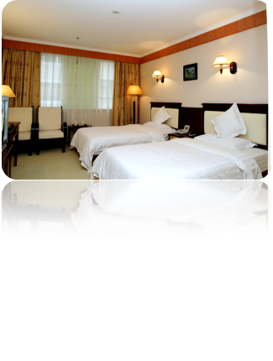
Speak up
Listen and answer
Where are they going to visit?
Beihai park.

Slide 10
Read and find more information.

Slide 11
Plan a trip in our school！
Group Work:
Welcome new teachers to our school!
Today after school please invite them to visit our school. Now you can make a plan for the visit.

Slide 12
NT--new teacher S--student
S(1/2/3/4): Would you like to visit our school after class
today. We’d like to be your guide.
NT: That sounds great...
S1: What time shall we meet?
NT: … Where shall we meet?
S: Let’s meet…
NT: What can we do here?
S2: There are a lot of interesting and beautiful places
in our school. At…, we can visit…
NT: Is it very far?
S3: No, it’s about…minutes on foot. At…,We can …
S4: My favourite place is… We can…at…
NT: The visit sounds great.
S: I’m sure we’ll have a great time here.

Slide 13
Homework
Finish workbook Period5
Make a plan for the coming spring outing

