Slide 1
Unit 1 Lesson 3
Everyone was happy that day.
WWW.PPT818.COM

Slide 2
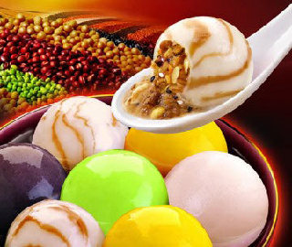

Slide 3
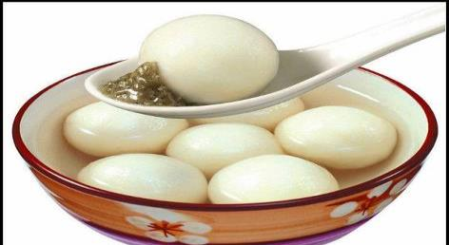
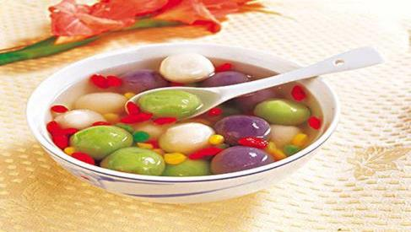
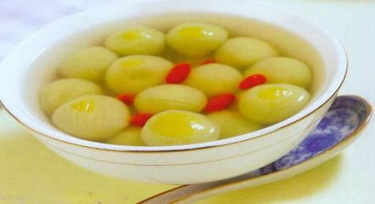
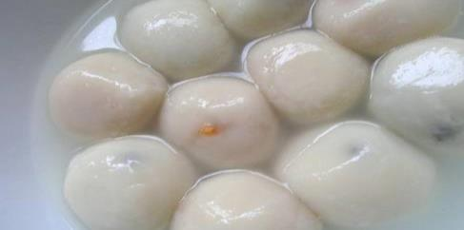
Yuan Xiao

Slide 4
The Lantern Festival
元宵节

Slide 5
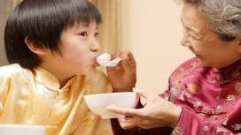
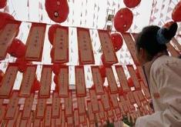
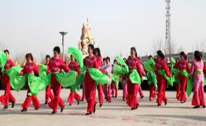
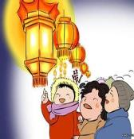
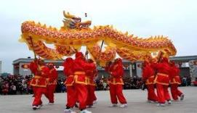
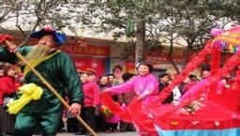
the Lantern Festival (元宵节）

Slide 6
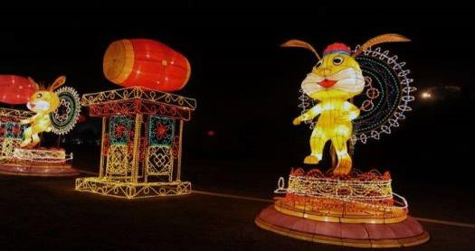
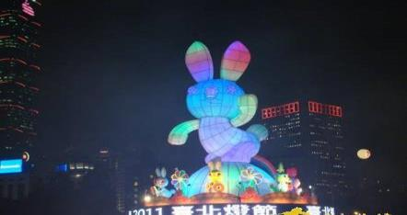
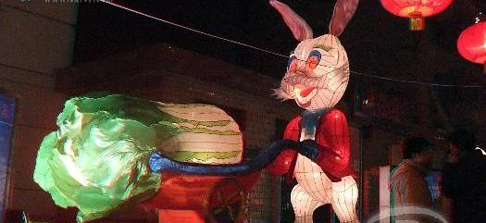
Big beautiful rabbit lanterns

Slide 7
Let's learn:
watch the lanterns
看花灯

Slide 8
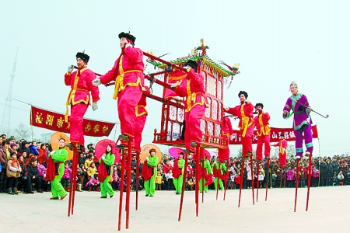
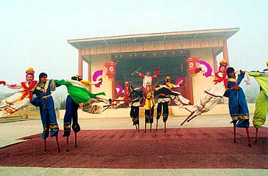
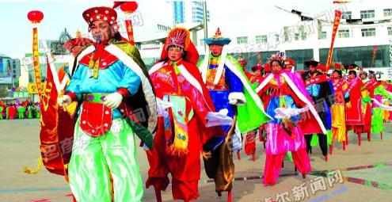
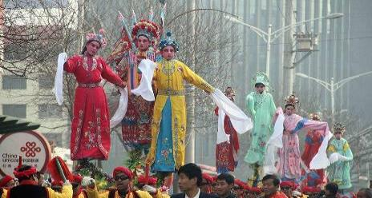

Slide 9
watch a parade
观看游行

Slide 10
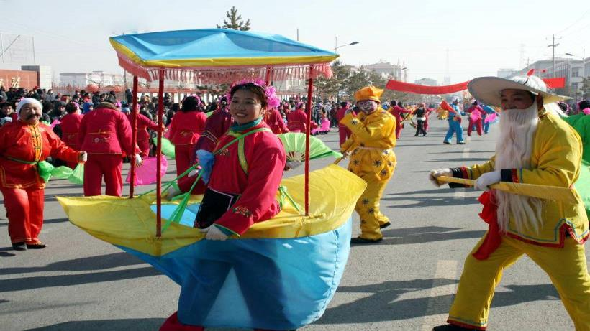

Slide 11
yangge dance
秧歌舞

Slide 12
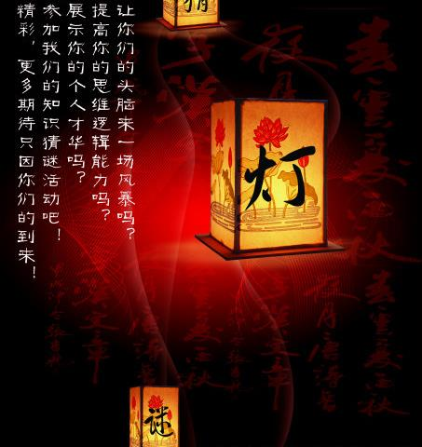
guess a riddle
猜谜语

Slide 13
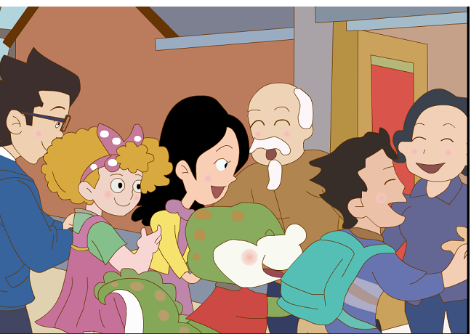

Slide 14
What did Li Ming, Jenny and Danny do at the Lantern Festival?
watch and answer
They ____________ for breakfast.
早饭
Then they___________________.
接着
In the evening, they ____________.
在晚上

Slide 15
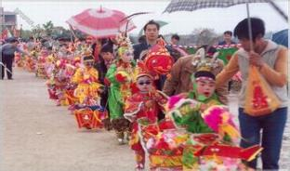
What did Lin Ming, Jenny and Danny do at the Lantern Festival?
watch and answer
had yuanxiao
They ______________ for breakfast.
went to watch a parade
Then they_____________________.

Slide 16
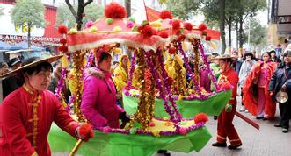
They watch a parade.

Slide 17
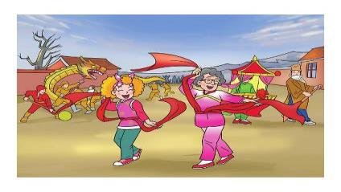
What did Jenny do in the parade?
Listen and answer
Jenny learned the yangge dance from grandma.

Slide 18
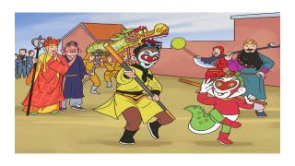
What did Danny do in the parade?
watch and answer
He joined the parade.
He acted like the Monkey King.

Slide 19
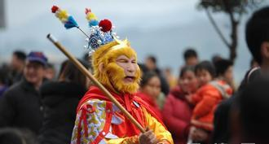
He acted like the Monkey King .

Slide 20
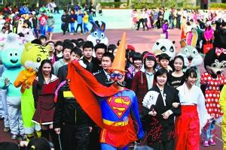
He acted like supper man .

Slide 21
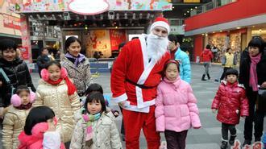
He acted like Santa .

Slide 22
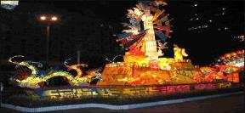
What did Lin Ming, Jenny and Danny do at the Lantern Festival?
watch and answer
had yuanxiao
They ____________ for breakfast.
went to watch a parade
Then they_____________________.
In the evening, they
___________________________.
watched the beautiful lanterns

Slide 23
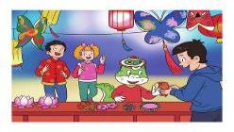
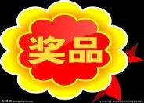
Read and fill in the blanks
In the evening ,
they watched the beautiful lanterns.
guessed a riddle
Danny__________________
and ____________.
got a prize

Slide 24
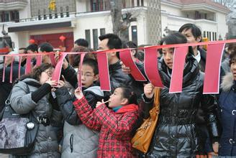
They guess riddles.

Slide 25
Did they have a good time?
Listen and answer
Yes , they did.
Everyone was happy that day.

Slide 26
The Lantern Festival
元宵节

Slide 27
What do you usually do at the Lantern Festival ?

Slide 28
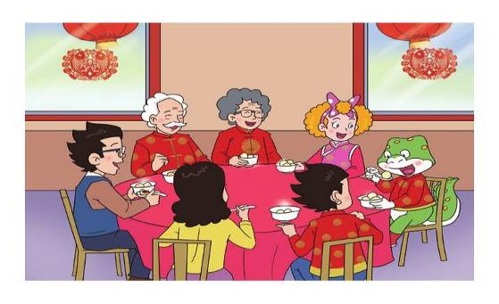
eat/have yuanxiao

Slide 29
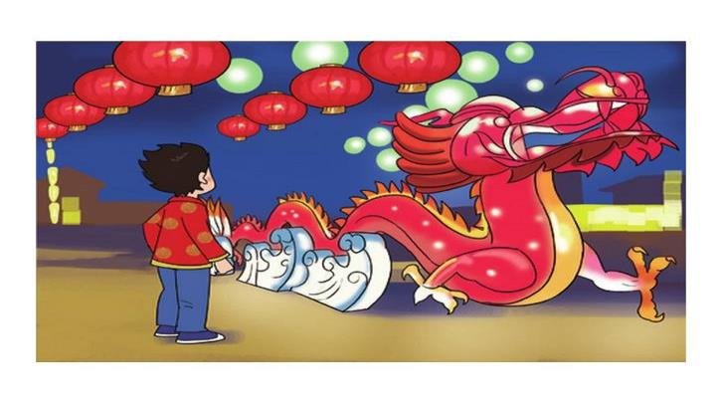
watch the beautiful lanterns

Slide 30
watch a parade

Slide 31
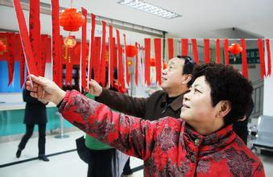
guess a riddle

Slide 32
The key phrases:
重点词组
the Lantern Festival
eat /have xuanyiao
watch a parade
watch the beautiful lanterns
guess a riddle

Slide 33
The key sentences:
重点句子
Everyone was happy that day.

Slide 34
Can you retell : 复述课文
the Lantern Festival
It was_______________________.
had yuanxiao
They_____________for breakfast.
went to watch a parade
Then they____________________.
In the evening,
they __________________________.
watched the beatiful lanterns.
happy
Everyone was _______ that day.

Slide 35
English report: 英语小汇报
题目： My winter holidays
要求：
简单描述你在寒假期间做的事情，
用学过的单词和句型写几句话。
（字数在40字左右，用一般过去式写。）

Slide 36
用到的句型：
开头：
1. I had a wonderful winter holidays.
2. I had a good time in my holidays.
3. I had a busy winter holidays.
4.My winter holidays were great!

Slide 37
过程：写写你做过的事情：
visited my friends and relatives 看望朋友和亲戚
played computer games 玩电脑游戏
watched films with my friends 和我的朋友看电影
went to zoo/ park ......去了动物园，公园.....
took many pictures 拍了照
set off fireworks 放烟花
got lucky money的压岁钱 ate jiaozi/yuanxiao
I learned.....我学了......

Slide 38
结尾：
1.I had a good time.
2.I had a busy holiday, but I enjoyed it.
3.I enjoyed my winter holiday.
4.Everyone was happy in......

