Slide 1
Neighbours
Unit 2
Reading I
WWW.PPT818.COM

Slide 2
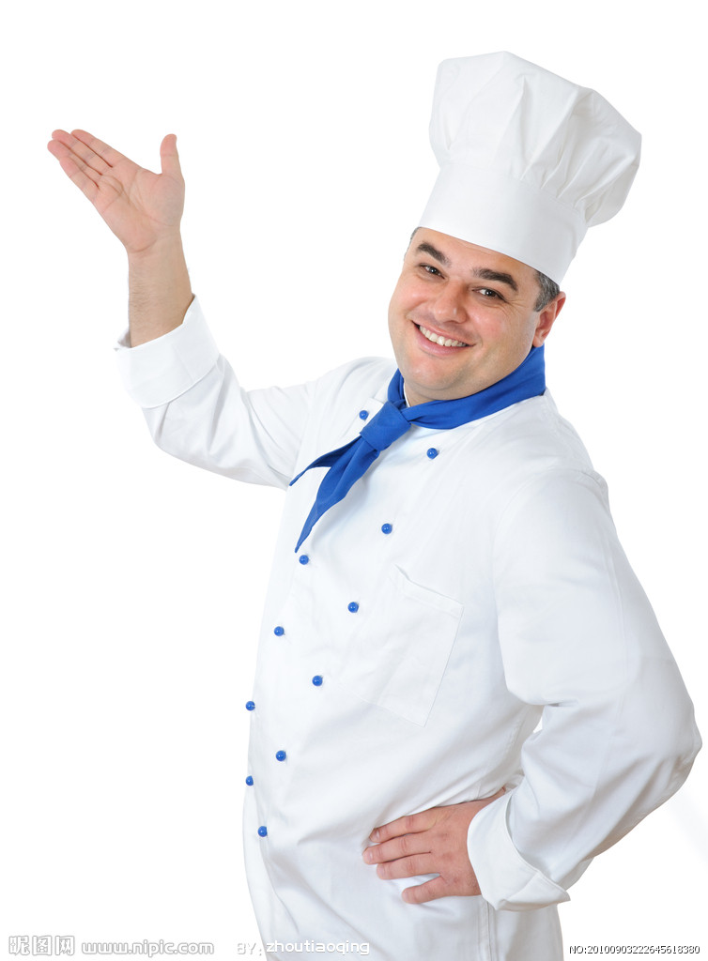
cook
restaurant

Slide 3
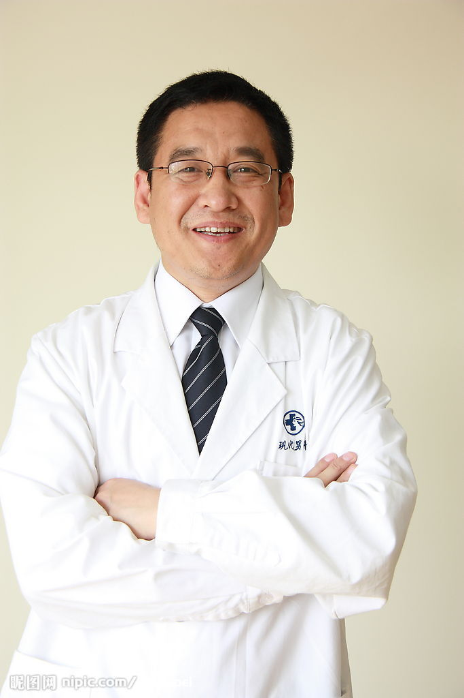
doctor
hospital

Slide 4
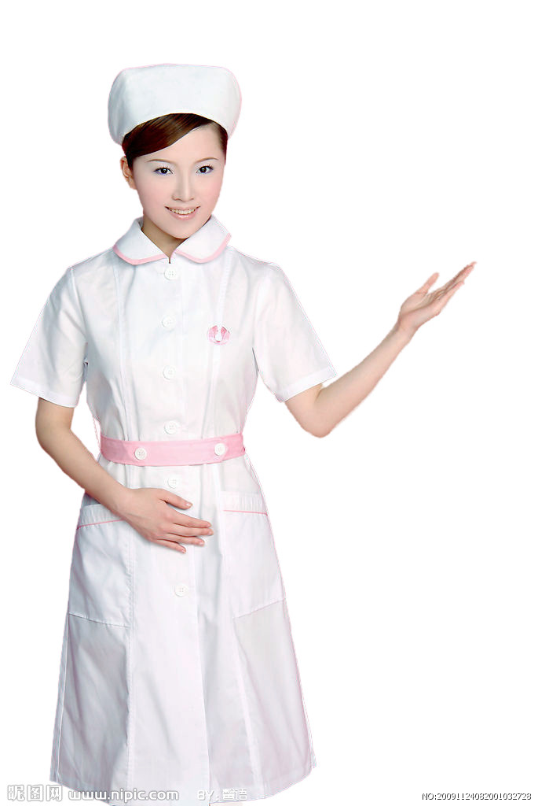
nurse

Slide 5
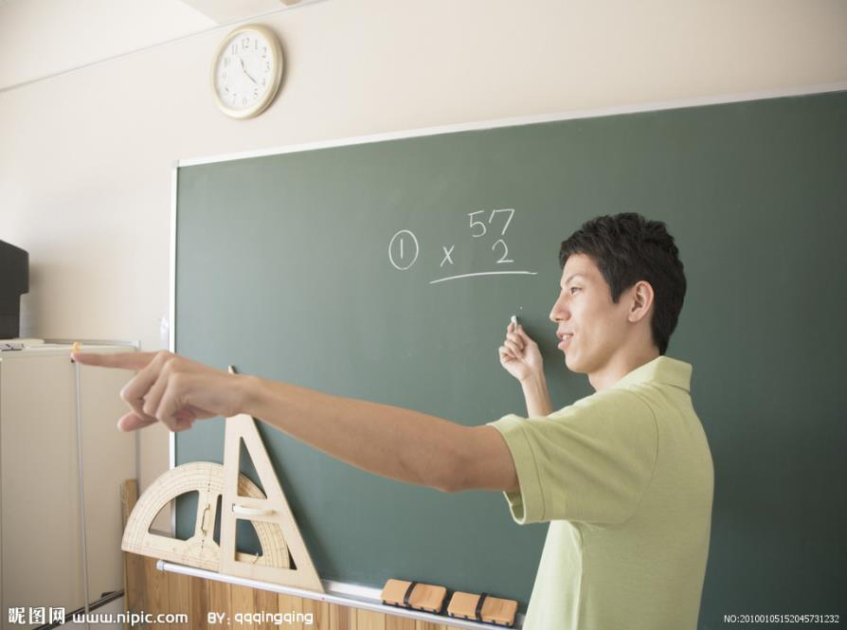
teacher

Slide 6
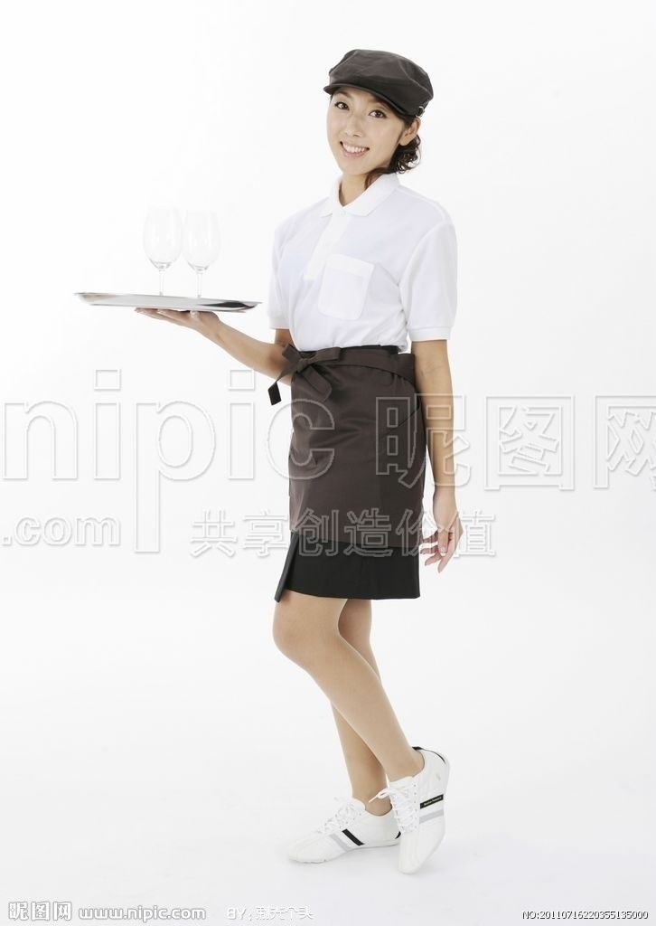
waiter

Slide 7
My name is Lucy. I am a w_____ and I work in a r______. I live in a f_____ near the center of the city. There are s______ , h_______ and s____ in my n_______. Annie is my neighbor, she is a t______, she has a son called Alex, he is a s_____, he likes playing football in the f____ ____ near my home.
aiter
estaurant
lat
ospitals
chools
upermarkets
eighborhood
eacher
tudent
ootball
field

Slide 8
Listen and answer
1. What do volunteers do?
2. When do they have the “helping hands” meeting?
3. Do the volunteers help the old people?
They help people with all kinds of problems.
At the weekend
Yes, they do.
Do some shopping for them; help them clean the flats.

Slide 9
Read and complete
People | Problems | How do volunteers help them?
Simon
Annie
Students
The old people
Computer
check the computer
Bicycle is broken
fix the broken bicycle
homework
help them with homework
Can’t do shopping and cleaning
help them do some shopping and clean the flats

Slide 10
Read their conversation carefully and try to find out the answers to the following questions.
1.What are Simon’s neighbours like？
They are kind and friendly.
2. When and where do the volunteers often meet?
They often meet at the community centre at the weekend.
3.What’s the name of their meeting?
They have a “helping hands” meeting.
4.Who can help Simon check his computer？
A computer engineer can help him.
5.How do the volunteers help the old people?
The volunteers often visit them, do some shopping
for them and help them clean the flats.

Slide 11
all kinds of problems at the weekend broken check different skills fix homework lucky ready to help
1. My neighbours are kind and helpful . Some of them are volunteers.They have and often help us with problems.
2. Usually there is a “helping hands” meeting .
3. People go there when they need help with their .
4.Computer engineers are popular. They help people their computers. You can also find someone to things like bicycles.
different skills
all kinds of
at the weekend
problems
check
fix

Slide 12
5.Students can get help with their .There are some college students among the volunteers,and they are always .Volunteers also help the old people.
6. We are to live in a neighbourhood like that. People here are like a big family.
homework
ready to help
lucky

Slide 13
Groupwork :As middle school students, what can we do to help our neighbours?
Rules:
1) Have a discussion in a group of four.
2) One student takes notes, the others
give ideas.
3) Each group will give a short report.

Slide 14
A short report
Dear classmates, we are middle school students now. We can do something for our neighbours.
For the old, we can….
For the young,we can ….
We can also….
If we all help each other,….

Slide 15
Homework
1、List(列出）the good things that Simon’s neighbours do .
2、Write the short report in your notebook.

